Slide 1
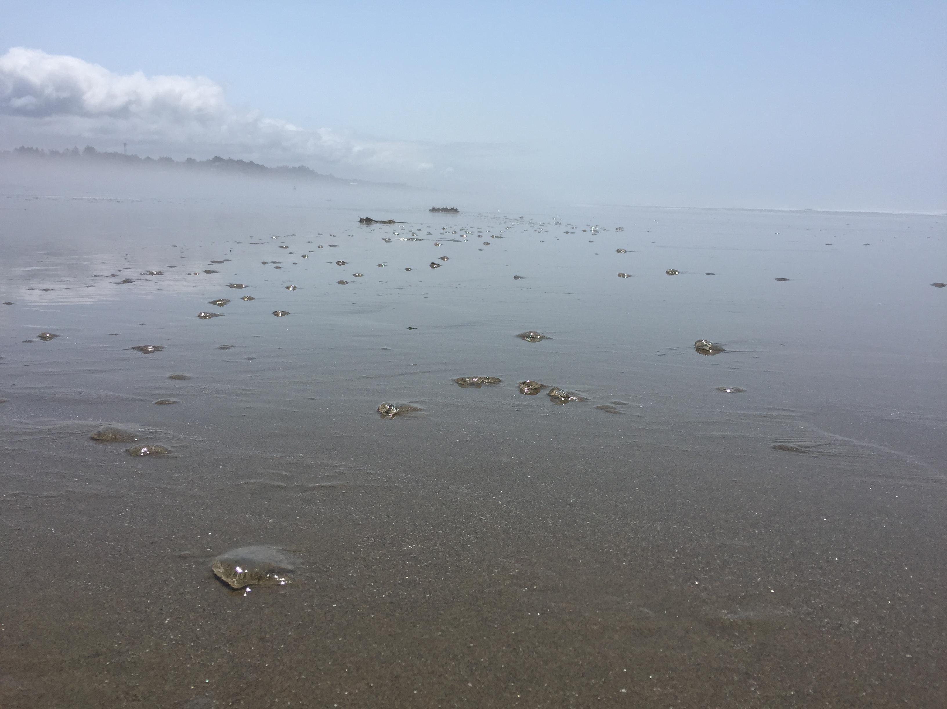

Lincoln County
Health & Human Services
Dan Norton, Emergency Preparedness
Making Water Safe & Emergency Toilets

Slide 2
Making water safe
Methods:
  Filtration
  Distillation/ Evaporation
  Boiling
  Disinfection
Contaminants:
  Microorganisms
  Dirt
  Chemicals

Slide 3
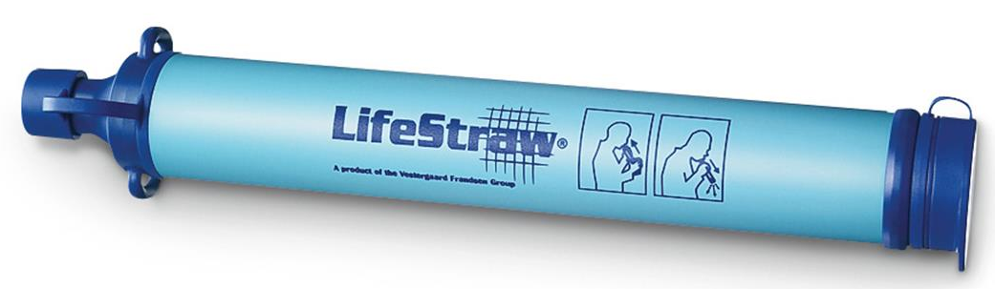
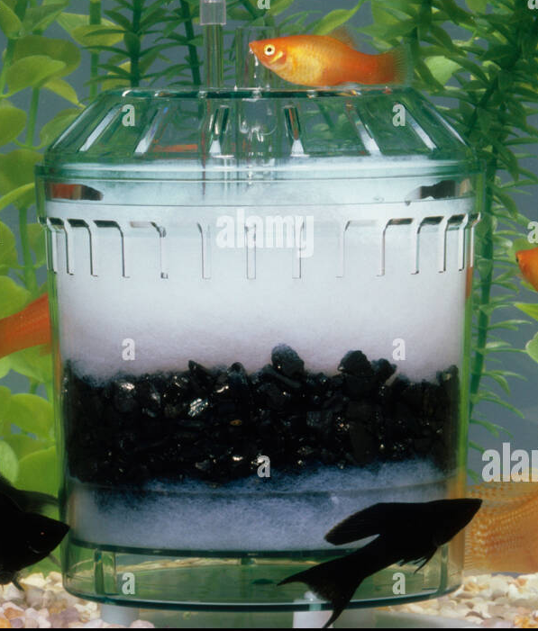
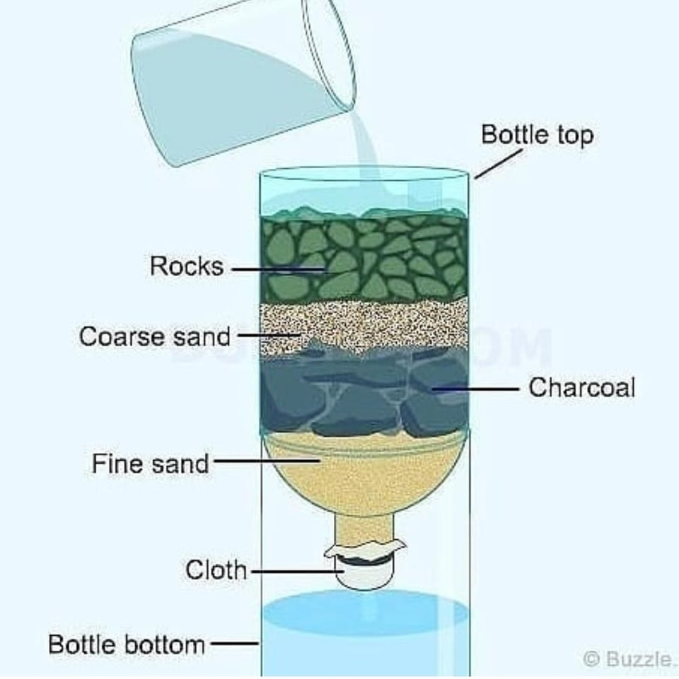
Filtration
Start with clear, clean, & running water if possible
Physical separation
Removes:
  Particulate matter
  Some microorganisms

Slide 4
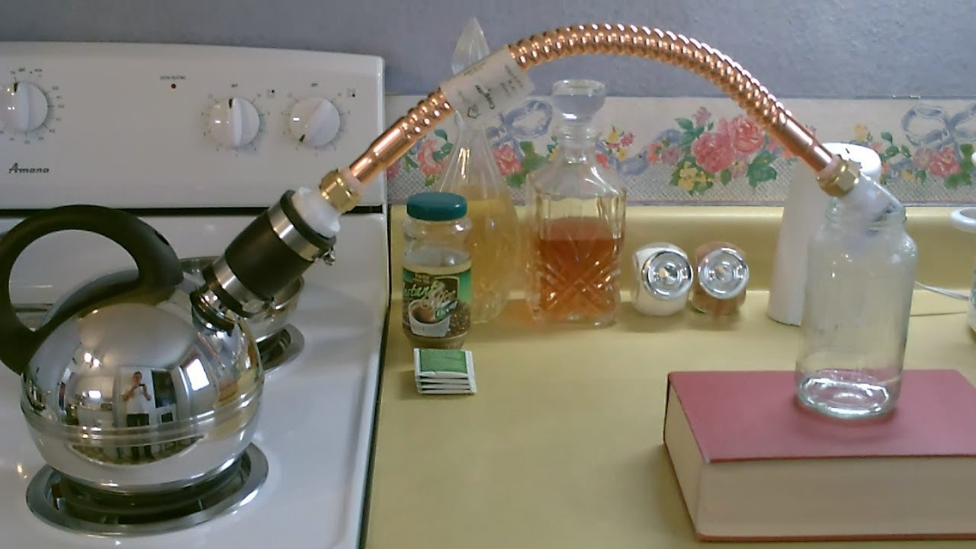
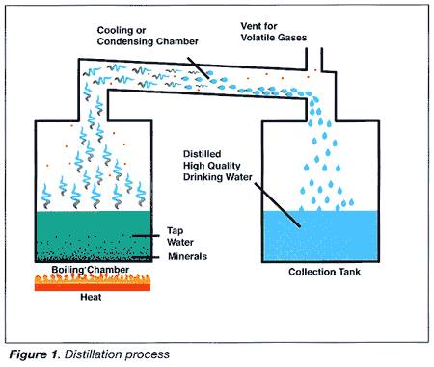
Distillation/ Evaporation
Remove water vapor & condense
Removes:
  Particulate matter
  Microorganisms
  Salt

Slide 5
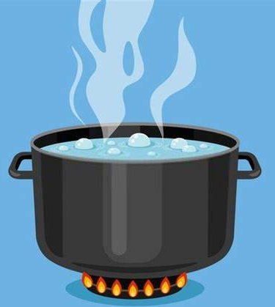
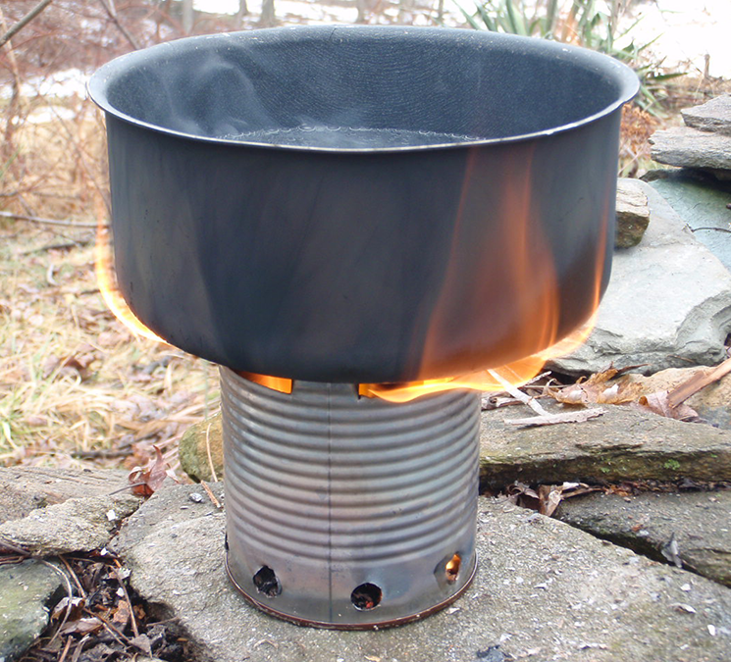
Boiling
Cooks any contaminants
Kills:
  Microorganisms
Leaves:
  Salt
  Sediment

Slide 6
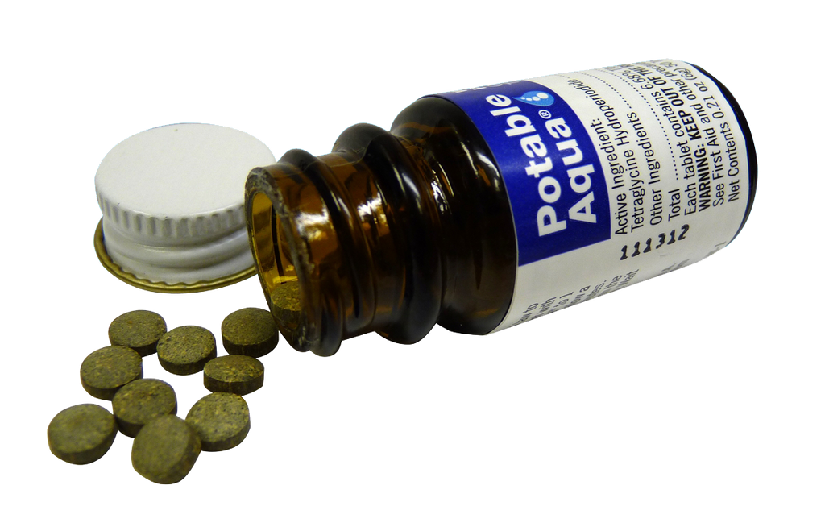
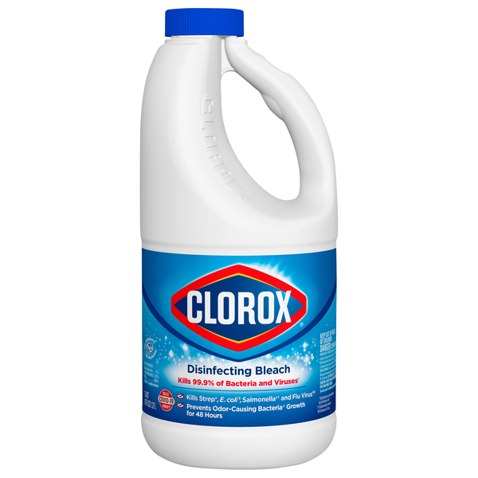
Disinfection
Iodine
Chlorine
Chemically kills microorganisms
Leaves:
  Salt
  Sediment
Bleach Use:
- 8 drops per gallon for clear water
- 16 drops per gallon for cloudy water
- Shake
- Let stand for 30+ minutes

Slide 7
Emergency Toilet Options
Septic system functional?
If yes, continue to use. If no, see below.
Use Twin bucket system
Two bucket toilets available?
Storage or compost
One bucket toilet available?
Use One bucket system
Storage or compost
Latrine/ Pit toilet
Talk to neighbors, grab a shovel
Determine location
Lincoln County
Health & Human Services

Slide 8
Sewage safety
Confirm septic or city sewer line intact: No puddles in yard, bad odor, visible sewage.
Toilet may flush but piping could be damaged
Understand issues/risks if composting
Store safely away from pets, kids, food, water, pests
Keep separate from regular garbage & yard debris
Do not bury sewage in plastic bags

Slide 9
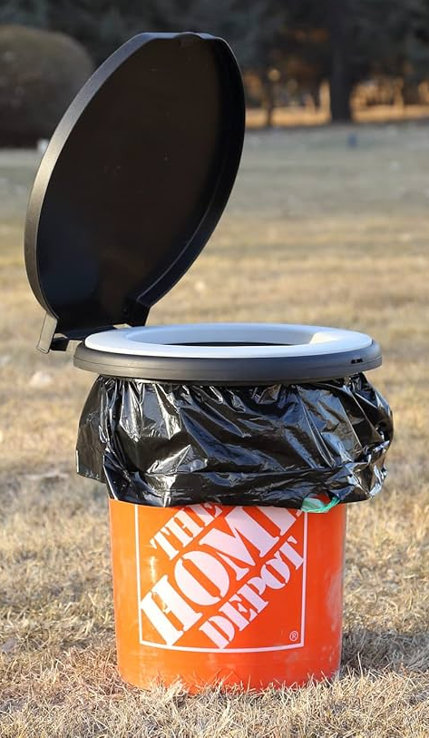
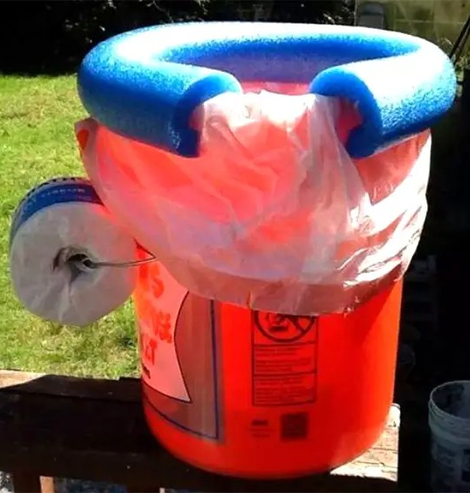
Two Bucket System
Poo Bucket:
  Reduce volume, slosh, contamination
  TP is ok
  Store or compost
Pee Bucket:
  Sterile, dilute & spread on lawn

Slide 10
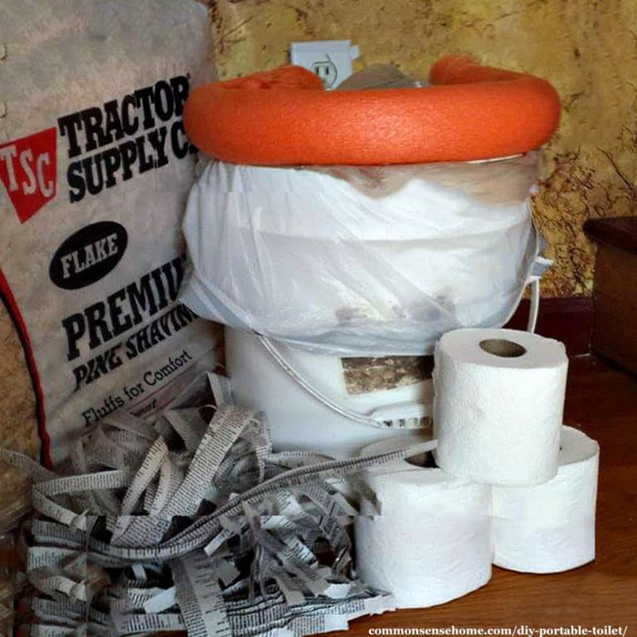
One Bucket System
Combined Bucket:
  Recommend double bagging waste
  Use carbon (sawdust, bark chips, pellets, cat litter, cut newspaper) to cover and reduce odor.
  Fill only 60% full
  Use care when moving
  Clean bucket as needed
  TP is ok
  Store or compost

Slide 11
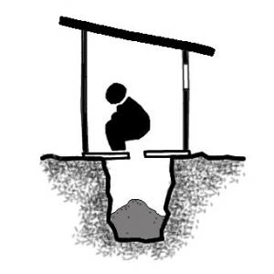
Latrine/ Pit toilet
Talk with neighbors, dig shared pit
Locate: 100+ ft from well or creek
Hole: 2-4 feet deep, 2 feet wide
Cover with handful of dirt after each use
Pit full if 1 ft left. Cover & dig new pit.

Slide 12
Thank you!
Lincoln County
Health & Human Services

