Slide 1

Lincoln County
Emergency Management
Preparedness Fair
7Sep2024
Personal Preparedness: Go Kits

Slide 2
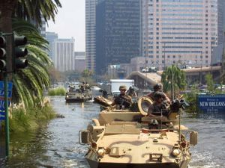
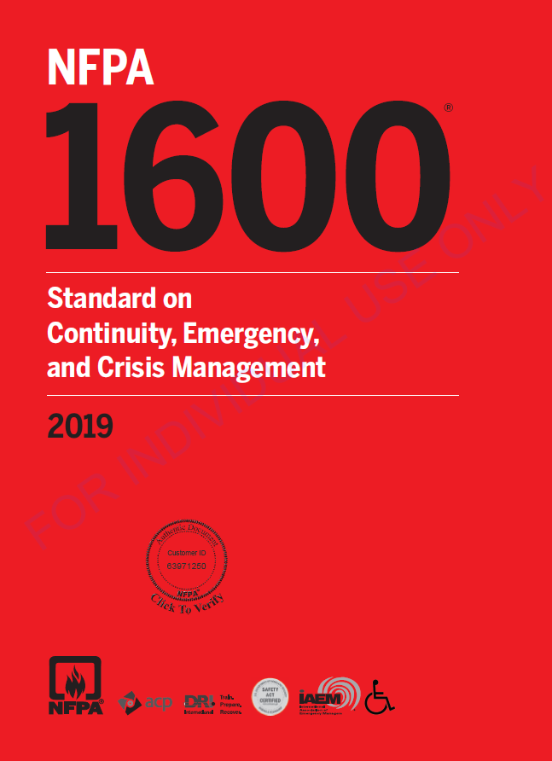




Why Disaster Preparedness?
Disaster Preparedness (AKA: Emergency Management) has a long and rocky history throughout the world
- Part of the human experience: cave drawings imply disaster response
- No global framework, heavy reliance on international partners
In the US
- 1803 fire in New Hampshire devastated a town, 1st federal assist
- 1800s-mid-1900s: multiple regulations, government offices est
- 1950s-70s: Cold war, nuclear threat, several major natural disasters
spurred many more federal efforts & offices
- 1978: FEMA established to consolidate efforts
National Guard members respond to Hurricane Katrina, 2005
careoregon.org ן page 5

Slide 3

Why do/should you do it?

Slide 4

Step 1:
Understand the threat
Natural Disasters
  Storms
  Landslide
  Earthquake & Tsunami
  Wildfire
Man-made disasters
  Active Violence (shooter, bomb, etc)
  Cyber Attack
  HAZMAT Spill
  Multi-vehicle traffic accidents
https://www.yachatsoregon.org/DocumentCenter/View/1576/Lincoln-County-Multi-5--Jurisdictional-Natural-Hazard-Mitigation-Plan-MJHMP-County

Slide 5
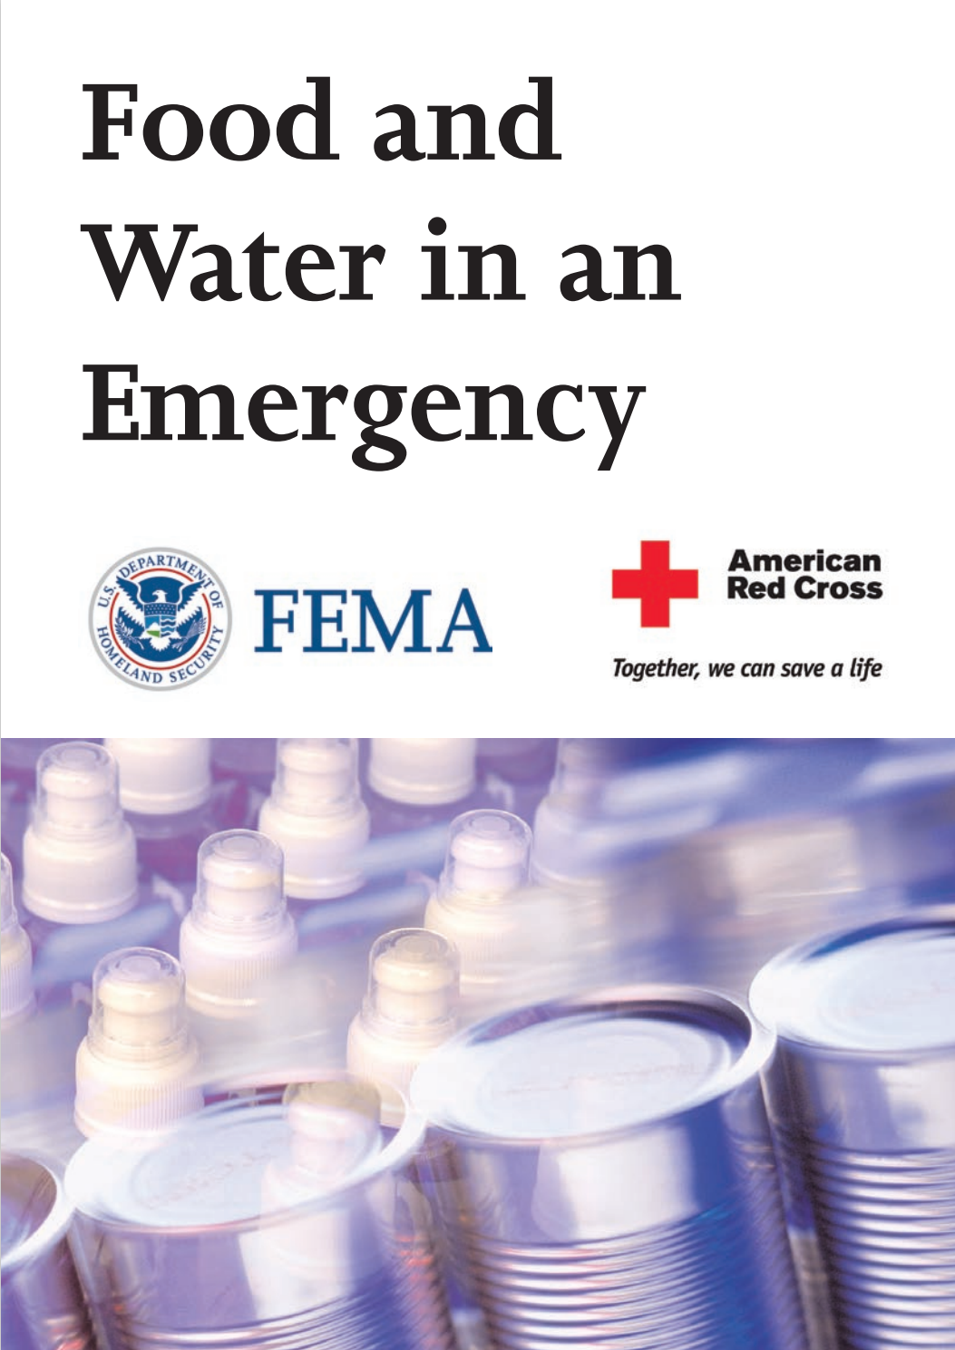




Step 2:
Make a Plan
How will I receive emergency alerts and warnings?
What is my shelter plan?
What is my evacuation route?
What is my family/household communication plan?
What do I need to update in my emergency preparedness kit?
Plan Ahead for Disasters | Ready.gov

Slide 6
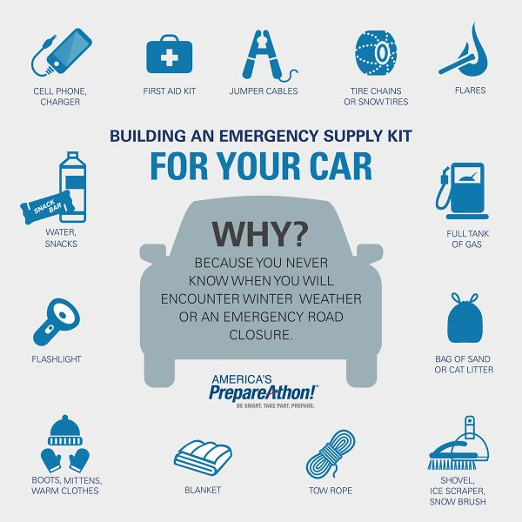
Make a kit:
72 hrs minimum
In your car, backpack, at work - always near you
- extra socks/undergear - small first aid kit - flashlights - snacks, water - emergency blanket - meds?
Extras for in the car >>>
ENCOUNTER DANGEROUS WEATHER OR OTHER EMERGENCY
It’s personal: what do YOU need?

Slide 7
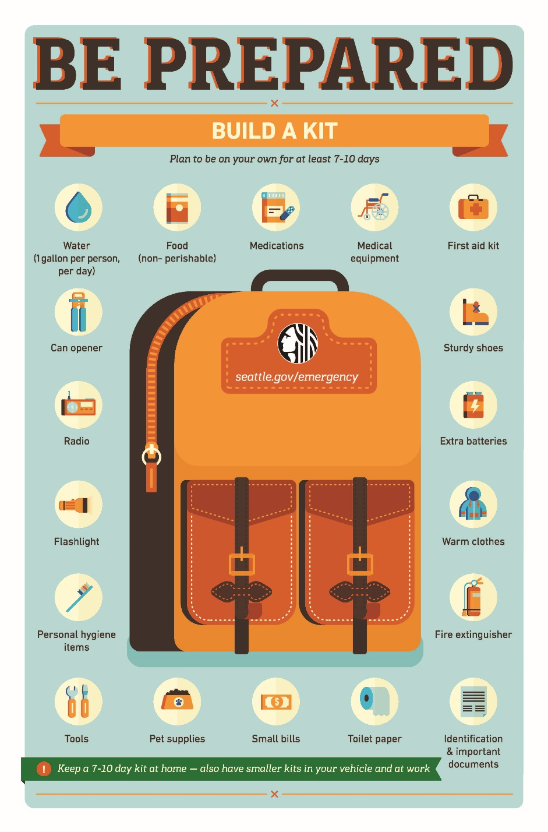
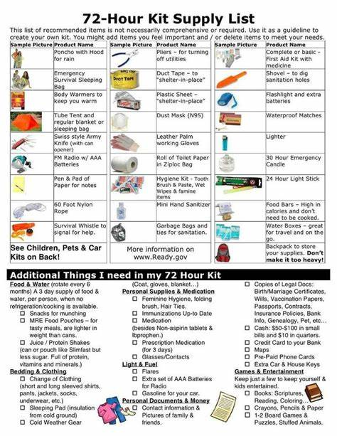
Make a kit:
Home needs
In the home
  Evacuate Now Kit (7-10 days)
  Shelter in Place Resources (2 weeks)
  Coastal Cascadia Ready (4+ weeks)
For your pets
For your neighborhood

Slide 8

Special Considerations
Prescription medications
Non-prescription medications
Supplies for babies and children
Supplies for pets
Any special needs – extra glasses, medical devices, etc.

Slide 9
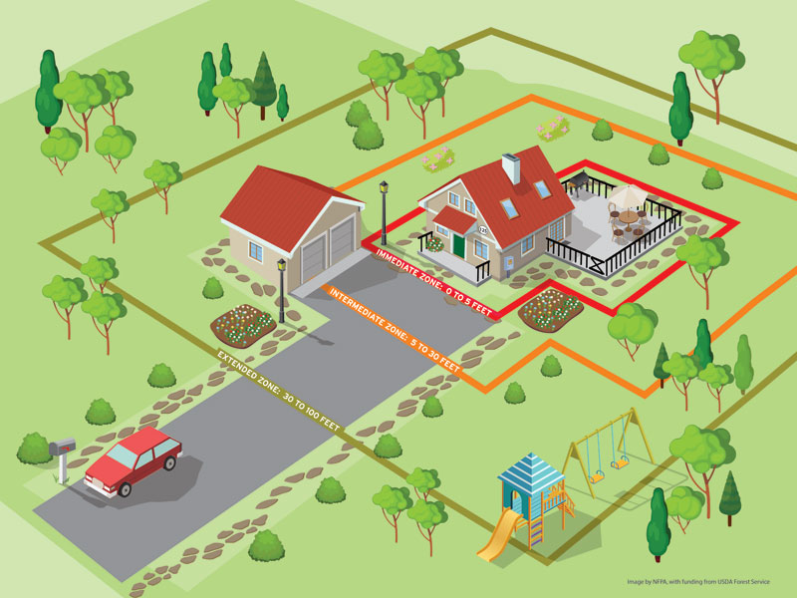
Some final thoughts: PREparedness
Preparing your home and property AHEAD of the emergency
  In the Home
  Winterizing your home
  Check fire and CO2 detectors yearly
  Check batteries, supplies
  Outdoors
    Keep debris clear
    Create defensible space
    Wildfire resistant landscaping

Slide 10
Know your Resources!
Ready.gov
Oregon Department of Emergency Mangement
https://www.oregon.gov/OEM/Pages/default.aspx
Lincoln County Emergency Management
https://www.co.lincoln.or.us/708/Emergency-Management
SIGN UP FOR LINCOLN ALERTS!
City and Tribal Emergency Management
https://www.newportoregon.gov/emergency/
https://www.oregon.gov/oem/Documents/locals_list.pdf
SIGN UP FOR LINCOLN ALERTS!!

Slide 11
THANK YOU!

