Slide 1
Be 2 Weeks Ready
Kayla Thompson,
Community Preparedness Coordinator

Slide 2
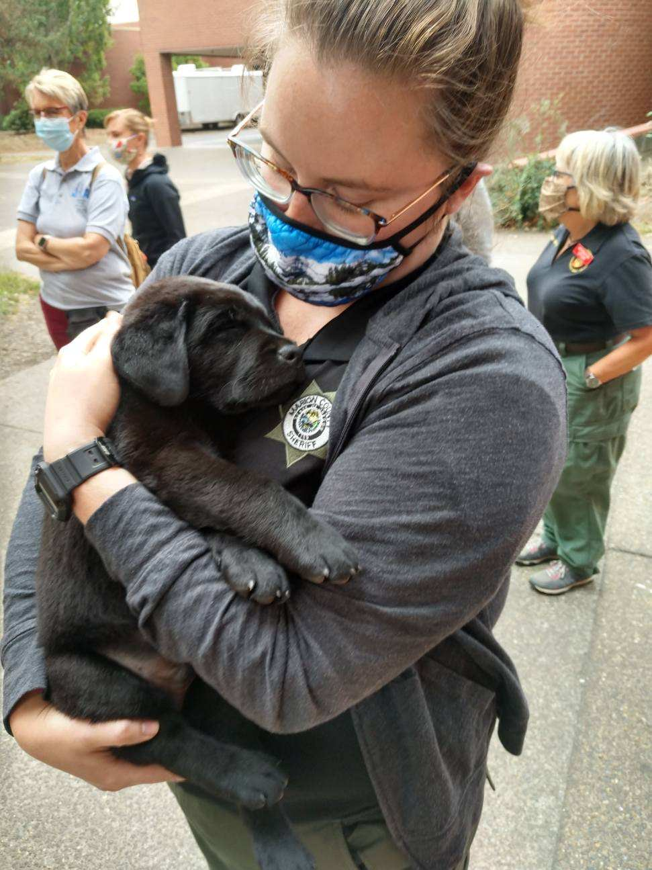
Presenter: Kayla Thompson
Community Preparedness Coordinator, Oregon Department of Emergency Management
Began emergency management career in August 2020 as a Marion County Search and Rescue Deputy
Manages the Be 2 Weeks Ready program
State CERT Coordinator
Oregon liaison for Region 10 Youth Preparedness Council

Slide 3
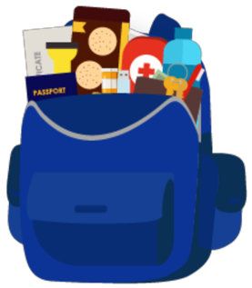
Why Do We Need This Program?
A go-bag is not enough
Help will not be readily available
Need to be self-sufficient for at least 2 weeks (longer for coastal communities)
Preparing for Cascadia Subduction Zone will prepare you for all other disasters

Slide 4
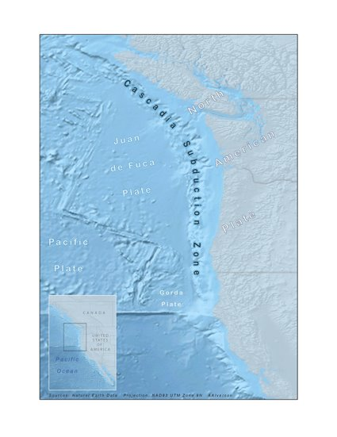
Cascadia Subduction Zone
Location: Extends from northern Vancouver Island in Canada to northern California in the U.S.​
Size: Approximately 600 miles long and 70 to 100 miles off the coast.​
Magnitude: Capable of producing a 9.0 or greater magnitude earthquake.​
Historical Event: Last major event occurred in 1700, causing a massive tsunami reaching Japan.​
10 to 17% chance of another major event in the next 50 years.

Slide 5

Community-centered, activity-based program focusing on
8 units of preparedness
Launched June 17, 2024

Slide 6

What is a Community?
Any group of people who spend time together and isn’t limited to those who physically live around you
Examples:
  Coworkers
  Parents/guardians of students in a school
  Neighborhood Associations
  4-H club
  Members of a congregation
  Recreational teams
  Students in a college dorm

Slide 7
Program Accessibility
The Be 2 Weeks Ready Tool Kit is available in the following languages and format:
English
Spanish
Vietnamese
Chinese
Russian
Videos with American Sign Language, closed captioning and voiceover recording
The Be 2 Weeks Ready Tool Kit is in the process of being made available in the following languages and format:
Korean
Large print format for low-vision needs
Formatted to be compatible with Braille printers
Other languages as requested

Slide 8
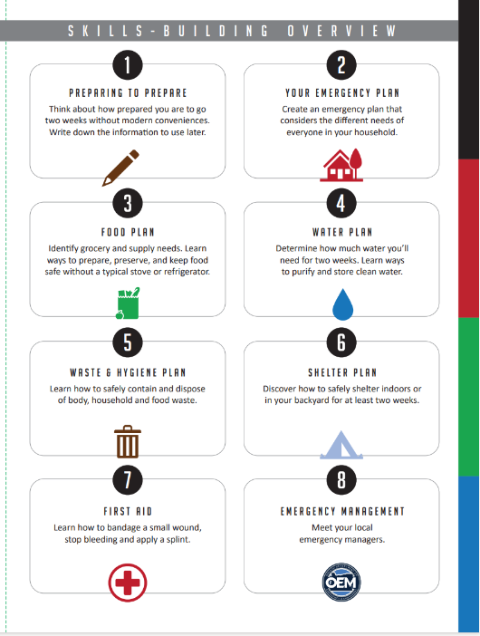
Program Structure
Be 2 Weeks Ready tool kit
Individual Structure
Community Structure
View tool kit online in
preferred language and
learn at your own pace
Attend in-person meetings facilitated by Community Hosts with a printed copy of the tool kit.

Slide 9
Program Roles
OEM’s Community Preparedness Coordinator
Manages the Be 2 Weeks Ready program and supports the Program Coordinators
Program Coordinator
Coordinates outreach in their community and identifies community hosts to provide training
Community Hosts
Facilitates meetings in their community on each unit of the program
Communities
Attend in-person meetings and learn each unit of the program

Slide 10
Program Responsibilities
OEM’s Community Preparedness Coordinator
Provide ongoing support to Program Coordinators​
Provide printed copies of the Be 2 Weeks Ready Tool Kit for Community Hosts
​
Track program progress

Slide 11
Program Coordinators
This person is in an outreach, networking or training position within their
community
Coordinate outreach​ to communities
Connect with local organizations or groups who may be interested in
Be 2 Weeks Ready​
Identify Community Hosts​
Track program progress and report to OEM

Slide 12
Community Hosts
This person is a member of a community who wants to take the lead on
educating others
Learn the Be 2 Weeks Ready Tool Kit​
Facilitate conversations for each unit within communities ​
Report program attendance and progress to Program Coordinators

Slide 13
Communities
Attend ongoing meetings ​
Participate in learning units and activities​
Complete community survey and provide feedback to Community Hosts​

Slide 14
Program Coordinator Trainings
137 people from organizations across Oregon completed the Program Coordinator training since March.
Learned the purpose of the program, how to coordinator outreach and create partnerships, set goals for their program and review the Be 2 Weeks Ready tool kit.
They are now planning how and when they will share the program with their communities
They will continue to work with the Community Preparedness Coordinator on their outreach and receive ongoing support

Slide 15
Program Examples
Local Parish
Reason for program: educate parishioners on how to have 2 weeks’ worth of supplies
Program Coordinator: Parish leader
Community Hosts: Parish leader
Community: Parish leadership and then parishioners

Slide 16
Program Examples
Hospital on the coast
Reason for program: train all staff to prepare their households for a disaster so they can respond to the hospital
Program Coordinator: Training Coordinator at the hospital
Community Hosts: Staff member from each department
Community: 700 staff at a coastal hospital

Slide 17
Program Examples
County Emergency Management office
Reason for program: teach community members to be self-sufficient for 2 weeks during a disaster
Program Coordinator: Community Outreach Coordinator
Community Hosts: CERT members
Community: neighborhood groups, places of worship and schools

Slide 18
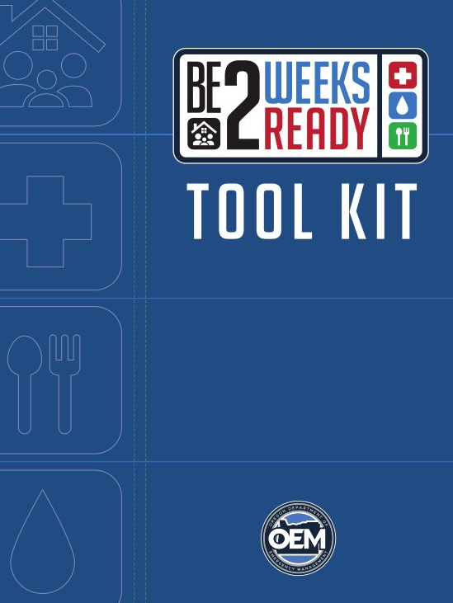
The Be 2 Weeks Ready Tool Kit
90 pages
8 units of preparedness
3-4 activities per unit
Electronic copy available on OEM’s website
Printed copies provided to Program Coordinators who host in-person meetings

Slide 19
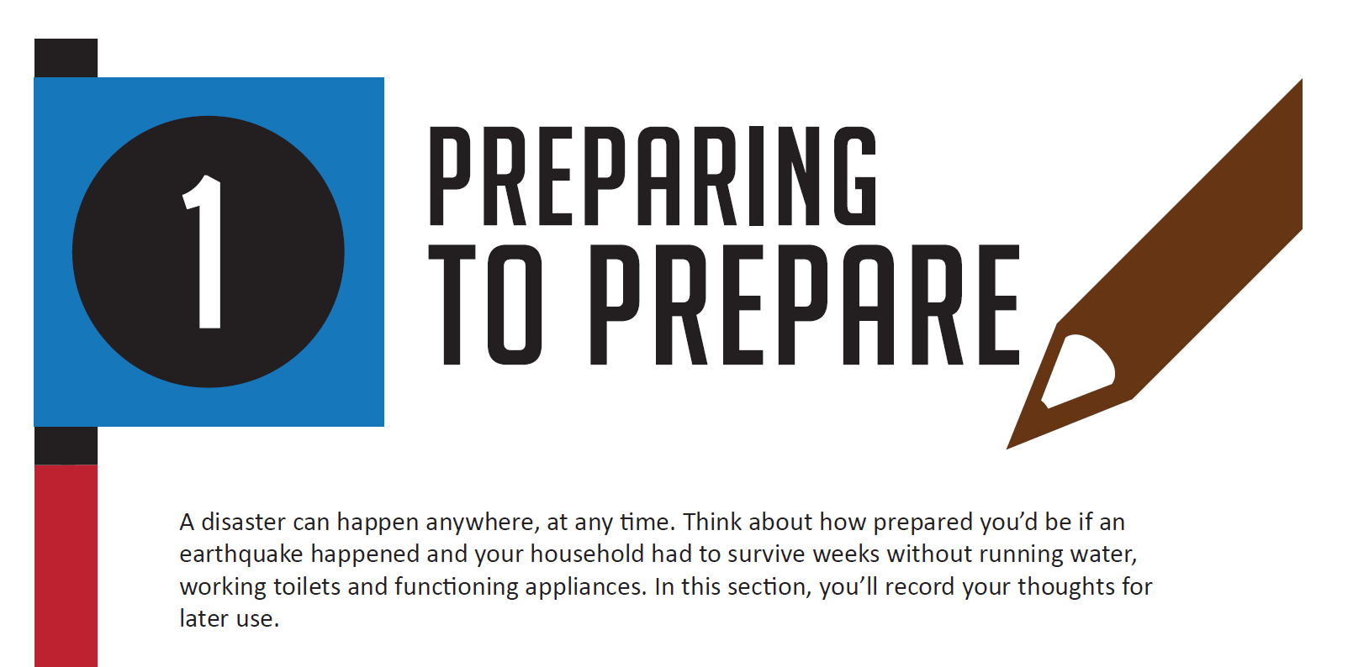
Unit 1: Preparing to Prepare
Learn how to mentally prepare for living through a disaster and take a baseline assessment of your preparedness plan
Activities include:
  Journal Two Weeks of a Disaster Scenario
  Track Your Food and Water for Two Weeks
  Words to Your Future Self
  Practice Mindfulness to Build Preparedness

Slide 20
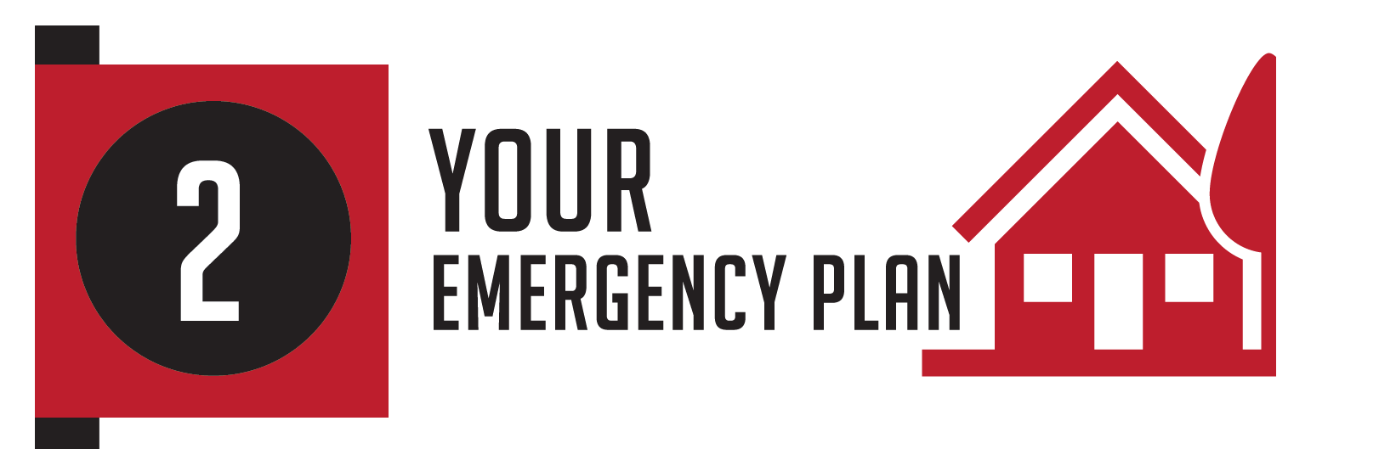
Unit 2: Your Emergency Plan
Learn what your household needs in an emergency, how to create an emergency communication plan, how to sign up for alerts and to practice your plan
Activities include:
  Get Kids Involved!
  Build Your Emergency Plan
  Build a 2 Weeks Ready Disaster Plan and Stash
  Catalog and Insure Belongings
  Test Your Out-of-Area Contacts
  Practice Protective Actions

Slide 21
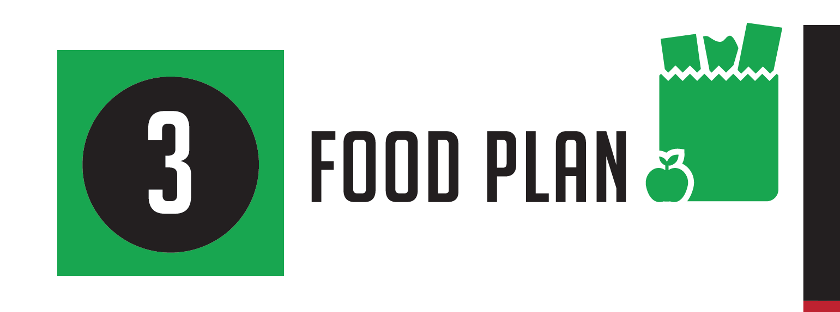
Unit 3: Your Food Plan
Learn how much food your household needs, how to safely store it, and how to use alternative cooking methods
Activities include
  Create Your Food Plan
  Grow Your Own Food
  Alternative Cooking Methods
  Pizza Box Solar Oven Cooking

Slide 22
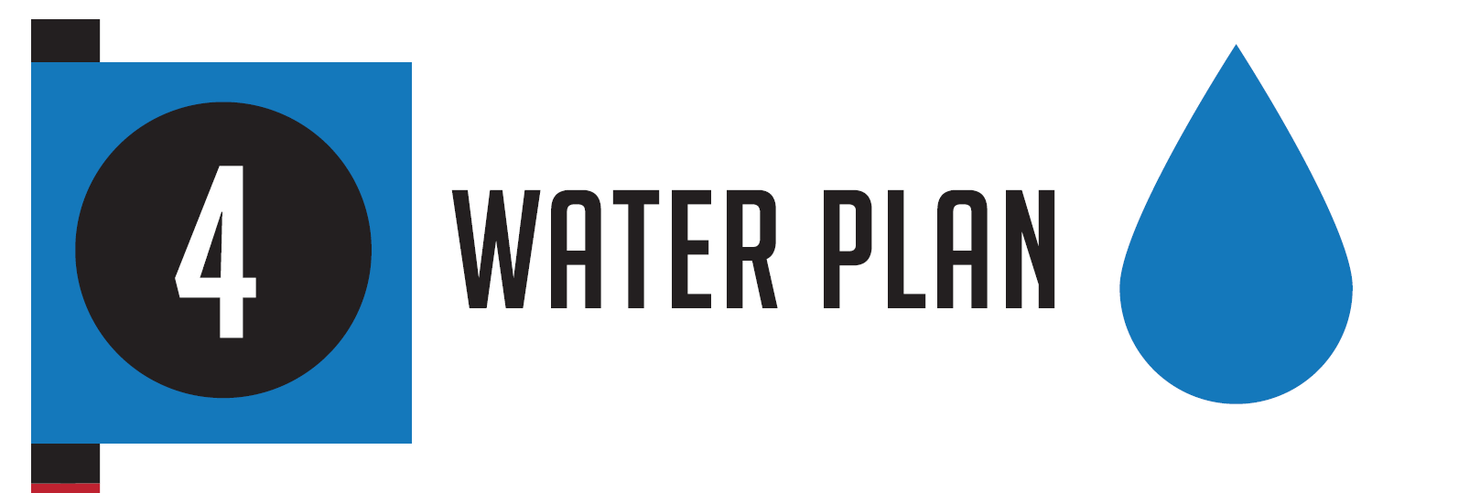
Unit 4: Your Water Plan
Learn how much water your household needs, how to store it and multiple methods of sanitation
Activities include
  Learn How to Store Water
  Learn How to Boil Water by Using Common Methods
  Finding Other Water Sources After Disaster Strikes
  How to Remove Water from a Water Heater Tank
  How to Distill Water

Slide 23
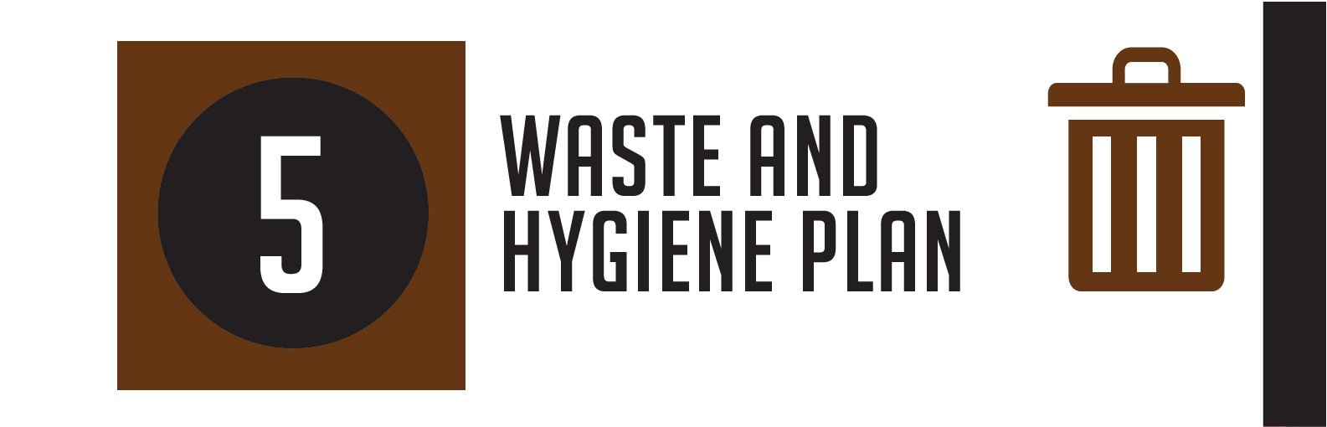
Unit 5: Waste and Hygiene Plan
Learn how to stay clean and healthy without running water, how to dispose of waste and alternative laundry methods
Activities include:
  Build a Handwashing and Dishwashing Station
  Prepare a Two-Bucket Toilet
  Make an Emergency Washing Machine

Slide 24
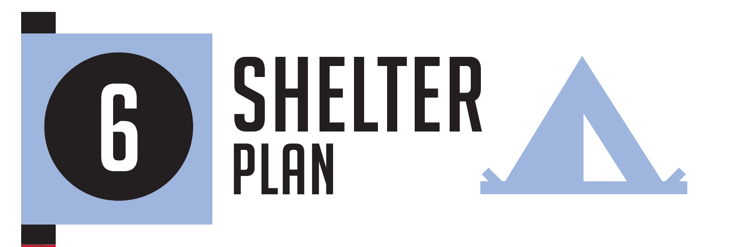
Unit 6: Shelter Plan
Learn about potential hazards, how to make your living space safer, and safety measures to take after a disaster
Activities include:
  Home Hazard Hunt
  Utility Shut-off
  Prepare a Go-bag

Slide 25
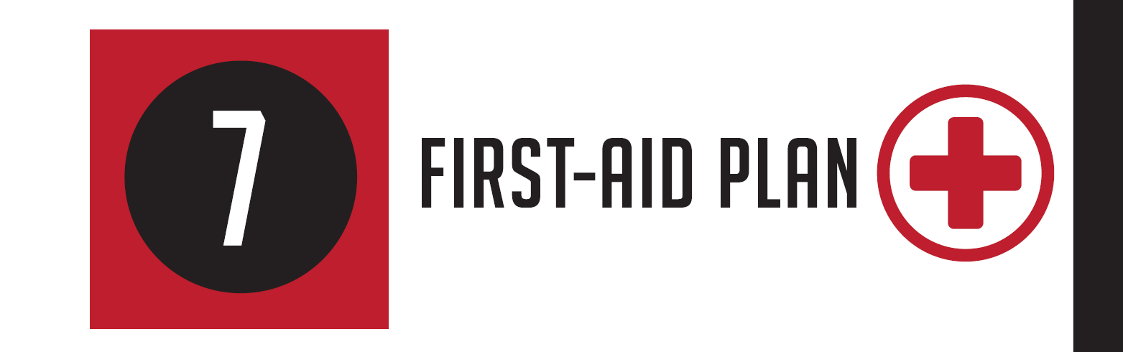
Unit 7: First-Aid Plan
Learn what to include in a first-aid kit and basic first-aid skills
Activities include:
  Build Your First-Aid Kits
  Take a First-Aid Training Class
  Practice Your First-Aid Skills

Slide 26
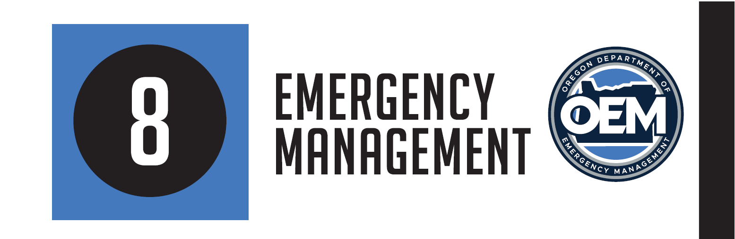
Unit 8: Emergency Management
Learn what an emergency manager does and how to be more involved in increasing your community’s preparedness
Activities include:
  Meet Your Local Emergency Manager
  Sign Up or Update Your Contact Information for Emergency Alerts
  Help Your Community Prepare

Slide 27
How Do I Get Involved?
Who can be a program coordinator?
Anyone in an outreach, networking or training position
Who can be a community host?
Anyone who is passionate about preparedness and is comfortable sharing the information with others
Who can be a community?
Any group of people who spend time together and want to learn to be better prepared and more resilient

Slide 28
How Do I Get Involved?
Email community.preparedness@oem.Oregon.gov to find a Be 2 Weeks Ready program near you or to become a Program Coordinator
Program Coordinator training will be offered quarterly (virtual)
Visit www.Oregon.gov/oem/Be2WeeksReady to view the tool kit

Slide 29

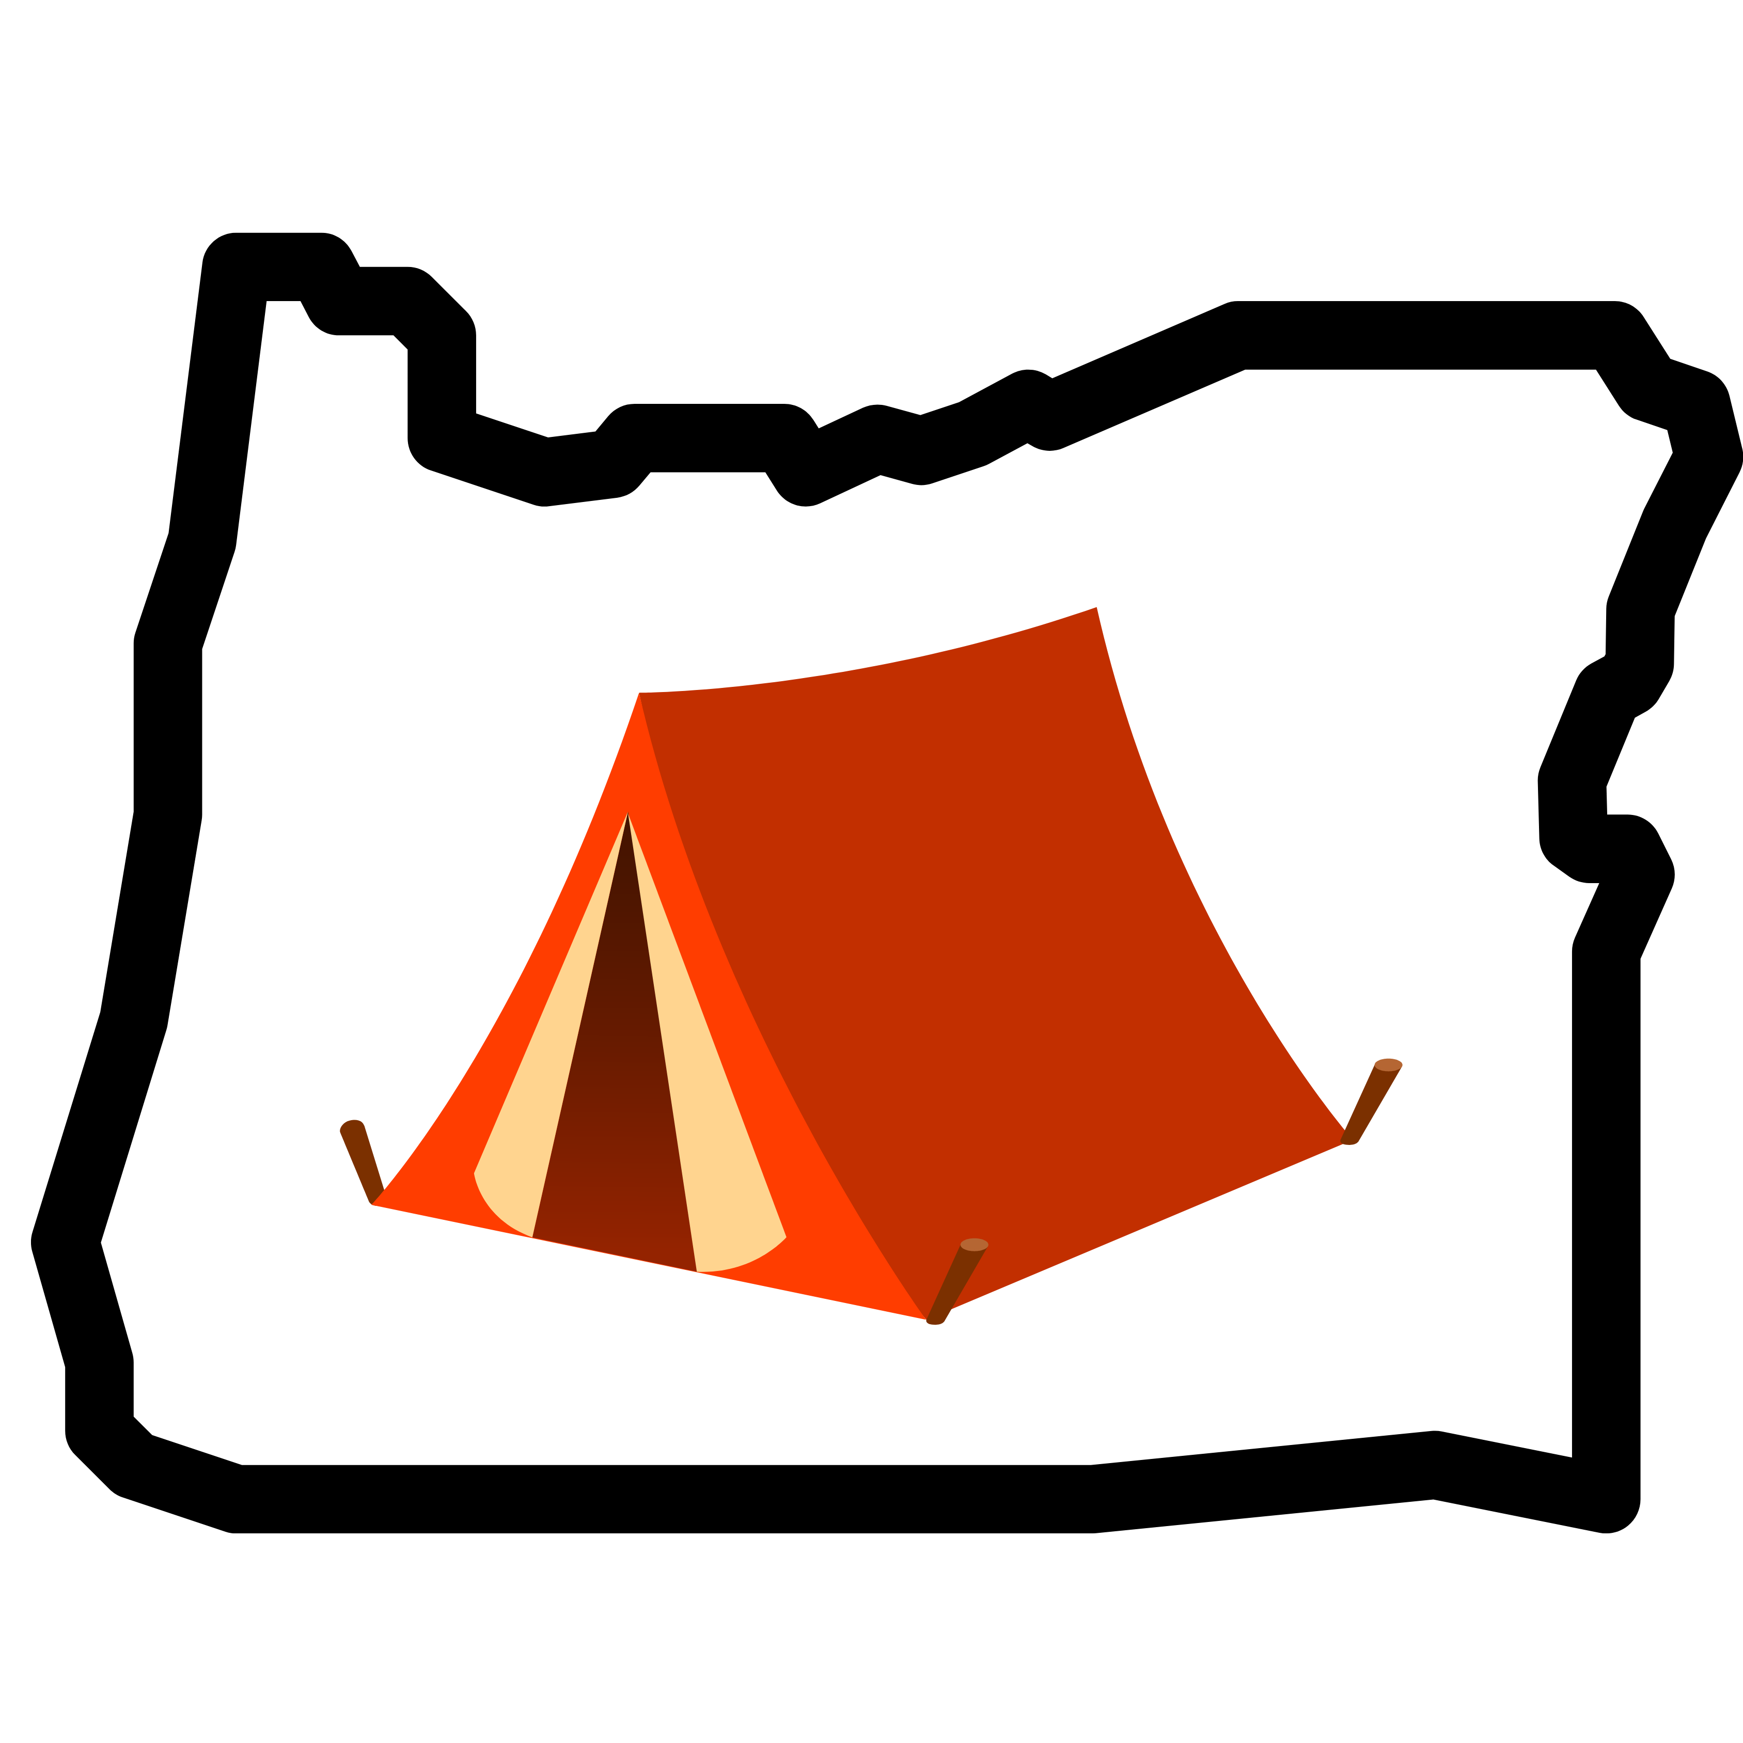
The Great ShakeOut/Camp-In
Great ShakeOut
National earthquake drill
Takes place this year on Oct. 17 at 10:17 a.m.
Register at www.shakeout.org
Great Camp-In
Opportunity to practice your emergency plan
Takes place Oct. 18-20 (entire weekend or just a coupe of hours)
Turn off your power and utilities to simulate an outage, set up a campsite inside your home, practice your evacuation plan, or do an inventory of your supplies
check the “Great Camp-In” box when you register at www.shakeout.org

Slide 30
Thank You!
Kayla Thompson
Community Preparedness Coordinator
Oregon Dept. of Emergency Management
Kayla.thompson@oem.Oregon.gov

