Slide 1
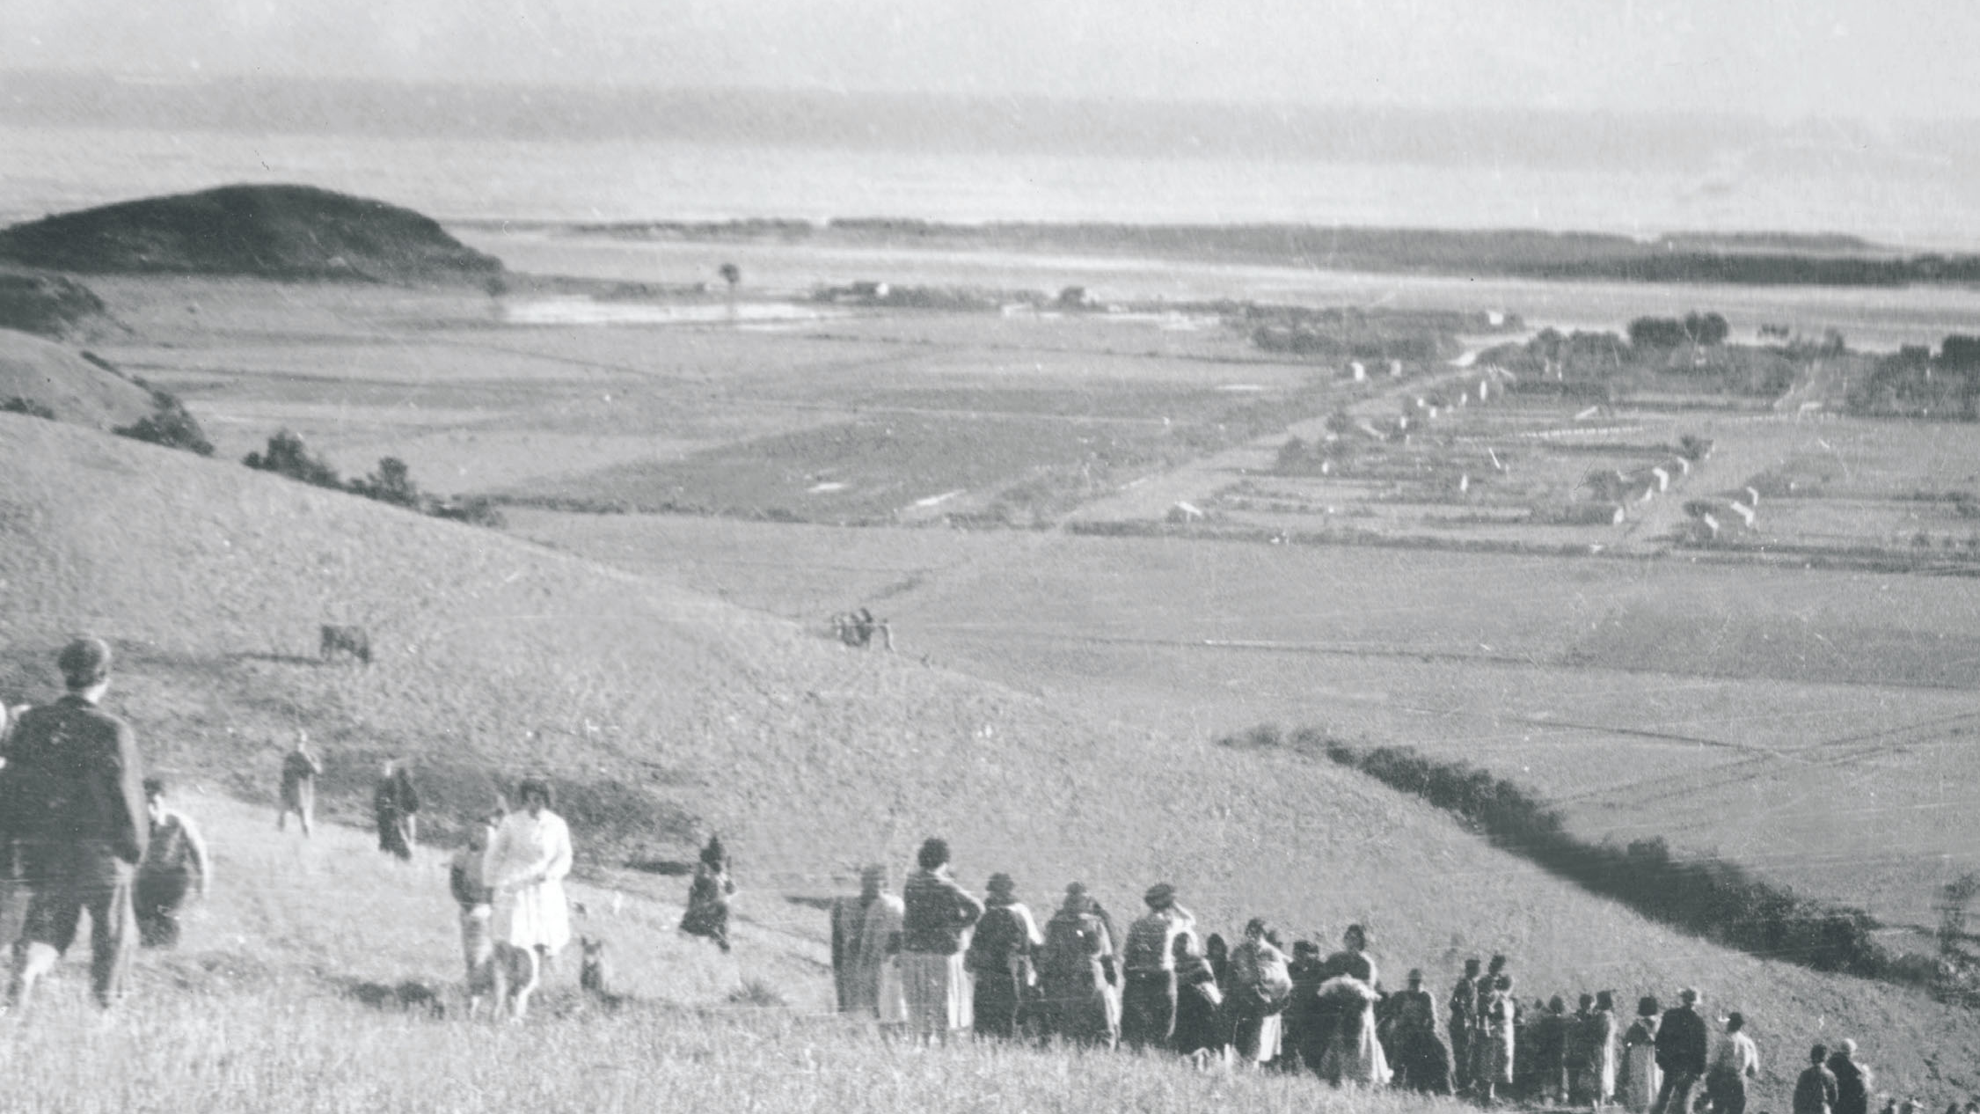
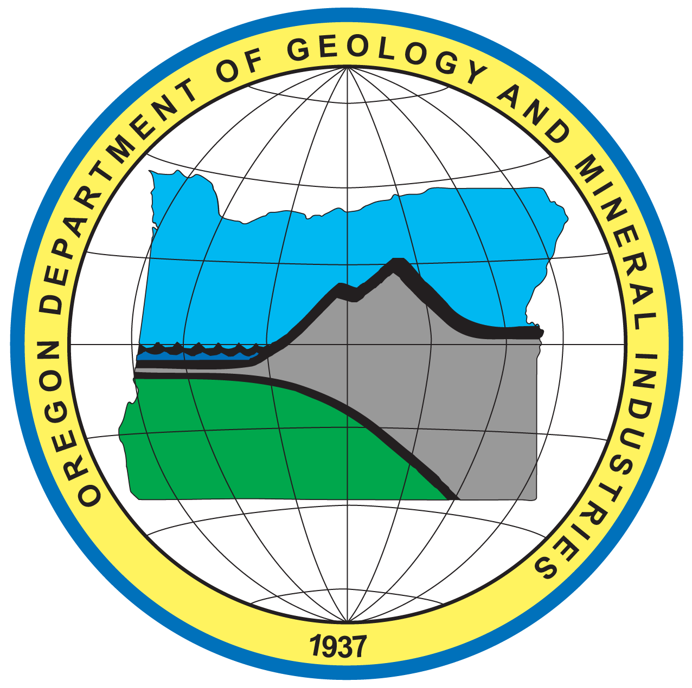
In preparation for the Next Cascadia Earthquake and Tsunami
Laura Gabel
Oregon Department of Geology and Mineral Industries (DOGAMI)
Notes:
Puerto Saavedra chile 1960 knew to head immediately to high ground after the EQ
Same geologic setting and coastal communities
Different: lived history of earthquakes and tsunamis, creating a culture that has an innate understanding of what to do as shown here.
They knew what to do, they were able to do it, and did it promptly

Slide 2
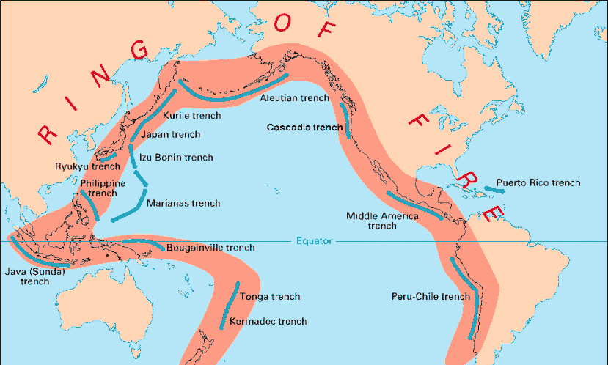
WHERE DO OREGON TSUNAMIS COME FROM?
Subduction Zones
Distant tsunami
No EQ in Oregon
Arrives 4+ hours after the earthquake
Lower damage and flooding than local tsunamis
National Tsunami Warning System can warn you
Local tsunami
Large EQ in Oregon
Arrives minutes after the earthquake
Much higher waves
Much further inland penetration
National Tsunami Warning System ineffective
Earthquake = only warning
USGS, https://pubs.usgs.gov/gip/dynamic/graphics/Fig22.gif

Slide 3
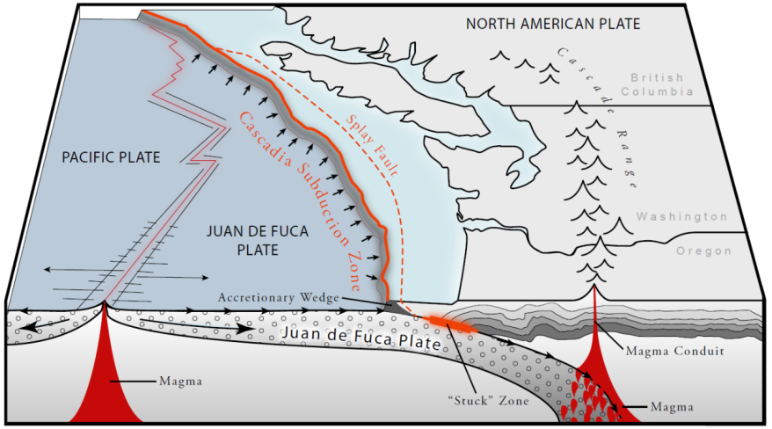
Cascadia Subduction Zone (CSZ)
North American Plate Overrides Juan de Fuca Plate Along
Cascadia Subduction Zone at a rate of 1.5 inches/year

Slide 4
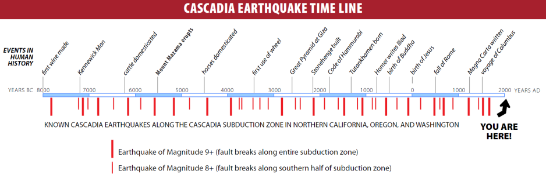
A 10,000-year history of
~40 Cascadia earthquakes in Oregon
The last Cascadia earthquake and local tsunami occurred on January 26, 1700 at 9 PM
Notes:
Comparison of the history of subduction zone earthquakes along the CSZ in northern CA, OR and WA with events from human history. Ages of EQs are derived from study and dating of submarine landslides triggered by the EQs. EQ data provided by Chris Goldfinger, OSU; timeline by Ian Madin, DOGAMI.

Slide 5
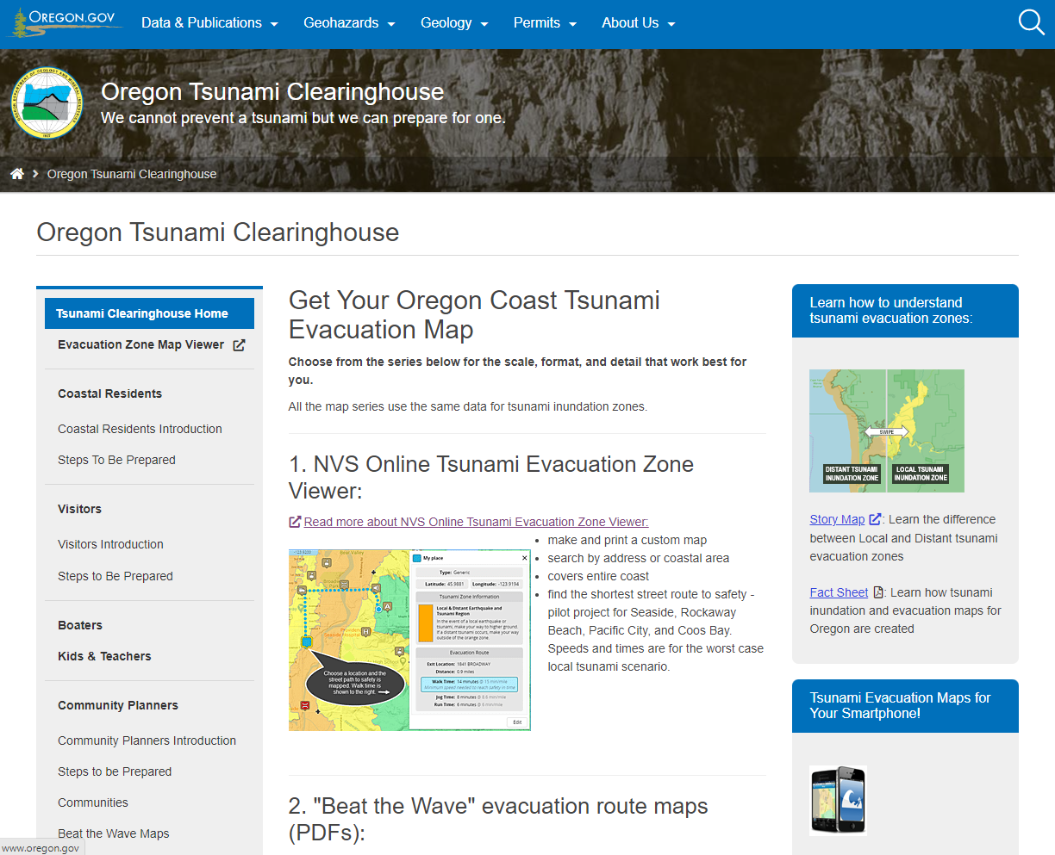
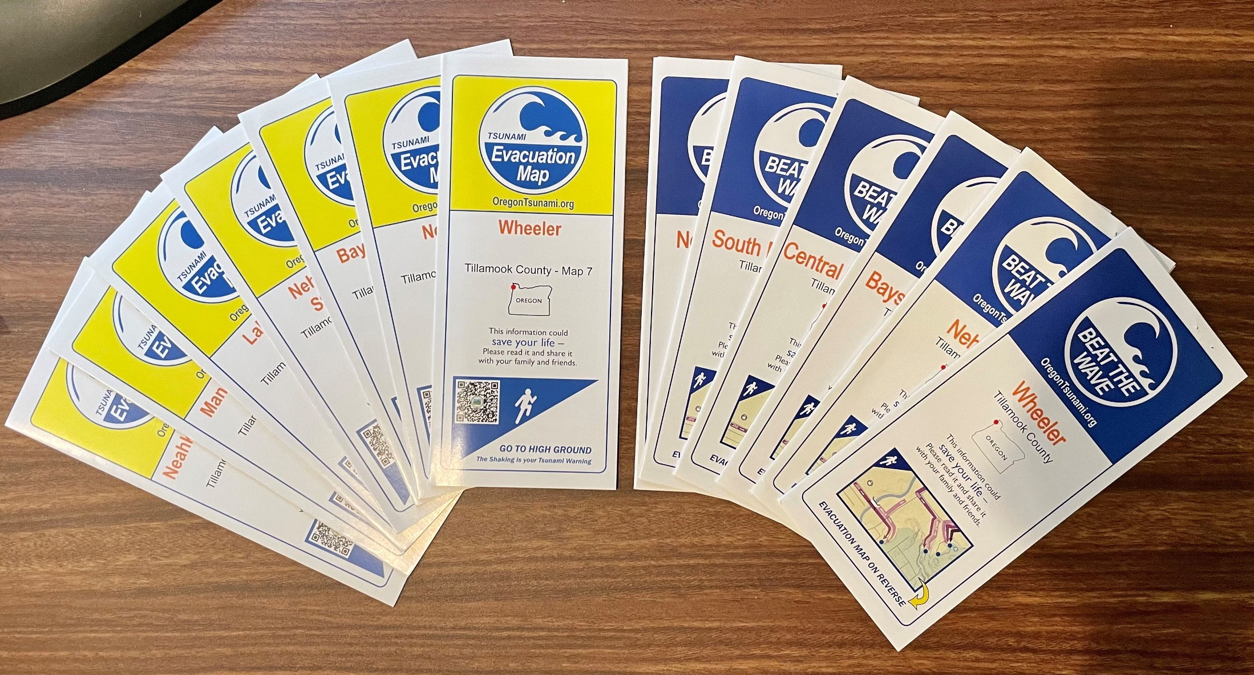
www.OregonTsunami.org

Slide 6
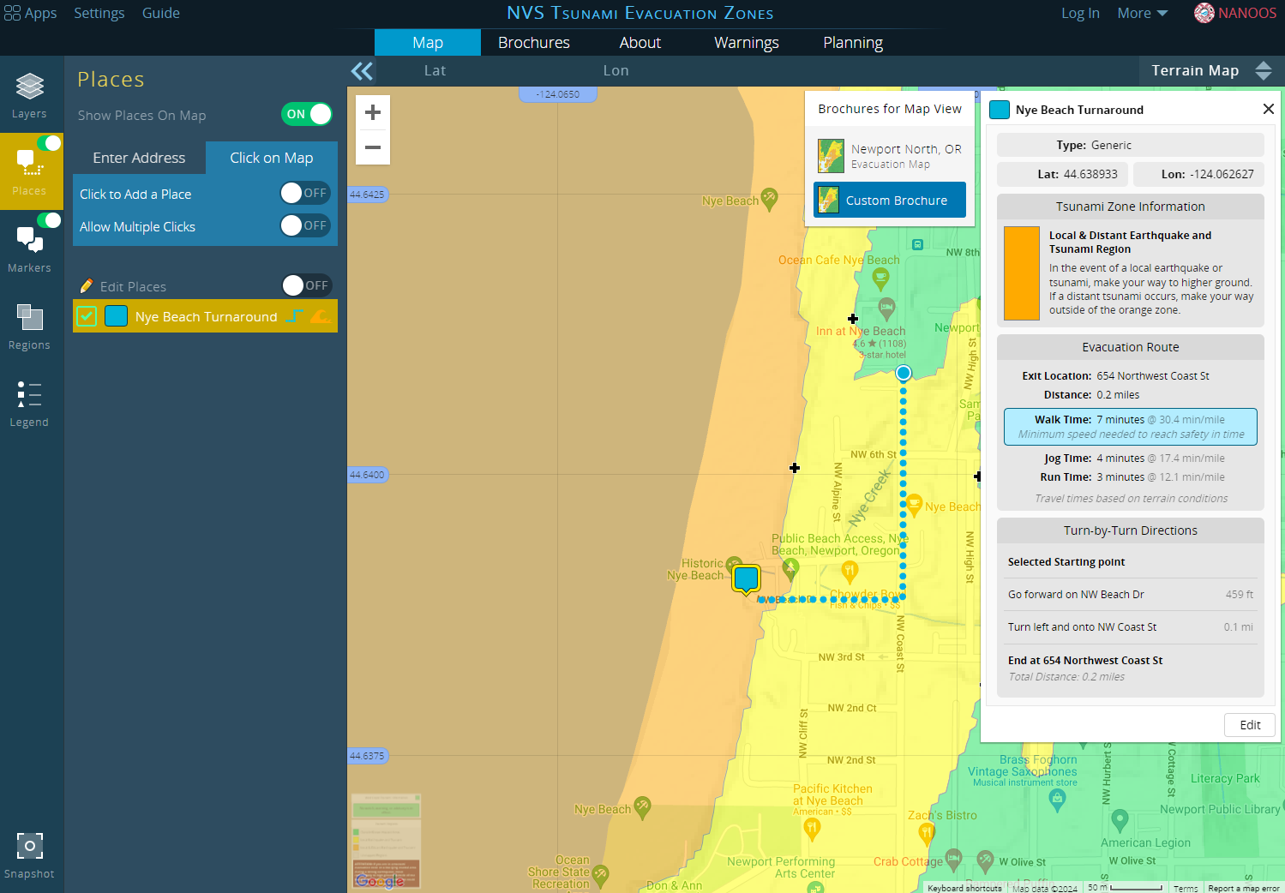
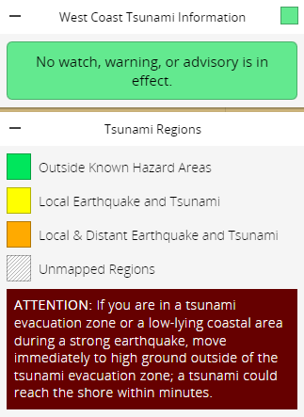
Online Evacuation Mapping Tool

Slide 7
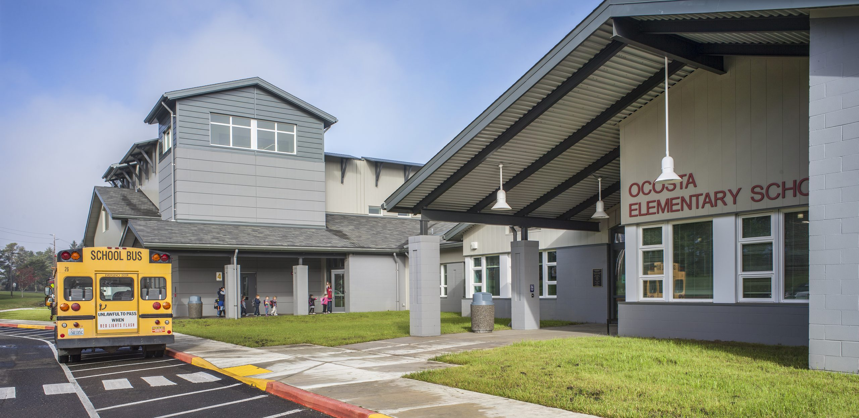
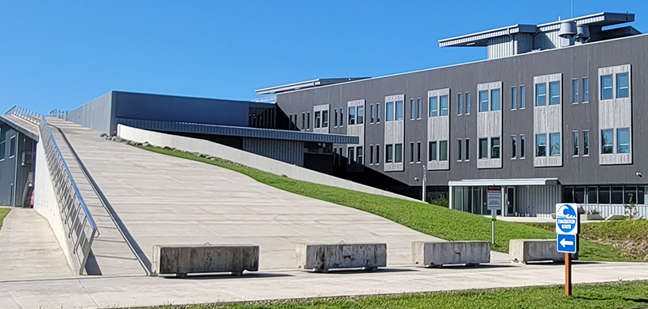
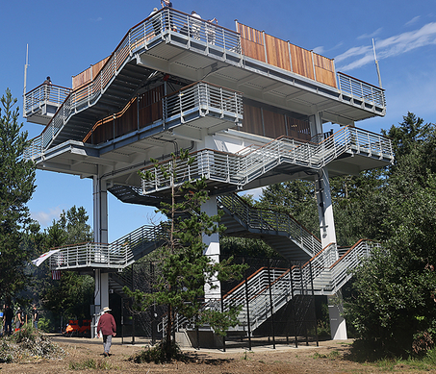
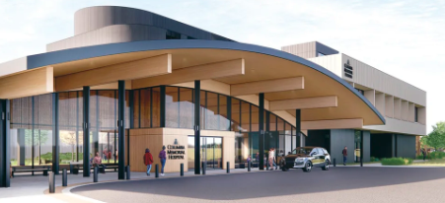
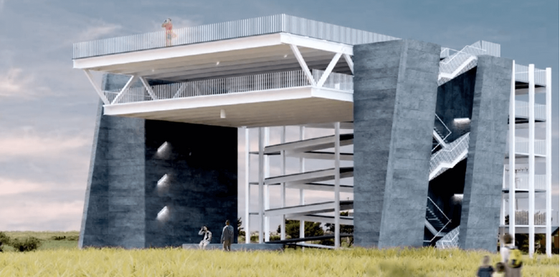
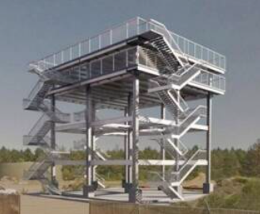
Vertical Evacuation Structures in the U.S.
Ocosta, WA (2016)
Newport, OR (2020)
Tokeland, WA (2022)
Completed
Astoria, OR
Westport, WA
Ocean Shores, WA
Funded

Slide 8
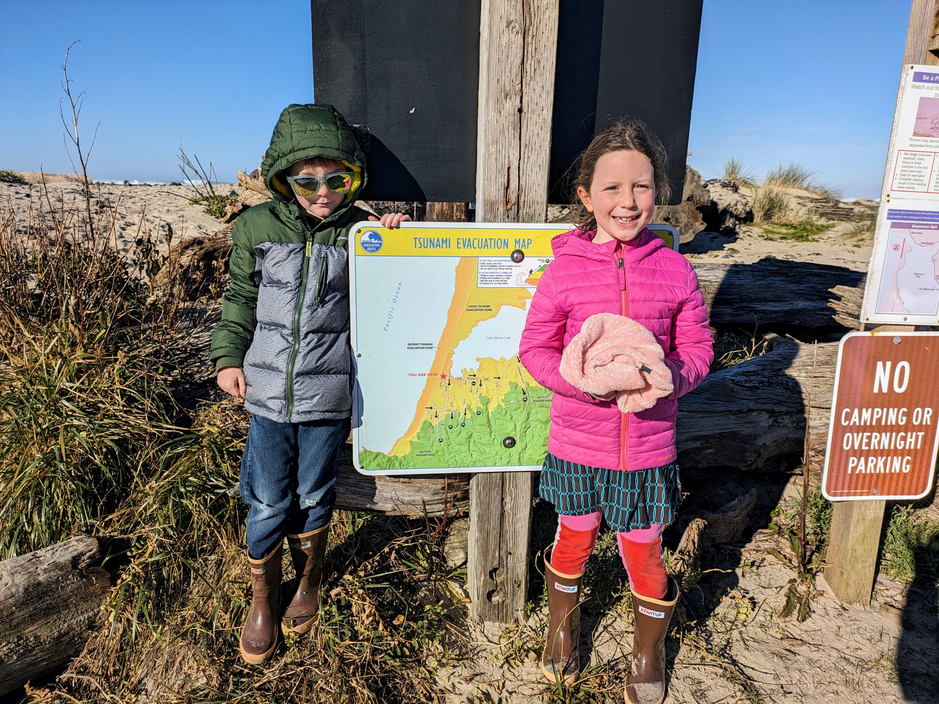
Thank you!
www.OregonTsunami.org
Laura.Gabel@dogami.oregon.gov
(971) 413-0624
Newport, OR

Slide 9
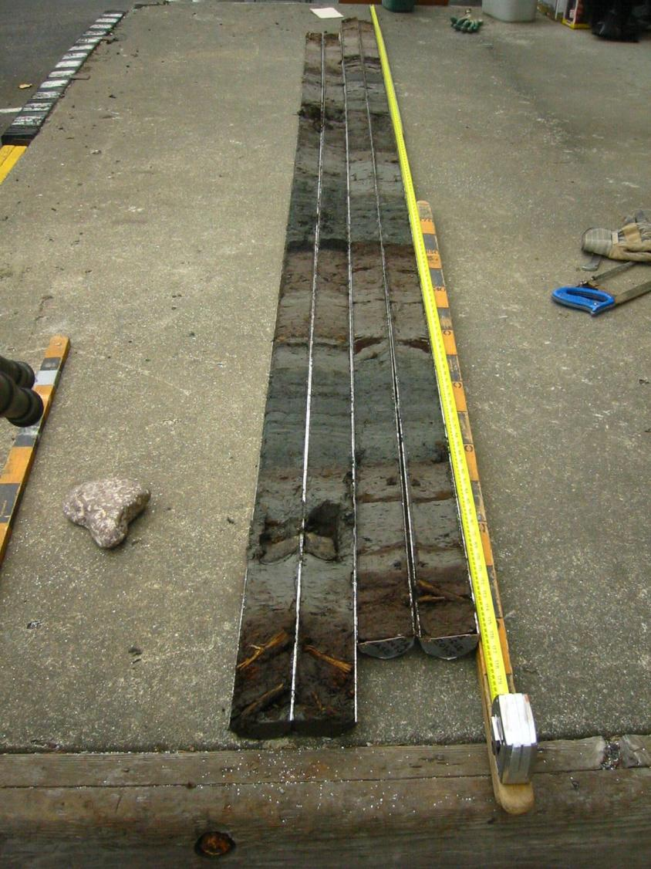
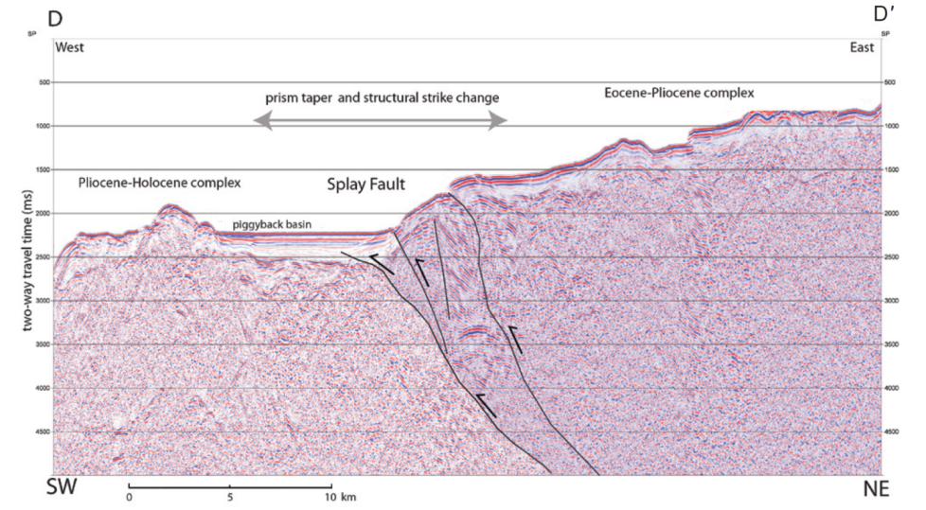
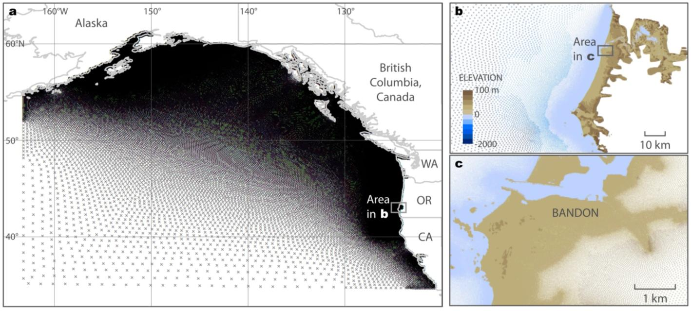
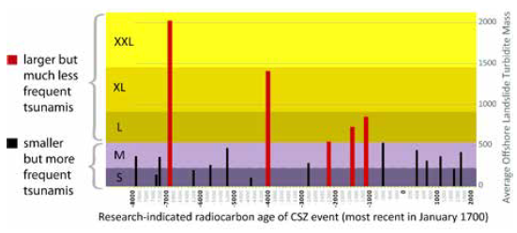
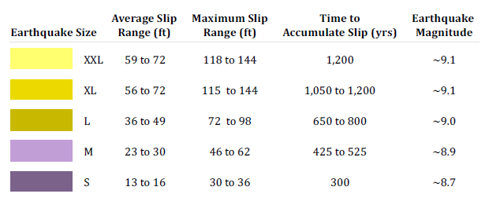
DOGAMI Tsunami Modeling
2009-2012
Funded by the National Tsunami Hazard Mitigation Program
Team of scientists using the latest geophysical data & models
Splay fault imaged in seismic lines offshore Oregon (Mann & Snavely, 1984)
Hydrodynamic model SELFE (Zhang and Baptista, 2008)
Marsh core, Coquille estuary, showing 8 EQ/tsunamis (Witter et al, 2003)
Five LOCAL and two DISTANT tsunami scenarios modeled
= 100% of local tsunamis (~5000-yr event)
Local Tsunami Evacuation Zone for Oregon
= 98% of local tsunamis (~5000-yr event)
= 95% of local tsunamis (~2500-yr event)

Slide 10
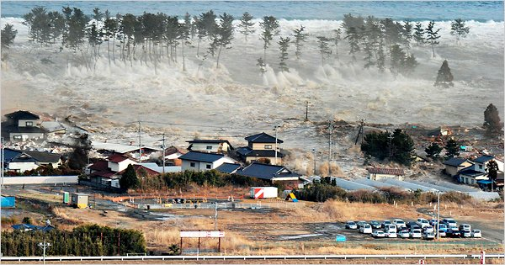
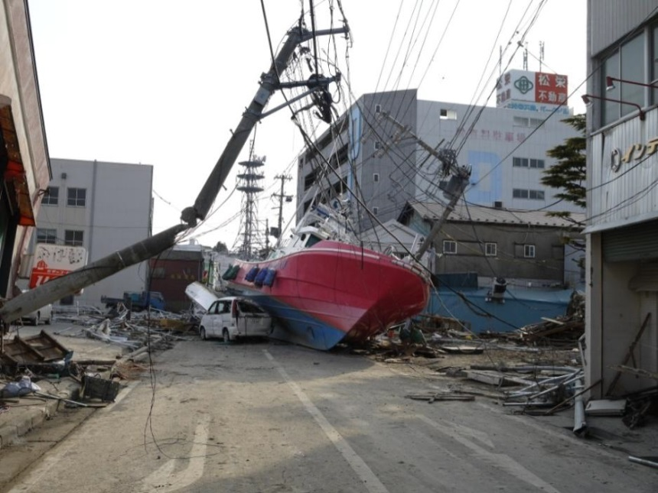
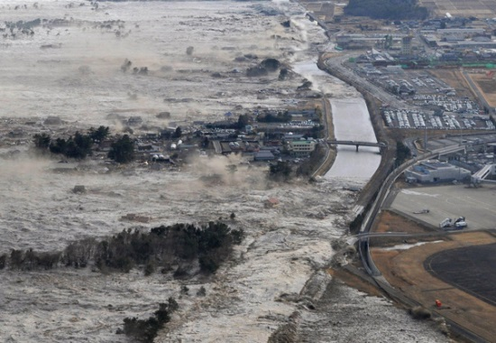
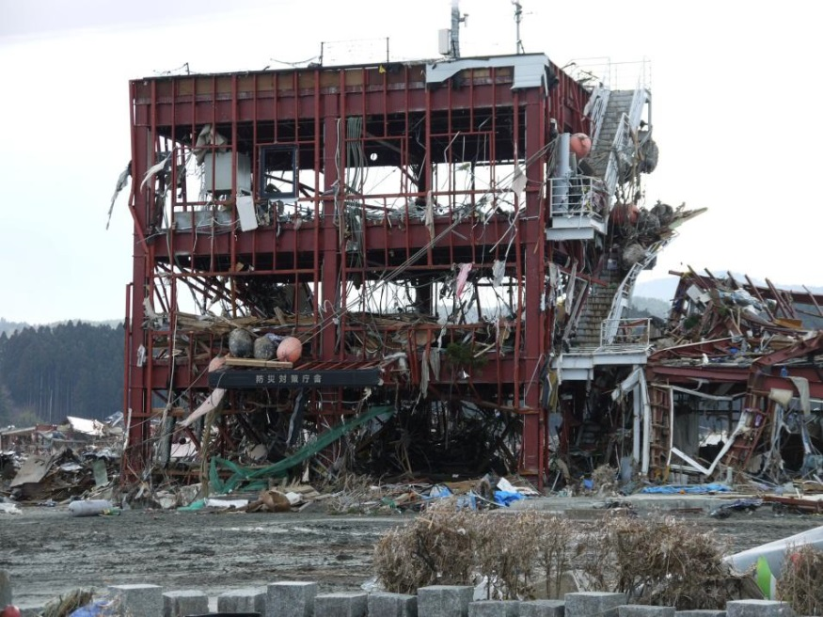
Why we care: Tohoku, Japan, March 11, 2011
Associated Press

Slide 11
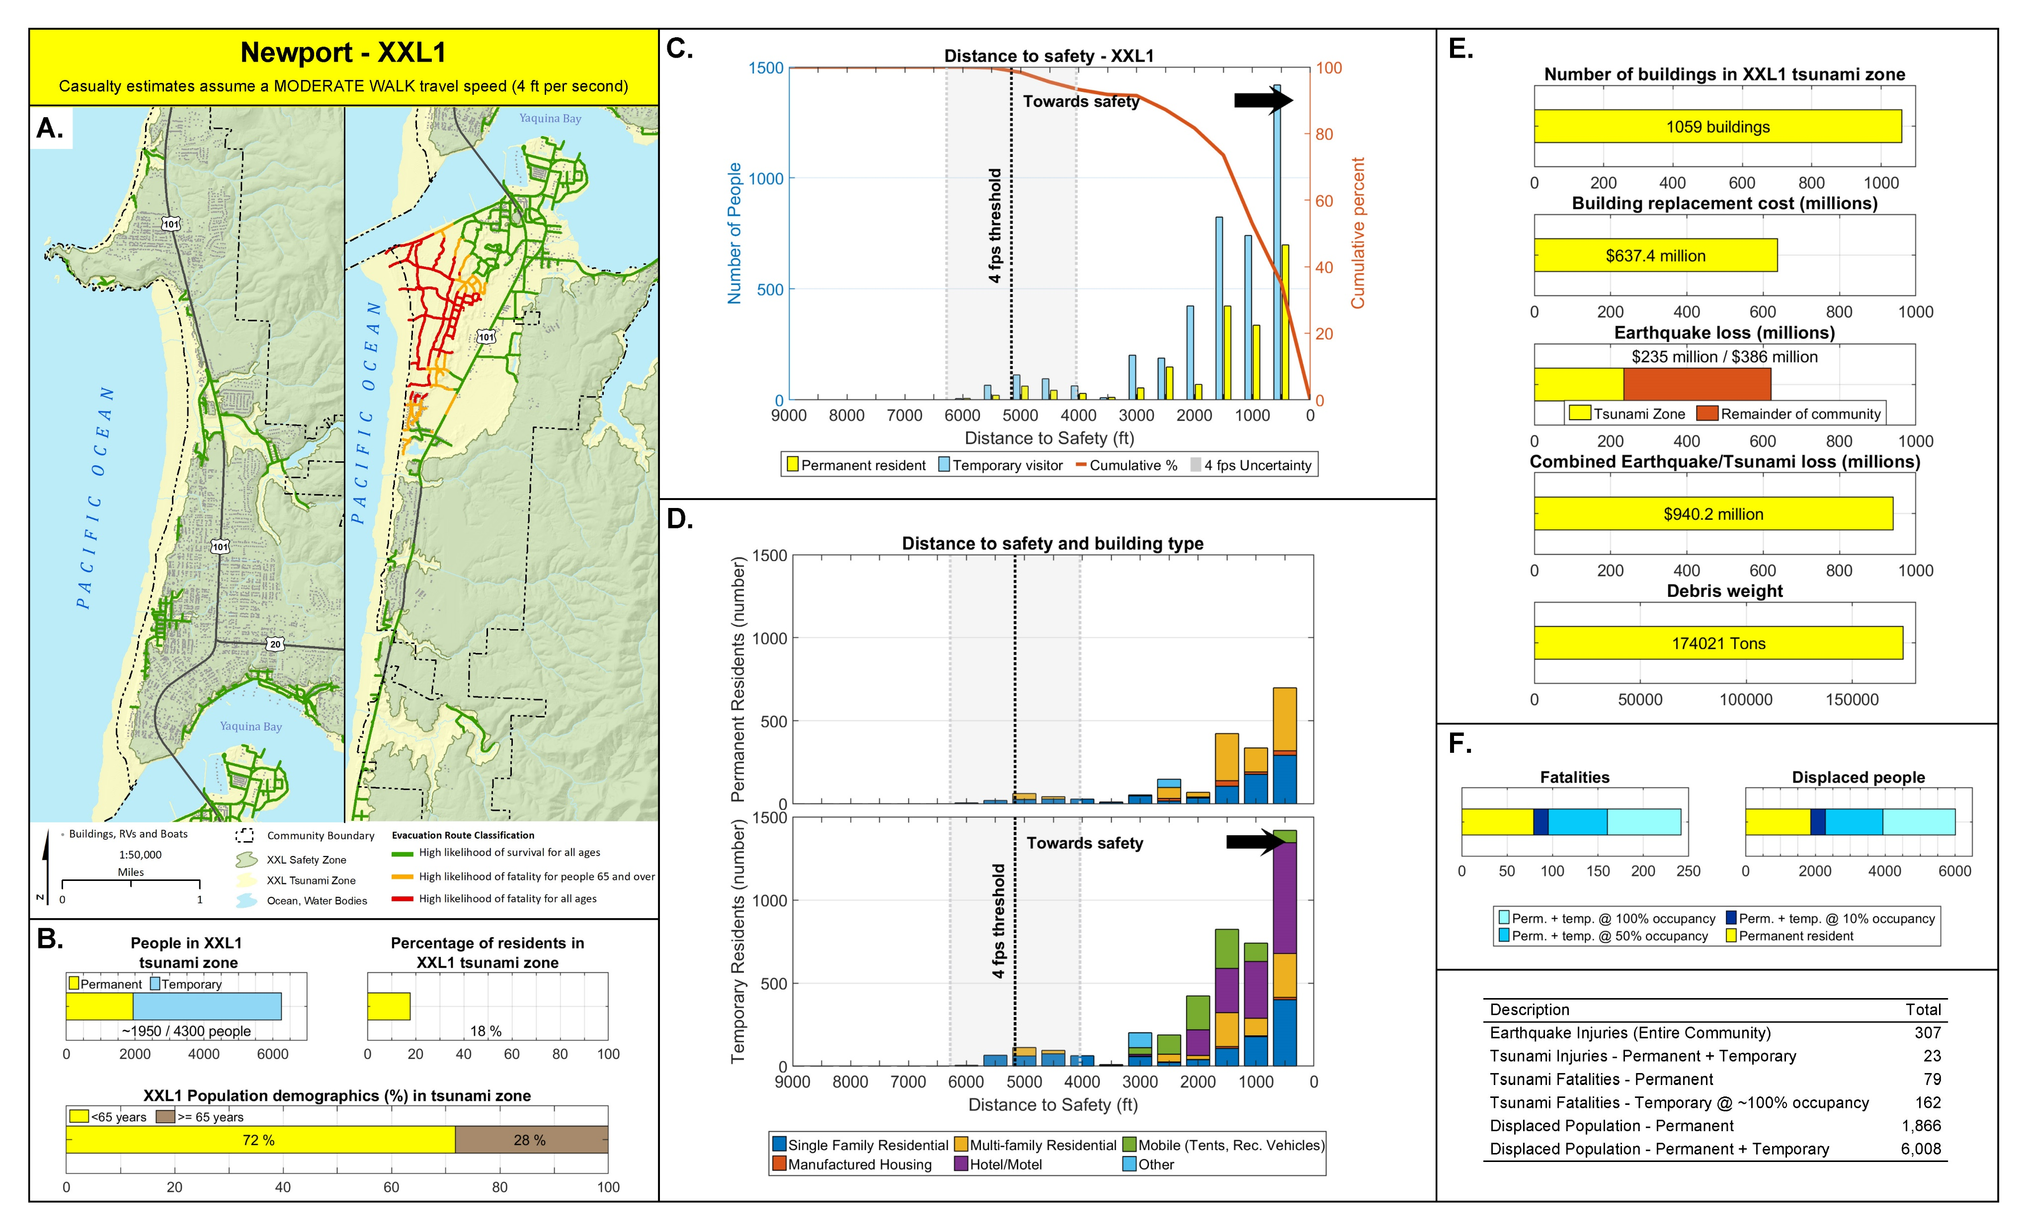
Associated Press

Slide 12
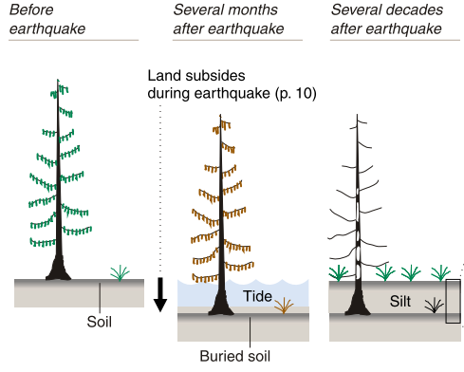
The Onland Paleoseismic Record
Evidence types:
  Coseismic subsidence (buried soils)
  Tsunami deposits
  Liquefaction (sand dikes, sills, blows)
  Landslide deposits
Applicability:
  Estimates of rupture and tsunami source areas
  Estimates of amount of subsidence
  Tsunami modeling (inundation (minimum) extent, sediment movement)
Dating techniques:
  Tree rings (best)
  Radiocarbon (min/max ages… greater uncertainty)
Limitations:
  Evidence is not equally distributed
  Preservation is not equal
  Age control
(Benson et al., 2001)
Spruce tree killed by earthquake subsidence when forest sank into tidal zone
Resistant
cedar trunk
tsunami
(Atwater et al., 2005)
(Garrison-Laney, 2022)
Notes:
Bank sections and sediment cores preserve repeated sequences of organic-rich tidal wetland soils formed in the interseismic period, sharply overlain by tidal mud deposited following decimeter-scale coseismic subsidence
In coastal lakes, landward thinning sand beds signal marine incursions from past tsunamis

