Slide 1

Lincoln County Long Term Recovery Group (LTRG)

Slide 2
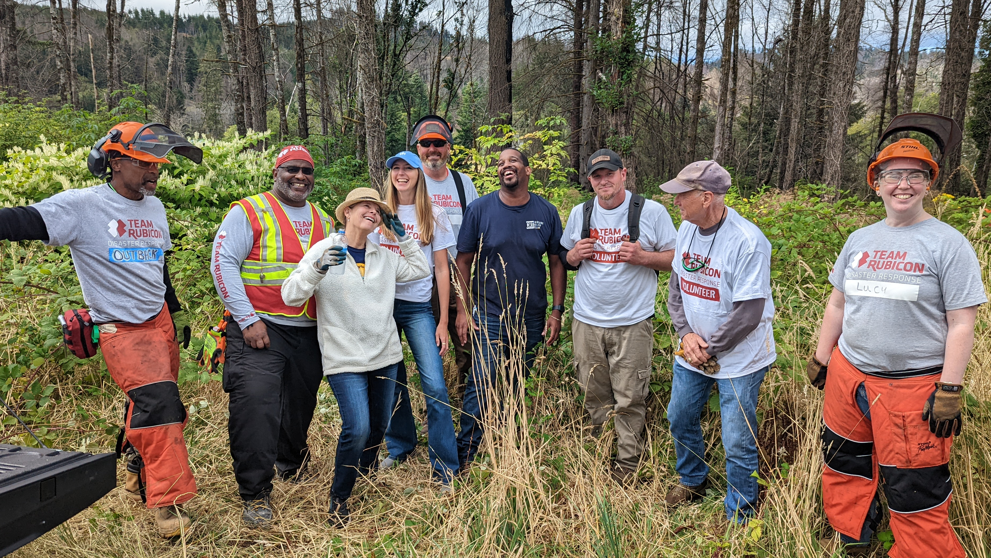
Mission
Coordinate resources and services to support
the resilience of local residents impacted by disaster

Slide 3
What is a Long Term Recovery Group (LTRG)?
A long-term recovery group (LTRG) is a cooperative body made up of representatives from faith-based, non-profit, government, business and other organizations working within a community to assist individuals and families as they recover from disaster.
501c3 nonprofit organization

Slide 4
How is a LTRG Formed?
After disaster, FEMA is deployed to disaster area
  Otis – Echo Mountain Fire
A FEMA Volunteer Agency Liaison (VAL) works with the impacted disaster community and identifies community leaders to form the LTRG

Slide 5
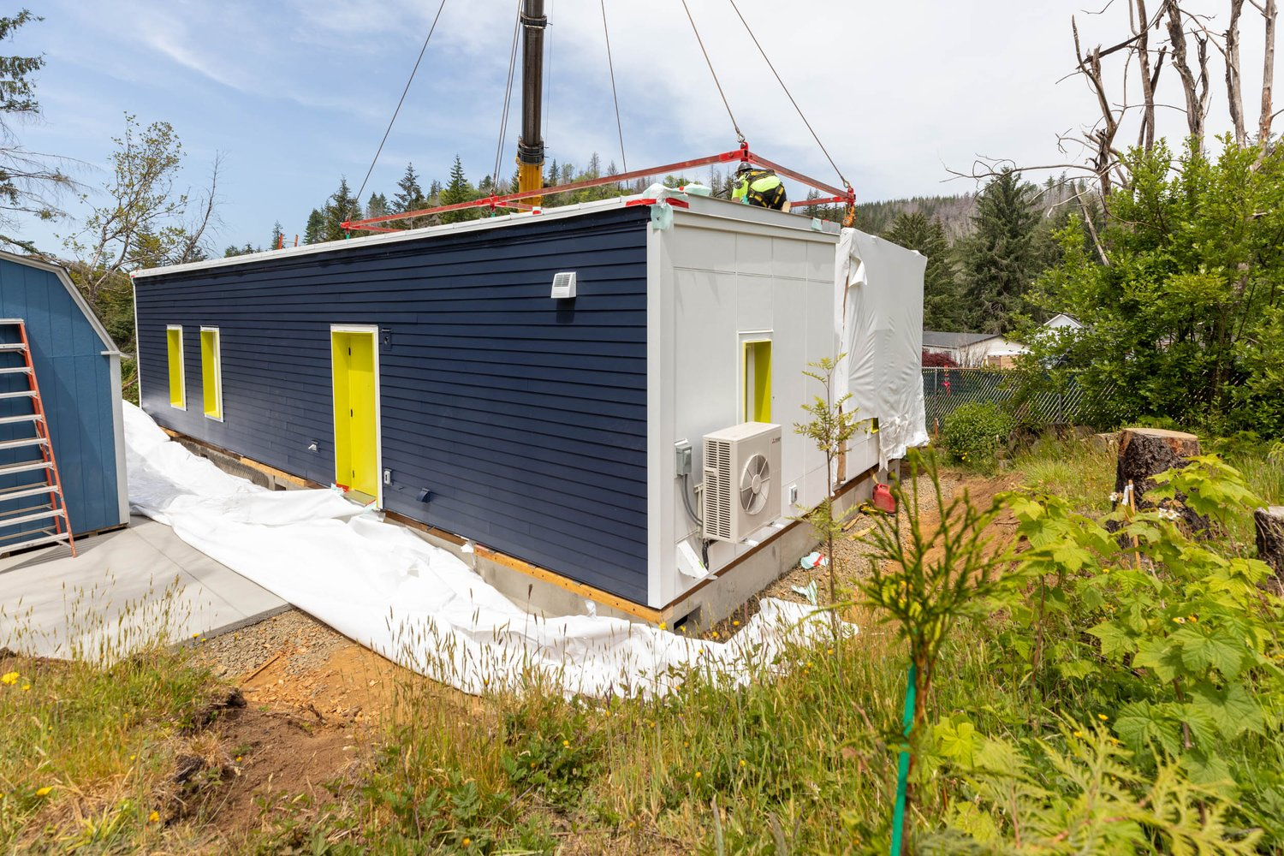
Where is the Lincoln County LTRG?
Serves all of Lincoln County
Currently responding to 2020 Echo Mountain Wildfire
On average, it takes
5 – 7 years for a community to recover from a major disaster

Slide 6
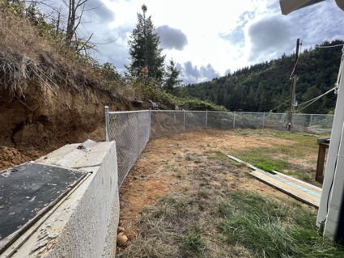
Unmet Needs Roundtable
Coordinates resource navigation, outreach, and program referrals throughout the case management process
Disaster Case Managers present the unmet need of a disaster survivor to a committee of funders
The UNR has provided nearly $500,000 of private funding to Lincoln County wildfire survivors
Notes:
Bringing together disaster case managers representing survivors and a committee of funders. Survivor needs are presented and funding is committed at the table.

Slide 7
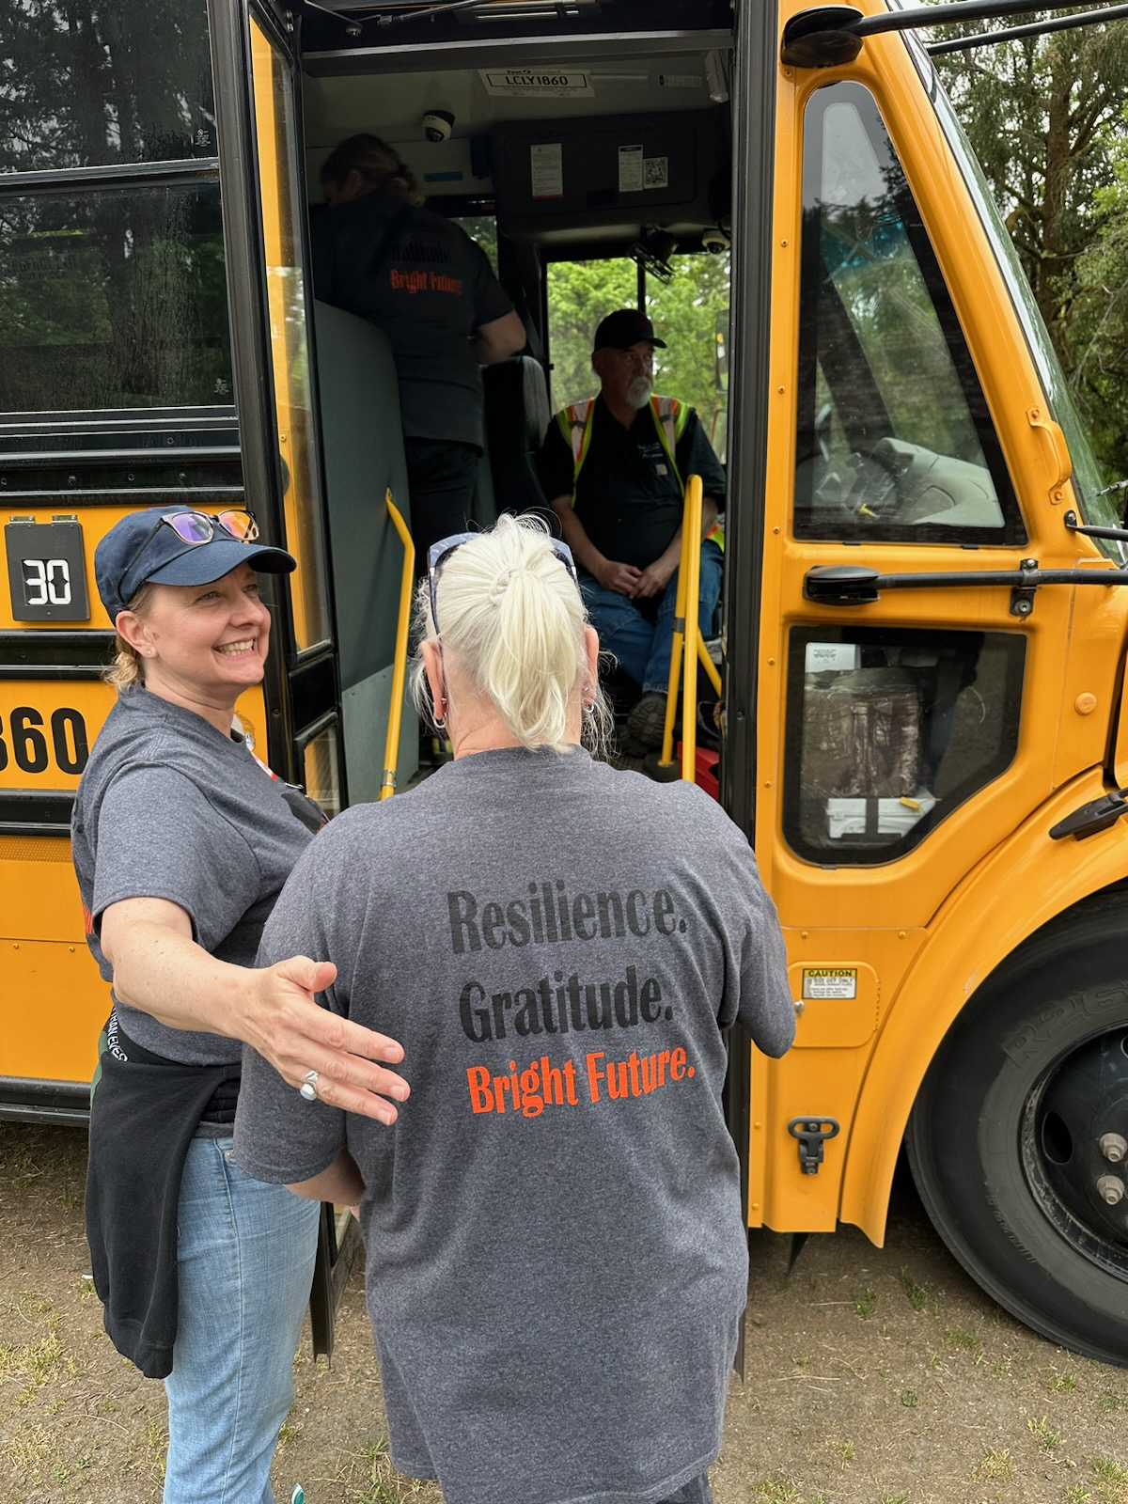
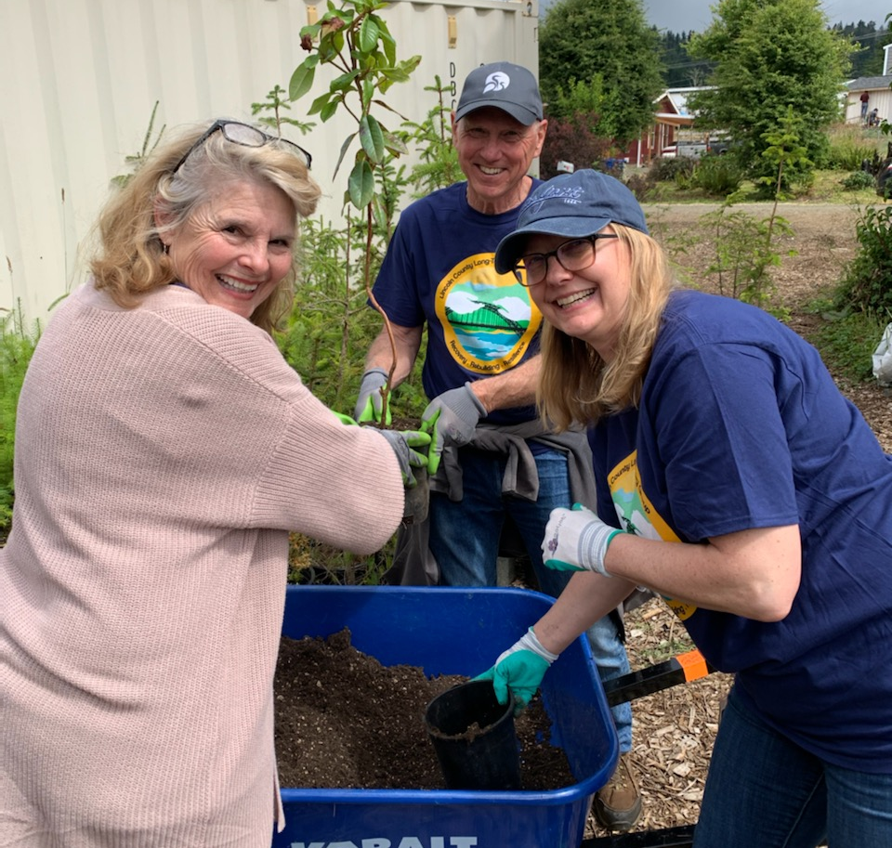
Spiritual & Emotional Care Committee

Slide 8
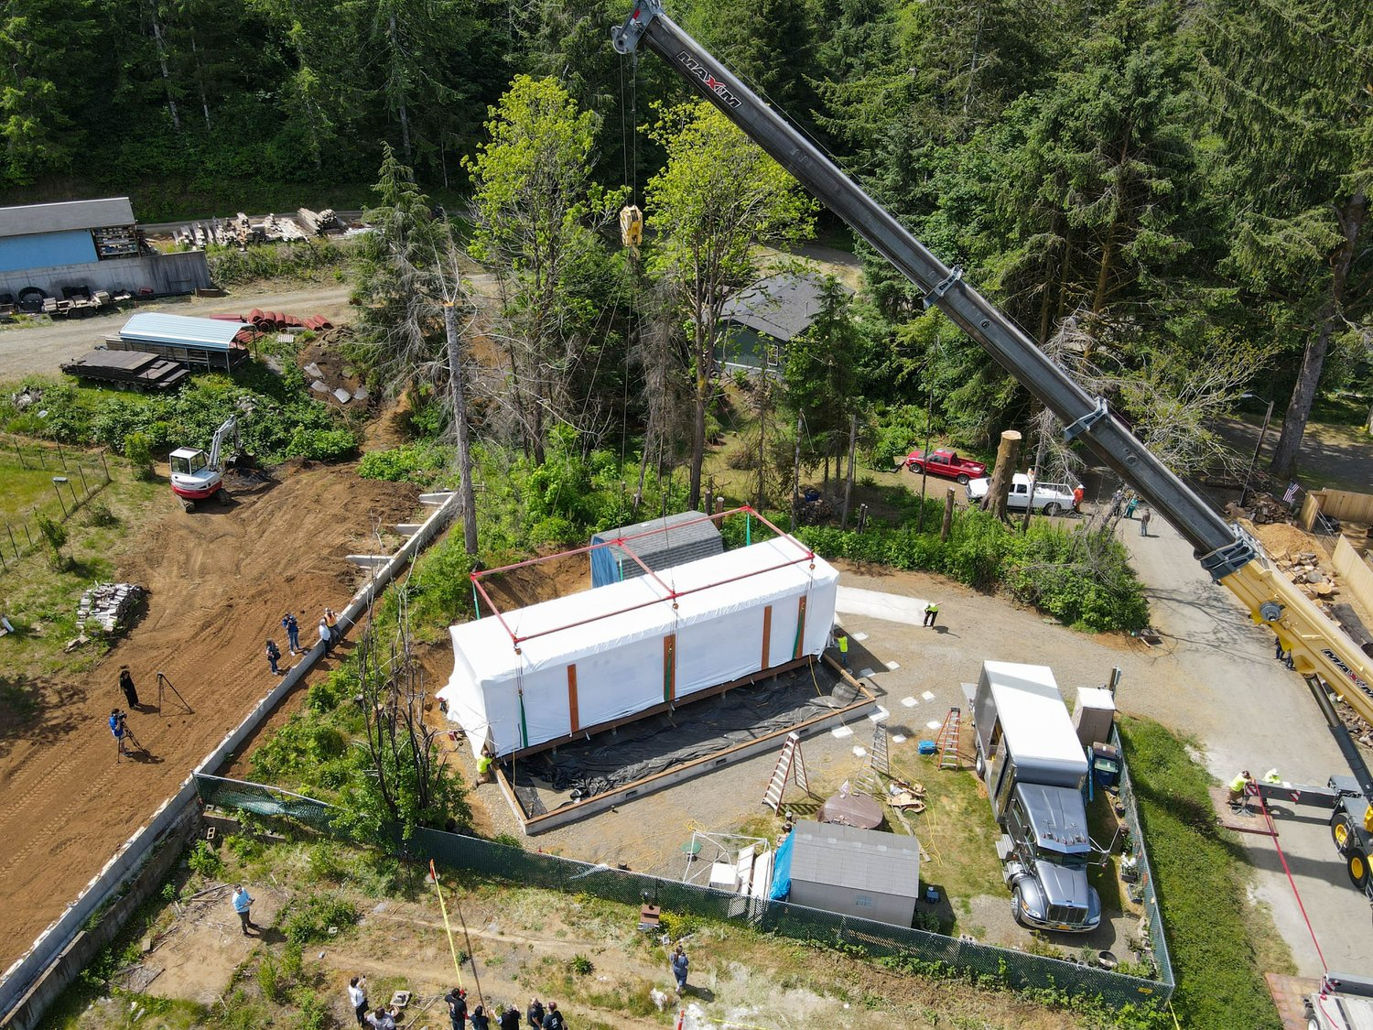
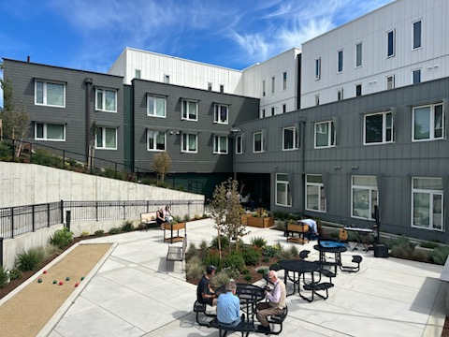
Current Recovery Status – Echo Mountain Fire

Slide 9
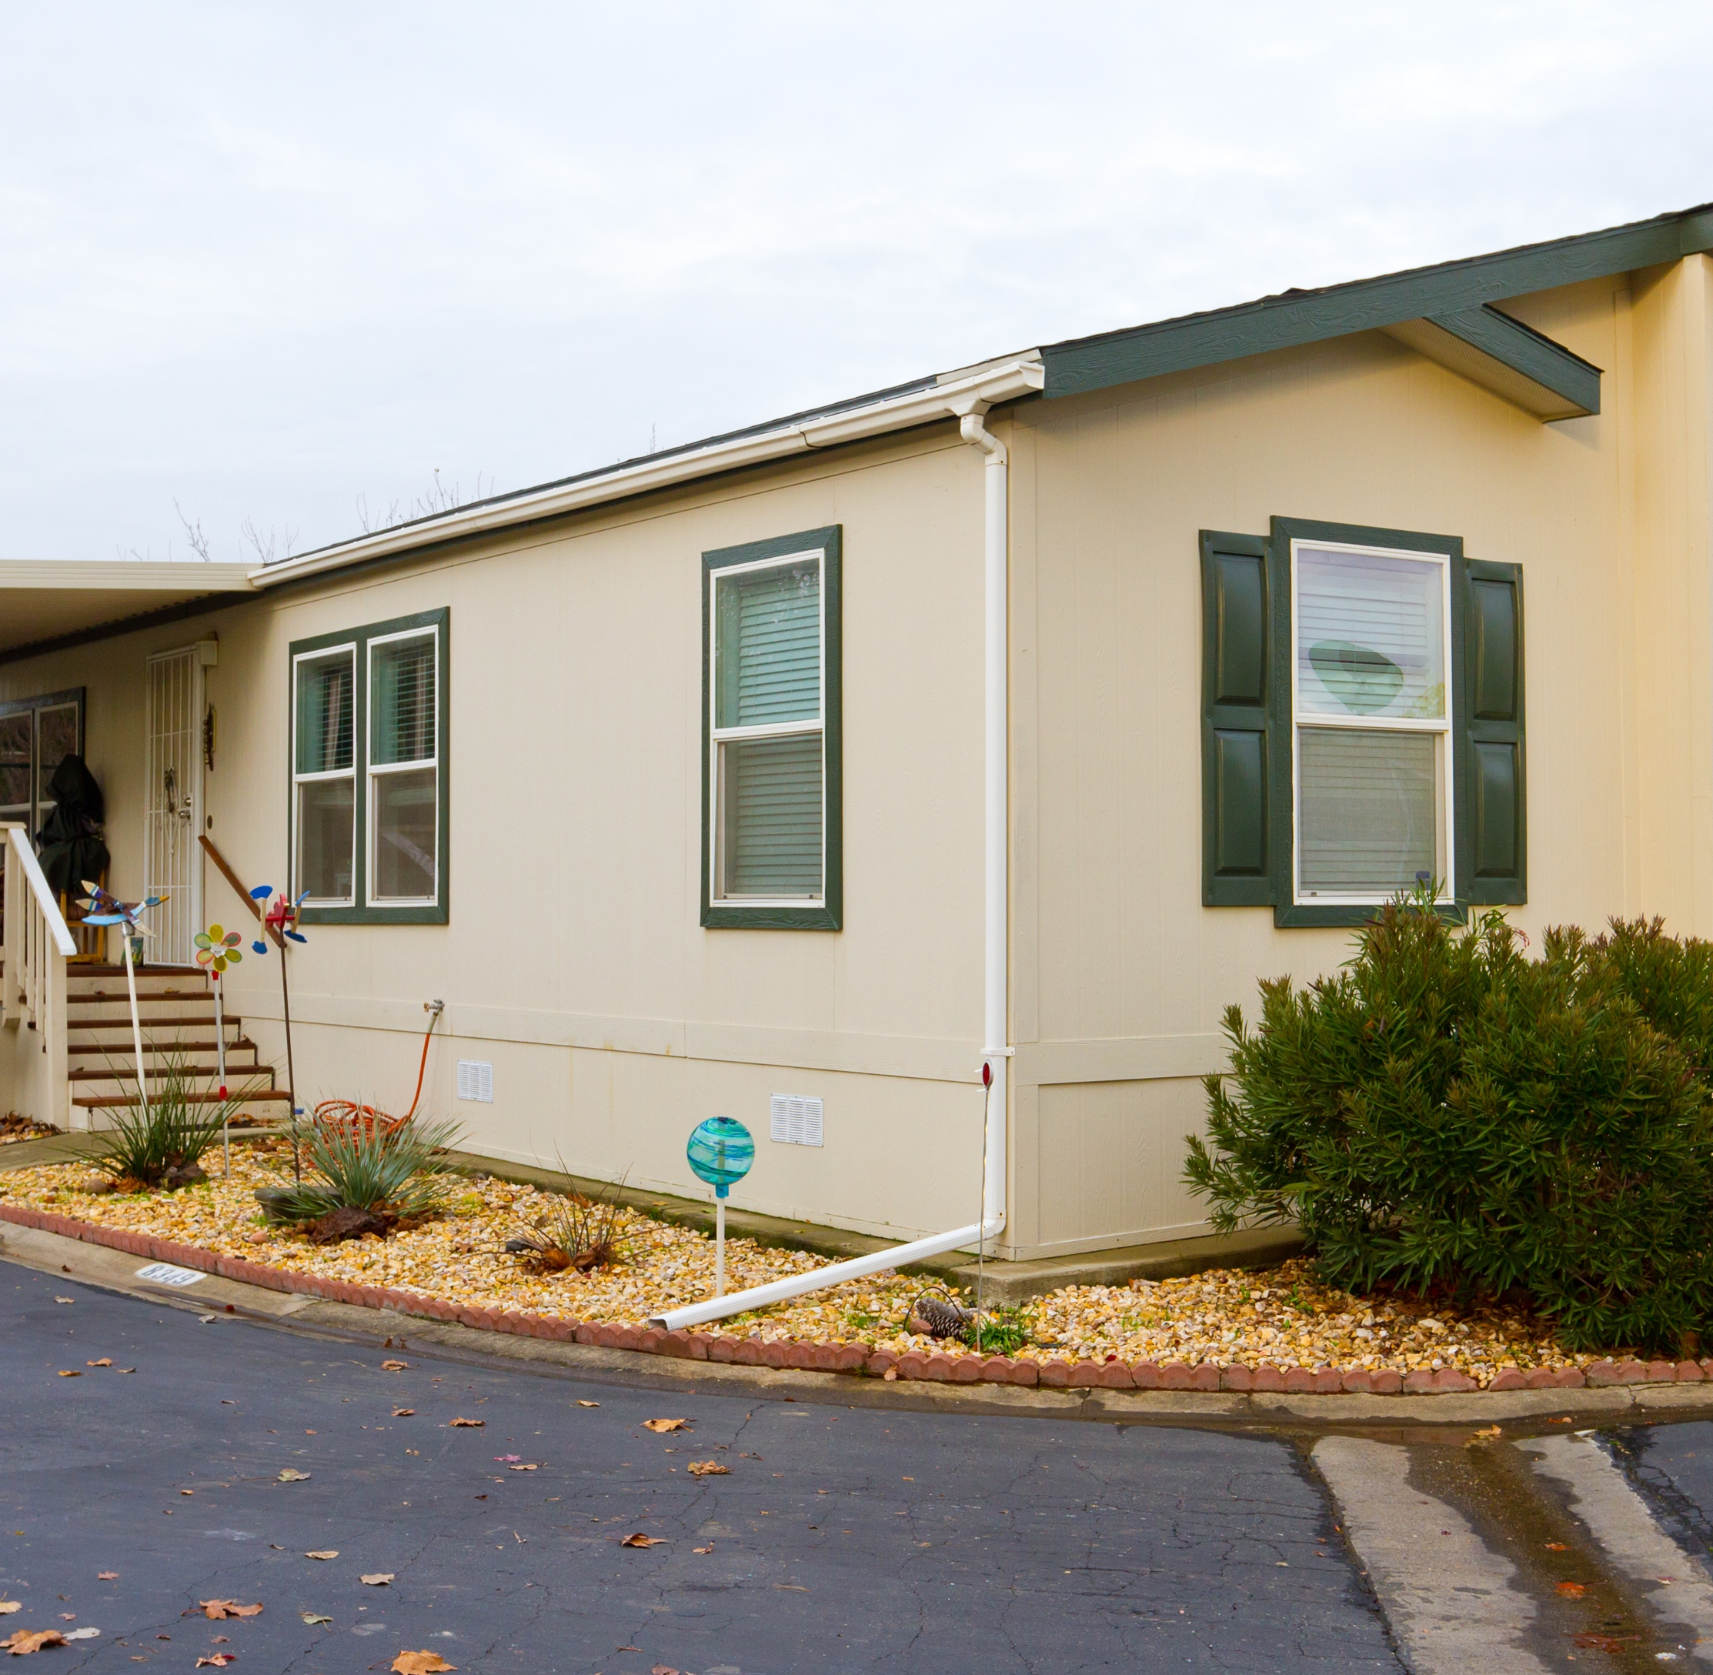
Homeowner Assistance and Reconstruction Program
(HARP) for Wildfire Survivors
Assistance is available to meet the unmet needs of eligible Homeowners as they complete the Rehabilitation or Replacement of their home.
HARP will provide grants for eligible rehabilitation, reconstruction,
or replacement costs, including costs to comply with federal, state, and local construction standards. Eligible costs also include:
Elevation, if approved
Fire hardening or other program-required mitigation
costs to help protect the home
Green Building Standards
Accessibility for senior residents and individuals with disabilities

Slide 10
More Info
Facebook.com/LCLTRG
Allyson West, Executive Director
Allyson.West@habitatlincoln.org
ReOregon – HARP
Re.Oregon.gov

