Slide 1
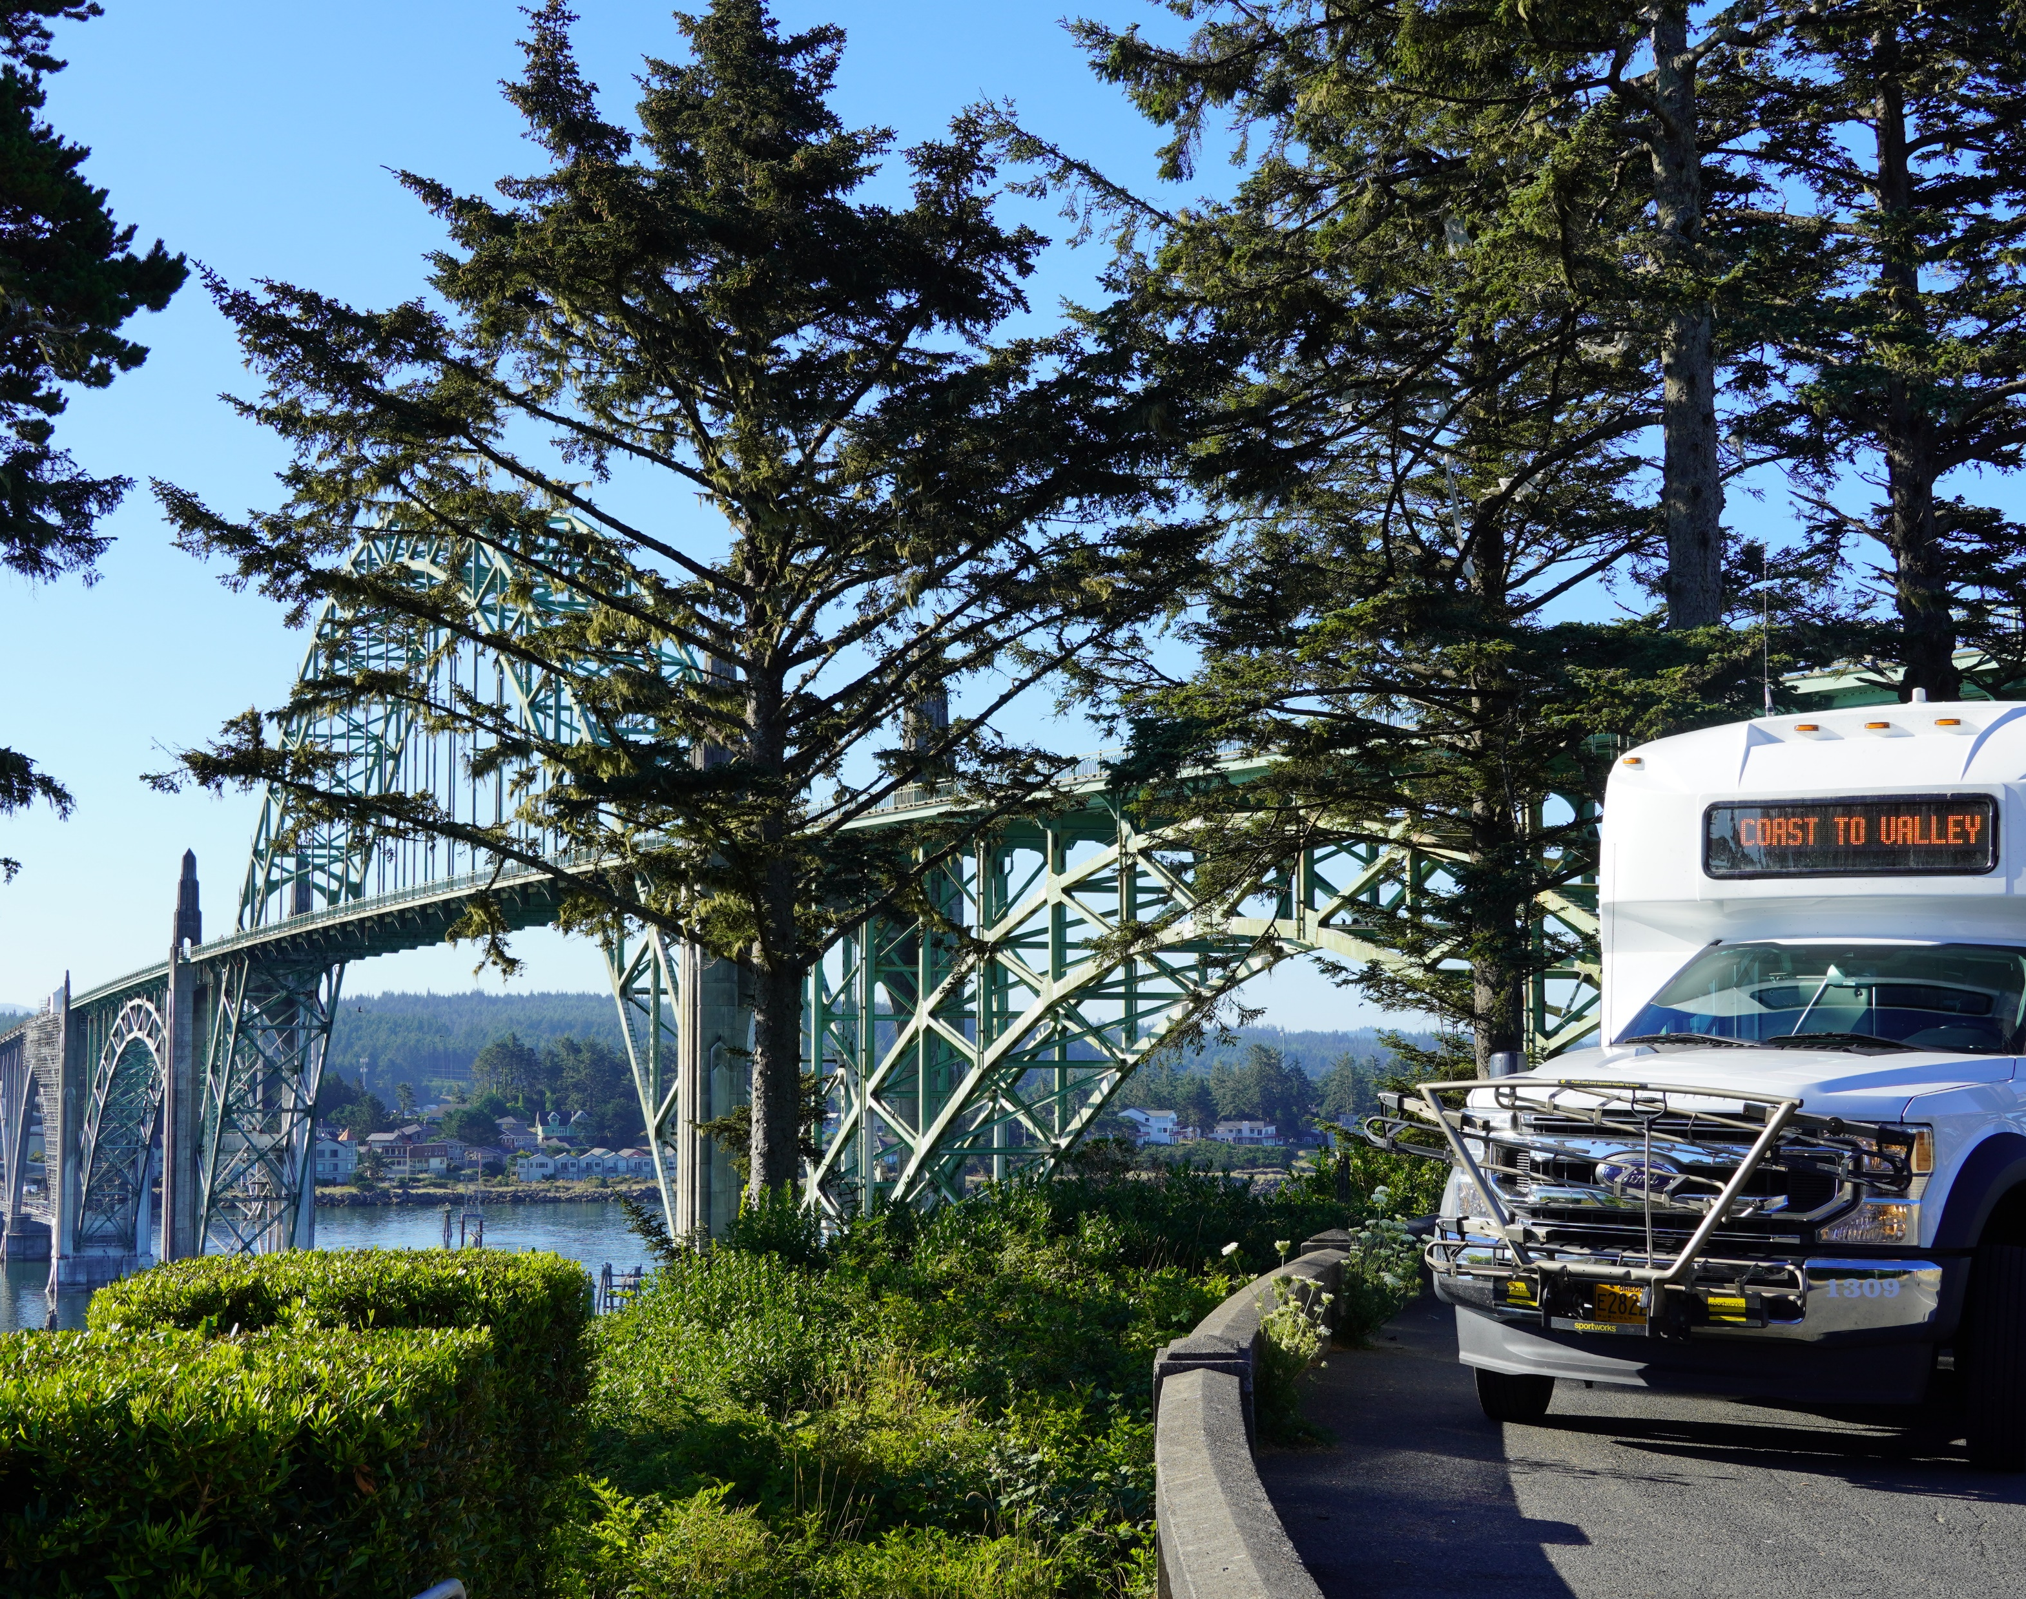
Lincoln County
Transit
Fiscal Year 2024-25
Budget
Presentation

Slide 2
Lincoln County Transit
FY 2023/24 Statistics
Rides Provided = 257,450
Hours of Services = 29,412
Annual Miles Traveled = 510,713
Total Number of Buses = 19

Slide 6
Goals & Objectives
Recruit, train and retain CDL bus drivers to maintain and increase services to residents and visitors of Lincoln County
Secure funding for and complete a feasibility study and implementation strategy for alternative fuels/electric buses
Complete initial marketing/branding campaign to increase visibility and ease of use of the public transit system
Begin design and construction of the Waldport bus hub, to be located near Ray’s Food Market
Initiate Waldport City Loop

Slide 7
Recent Accomplishments
Sunday service on south county inter-community route, began December 2023
Sunday service on blue line route, began December 2023
Assisted in weather related evacuations
Implemented additional driver training
Notes:
These expansions and new services were the result of input of Lincoln County residents through surveys, public outreach and public meetings. The Statewide Transportation Improvement Program advisory committee made recommendations to the Board of Commissioners on which projects to move forward

Slide 8
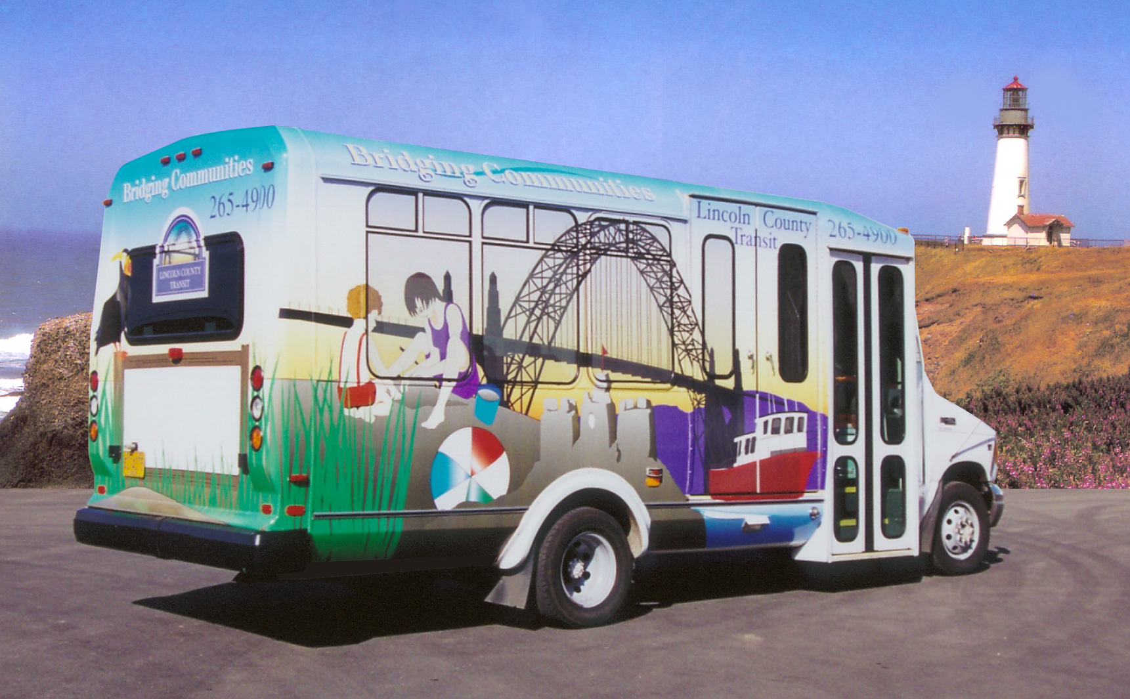
Questions?
Thank you for your continued support of Lincoln County Transit!

