Slide 1
DISTRICT ATTORNEY’S OFFICE BUDGET PRESENTATION FY 23/24

Slide 2
Organizational Structure of the District Attorney’s Office
CITIZENS OF LINCOLN COUNTY
ELECTED DISTRICT ATTORNEY
LANEE DANFORTH
Chief Deputy District Attorneys
2 FTE
Administrative Chief
1 FTE
Executive Chief
1 FTE
Support Staff
8 FTE
2 PT
Victim Assistance Supervisor
1 FTE
Child Support Staff
2 FTE
Deputy District Attorneys
8 FTE
Digital Forensic Analyst
1 FTE
Detectives
2 FTE
Victim Advocates
2 FTE
2 PT
*Chart assumes we are fully staffed
When fully staffed the DA’s Office has an estimated total of 33 employees. 10 of those employees (approximately 30%) are partially or fully grant funded.
FTE = Full time employee
PT – Part time

Slide 3
District Attorney’s Office
  Child Support Enforcement
  Medical Examiner
  Victim’s Assistance Program
  VOCA Grant
  My Safe Place Grant
District Attorney’s Office Overview

Slide 4
Review and prosecute misdemeanor and felony crimes for all municipalities in Lincoln County
Lincoln County Sheriff’s Office
Newport Police Department
Lincoln City Police Department
Toledo Police Department
Participate in specialty court programs
Drug / Hope court
Mental health and wellness court
Family support court
Domestic violence court
Represent the state at parole board hearings and psychiatric review board hearings
Expungements / SB 819 / Clemency
Establish and oversee statutorily required multidisciplinary teams (MDTs)
Child Abuse
Elder Abuse
Sexual Assault
Human Trafficking
Domestic violence
Oregon State Police
DA’s Office Responsibilities

Slide 5
Major Crime Team and Crash Team
Officer involved shooting and use of force investigations
Civil commitment hearings
Child support enforcement
Death investigations
Legislative committee
Enforce crime victims’ rights and provide services to crime victims
DA’s Office Responsibilities, cont.

Slide 6
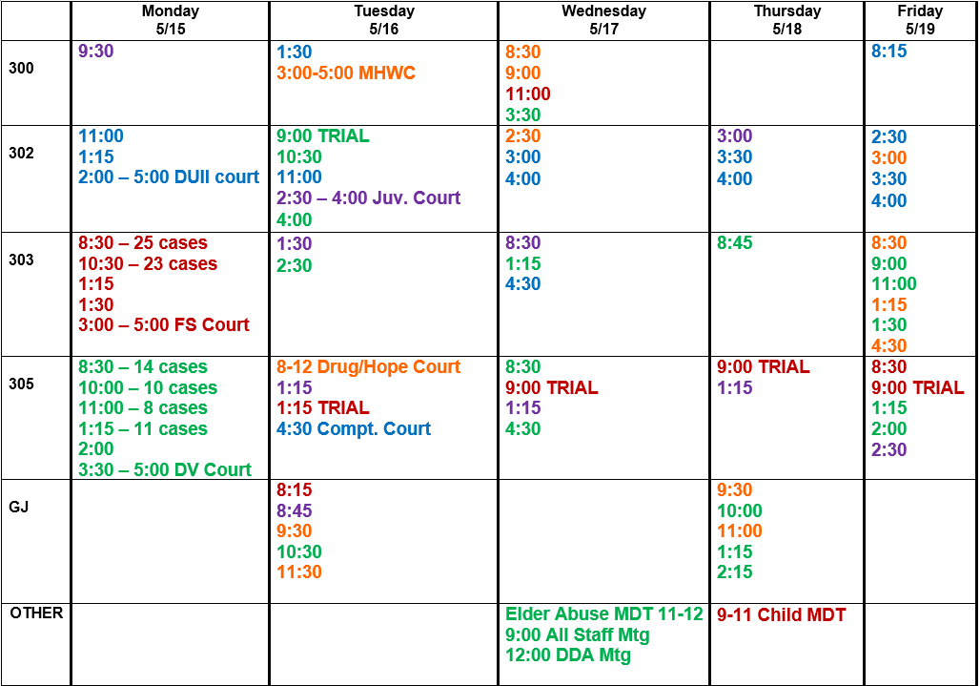
A DAY IN THE LIFE
Charge cases by 10am
Charge cites (20+ cases) by Wed.
Charge review cases
Make plea offers / negotiate cases
Contact victims / witnesses
File motions
Trial preparation
Multidisciplinary Teams
On call 24/7
  Review search warrants
  Advise law enforcement
  Major crimes / crashes
  Release every death
2 DDA supervisors + 4 DDAs
50% staffing

Slide 7
Filing Statistics
*Statistics are approximate based on case management system*

Slide 8
Types of Cases
Murder
Attempted Murder
Manslaughter
Robbery
Arson
Assault
Burglary
Child Sexual / Physical Abuse
Adult Sexual Abuse
Domestic Violence
Elder Abuse
Drugs
DUII / Traffic Crimes
Theft and other property crimes
Public nuisance crimes
Juvenile

Slide 9
Greatest Challenges
Staffing
Recruitment
Retention
Burnout
Salary
Housing
Cost of living
Law Changes
Nonunanimous verdicts
Decriminalization of drugs
Specialty courts
Retry decade old cases
Increased crime
Increased fatalities

Slide 10
Accomplishments
Supporting Justice Reinvestment
Downward Departure = people eligible for prison sentence but given an opportunity to successfully complete probation in lieu of prison.

Slide 11
Accomplishments
Specialty court program numbers since January 1, 2022
Drug / Hope Court = 44
Mental Health & Wellness Court = 20
Family Support Court = 15
Supporting Treatment Court Programs

Slide 12
Accomplishments
CSAM CHARGES FILED
In 2022 we successfully prosecuted several CSAM cases resulting in lengthy prison sentences
Several 2022 cases still open
Seized/analyzed more than 110,000 images of child sexual abuse material
PROTECTING OUR CHILDREN FROM SEXUAL PREDATORS
Successfully convicted several child sexual abusers resulting in lengthy prison sentences that total 207 years combined.
CSAM = Child Sexual Abuse Material
formerly referred to child pornography

Slide 13
Criminal Division Accomplishments
PROTECTING OUR HIGHWAYS

Slide 14
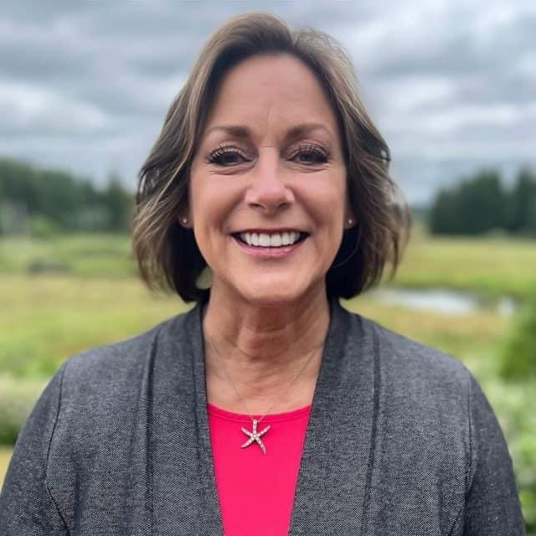
Criminal Division Accomplishments
Chief Deputy District Attorney Lynn Howard named 2022 National Traffic Safety Prosecutor of the Year.

Slide 15
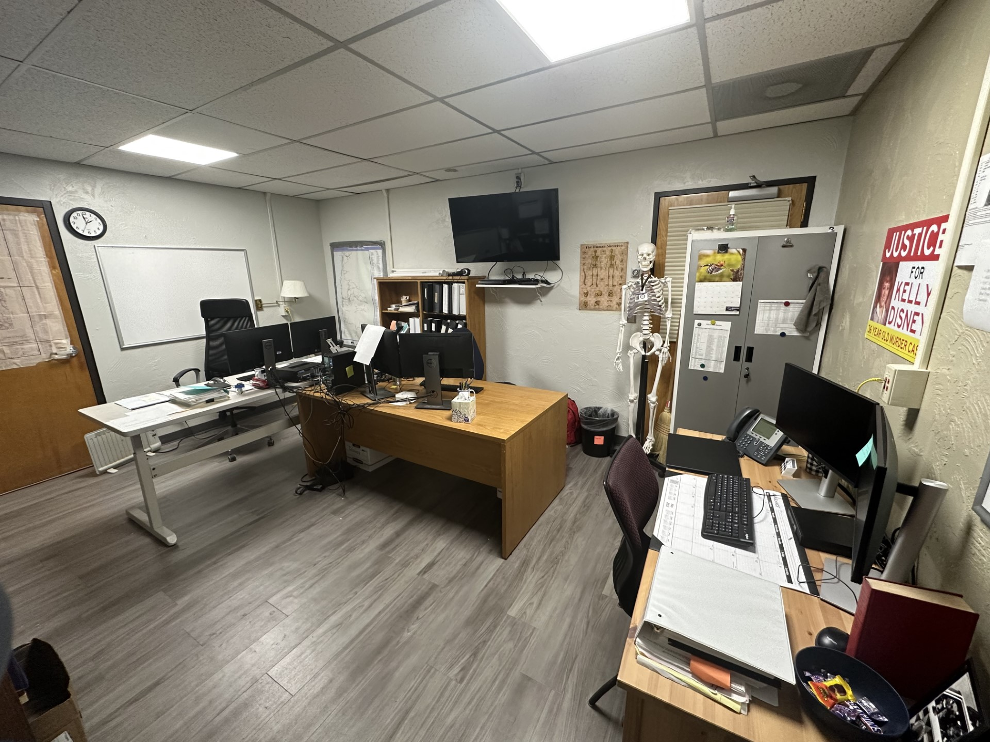
Accomplishments
COLD CASE INVESTIGATOR VOLUNTEER PROGRAM
3 cold case investigators with more than 60 years of combined experience.
Actively working on solving more than 12 cold case homicides in Lincoln County.

Slide 16
DA’s Office Goals FY 23/24
Become fully staffed with DDAs
Start Digital Forensic Lab
Collaborate with local law enforcement to reimplement the Lincoln Interagency Narcotics Team (LINT)
Collaborate with schools to educate our youth
Expand information on website and make information available in English / Spanish

Slide 17
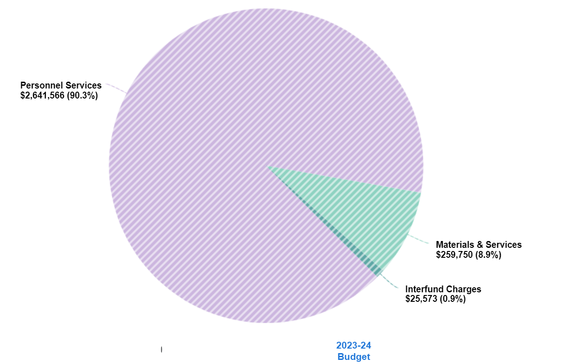
FY 23/24 Expenses for DA’s Office
Dept. 130

Slide 18
Child Support Enforcement
Responsible for collecting current and past due child support payments
Currently managing 656 cases – one DDA

Slide 19
Child Support Enforcement Accomplishments
Between October 1, 2021 and September 30, 2022, collected $2,848,147 in child support.
Recovered hundreds of thousands of dollars in past due child support payments, including payments exceeding $15,000, without needing to take legal action in court.

Slide 20
Child Support Enforcement Goals FY 23/24
Continue to collect current and past due child support to ensure children are receiving support they are entitled to under the law.
Continue to voluntarily collect payments without needing to use resources to take legal action in court.

Slide 21
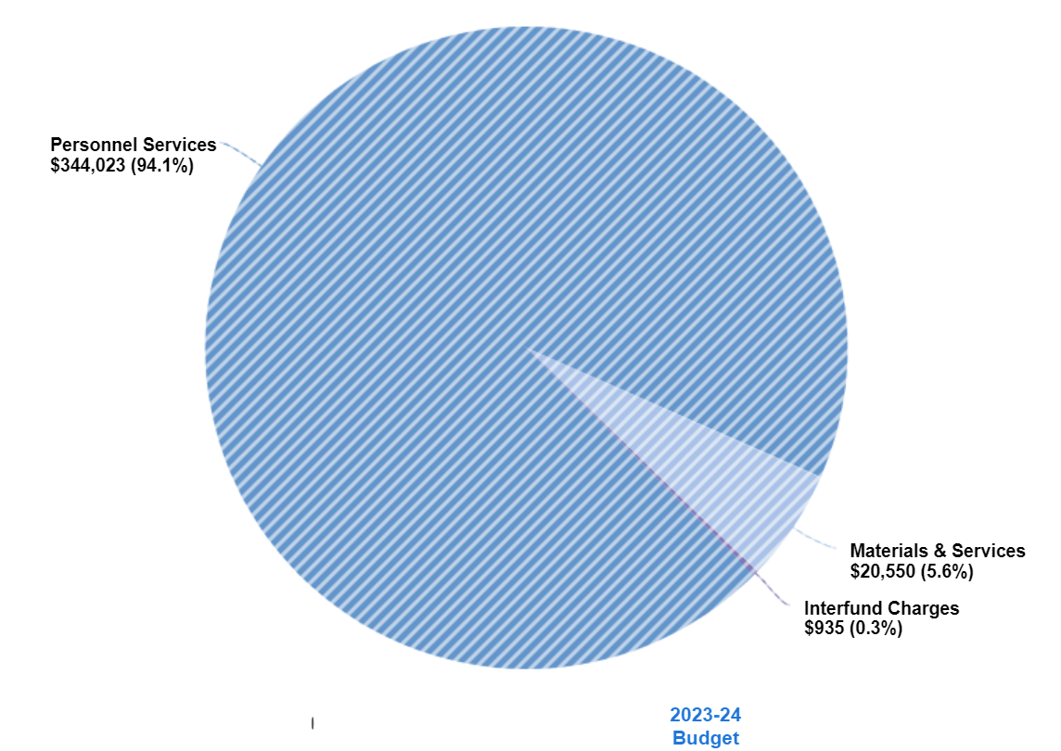
FY 23/24 Expenses for Child Support Enforcement
Dept. 135

Slide 22
Investigates all unattended deaths in Lincoln County
Processes death certificates
Ensure statutorily mandated information accurately entered in statewide database
Oversees Medical Legal Death Investigators (MDLIs)
Releases bodies to funeral home
Medical Examiner
Dept. 134

Slide 23
Death Statistics
Unattended deaths = deaths occurring outside of a medical facility

Slide 24
Projected to have more than 300 unattended deaths in 2023

Slide 25
Medical Examiner Accomplishments
Maintained Medical Examiner services locally
Medical Legal Death Investigator Program
Investigating overdose deaths for possible criminal charges for drug dealers
Created an informational brochure for family members of deceased individuals that provides guidance on what happens next with death investigation process along with contact information for the Funeral Home, DA’s Office, and Medical Examiner

Slide 26
Medical Examiner
Goals FY 23/24
Maintain Medical Examiner program locally.
Recruit, train, and certify more Medical Legal Death Investigators, including Chief Deputy DA Lynn Howard.
Provide easily accessible information on DA website for families in English / Spanish.
Educate community on lethality of fentanyl and other illicit drug use.
Schools – staff and students

Slide 27
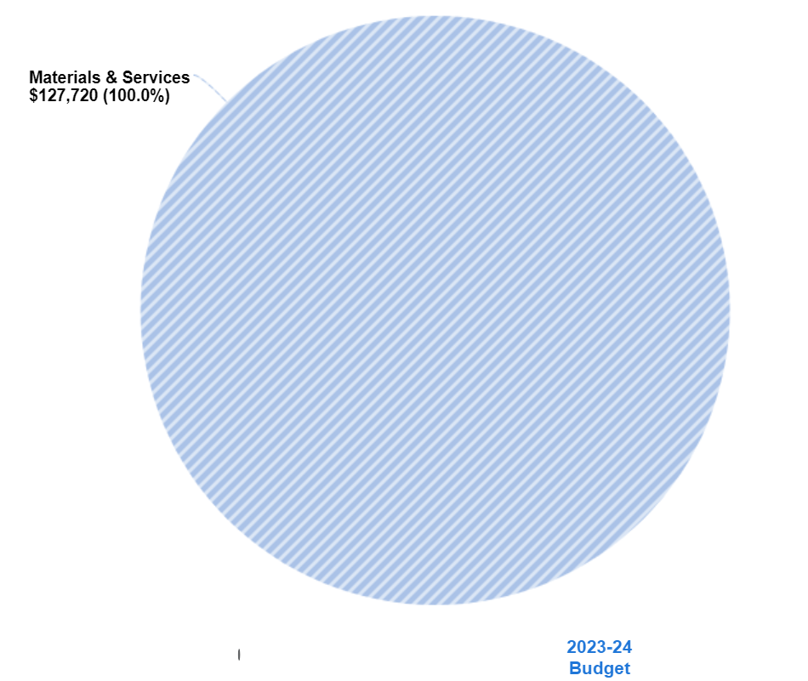
FY 23/24 Expenses for Medical Examiner
Dept. 134

Slide 28
Provide direct services for crime victims
Ensure victims and witnesses appear at grand jury and trial by arranging travel and providing services
Advise and enforce crime victim rights
Victim’s Assistance Program

Slide 29
Victim Assistance Program Accomplishments
Served 2,989 individual crime victims and provided 25,588 crime victim services
Made victims’ rights forms available in Spanish
Hired restitution clerk whose sole focus is to ensure crime victims are compensated for economic loss as a result of the crime(s) committed against them
Combined three part-time advocate positions into one full time, fully grant funded, advocate position

Slide 30
Victim’s
Assistance Program
Goals FY 23/24
Implement volunteer victim advocate program
Hold annual victims’ rights fundraiser to generate additional revenue sources
Provide digital victim rights forms accessible online in English and Spanish

Slide 31
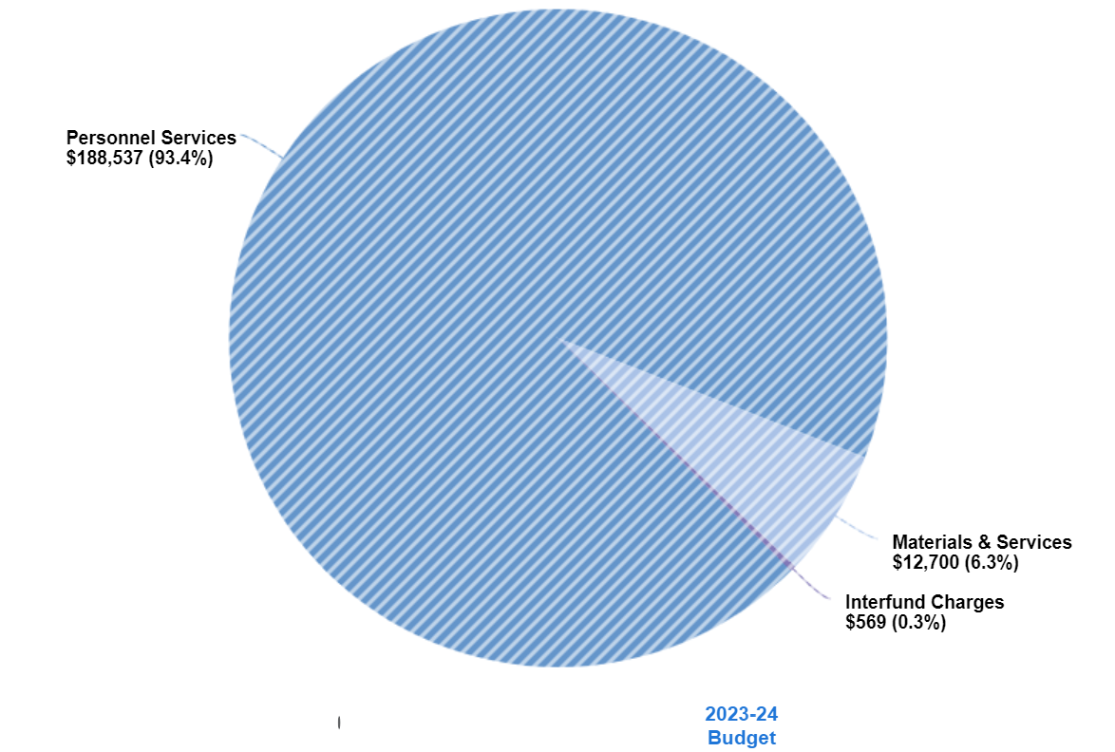
Victim’s Assistance Program Dept. 150
FY 23/24 Expenses for Victim Assistance Program / VOCA grant
Depts. 150, 155
VOCA grant Dept. 155

Slide 32
My Safe Place Grant
Depts. 142
Grant funds 1 FTE Detective in DA’s Office.
Responsible for follow up investigations in child physical and sexual abuse, elder abuse, adult sexual abuse, domestic violence, human trafficking, and elder abuse cases.

Slide 33
Accomplishments
Reviewed more than 30 child and adult sexual abuse cases older than 2016
  Successfully tried one adult sexual abuse case from 2016 resulting in a 100 month prison sentence
Implemented policies and procedures to ensure cases are reviewed timely and there is no future backlog
Provided follow-up investigation in 131 sexual assault cases and 150 domestic violence cases
Reviewed hundreds of cases on warrant status to apprehend suspects charged with crimes of sexual and physical violence

Slide 34
My Safe Place Grant Goals for
FY 23/24
Continue to take proactive approach to crimes involving the sexual exploitation of children
Training for law enforcement
Community education about crimes involving domestic and sexual violence
  Collaborate with schools

Slide 35
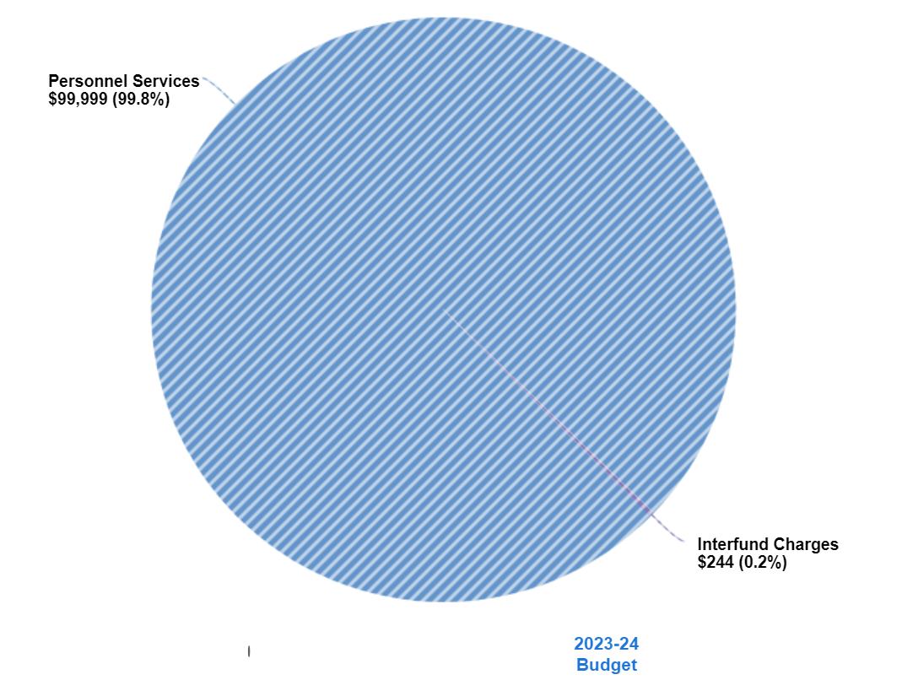
FY 23/24 Expenses for My Safe Place Grant
Depts. 142

Slide 36

QUESTIONS?

