Slide 1

CAPITAL IMPROVEMENTS
Commons
Animal Shelter
HHS
Transit Center
Echo Mountain Fire Restoration
Public Works - Roads

Slide 2

CAPITAL IMPROVEMENTS
Commons
Master Plan
  4-H Barn
  Rodeo and Equestrian Pavilion
  Exhibit and Conference Center
  Floral Building
  Storage
  Parking
  Ticket & Admission
  Formal Entrance
  Expo Barn

Slide 3
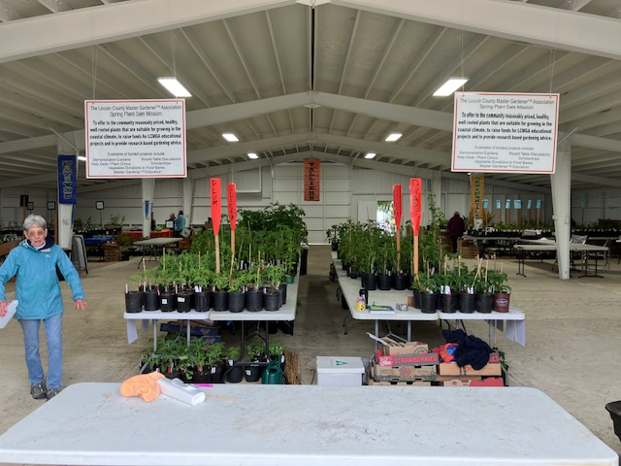
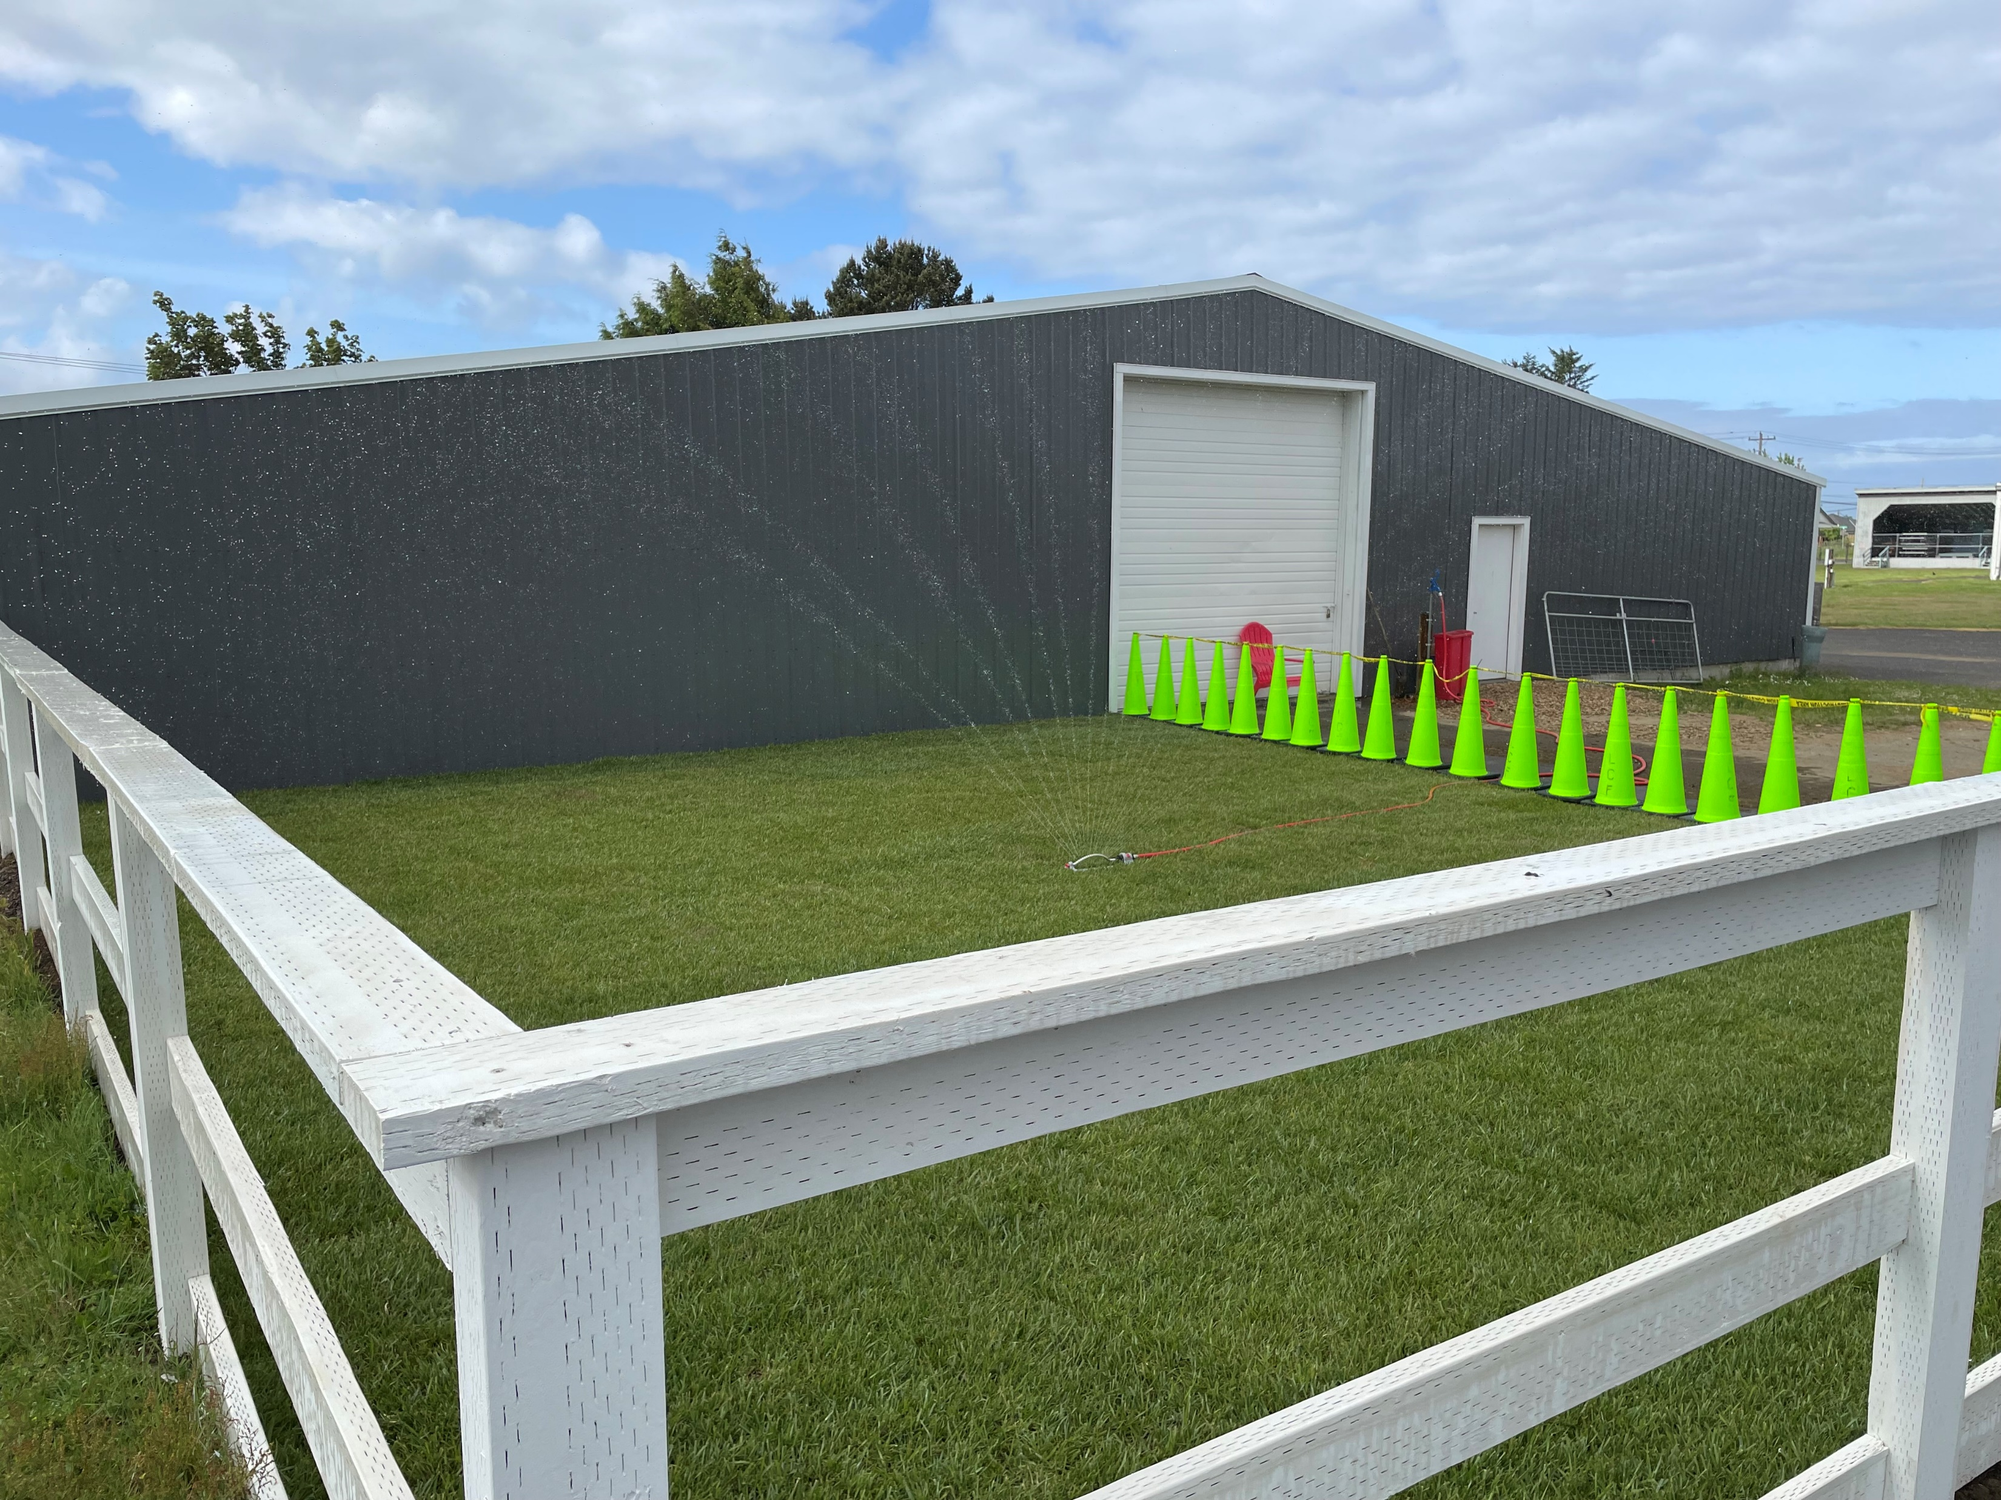
CAPITAL IMPROVEMENTS
Commons - 4-H Barn

Slide 4
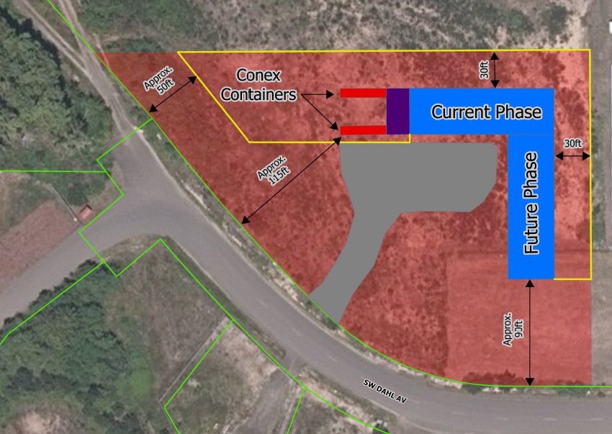
CAPITAL IMPROVEMENTS
Animal Shelter
$5 to $6 million
Financed with low interest loan and ARPA
Property Acquired
In Development Stage, (Planning)
Completion 3rd Qtr 2024

Slide 5
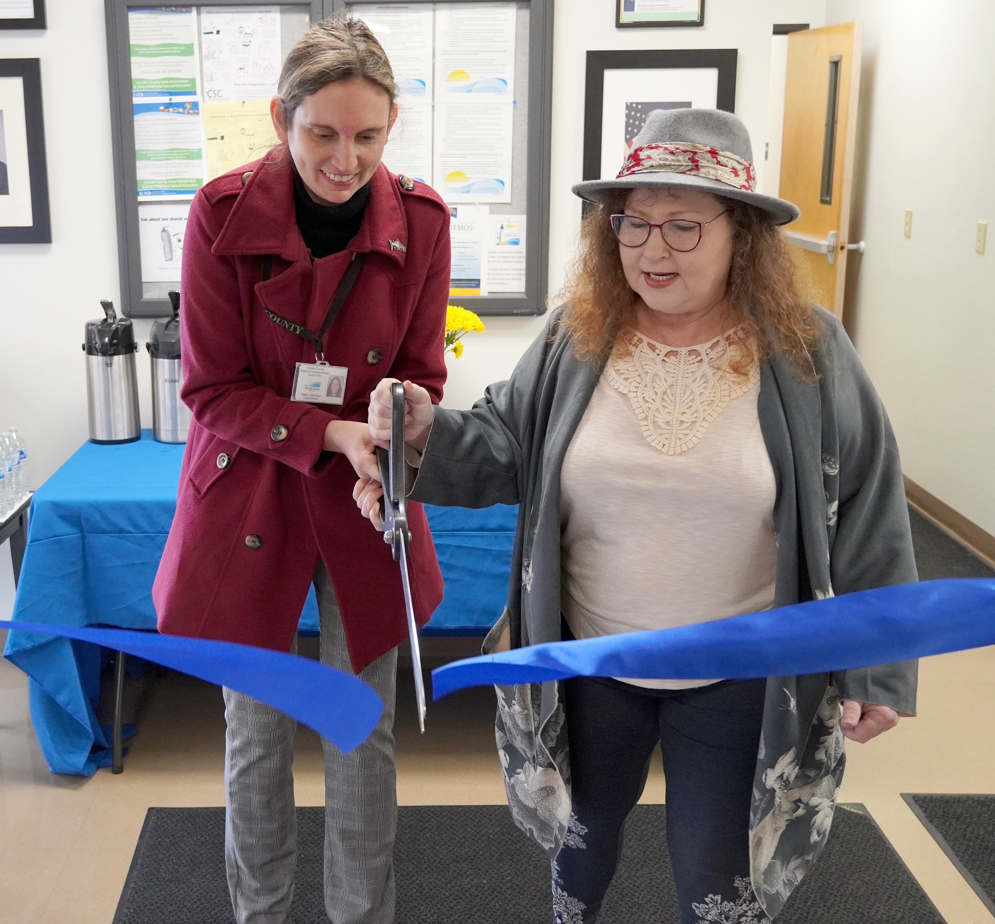
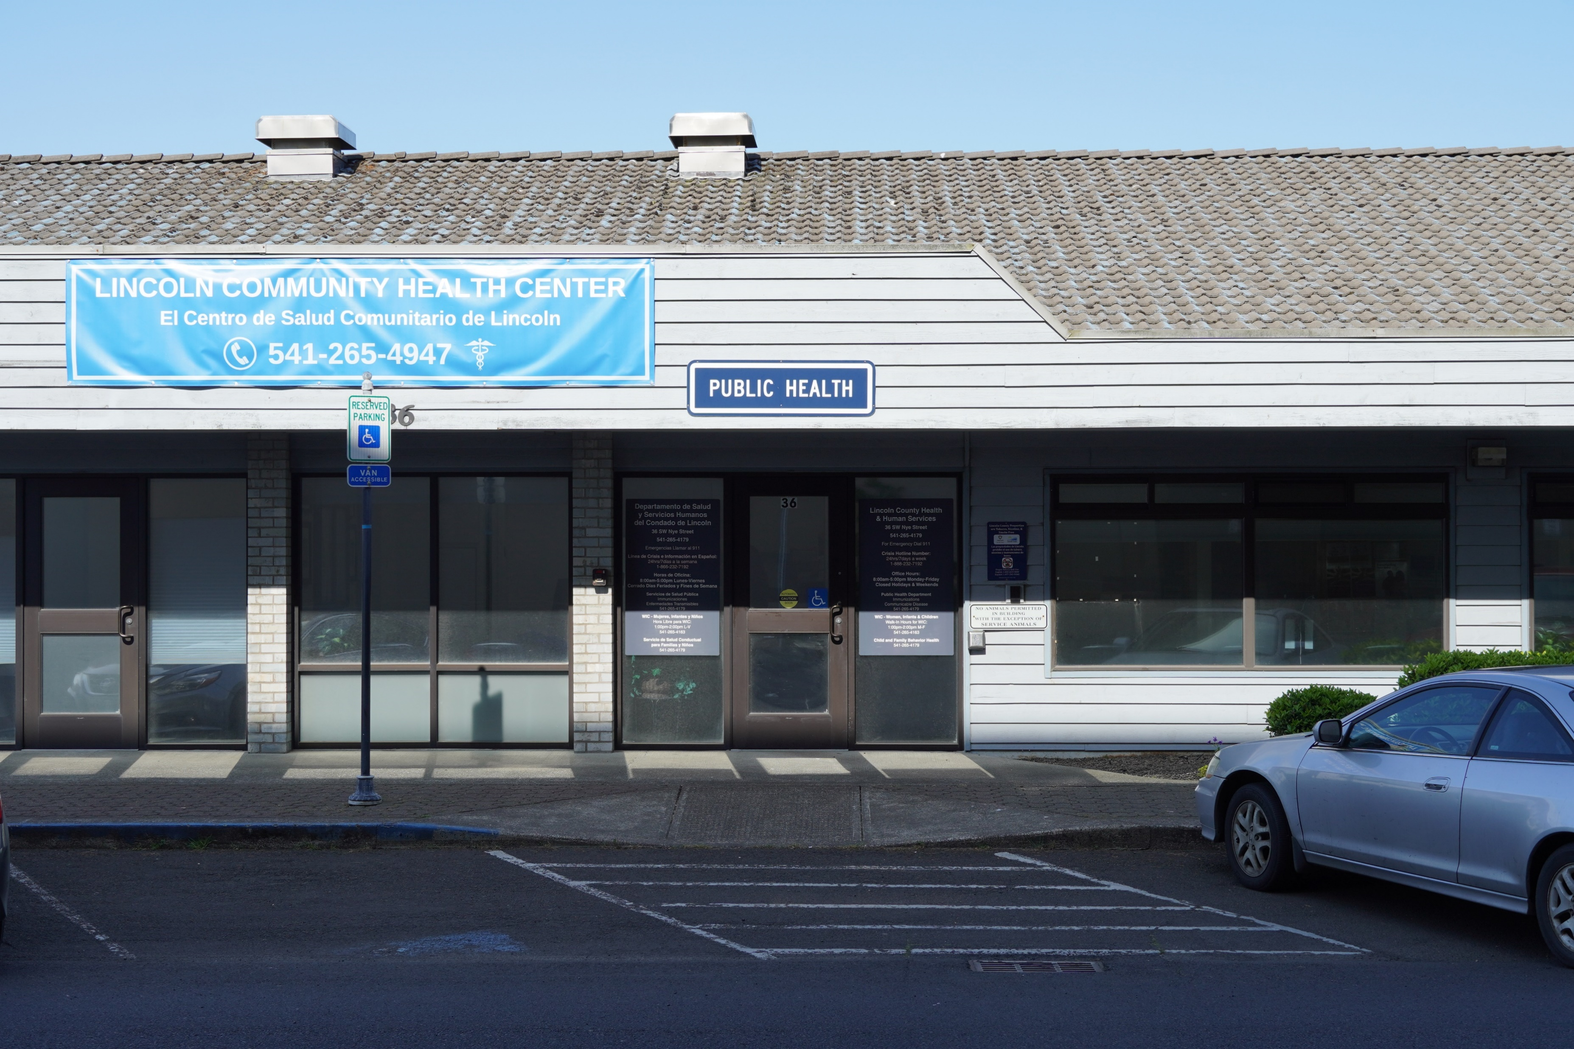
CAPITAL IMPROVEMENTS
HHS
Lincoln Community Health Center
Nye Street Renovation

Slide 6
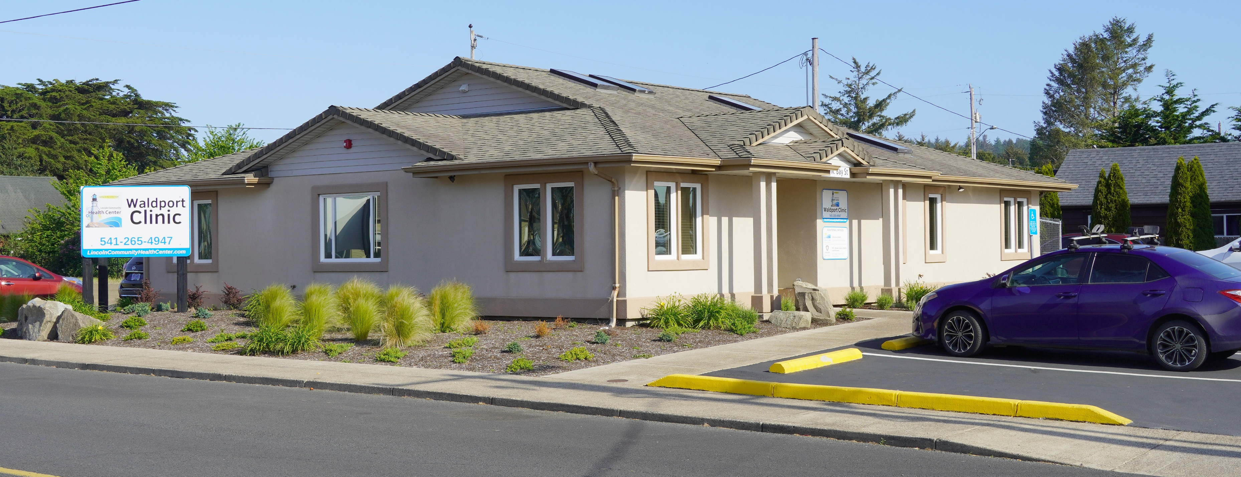
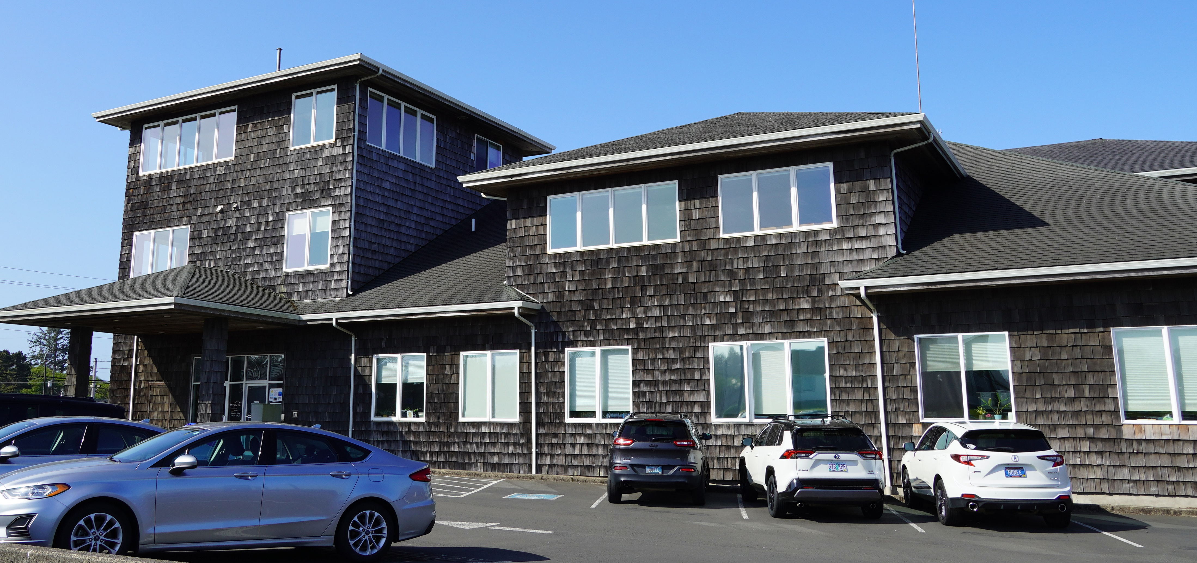
CAPITAL IMPROVEMENTS
HHS
Lincoln Community Health Center Waldport Clinic
HHS’s 225 Building
Newport Crisis Stabilization Center
Mental Health Residential Units

Slide 7
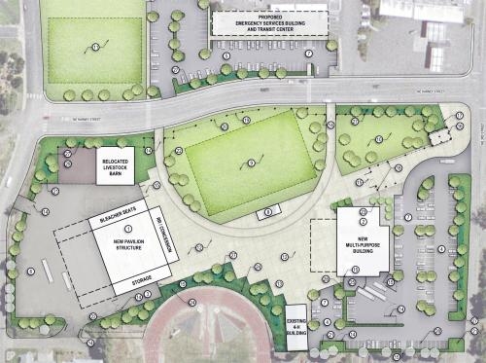
CAPITAL IMPROVEMENTS
Transit Center
Location east from the Commons
Offices and Transit Yard
Estimated costs $3-$5 million
Construction begins after movement of Animal Shelter

Slide 8
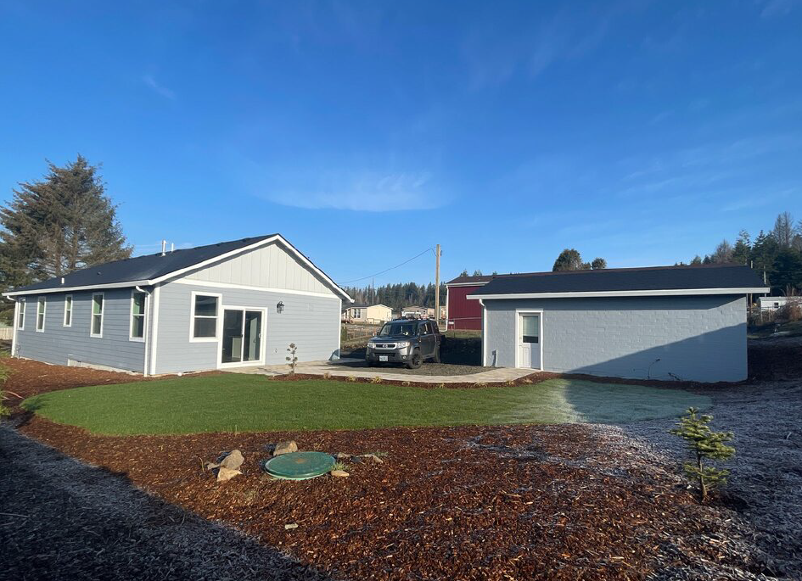
CAPITAL IMPROVEMENTS
Echo Mountain Fire Restoration
Wildfire Survivor Homeownership Program
Septic, Well, and Water System
Repair and Replacement
County-owned home on North Yodel Lane in Otis

Slide 9
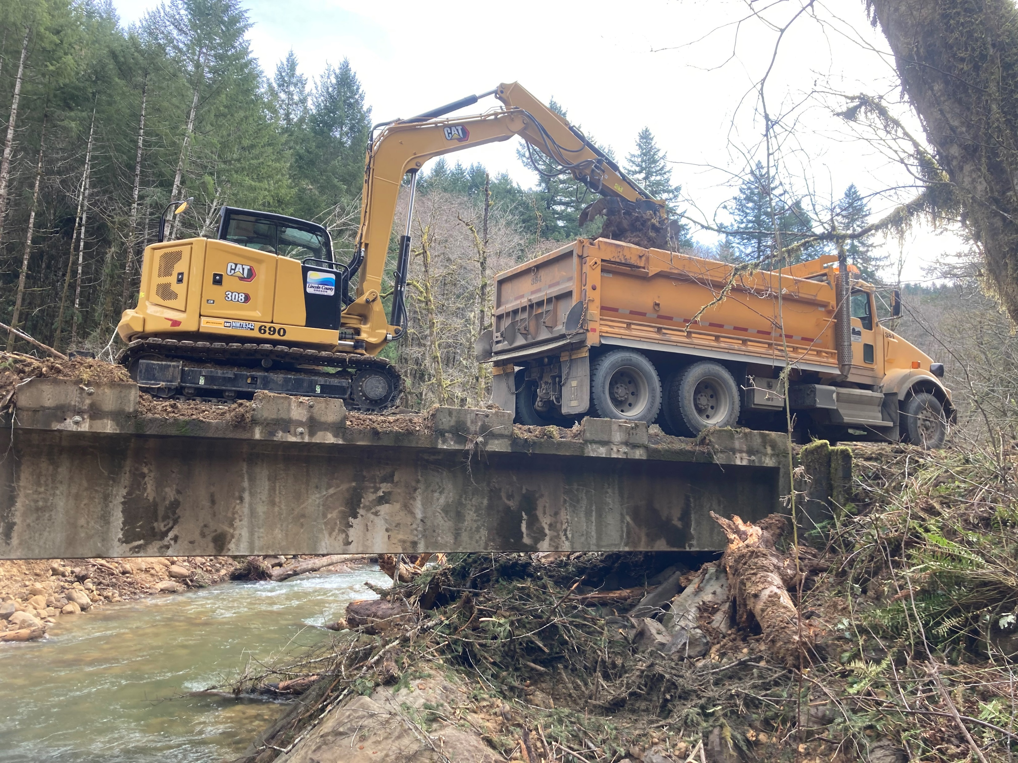
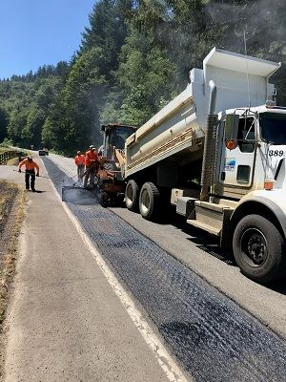
CAPITAL IMPROVEMENTS
Public Works - Roads
A Roads crew works to repair damage from a landslide at Fall Creek
Paving

Slide 10
CAPITAL IMPROVEMENTS
Questions?

