Slide 1

BOARD OF COMMISSIONERS
Overview
The Commission is comprised of three elected officials that legislate and administer county government with the limits of its authority granted in the charter and by state and federal laws.
3 Full Time Elected Positions
Part of General Government
General Fund Supported

Slide 2
BOARD OF COMMISSIONERS
Major Accomplishments
Approved and Implemented 2022/23 Budget
Acquisition of Grants for rebuilding infrastructure and housing in Echo Mountain Fire area: Echo Mountain Fire Recovery
Leading and addressing a countywide strategic plan on reducing homelessness
Continuation of input and direction on countywide broadband analysis
Continued work on redevelopment of Commons ( $277,000 State Grant for renovation of 4-H Barn
Implementation of nearly $10 million form the American Rescue Plan Act- Local Fiscal Recovery Fund to the County

Slide 3
BOARD OF COMMISSIONERS
Major Accomplishments
Housing Study
Acquisition of Property for New Animal Shelter
Participation on “Cascadia Rising: An Emergency Preparedness Event
Continued development of STR policy
Support of Veteran’s Programs and Service
Approved Implementation of Abandoned Recreation Vehicle Abatement Program
Approval of Childcare Provider Assistance Grant
Deployment of Nonprofit/social service , community and economic development and Emergency Preparedness Grants

Slide 4
BOARD OF COMMISSIONERS
Major Accomplishments
Major project support for deploying the County’s new website
Continued regional and statewide project direction of numerous committees including but not limited to: CSC (Community Services Consortium), CWCOG (Cascades West Council of Governments), AOC (Association of Counties), NW Oregon Works, National Association of Counties' Military and Veterans Committee, and NACO's Health Policy Committee, IHN-CCO - Coordinated Care organization for Linn, Benton and Lincoln counties

Slide 5
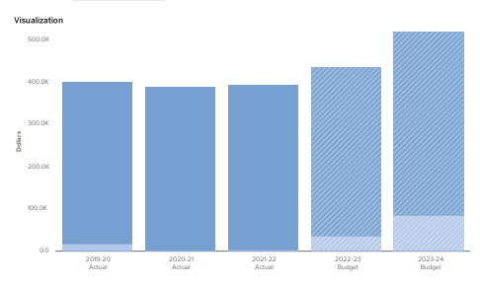
BOARD OF COMMISSIONERS
Budget
FY 2023/24
Personnel
Materials and Supplies
Budget $518,106

Slide 6

BOARD OF COMMISSIONERS
Future Activities
Continued deployment of effective and efficient County Services including:
Homeless Strategic Plan and Implementation
Regional Effort on Winter Shelter
Affordable, Workforce, and Market Rate Housing
Childcare Grants
Echo Mtn. Fire Area Grant Deployment
Review of Solid Waste Haulers Rates

Slide 7
BOARD OF COMMISSIONERS
Future Activities
Redevelopment of Commons property
Completion of New Animal Shelter
Review and approve Insurance Policies
Review and approve Labor Contracts
Review and approve organizational communications policy
New Committee and Board Management Software Deployment
Direction and implementation of M-TEAM strategic planning and vision

Slide 8
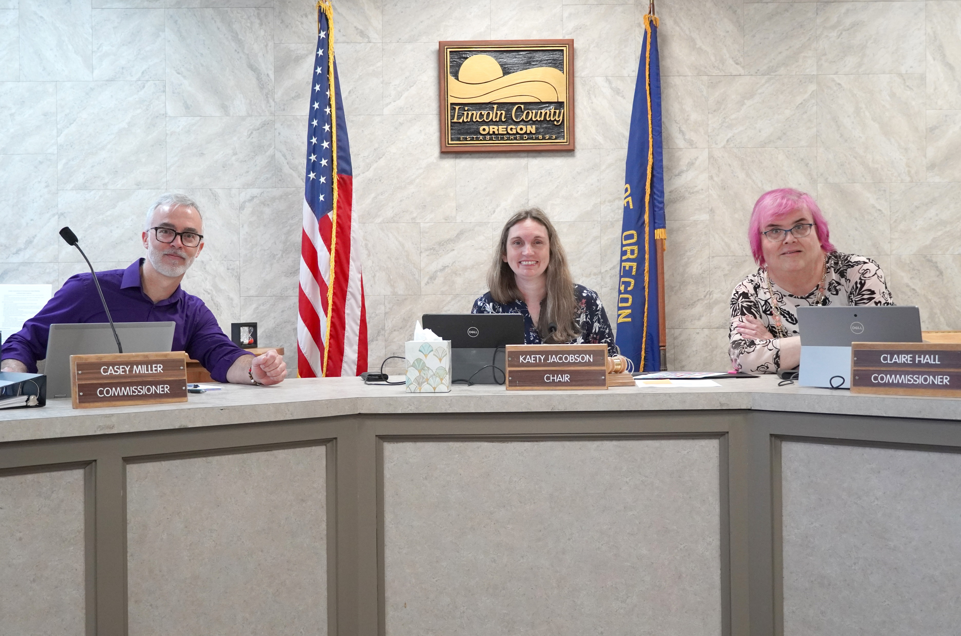

BOARD OF COMMISSIONERS
QUESTIONS?

