Slide 1

COUNTY ADMINISTRATION
Overview
Administration provides an array of services, from support for the Board of Commissioners, managing county day-to-day operations, providing financial and budgetary direction, anticipate and responding to community needs.
Support Veteran’s Services, County Fair, Budget and Capital Improvements
    Central Services
    General Fund & Grant Funded
    5 FTE’s
    1 PT

Slide 2
COUNTY ADMINISTRATION
Major Accomplishments
Stood up the First County Administrator’s Office
Staffing BoC meetings
Coordinated Review and contract services for Solid Waste Haulers
Coordinated Review of Ambulance Service
Coordinated Budget Process including new software
Formulated and Implemented Project: Lincoln 3.0
Participated on Review of Urban Renewal/TIF Nelscott Plan Area-
Lincoln City
Coordinated RFP/Homeless Strategic Plan & Stand Up Countywide Homeless Advisory Board

Slide 3
COUNTY ADMINISTRATION
Major Accomplishments
Implementation of Deployment of ARPA Grant funding
Acquisition &Deployment of Grants in support Echo Mtn. Fire Recovery
  Municipal Wildfire Assistance Program
  2020 Wildfire Relief Grant
  Onsite Septic Financial Aid Program
  Oregon Housing & Community Services - Wildfire Recovery Sub-Allocation
  Panther Creek Sceptic Grants
  Lincoln County Well Repair Grants
Implementation of Childcare Provider Assistance Grants
RV Grant Abatement Program

Slide 4
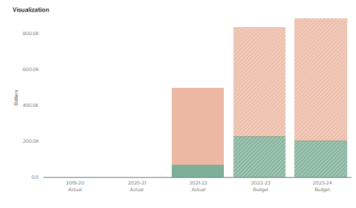

COUNTY ADMINISTRATION
Budget FY 2023/24
BUDGET $890,007
5 FTE’s
.5 PT

Slide 5
COUNTY ADMINISTRATION
Future Achievements
Department Work Plan
Countywide Strategic Plan
Identification and Implementation of New Revenue Options
Coordinate New Animal Shelter Construction
Coordinate Commons Redevelopment
Oversee Selection of RFP/Contract Auditing Firm
Coordination of Homeless Strategic Plan
Researching and Writing New Grants

Slide 6
COUNTY ADMINISTRATION
Future Achievements
Develop and Implement a Communications Plan
Enhancing Annual County Fair event and organization
Next Steps - Project: Lincoln 3.1 - Developing policies, new content and interactive features for the website
Review and Update of Countywide Insurance
Negotiations with Employee Labor Unions
Deployment of Digital Road Signs

Slide 7

COUNTY ADMINISTRATION
Questions?

