Slide 1

VETERAN SERVICES
Overview
General Fund and State Funded
3 Employees
4325 veterans served by the office
  123 new veteran clients FY 22/23
  800 + office and home visits FY22/23
  1800+ phone calls FY22/23

Slide 2
VETERAN SERVICES
Overview
Focus on Services Provided to Qualifying Veterans of the Armed Forces in Lincoln County
    Service-Connected Disability Claims/Compensation
    Non-Service-Connected Disability Claims/Pension
    Surviving Spouse Benefits
    Burial, Marker and Flag Applications
    Dependent Children’s Benefits
    Educational Benefits
    Vocational Rehab. Applications
    Locating Service/Medical Resources
    Aid in Upgrading Veteran’s Disability Percentage
    Support in VA Medical Enrollment Applications

Slide 3
VETERAN SERVICES
Major Accomplishment
Veteran’s Stand Down
Veteran’s Luncheon
Advertising for Services to Support Veteran’s and Family with
Federal Claims for Agent Orange Cases
Brought in an additional $184,000 in new monthly benefits for Veterans.
Helped Acquire $621,589.93 in Retroactive Pay

Slide 4
VETERAN SERVICES
Reality of Program
Contacted by Homeless Veteran needing emergency in-patient health care but had a pet that they were unwilling to leave alone.
Office worked closely with the Animal Shelter staff to have the dog housed while the veteran was in the hospital. The pet was vaccinated and groomed.
Worked with community partner to arrange for grants to board the pet and purchase food and essentials for the dog.
Then, while in the hospital worked to get the veteran and dog housed. The Veteran and dog are currently housed and getting healthy.

Slide 5
VETERAN SERVICES
Budget
FY 2022/23
$425,170

Slide 6
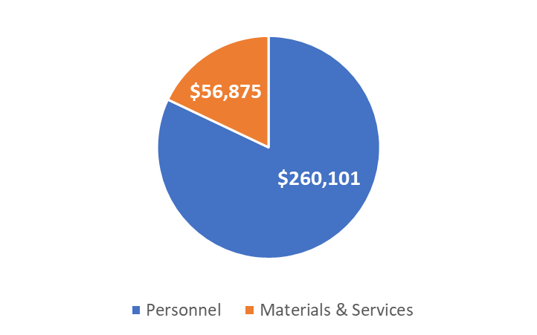
VETERAN SERVICES
Budget
FY 2023/24
$316,976

Slide 7
VETERAN SERVICES
Proposed Achievements
Continue & Enhance the Services to Lincoln County Veteran’s
Annual Veterans’ Stand Down
Annual Veteran's Luncheon
Purchase of Van for Enhanced Service Outreach

Slide 8

VETERAN SERVICES
Questions

