Slide 1
Lincoln County Property Tax
Presented by
Amy Bendel, Chief Deputy Tax Treasurer

Slide 2
Tax
Department Overview
Billing and collecting of all property taxes for Lincoln County
47,000 tax statements will be mailed out
Statutory 3% discount results in high volume collections by the due date
22/23 taxes were 89% collected by Nov 15th
Notes:
The Property Tax Department is responsible for the billing and collecting of all property taxes for Lincoln County.
Every year in October, we send out approximately 47,000 tax statements to bill for the new tax year.
Because statute provides that taxes paid in full by the due date of November 15th will receive a 3% discount, the bulk of the taxes will be paid by the due date.
For the current tax year, approximately 89% was collected by November 15th.

Slide 3
Responsibilities
Generating and mailing Installment and Delinquency notices
Providing refunds on overpaid and double paid accounts
Monitoring accounts included in active bankruptcies
Processing BOPTA modification refunds
Processing foreclosures on accounts four years past due
Notes:
In addition to sending the annual tax statements, the Tax Department also generates and mails trimester statements and delinquency notices.
We process foreclosures on properties that are four years behind in taxes, provide refunds to taxpayers on accounts that are overpaid or double paid, monitor accounts with active bankruptcies, and process BOPTA refunds (BOPTA being the Board of Property Tax Appeals).

Slide 4
Staff
• Appointed Tax Collector
• Chief Deputy
• 2 full time employees
Seasonal helpers are former Lincoln County employees with 50+ combined years of experience
Seasonal employees assist in processing the high volume of payments
Notes:
The permanent Tax Department staff consists of the appointed Tax Collector - who is also the elected Treasurer, the chief deputy, and 2 full-time employees.
During the busy tax season in October/November, we bring in two seasonal employees to assist in processing the high volume of payments
Our seasonal helpers are both retired employees of Lincoln County. One that worked for HHS for 20 years, and one that worked for the Tax Department for over 30 years.
We are incredibly fortunate to have personnel with such experience available to us.

Slide 5
Expenses
Notes:
While Personnel Services make up the bulk of the Tax Department’s expenses, Materials costs contain big ticket items such as contractual services and postage. Postage costs alone for the 2023/24 budget are forecasted at $35,000.

Slide 6

Funding Sources
Notes:
Revenue sources come primarily from property tax collections with a very tiny portion received from service charges.

Slide 7
Property Tax Collections
Notes:
Although the Property Tax Department performs many services, our main function is to bill and collect property taxes.
As of April 30, 2023 our collection percentage for the current tax year of 2022/23 stands at 95.63%. Historically, by June 30th of each year, collections average 97.25%. We expect to surpass that this year.
The revenue we collect is turned over monthly to the Treasurer’s Office to be distributed to the General Fund and local taxing districts.

Slide 8

Achievements
Notes:
Now for the fun stuff. Let’s talk about some of our recent achievements.

Slide 9
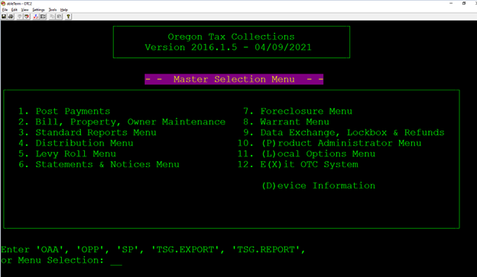
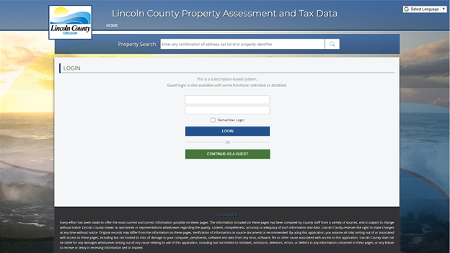
Old & Outdated vs.
New & Improved
OTC
Oregon Tax Collections
ATP
Assessment & Tax Pro
Notes:
One exciting upgrade the Tax Department has made recently is the unveiling of our new taxing software in June of 2022.
This was a multi-year implementation project that we worked on in conjunction with the Assessor’s Office. Switching from an AS400 DOS based program – affectionately termed ‘green screen’ by many of us longtime users, to a now web-based program proved challenging.
However, as we are now coming up on the one-year anniversary of our Go Live date, I think we would all confirm that all the hard work and effort was worth it.

Slide 10
Software Upgrade
Public Access
Available from any computer or mobile device with internet access
24/7 access to real-time information
Notes:
With the new software came new options such as public access. The public can now access their tax accounts 24/7 and see real time information.
Whether it’s researching property details, obtaining a tax statement, or seeing the payment history on an account, it can all now be done from any computer or mobile device with internet access.
With our tax payers not just living in Lincoln County, but many residing internationally - this has been an extremely convenient upgrade for everyone.

Slide 11
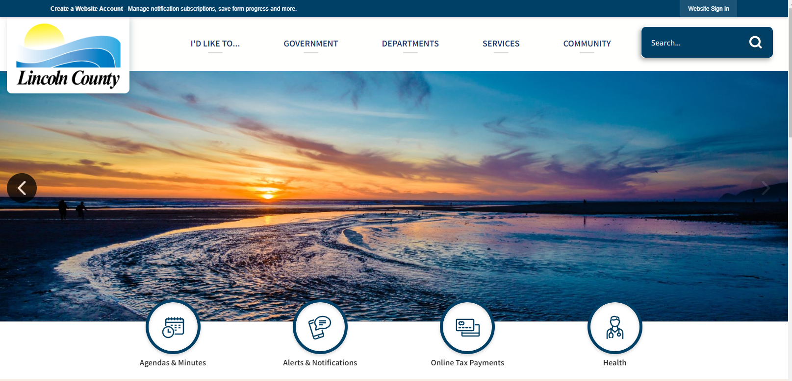

Payment Options
Notes:
Another advancement made by the Property Tax Department in recent years is the expansion of payment options. We now offer online payment via debit and credit card, or electronic check. The online payment portal can be accessed through a button on the new County homepage and for anyone not wanting to access the service for themselves, Tax Department staff will process debit and credit card payments via phone for our taxpayers.

Slide 12
Electronic Payments
Notes:
Many taxpayers choose electronic forms of payment to avoid both the delay of snail mail and the inconvenience of making a trip to the courthouse. In the last four years, we have seen more than a 200% increase in electronic payment methods being used. Nearly 10% of our collections now come in via an electronic payment type.

Slide 13
Payment Methods
Notes:
For those that prefer not to use electronic payment types, we do still accept payment in-person for both cash and checks. In fact, the bulk of the payments we receive are still cash or check.
We also have two secure drop boxes – one in the parking lot next to the elections drop box, and one just outside our office where payments can be placed for collection.
Of course, snail mail is still an option that is widely utilized.

Slide 14



Property taxes fund our County
Notes:
The Tax Department plays a vital role in ensuring the cities, schools, hospitals, fire departments and many other services in Lincoln County receive their funding.
Our goal is to provide the public with excellent, friendly, and respectful services. We pride ourselves on meeting this goal each and every day.

Slide 15
Questions?

Slide 16
Thank You

