Slide 1
Lincoln County
Treasurer’s Office
Presented by
Jayne Welch, Treasurer/Tax Collector

Slide 2
The
Treasurer
The Treasurer is Elected
Fiduciary responsibility
Protects and Secures investment of public funds
Receives, Deposits and Monitors County room tax revenue
Notes:
The Treasurer is an elected position that upholds the commitment to deliver service with competence and high standards for all of Lincoln County. This position has full fiduciary responsibility for safekeeping local government monies and investments.
The Treasurer is responsible for maintaining accurate records, protecting and securing investments of public funds in accordance with Oregon statutes and the guidelines of the Lincoln County investment policy. We also deposit and monitor County room tax revenue from the unincorporated areas of Lincoln County.
The Treasurer is also appointed by the Board of Commissioners as the Tax Collector.

Slide 3
Staff
Elected Treasurer
1 full time employee
Chief Deputy
Notes:
Staff of the Treasurer’s Office consists of myself, the Treasurer, Chief Deputy, and an Accounting Clerk.
The Treasurer’s Office receipts and deposits all the funds collected by other departments as well as Federal and State agencies.
This office funds operations of other departments such as Accounts Payable, County Excise Tax, County Insurance and Payroll.
We reconcile monthly bank statements and process interest allocations to departments and taxing districts.

Slide 4

Funding
Sources
Notes:
Revenue sources come primarily from property tax collections and transient lodging tax from the unincorporated areas of Lincoln County.

Slide 5
Property
Tax
Distribution
Notes:
Monthly, we distribute property tax collections to the local taxing districts which include the cities, schools, hospitals, fire departments, road and water districts, and many other services in Lincoln County. As you can see, the bulk of our collections happen in the 2nd quarter – when tax statements are sent out.

Slide 6
Transient Room Tax
Notes:
Quarterly, we collect transient room tax payments. In the first three quarters for the 2022/23 fiscal year, we have already collected over $3.7 million dollars. These monies help to fund the Aquarium, Fair, and Economic Development projects in the unincorporated areas of Lincoln County and our General Fund.

Slide 7
Timber Harvest Distribution
Notes:
We also distribute funds received quarterly, from State and Federal agencies for timber harvesting. In the first three quarters for the 2022/23 fiscal year, we have distributed approximately $744,000 dollars. The timber harvest program helps to fund the Animal Shelter, Schools, Extension Office, County Transportation, Library, Port and the General Fund.

Slide 8
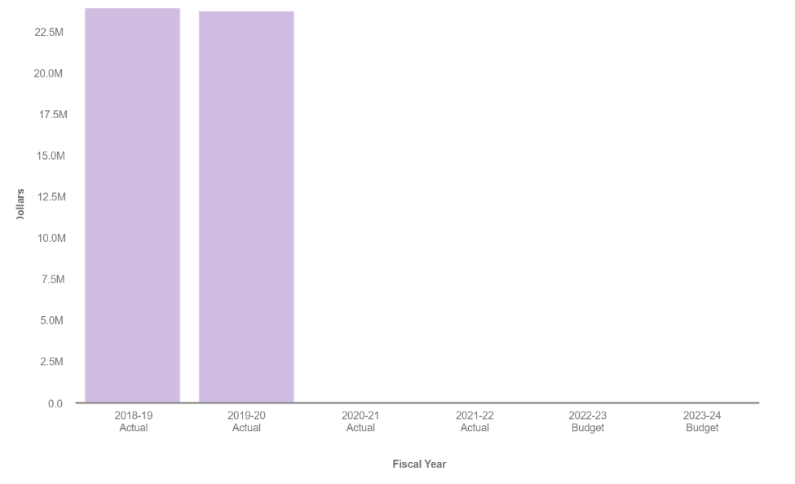
Revenue
Notes:
This graph represents the revenue for the Treasurer’s Office. As you can see, we have not had figures since fiscal year 2019-20. This is due to a procedure change in how revenue is tracked by the Finance Department, but we wanted to give a general idea of tax revenue.

Slide 9
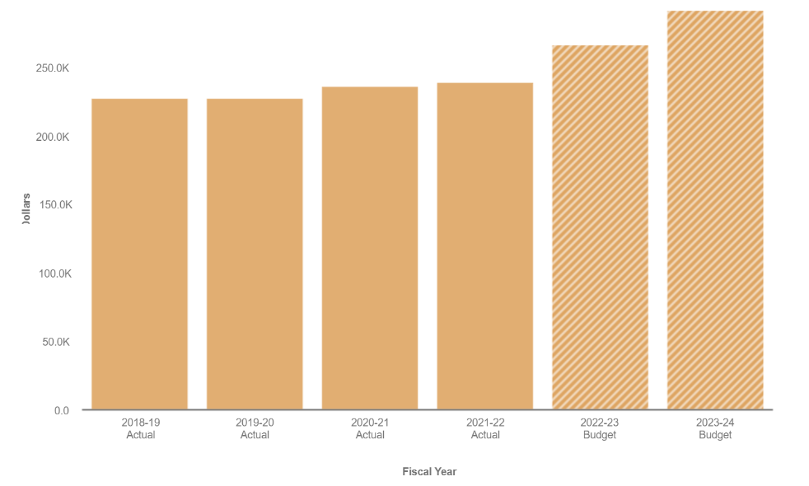
Expenses
Notes:
This graph represents the expenses for the Treasurer’s Office. As you can see, we lean toward a frugal approach. Over the last five years, our expense budget has increased only by $63,850.

Slide 10
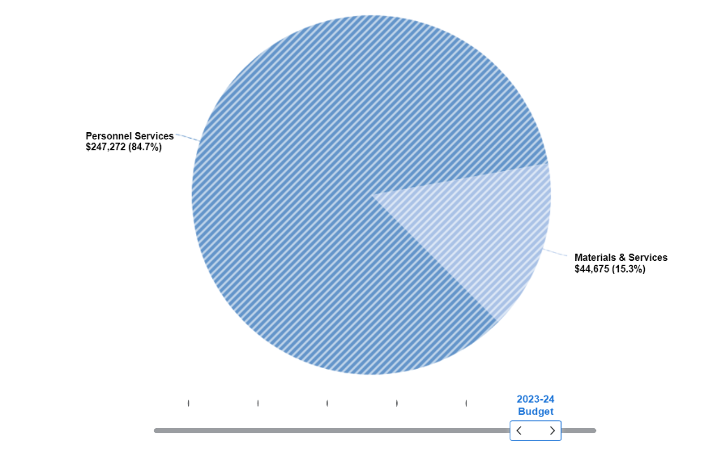
Notes:
Forecasting for the upcoming fiscal year, 84.7% of the expenses for the Treasurer’s Office will come from Personnel costs, with only 15.3% being attributed to materials. Material costs include not only office supplies but also funds for travel and professional development. It is my goal to have a highly trained and motivated staff that can assist both the public and County personnel in an efficient and competent manner.

Slide 11
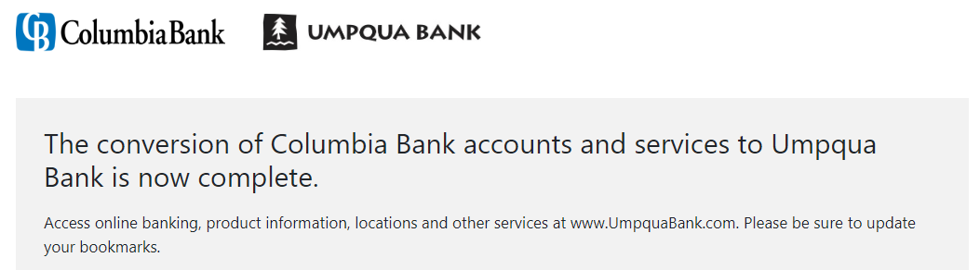
Mergers and
Acquisitions
Notes:
One accomplishment for my office that occurred this fiscal year was the successful transition of the County’s bank accounts to Umpqua Bank. As you may know, Columbia Bank and Umpqua Bank recently merged. However, our local branch of Columbia Bank – where most of the County’s banking was handled, was acquired by 1st Security Bank of Washington.
As Treasurer, I have a fiduciary responsibility to ensure the County funds are safe and secure. As a result of all the banking movement, Umpqua Bank is now our primary banking institution.
With these financial transitions, the responsibility of certifying the banking regulations and fund transactions became a huge undertaking. After dozens of hours of intense work for many months, I’m happy to say that we are finally nearing the end of our journey with this complex endeavor.
At this time, I would like to take a moment to thank our local bank branches, and Treasury Management for all their hard work and assistance during this change. I also would like to thank all those involved on a County level who participated in this project.

Slide 12
Future
Goals and Objectives
Safekeeping of monies
Professional customer service
Fostering working relationships
Notes:
When looking to the future, I have several goals and objectives. These include the continued safekeeping of our local government monies; fostering good working relationships with all our local banks and investment institutions, including inter-departments, and outside agencies. And continuing to provide a high level of professional customer service to all departments, entities, and auditors.
As we near the end of this budget presentation, I think it is important to recognize staff in the Tax Office and Treasurer’s Office for their outstanding work and commitment to Lincoln County. Together we get our important work done accurately, efficiently and professionally.

Slide 13
Questions?

Slide 14
Thank You!

