Slide 1


Assessor’s Office
2023-24 Budget Report

Slide 2
Overview
Update and maintain property records, assess all taxable property in Lincoln County and assist in the administration of Oregon’s property tax system
Office Administration - 20 Employees, 3 Sections
57,000 property tax accounts
  Real Property, Business Personal Property, Manufactured Structures and Utilities
100 Taxing Districts
  County, Cities, Schools, Fire, Water, Road, Special Districts and Urban Renewal Agencies

Slide 3
Sections
Cartography: Scott Branchfield, Cartographic Supervisor
Appraisal: Nick Kolen, Chief Appraiser
Operations: Teresa Taylor, Chief Office Deputy

Slide 4
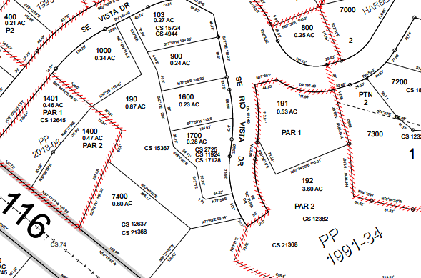
Cartography
Deed Processing
Property Ownership
Addressing – mailing and situs
Mapping – parcels and taxing districts

Slide 8
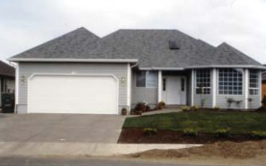
Appraisal
Valuation – Real Property and Manufactured Structures
    New Construction and Development
    Reappraisal Cycles (Maintenance)
Annual Sales Analysis and Market Trending
Appeals – BOPTA, State Tax Court, Supervisory Review (DOR)
Charitable and EZ Exemptions Administration
Specially Assessed Farm/Forestland Administration

Slide 13
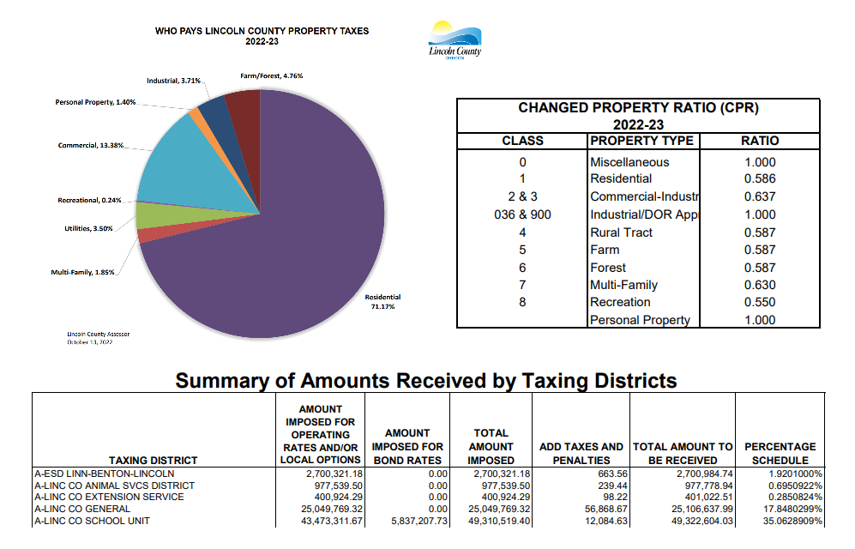

Operations
Customer Service and Office Clerical Duties
Senior/Disabled Citizen Deferrals (163)
Disabled Veteran/Surviving Spouse Exemptions (860)
Manufactured Home Transactions (500)
Business Personal Property: 6,718 accounts (1,496 taxable)
State Fire Patrol: 376,593 acres; $776,759 fees assessed
Levy – 100 Taxing Districts
Assessment Administration and Tax Roll Certification

Slide 18
Additional Accomplishments
Completed 3 ½ year conversion to a new computer system (Tyler Technologies, Assessment & Tax Pro) and online Property Info site
Contracted for digitization of appraisal records using ARPA funds
In-house scanning, indexing and upload of tax lot cards (25% complete)
Completed scanning of historic deeds processed

Slide 19
Goals
Remain compliant with annual statutory requirements
Recruit and train new staff
Continue adapting to new computer system and adjusting workflows
Continue reappraisal of rural Southeast County – Est completion 2025
Complete digitization of tax lot cards and appraisal records
Configure and implement Field Mobile app for appraisal
Convert to new ArcGIS Pro mapping software – Est 2025
ORMAP Grant funding for new aerial imagery

Slide 22
Assessor’s Office
Thank you!
Questions?

