Slide 1

CLERK’S OFFICE 2023/2024 BUDGET
PRESENTED BY
AMY SOUTHWELL, LINCOLN COUNTY CLERK and
DANA JENKINS, CHIEF DEPUTY ADVISOR

Slide 2
OVERVIEW of elections
KEY STAFF:
AMY SOUTHWELL - CLERK JANET CUMMISKEY - CHIEF DEPUTY CLERK
CUSTOMERS SERVED: ALL REGISTERED VOTERS IN LINCOLN COUNTY
Conduct all elections held within Lincoln County in accordance with state and federal laws and administrative rules. Provide adequate supplies and staffing to administer up to four countywide elections per year. Conduct elections by mail, in order to increase voter participation and reduce election costs. Work closely with The Oregon Secretary of State's office to make sure all statues and ORS are followed in the election process.
Mail out all ballots and voters' pamphlets to all qualified voters locally, overseas and military.
Coordinate observers for elections and staffing for pick up, counting and sorting ballots for Lincoln County. Send reports to The Oregon Secretary of State’s Office and publish on website, as well as have paper copies for the public.
We use the statewide voter registration database and election management system OCVR (Oregon Centralized Voter Registration) to maximize efficiency statewide. This summer the State will be updating to a new statewide data base (Oregon Votes).
Funding sources are the election cost reimbursements from districts and charges for printouts for elections, this averages out to be around $60,000 per year, around 20%. (The State, County or Cities don't have to pay their share of election costs) 80 % comes from General Fund.

Slide 3
2022-2023 election ACCOMPLISHMENTS
Last year we received $15,000 from the State of Oregon to update our election infrastructure, which we purchased new more secure ballot boxes for the county.
We added more security technology to the “elections observing process” per public request.
Last year we held 3 successful elections. The normal May (Primary) election, the November (General) election and also a Recall election in June.

Slide 4
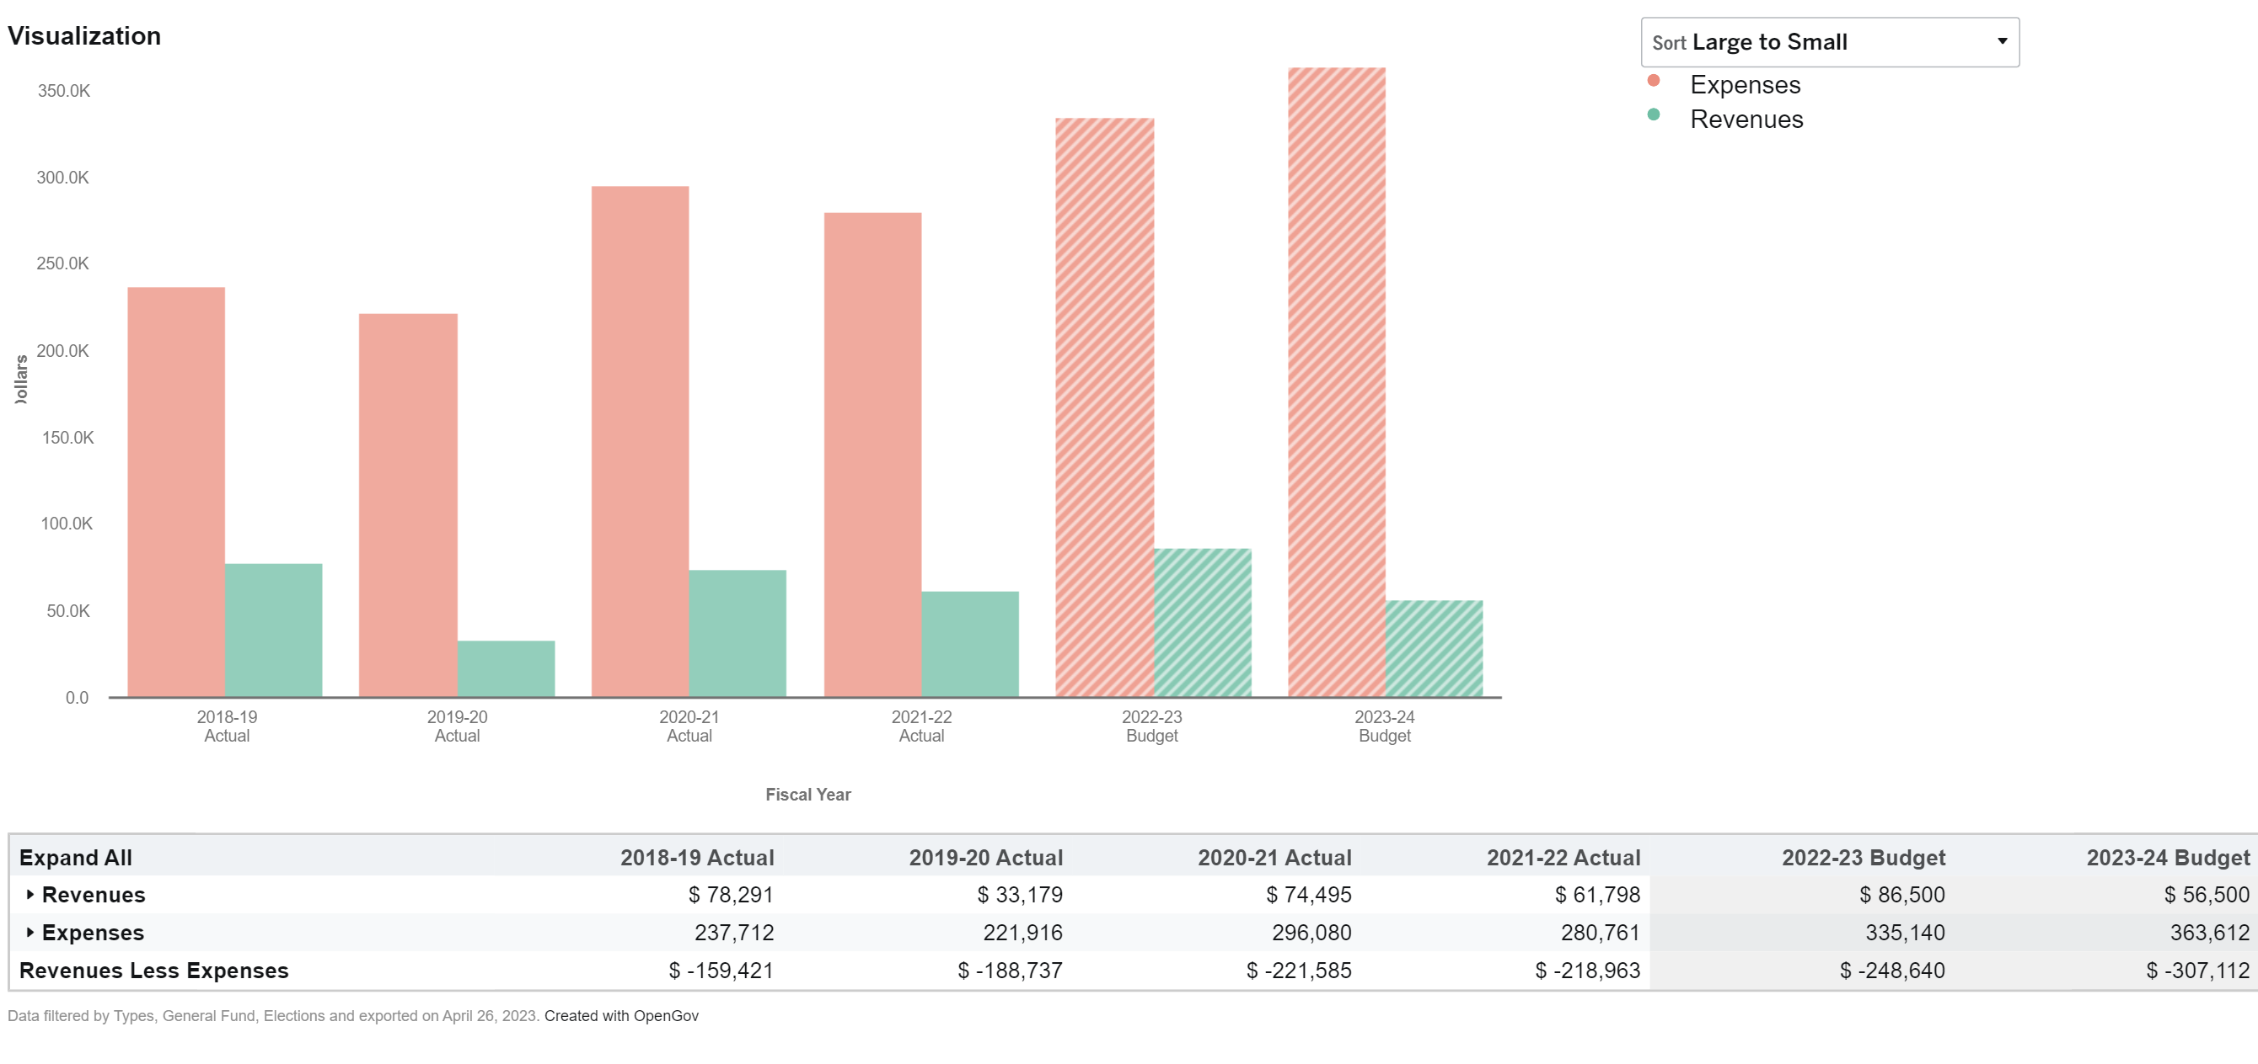
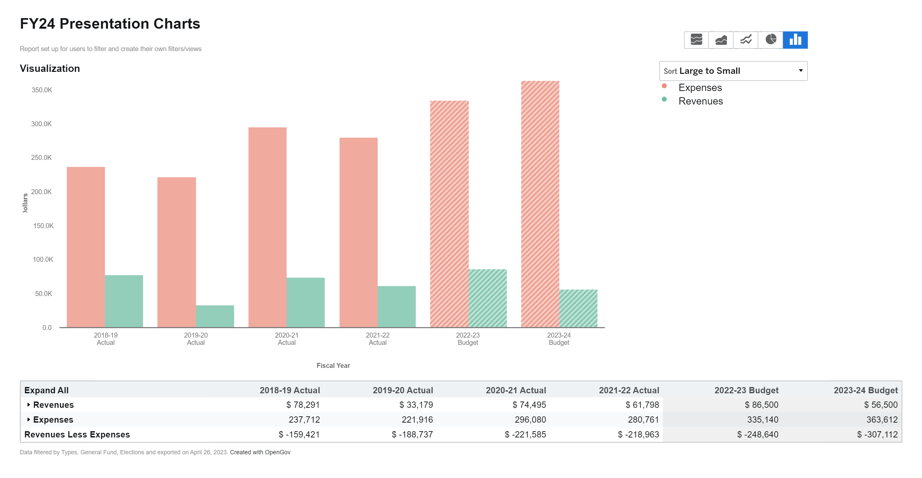
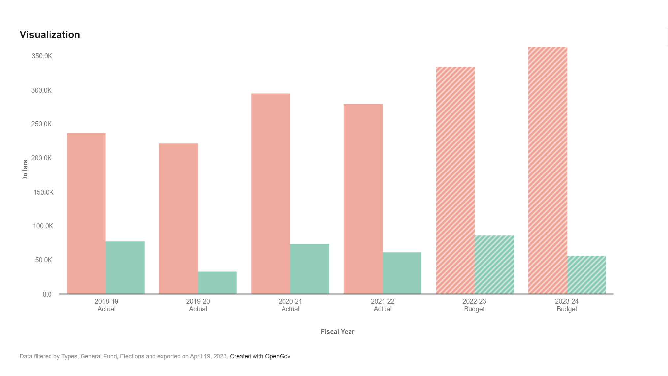
ELECTIONs
Fund: 101 General Fund
Dept: 031 Elections
Category: General Government
Key Staff:
Amy Southwell Elected County Clerk
Janet Cummiskey Chief Deputy Clerk

Slide 5
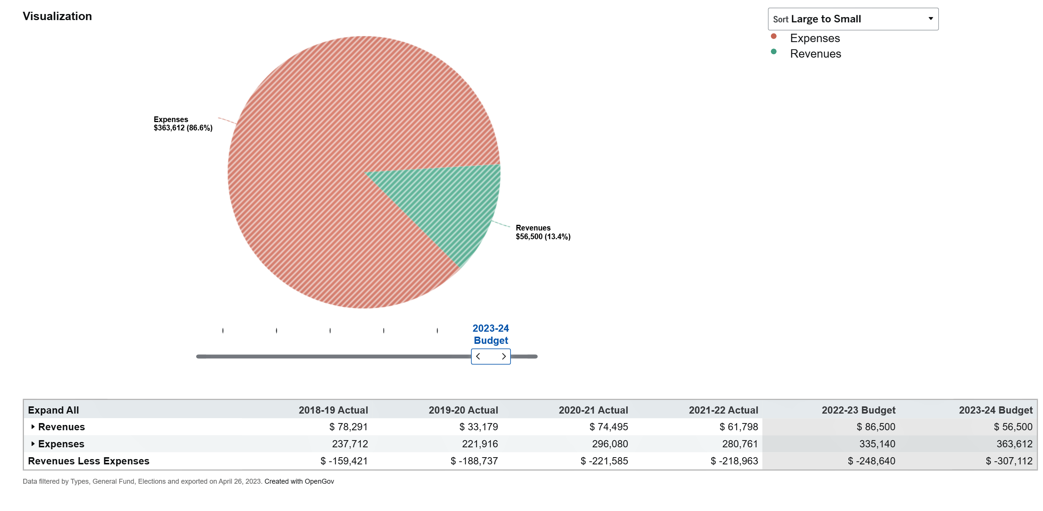
VISUALIZATION
ELECTIONS budget
2023-2024

Slide 6
FUTURE ELECTION GOALS
In early 2023 we were awarded an additional $5,000 from the Secretary of States office, to continue updating our election infrastructure.
Our goal is to add more security cameras for clearer viewing and also to hopefully feature a video of the election process in Lincoln County on our website. Voters would be able to watch and hopefully understand in depth what goes into an election and all processes, as well as the security & transparency taking place to run a successful election.
We are also considering putting cameras inside ballot boxes to help with additional security of ballots.
We will be working on finding more funding for election security as well as funding for other necessary items for The Clerks Office, such as a bigger processing area for elections.
The Clerks Office recently put a project manager in the office to help manage necessary functions in the office for the public and observers, as well as to oversee key customer service aspects of our daily office functions, such as public record requests.
We will continue to conduct fair & transparent elections, according to statues.

Slide 7
ELECTION DEPARTMENT METRICS
Working with Volunteers to expand customer service in elections.
The Secretary of State is building a new voter registration and election management system that will help maximize efficiency for our voters' information.
Continue to provide excellent customer service to the community we serve.

Slide 8
Overview of
BOARD OF PROPERTY TAX APPEALS(BoPTA)
Key Staff: Amy Southwell – Clerk Janet Cummiskey – Chief Deputy Clerk
Customers Served: Customers who own property in Lincoln County & file a BoPTA appeal.
The Board of Property Tax Appeals or BoPTA, consists of three non-office holding residents of Lincoln County.
They are responsible for hearing & making a decision on tax payers appeals filed for the reduction of the real market or assessed value of their property. The board has authority to reduce it or sustain it.
Decisions are made on the same day as the hearing & final orders are sent out by the next business day.
The BoPTA clerk is responsible for notifying the petitioner of their hearing date, sending out decisions to the petitioner, Assessor’s Office, Tax Office and the Department of Revenue. The BoPTA clerk takes minutes, coordinates training for board members and any other activities needed. They also set up the hearings & manage all documents presented or made for the hearing for 6 years.
The Board of Property Tax Appeals operation is closely coordinated with the Clerk’s Office, Assessor’s Office, and The State Department of Revenue, most of which is operated & planned by The Clerk’s Office.

Slide 9
Bopta
ACCOMPLISHMENTS FY 2022/23
Continued partnership with the Assessor’s office and petitioners to decrease the number of petitions filed.
Appeals have gone from 1400 filed to now typically around 60 appeals filed.
In 2022-2023 we had 42 petitions filed.
FUTURE GOALS FOR BoPTA
Continue to see a decline in petitions filed, by working with the Assessor’s office and the petitioner’s to meet this goal.

Slide 10
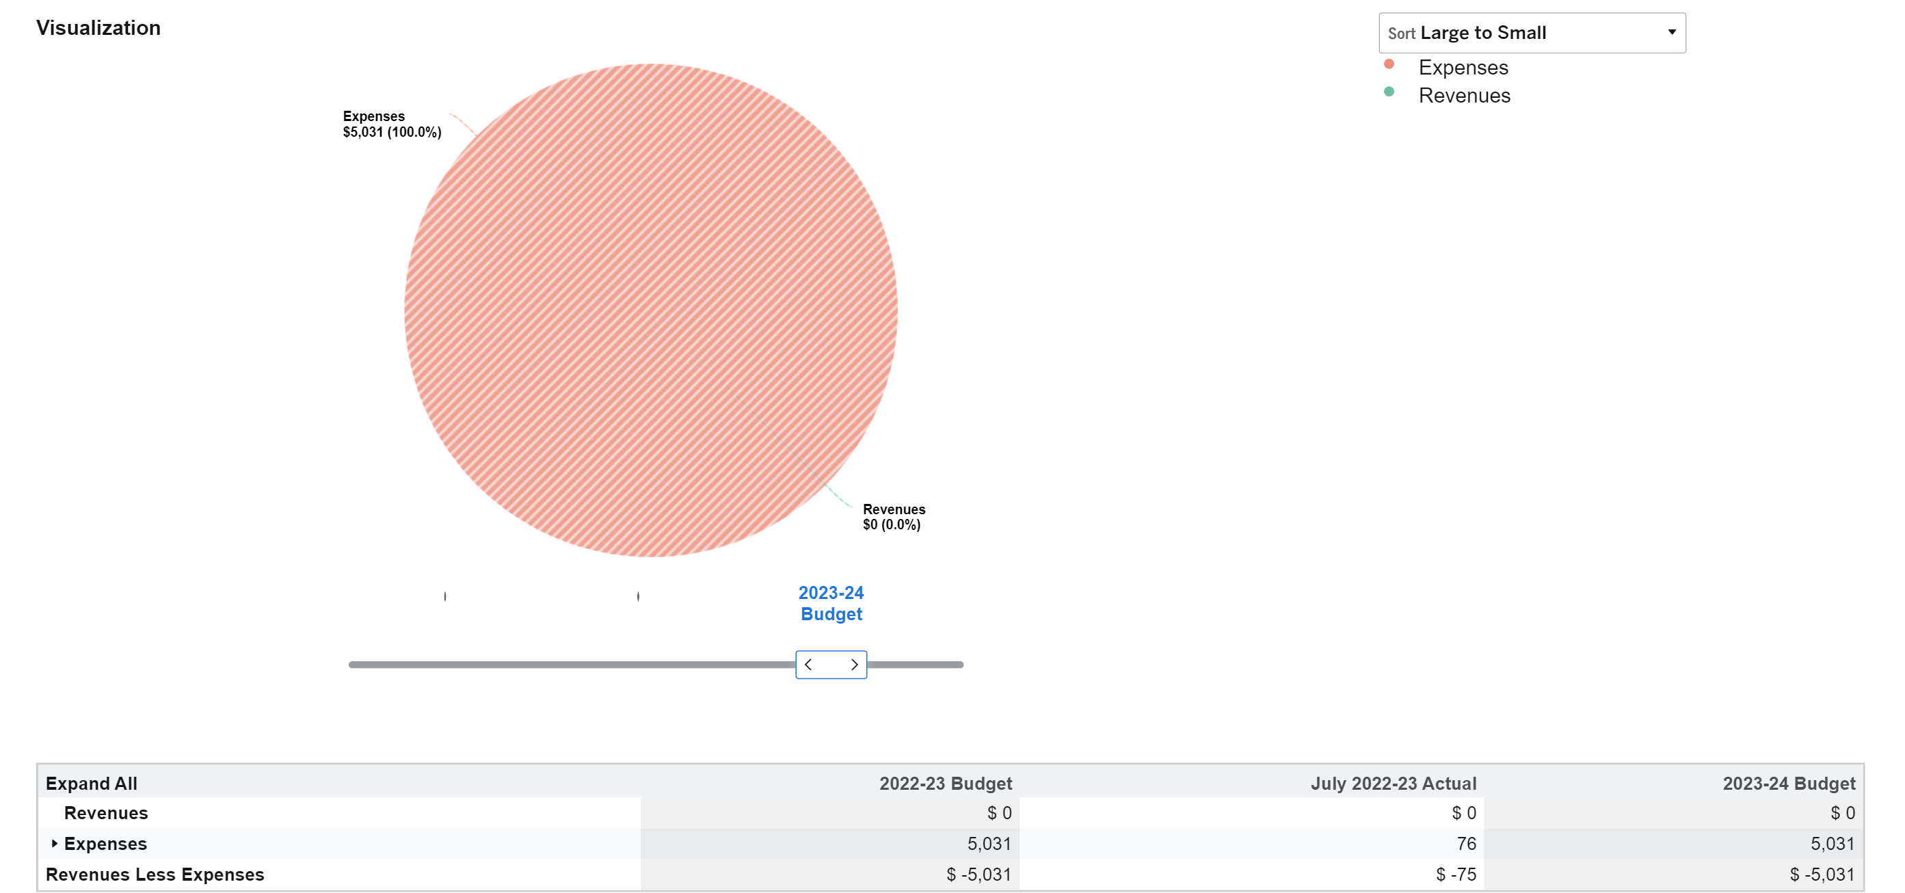
BOPTA VISUALIZATION 2023-2024

Slide 11
Overview of
CLERK records & Administration
Key Staff:
Amy Southwell – Clerk Janet Cummiskey – Chief Deputy Clerk
Rhonda Davidson – Recording & Operations Supervisor
Customers Served:
We serve any customer recording or searching documents recorded in Lincoln County, as well as anyone
owning or purchasing property in Lincoln County, Title Companies, Law firms , Interdepartmental Offices.
The County Clerk’s office is consistent with statutory requirements.
Primary concerns will be to maintain the integrity of the recording process and the timely processing of all licenses and passport requests, additionally to perform administrative functions for all departments, entities, and employees within the jurisdiction of The County Clerk.
Examine documents for accuracy, accept when properly completed, index, record and return all original documents presented to The County Clerk’s Office to the appropriate place.
Strive for higher level of efficiency in the use of computerized recording system.

Slide 12
2022-2023 CLERKS RECORD accomplishments
We have been outsourcing past historical data on microfilm of deed records to be digitized for the convivence of the public and county.
FUTURE GOALS & OBJECTIVES FOR 2023-2024
Continue working on getting all historical deed records that are on microfilm digitized for our customers.
Look into charging fees to customers for the use of the online version of deed records, as other counties are doing to help with revenue.
Continue to manually add more images of historical recordings on our website for the public to access.

Slide 13
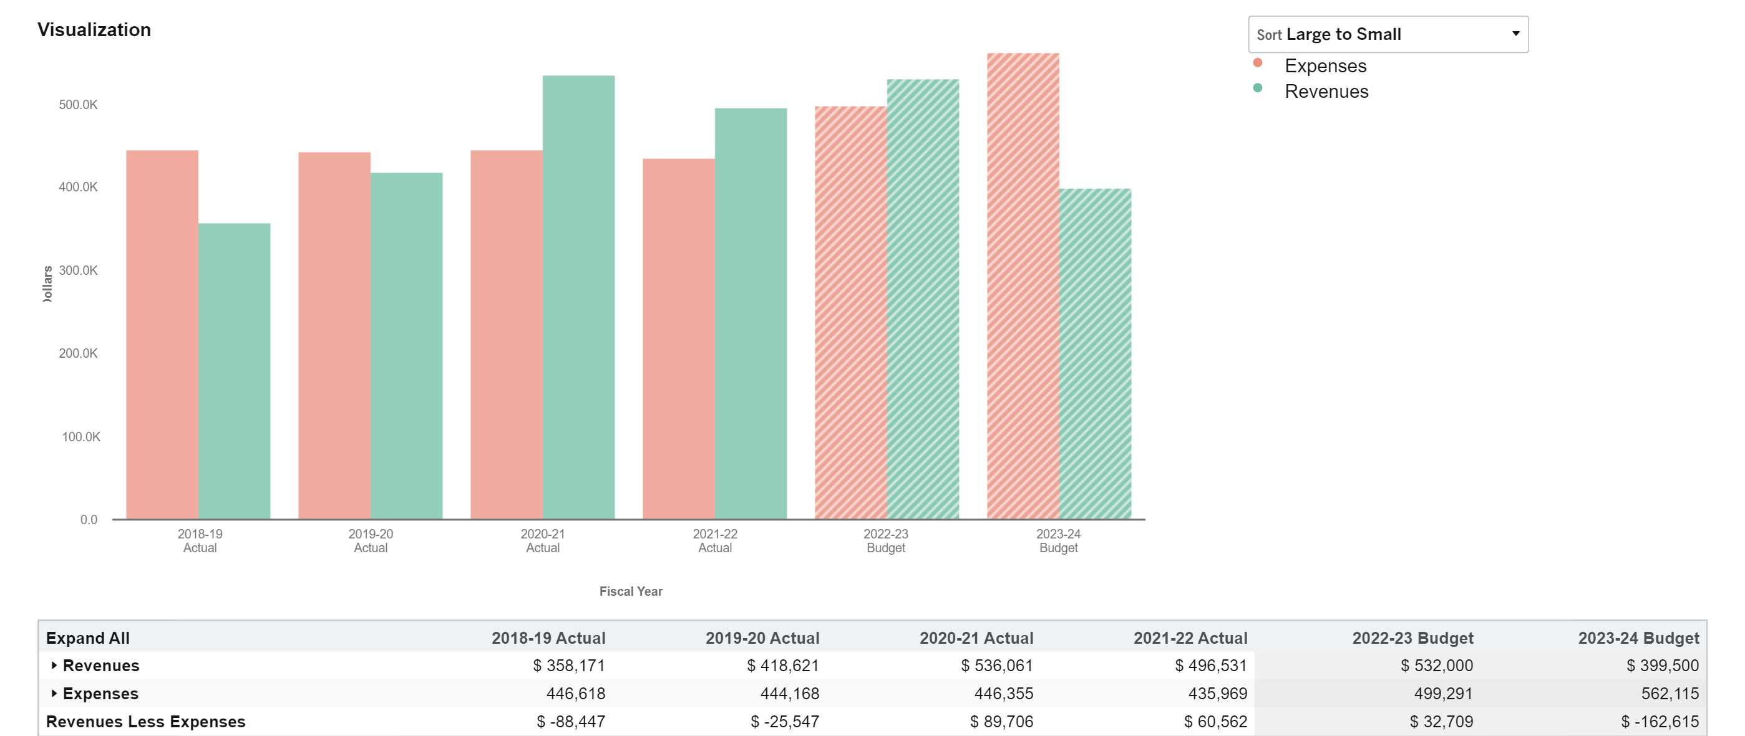
VISUALIZATION
CLERKS RECORDS & ADMINISTRATION 2023-2024

Slide 14
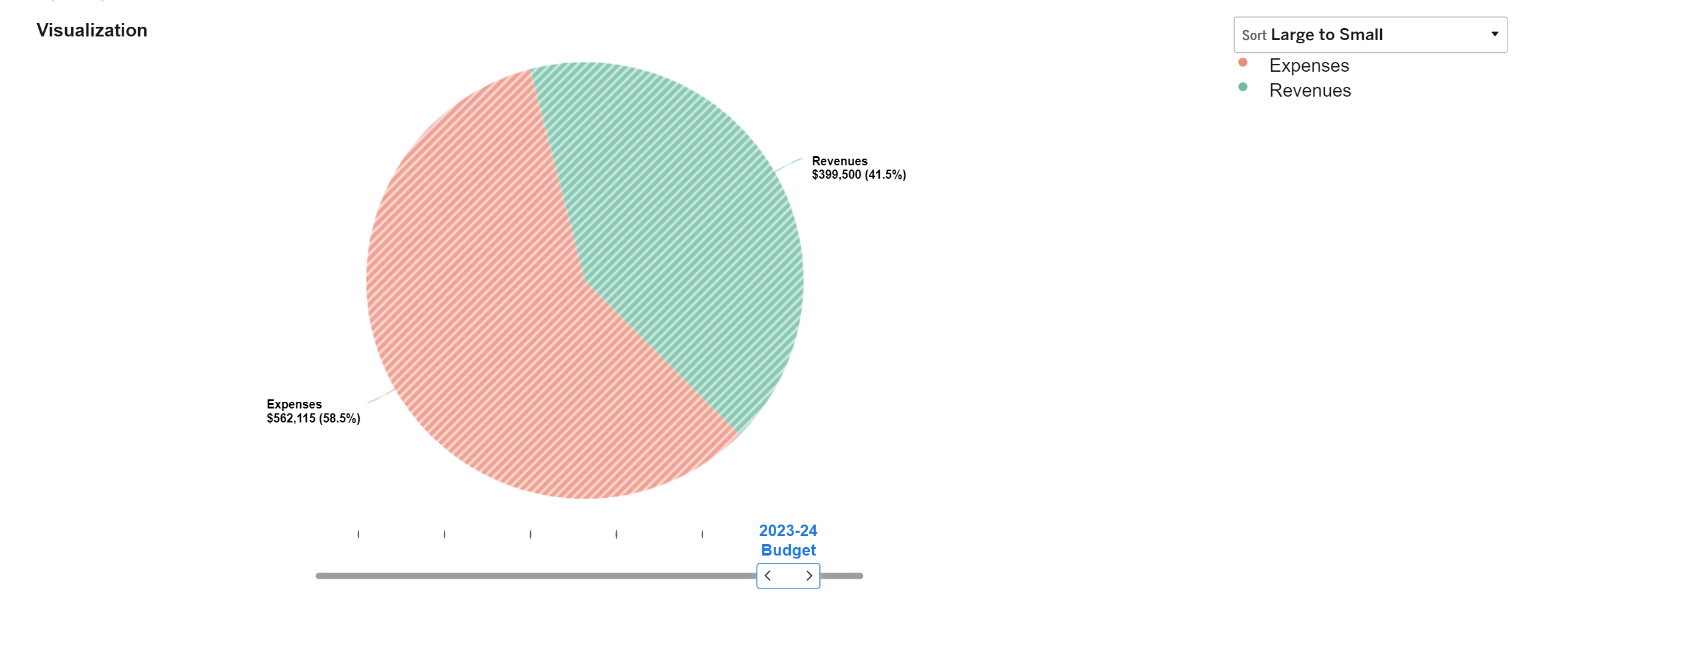
VISUALIZATION
CLERKS RECORDS AND ADMINISTRATION 2023-2024

Slide 15

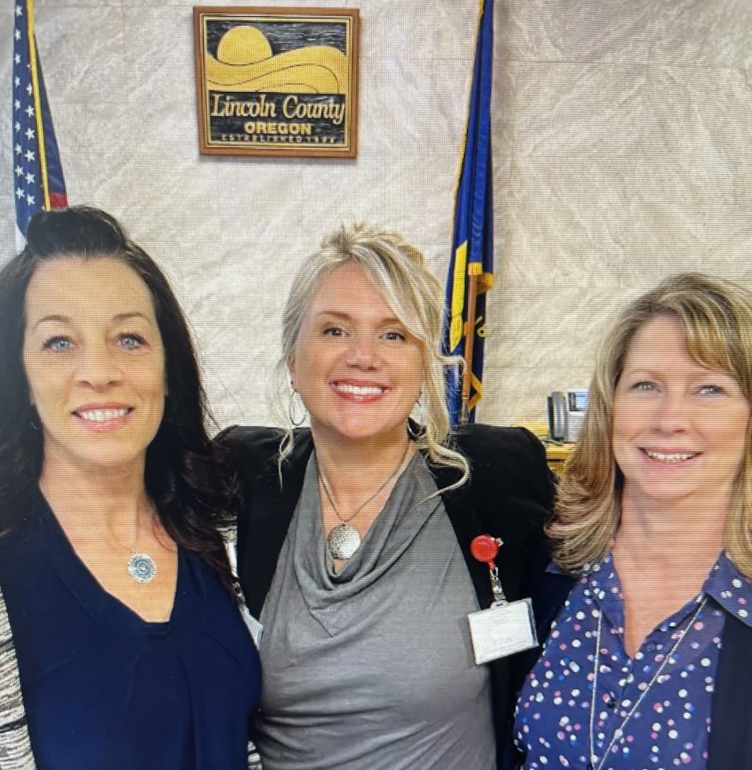
Thank you!
“A community that is engaged and working together can be a powerful force” – Idowu Koyenikan
Janet Cummiskey, Amy Southwell & Rhonda Davidson

