Slide 1
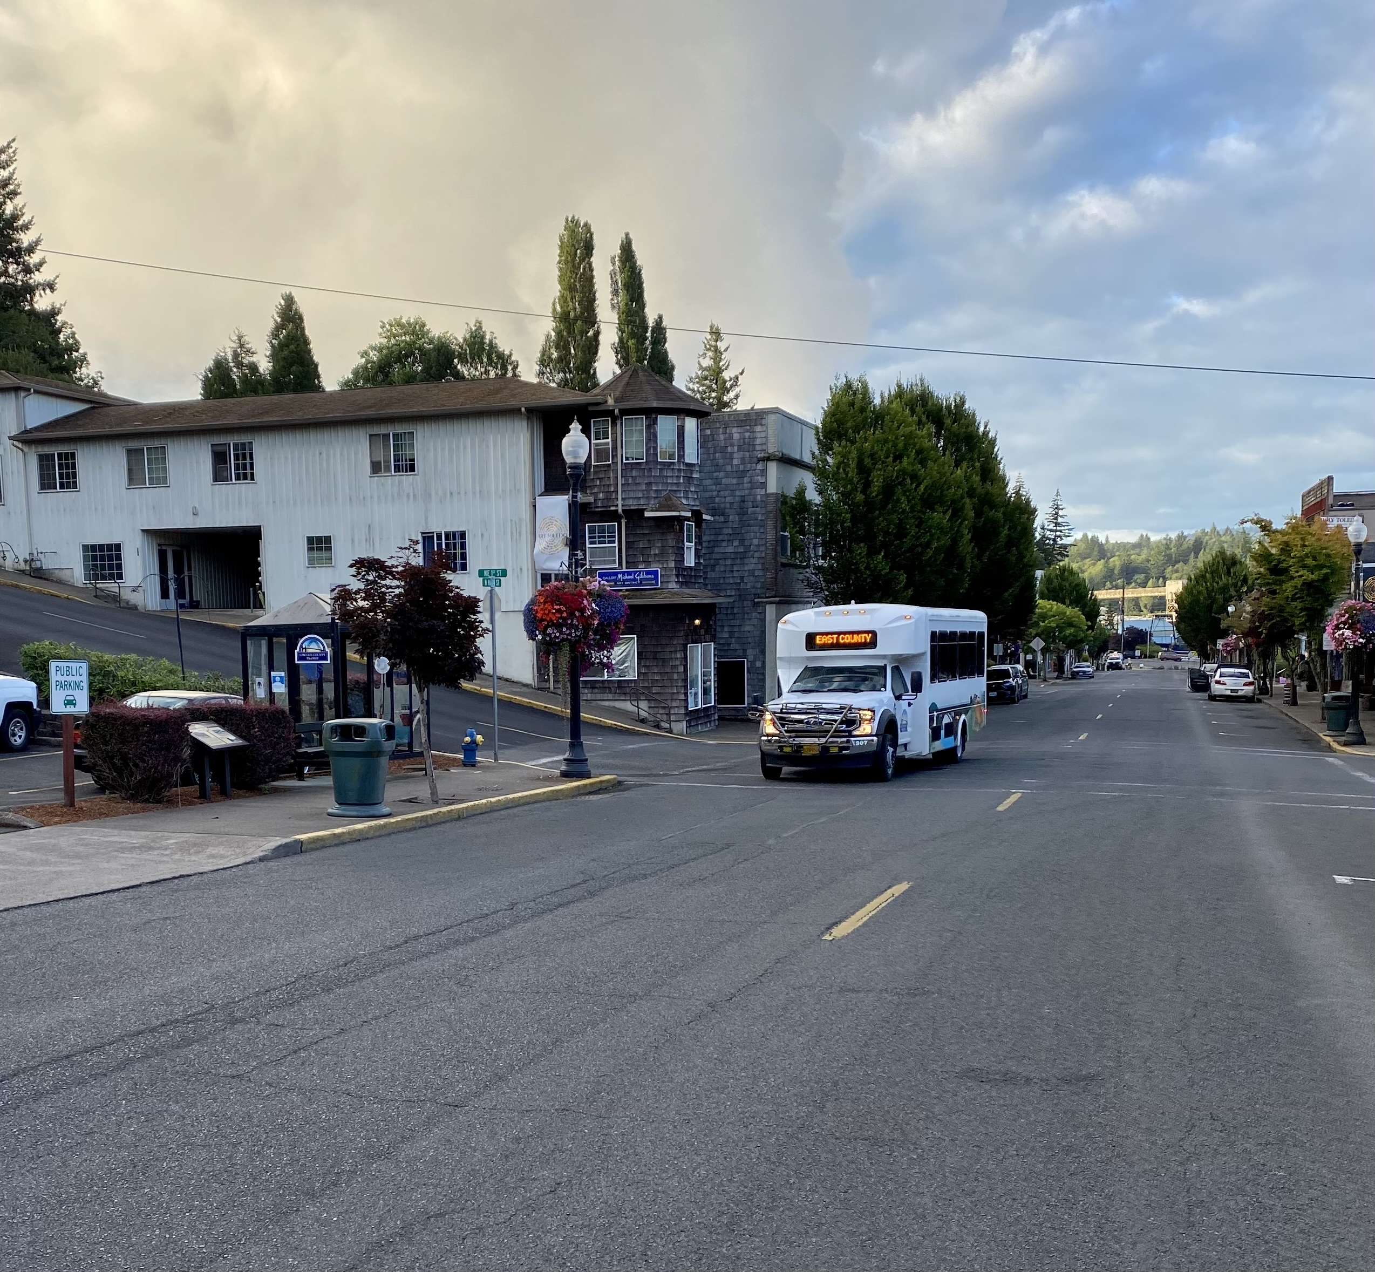
Lincoln County Transit
Fiscal Year 2023-24
Budget
Presentation

Slide 2
Lincoln County Transit
FY 2022/23 Statistics
Rides Provided = 250,123
Hours of Services = 29,487
Annual Miles Traveled = 510,652
Total Number of Buses = 19

Slide 6
Future Transit Service Enhancements
Sunday service on south county inter-community route
Sunday service on blue line route, east and north county combined inter-community route
Waldport city circular route, Monday through Friday
Service increase on Coast to Valley Express route
These expansions and new services were the result of input of Lincoln County residents through surveys, public outreach and public meetings. The Statewide Transportation Improvement Program advisory committee made recommendations to the Board of Commissioners on which projects to move forward.
Notes:
These expansions and new services were the result of input of Lincoln County residents through surveys, public outreach and public meetings. The Statewide Transportation Improvement Program advisory committee made recommendations to the Board of Commissioners on which projects to move forward

Slide 7
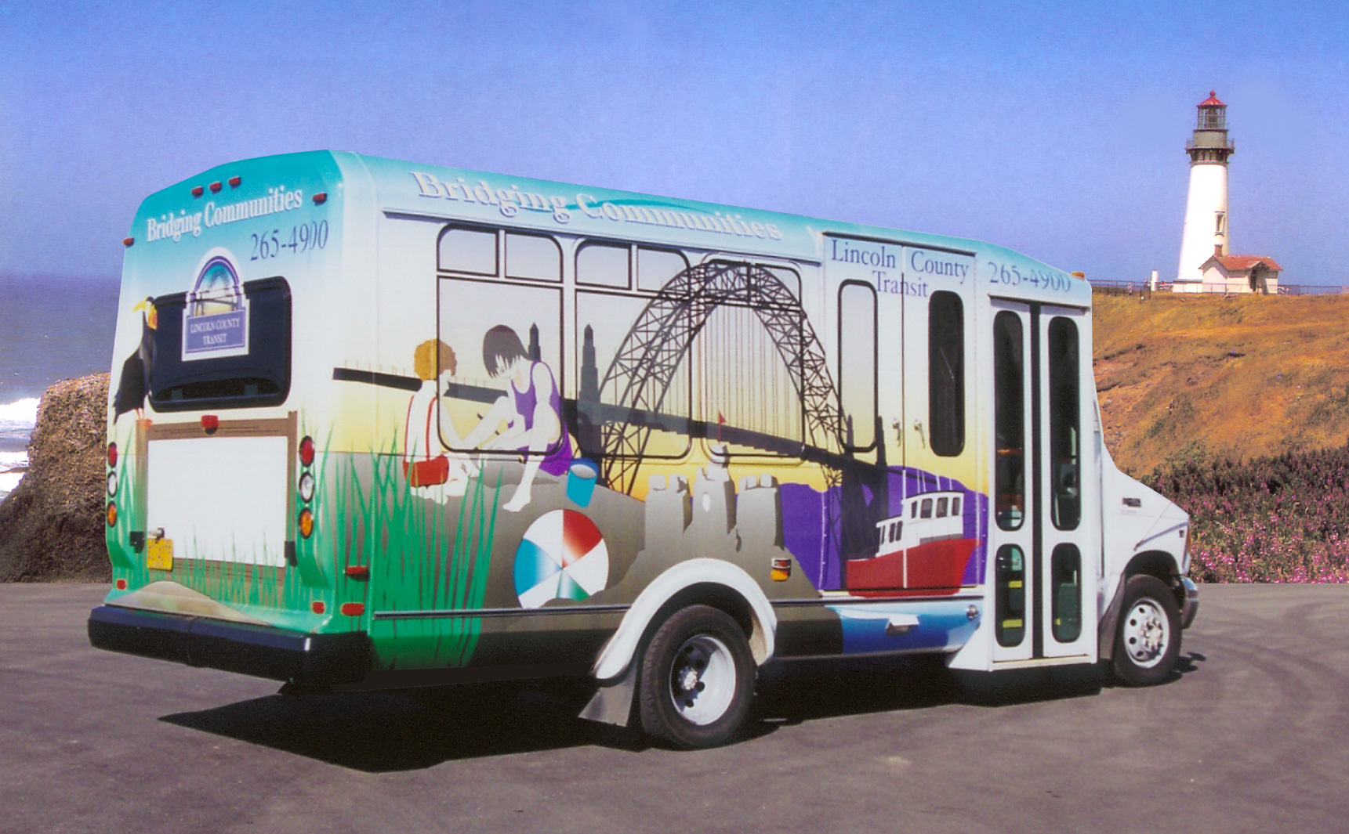
Questions?
Thank you for your continued support of Lincoln County Transit!

