Slide 1
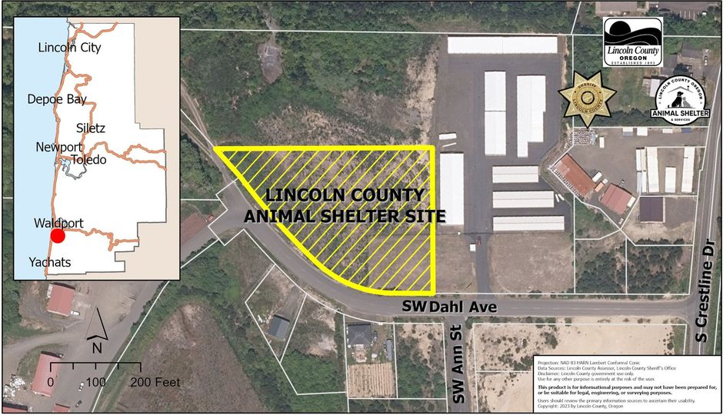
Lincoln county Sheriff’s Office
Budget Presentation fy23-24
Animal Services District

Slide 2
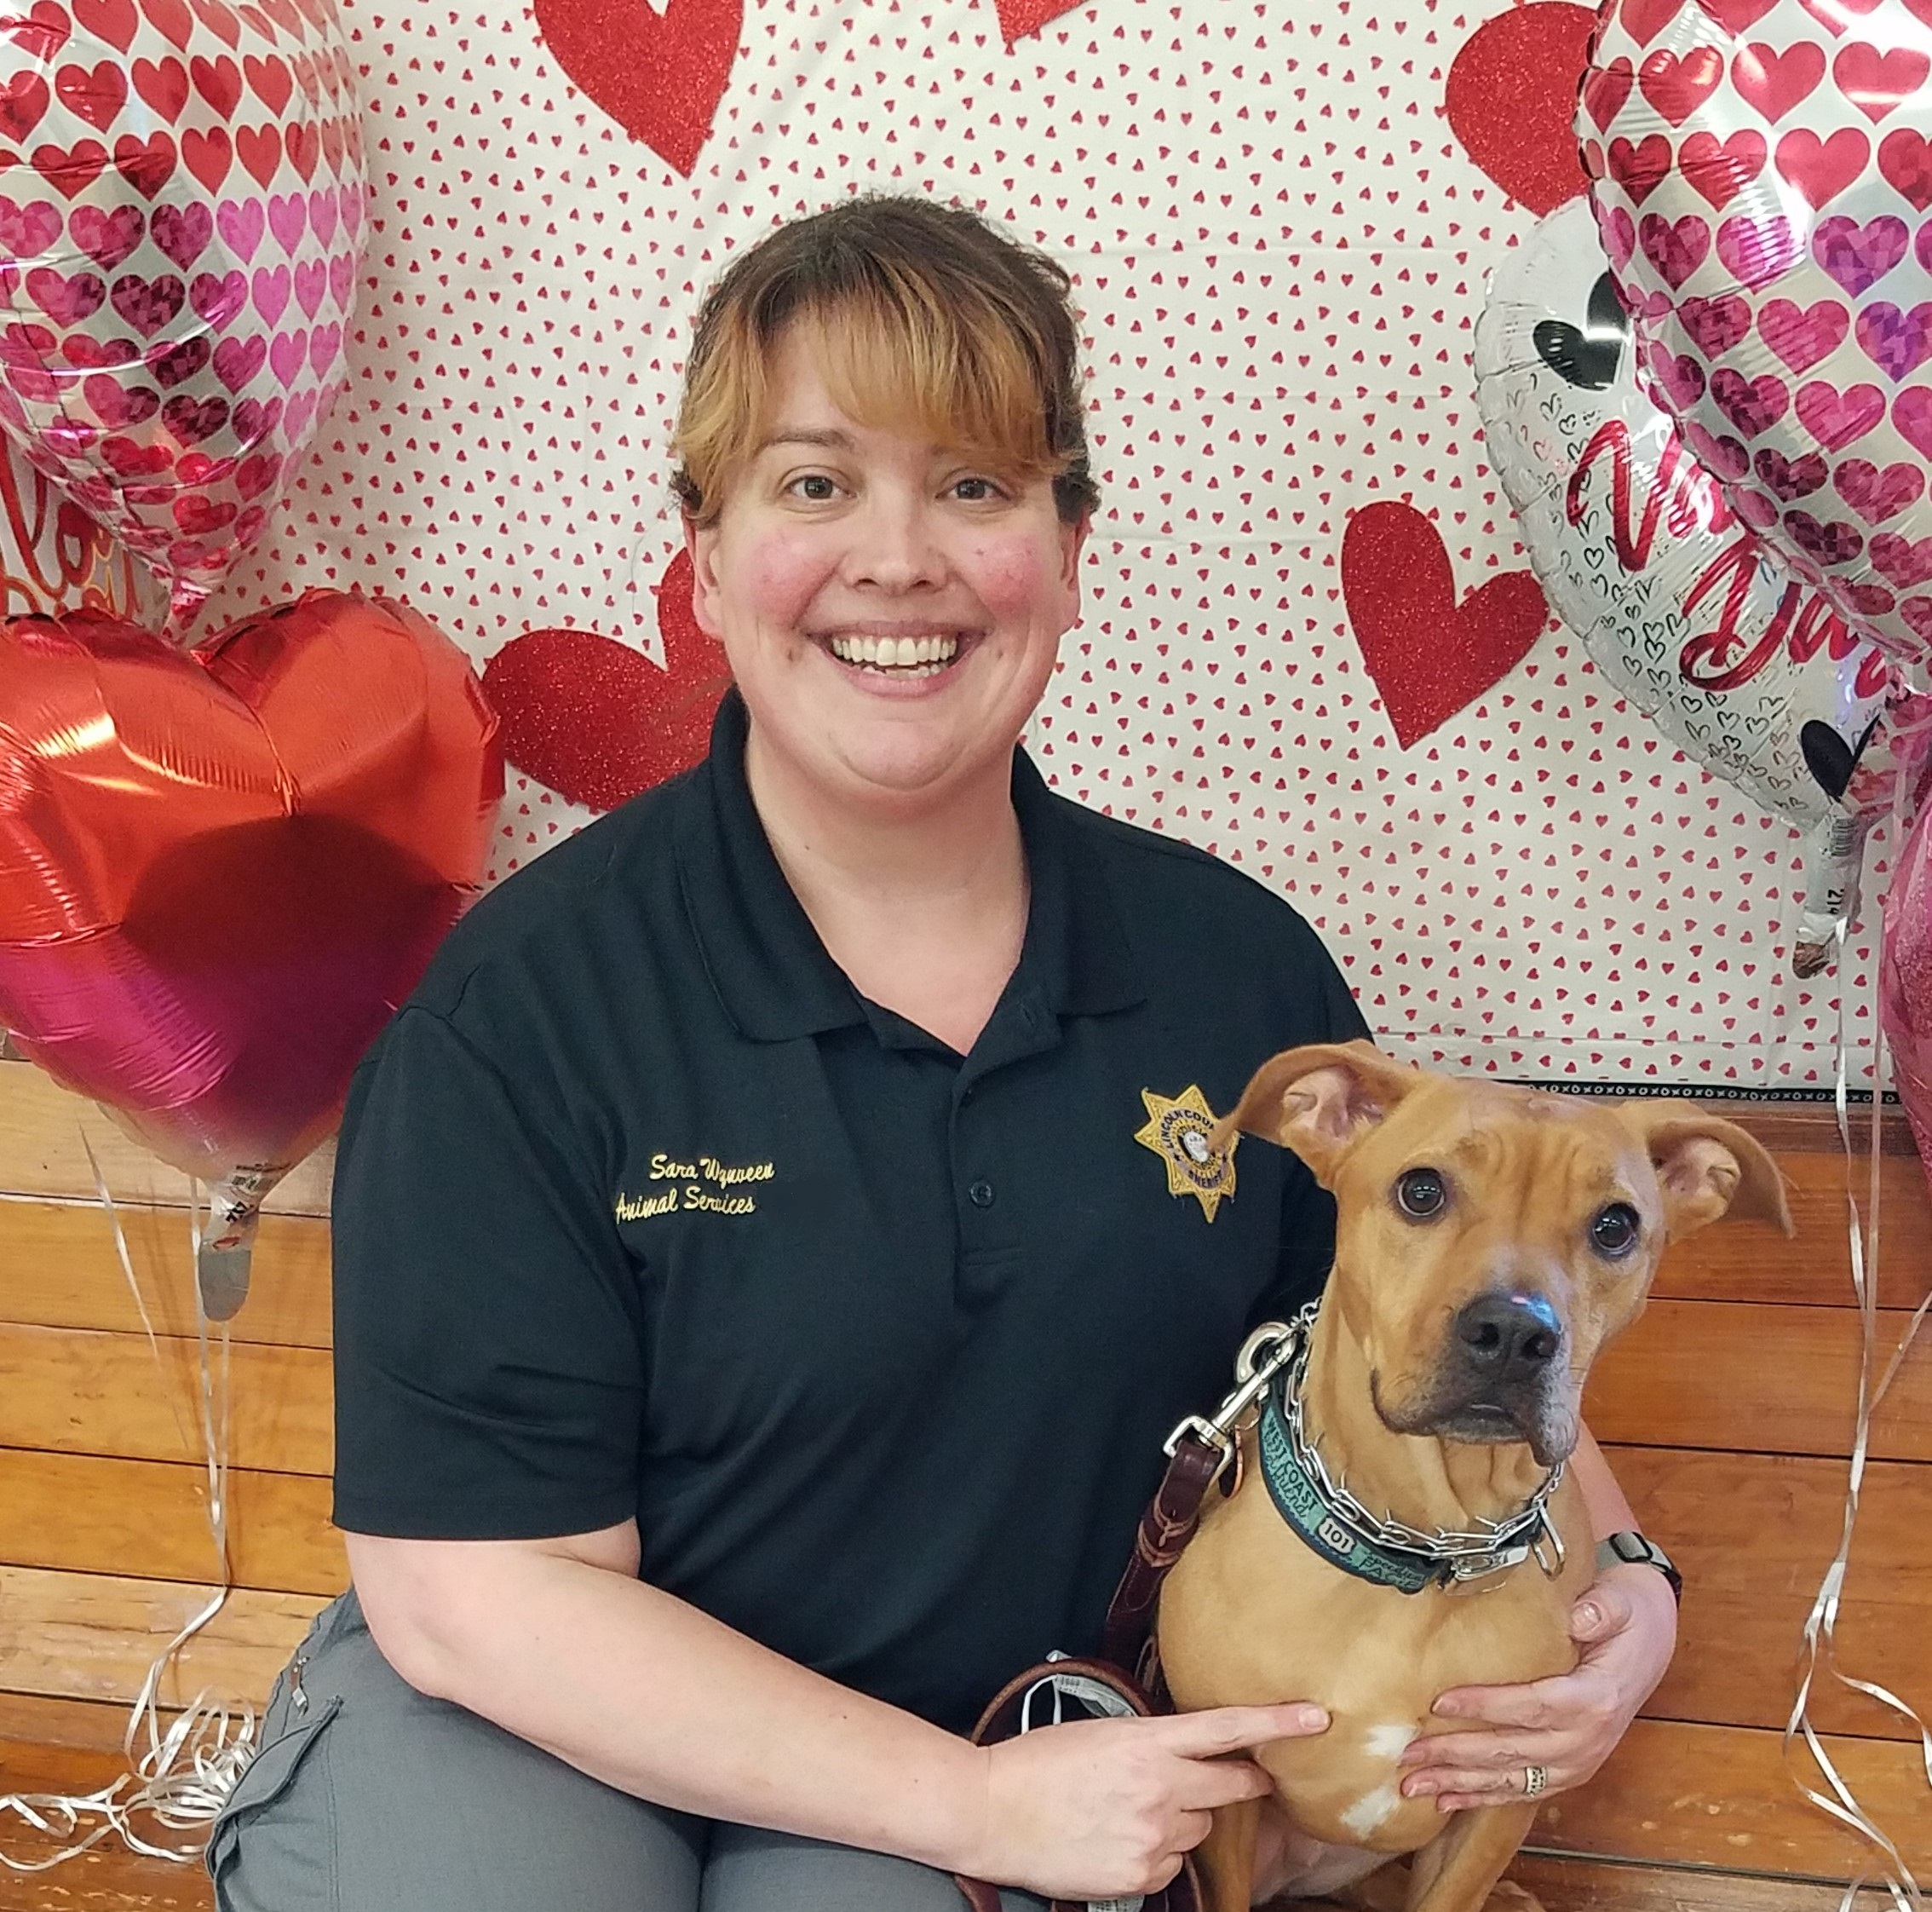
The Animal Shelter is committed to providing a safe haven for our community's animals by protecting animal welfare and public safety; rescuing, reuniting, rehabilitating and rehoming animals in need; helping keep pets and families together; and promoting responsible pet guardianship through licensing and education.
Animal Shelter
Animal Shelter Manager
Sara Wynveen

Slide 3
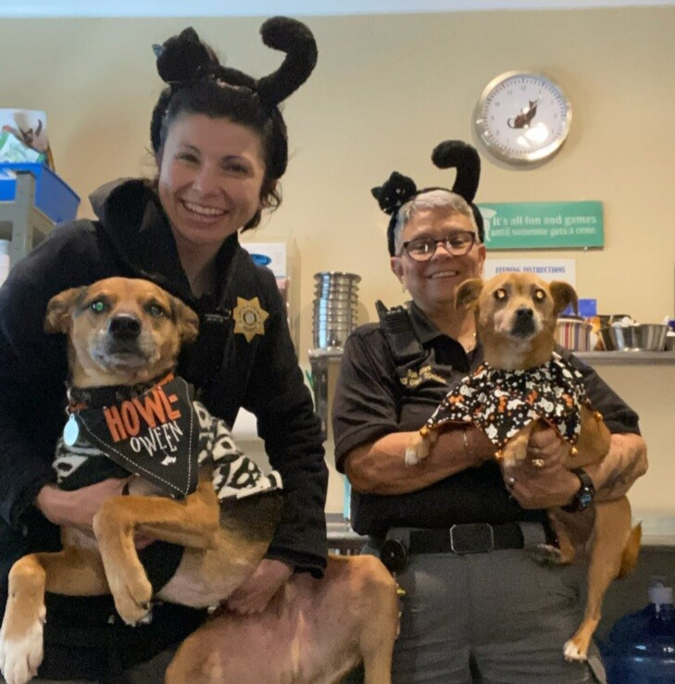
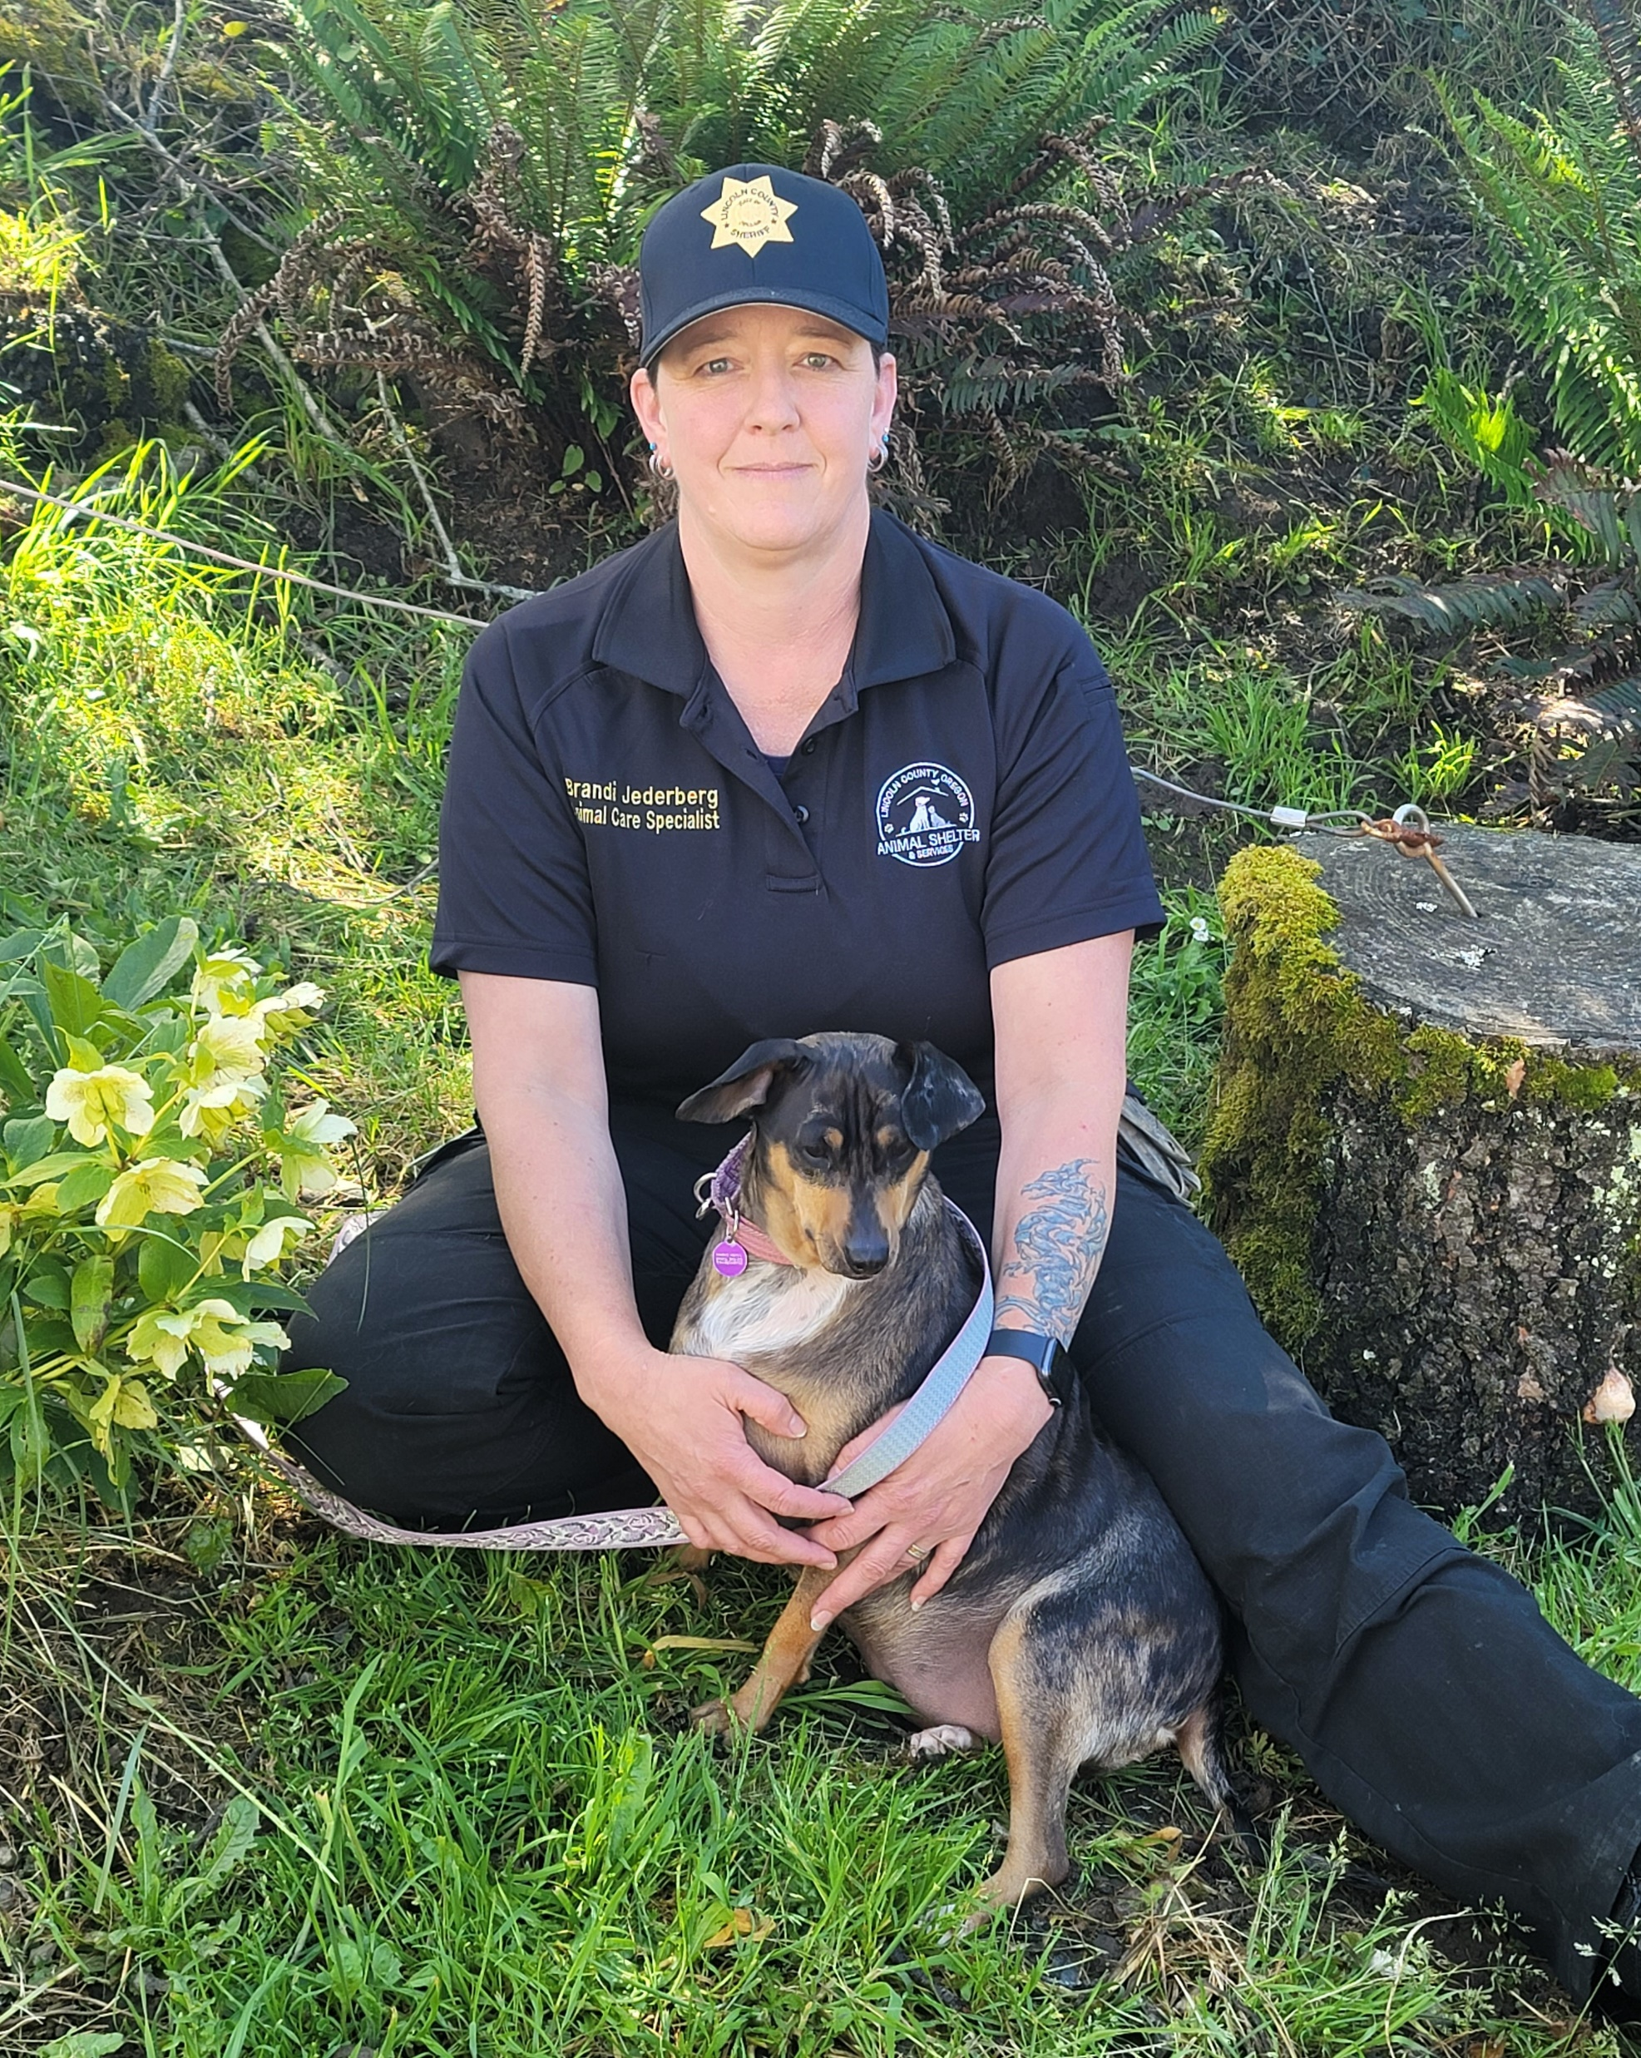
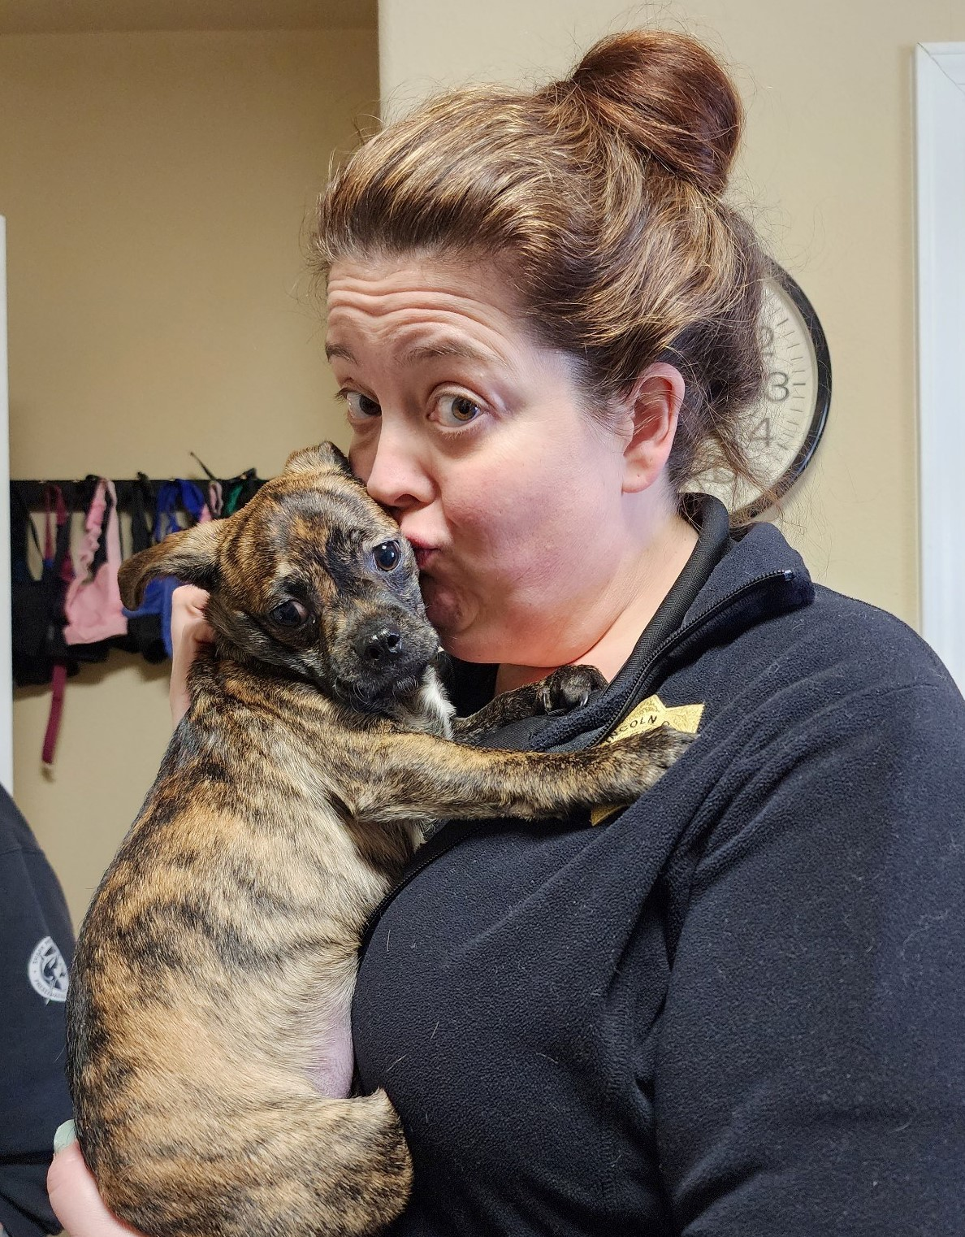
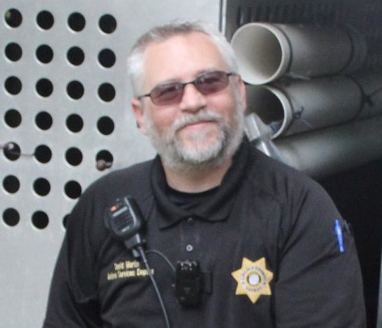
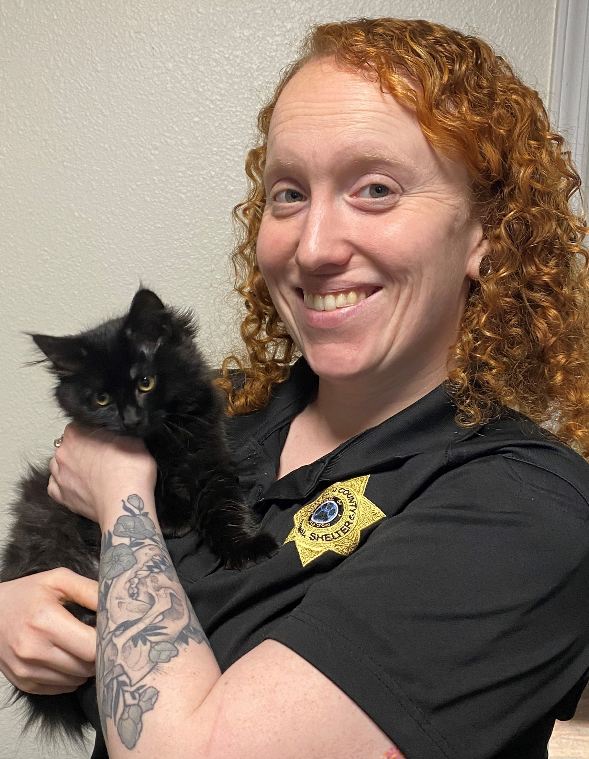
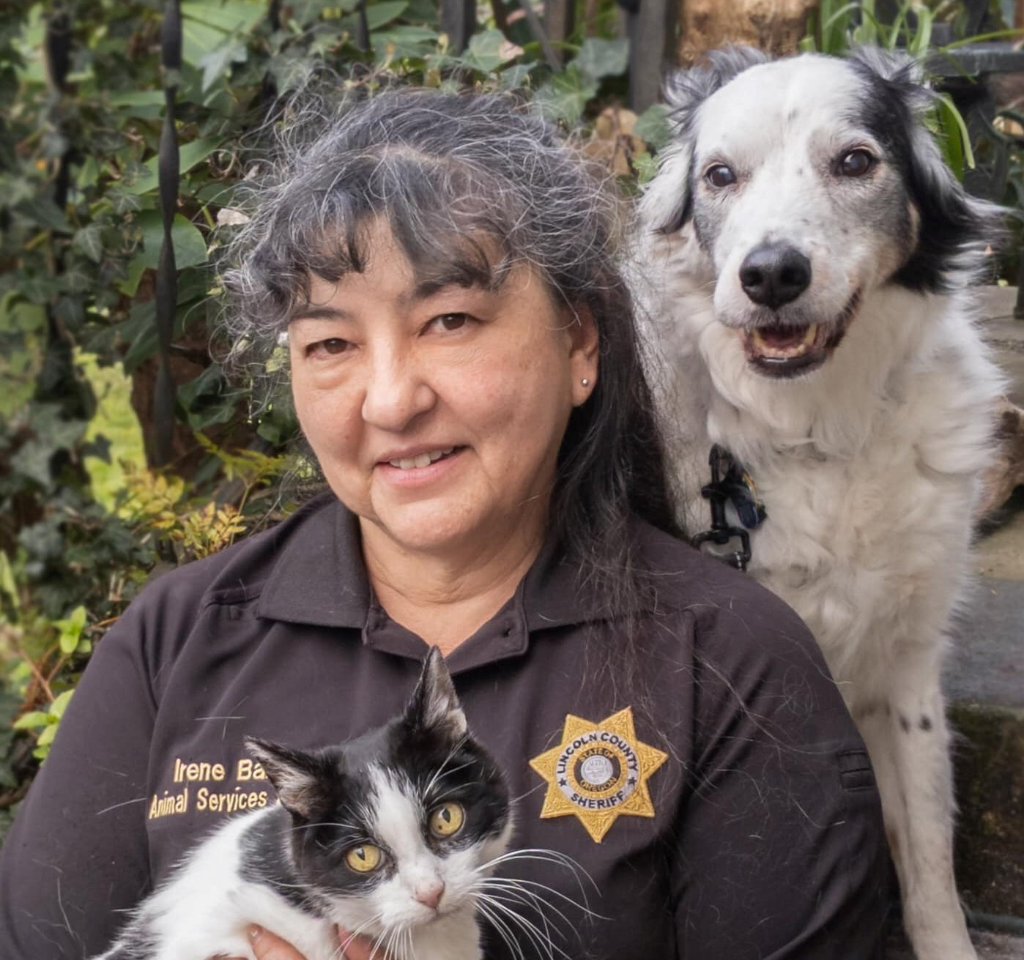
Animal Shelter Overview
  Animal Shelter Team:
  1 FTE Animal Shelter Manager
  4 FTE Animal Care Specialists
  2 FTE Animal Services Deputies
  1 PTNB Animal Care Specialist (Vacant)
  68 active volunteers
  1 Emergency/Outreach Trailer
  4 Vehicles
  Services:
  Provide safe, humane, and enriching housing to animals in care at the Lincoln County Animal Shelter
  Enforce laws related to animal care and welfare
  Maintain Lincoln County's dog licensing program
  Provide education to the public on animal welfare issues
  Pet retention programs
  Adoption programs
  Lost and found services

Slide 4
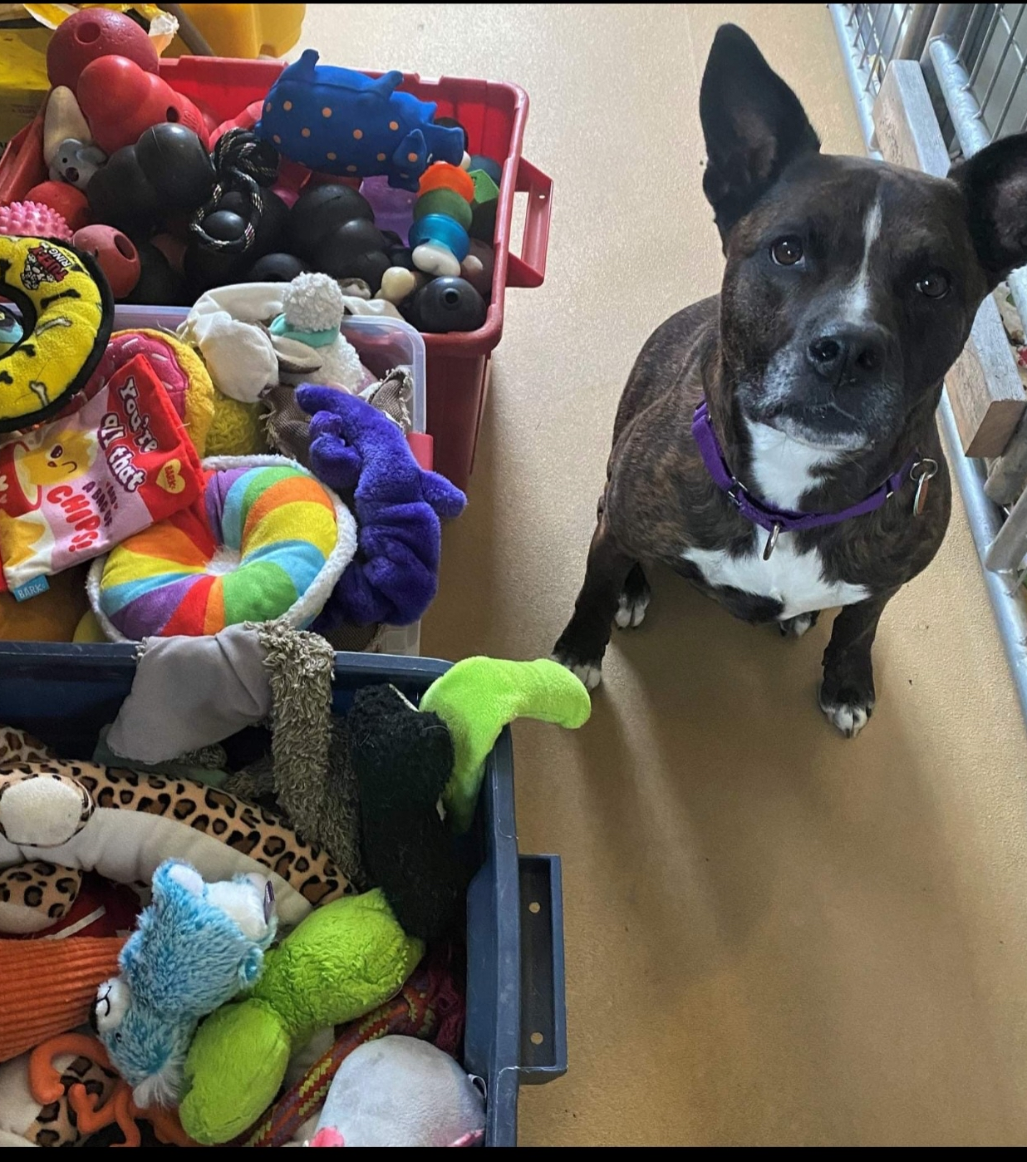
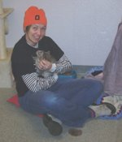
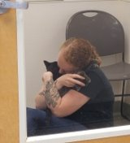
FY 2022-2023 Successes
  Cared for 661 animals.
  Licensed 1421 dogs.
  Animal Services Deputies responded to 1960 calls for service.
  Volunteer program grew from 24 to 68 active volunteers.
  Volunteer hours increased from 962 to 1,467.
  The Animal Shelter food bank program provided almost 5,000 pounds of pet food to 198 households.

Slide 5
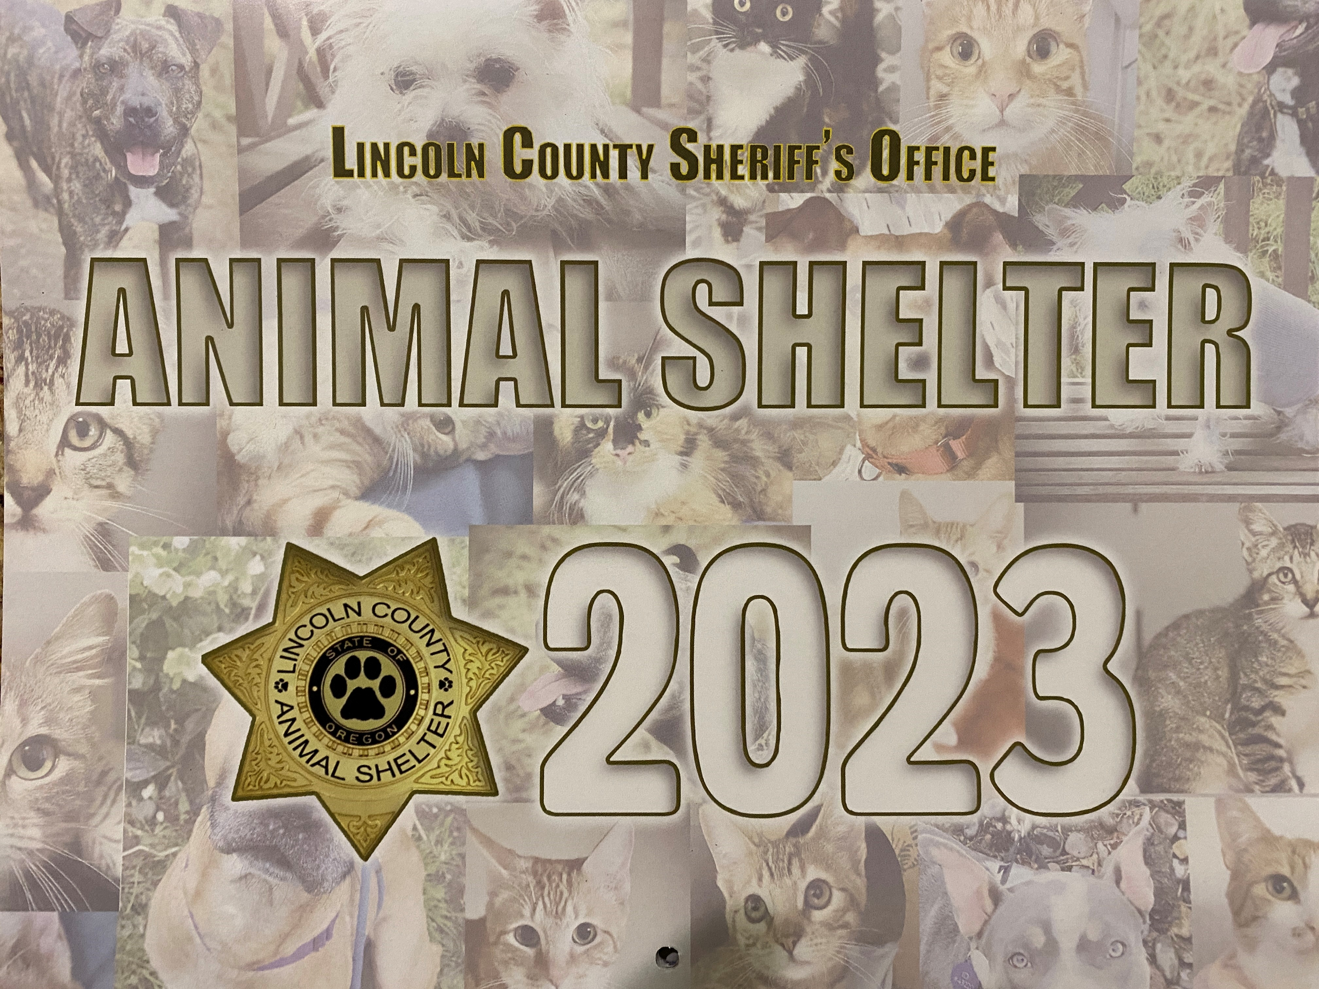
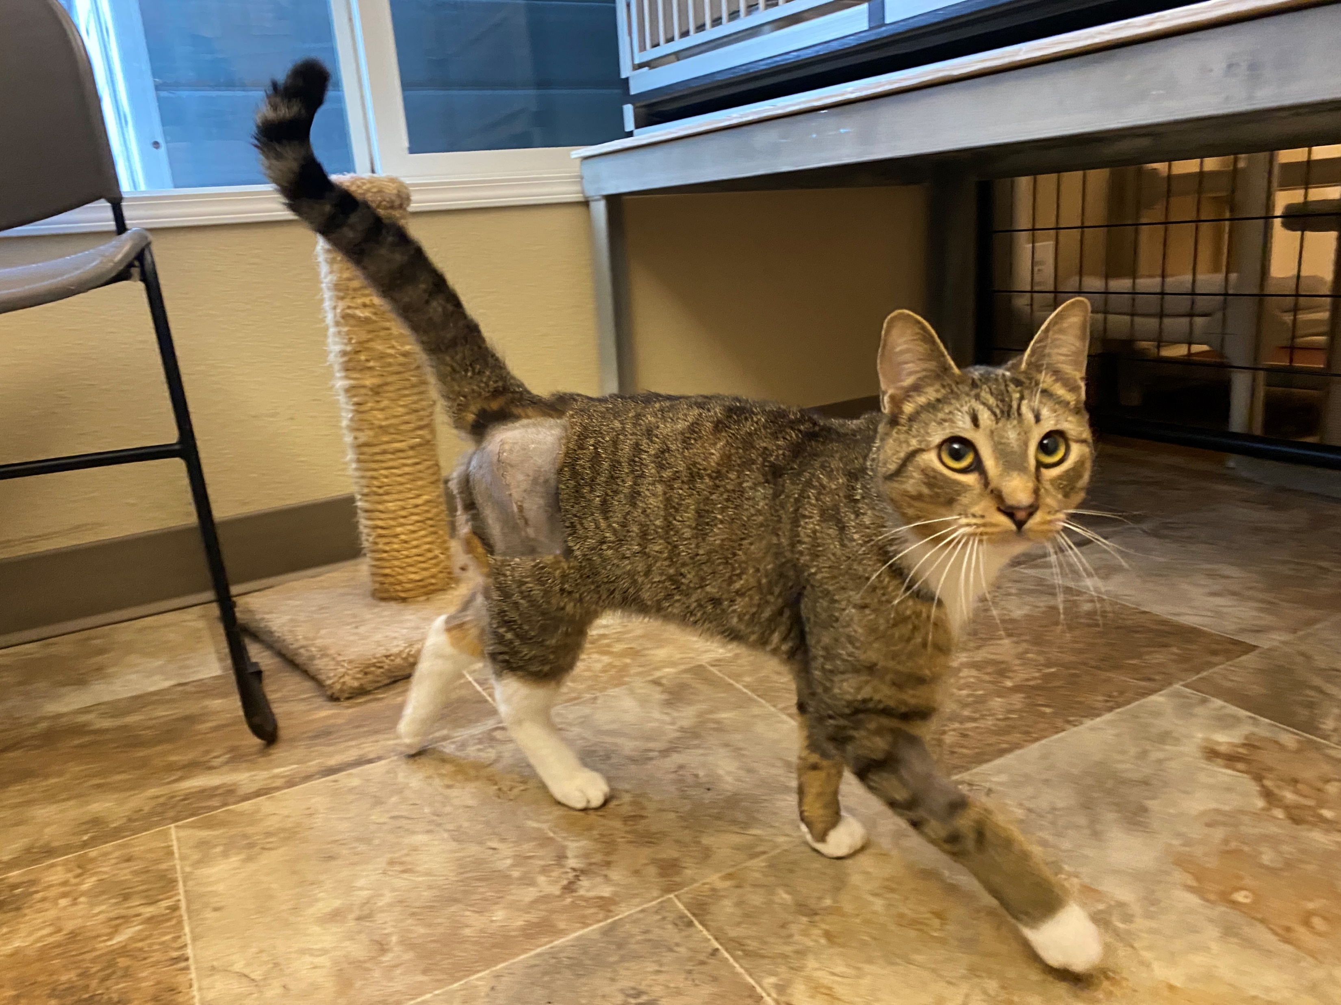
FY 2022-2023 Successes
Continued
  The Medical Trust Fund paid more than $24,000.00 for veterinary diagnostics and treatment for 55 seriously ill or injured animals.
  Successfully held another calendar fundraiser to help support costs for the new animal shelter building fund.
  Secured location for future animal shelter facility.
  Despite many challenges with space & facility, spay and neuter services, and overpopulation, this team continues to find creative solutions in order to prioritize animal health and safety.

Slide 6
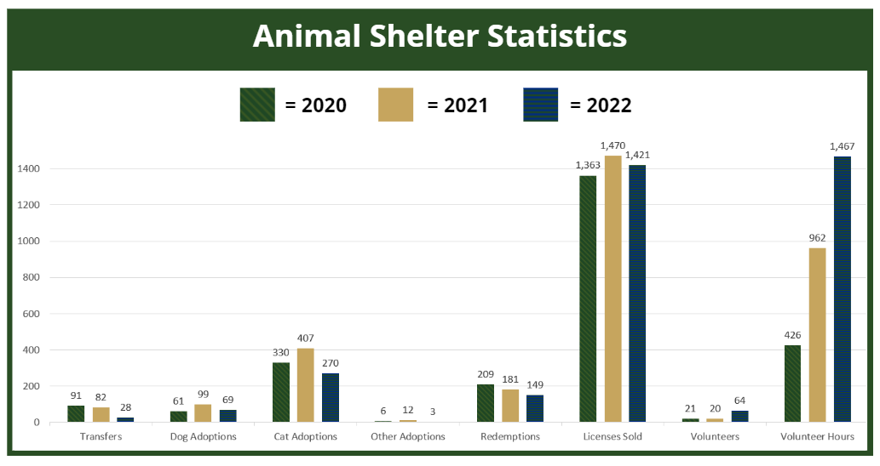

Slide 7
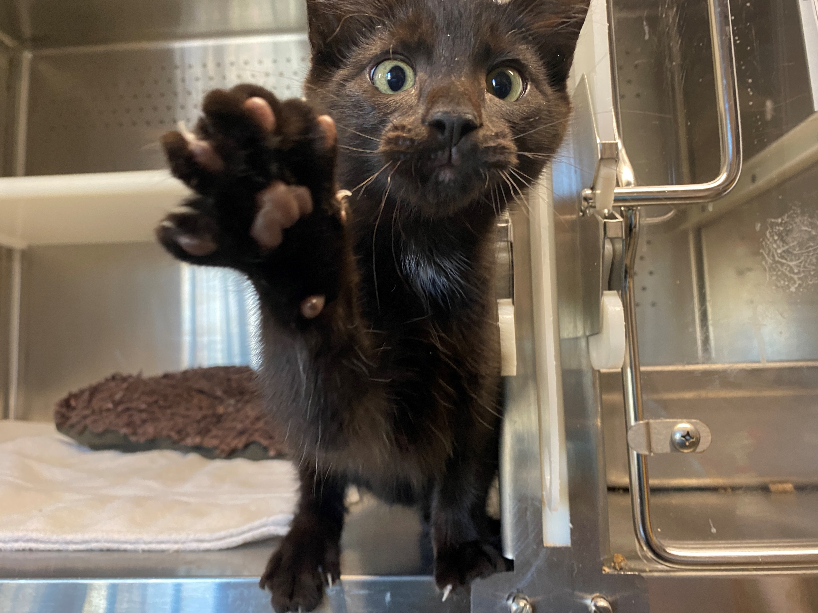
Impacts to Budget
  $300,000 donation in the FY 2021-2022 budget help sustain fund.
  Permanent tax district approved in November 2012 election ($.11/$1,000).
  Annual calendar fundraiser.
  Volunteer hours continue to supplement daily care and cleaning required for basic facility functioning.

Slide 8
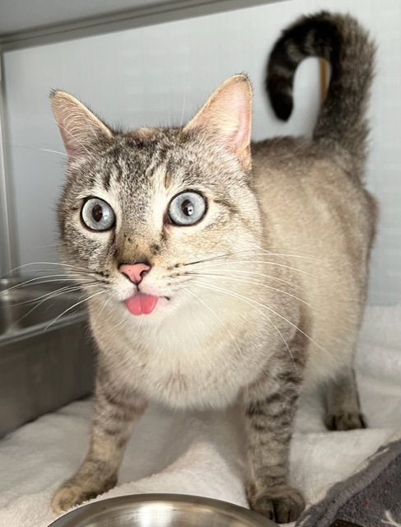

Impacts to Budget Continued
  $47,000 reduction from excess value used in Urban Renewal areas for 2022-2023.
  $150,000 removed from the Animal Services District in 2019-2020 budget to Capital Projects for new animal shelter site.
  $104,000 proposed indirect cost for FY 2024-2025. Indirect cost began for this fund in the 2019-2020 FY and have not previously been collected.

Slide 9
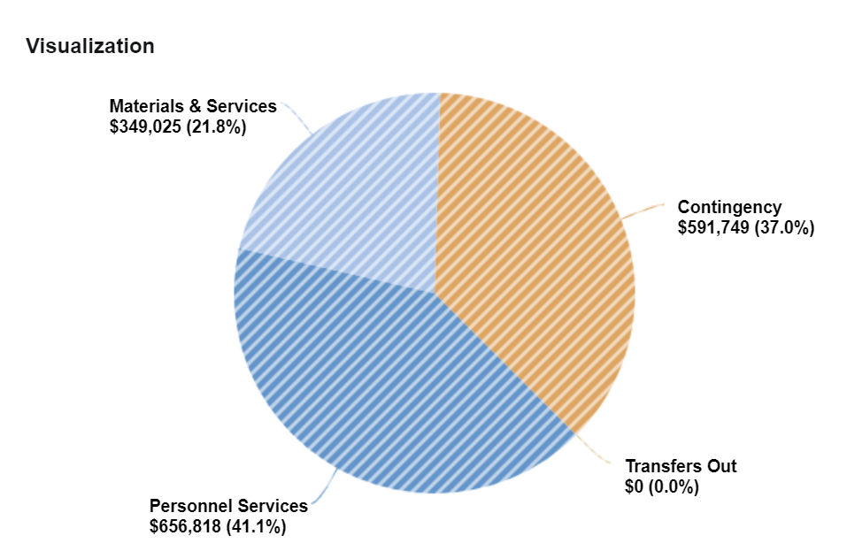
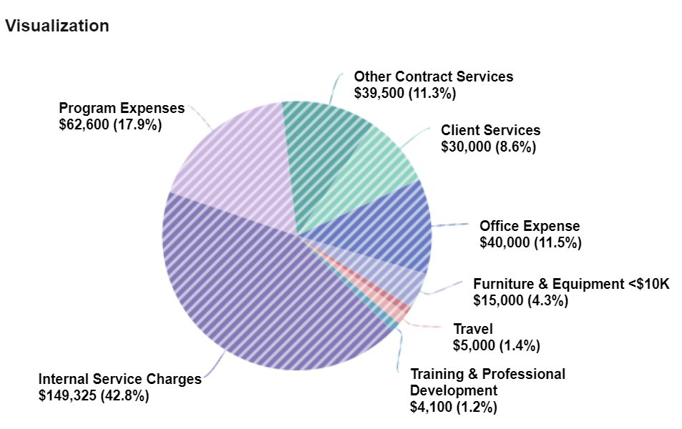
animal services district expenses
EXPENSES
MATERIALS & SERVICES

Slide 10
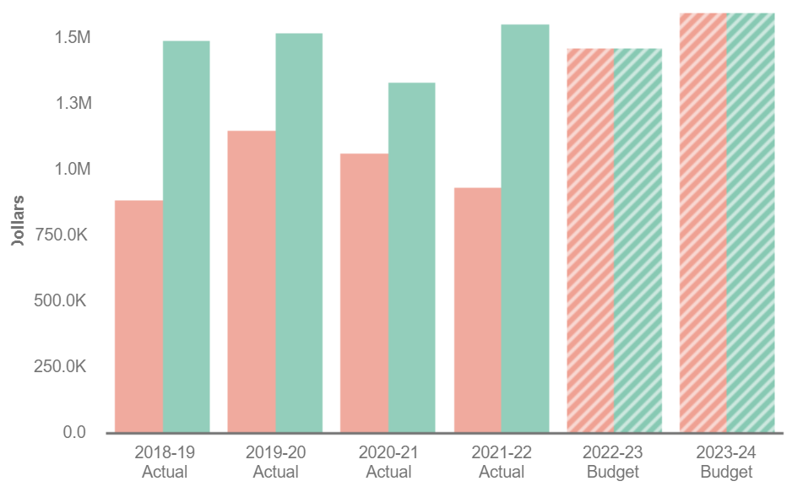



Animal services district
Expenses and Revenue
= Expenses
= Revenues
= Projected Expenses
= Projected Revenues

Slide 11
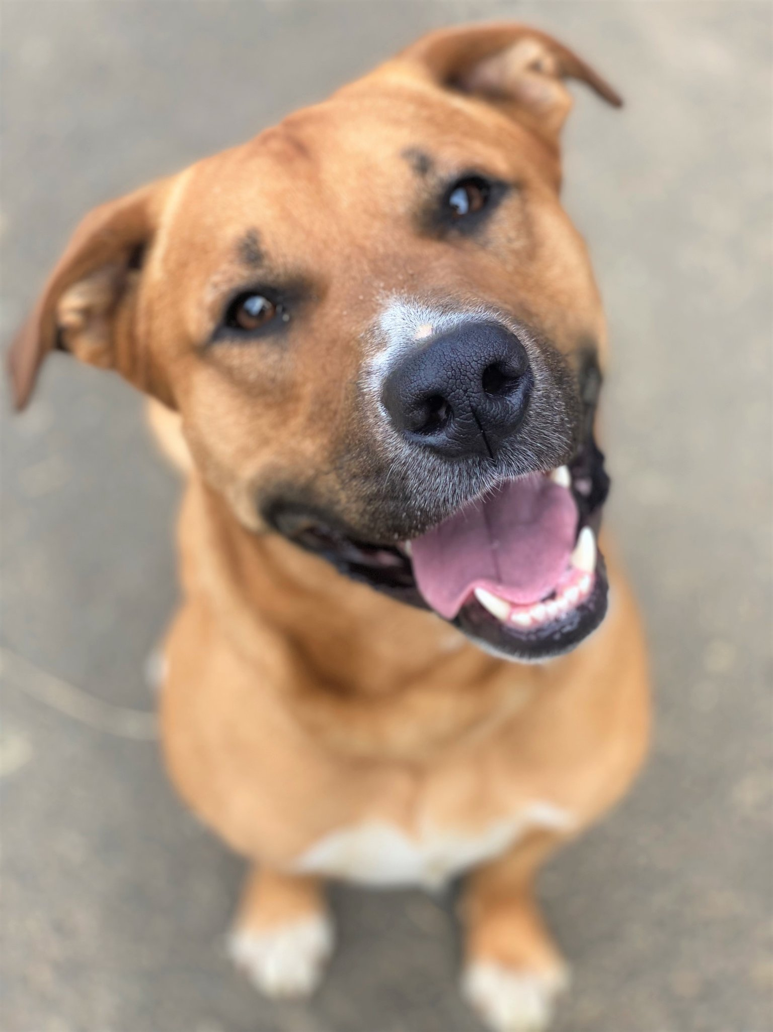
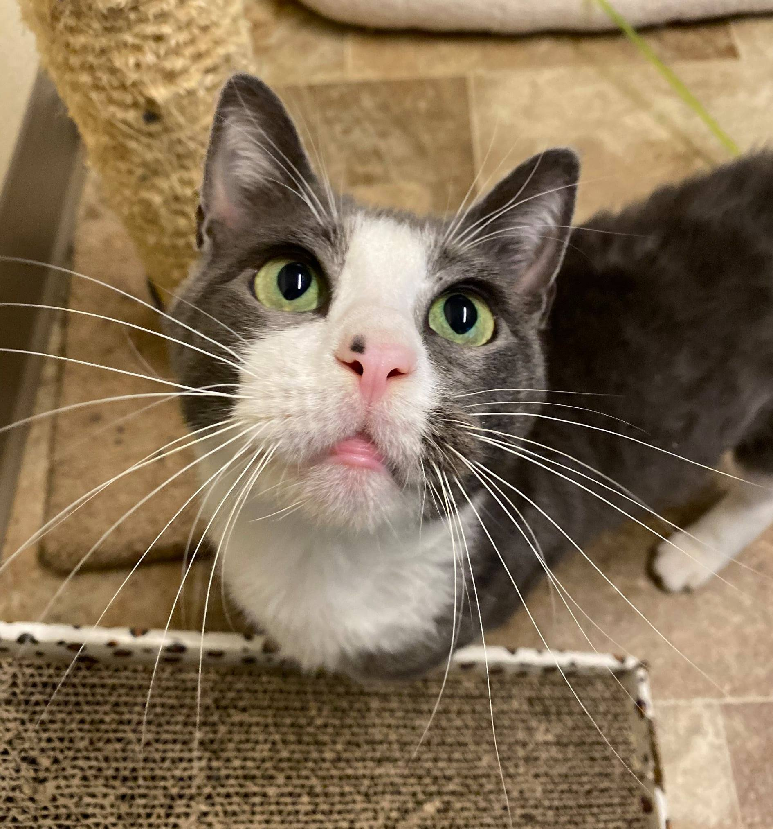
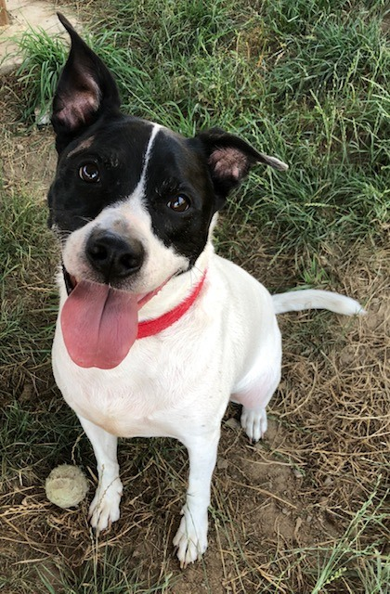
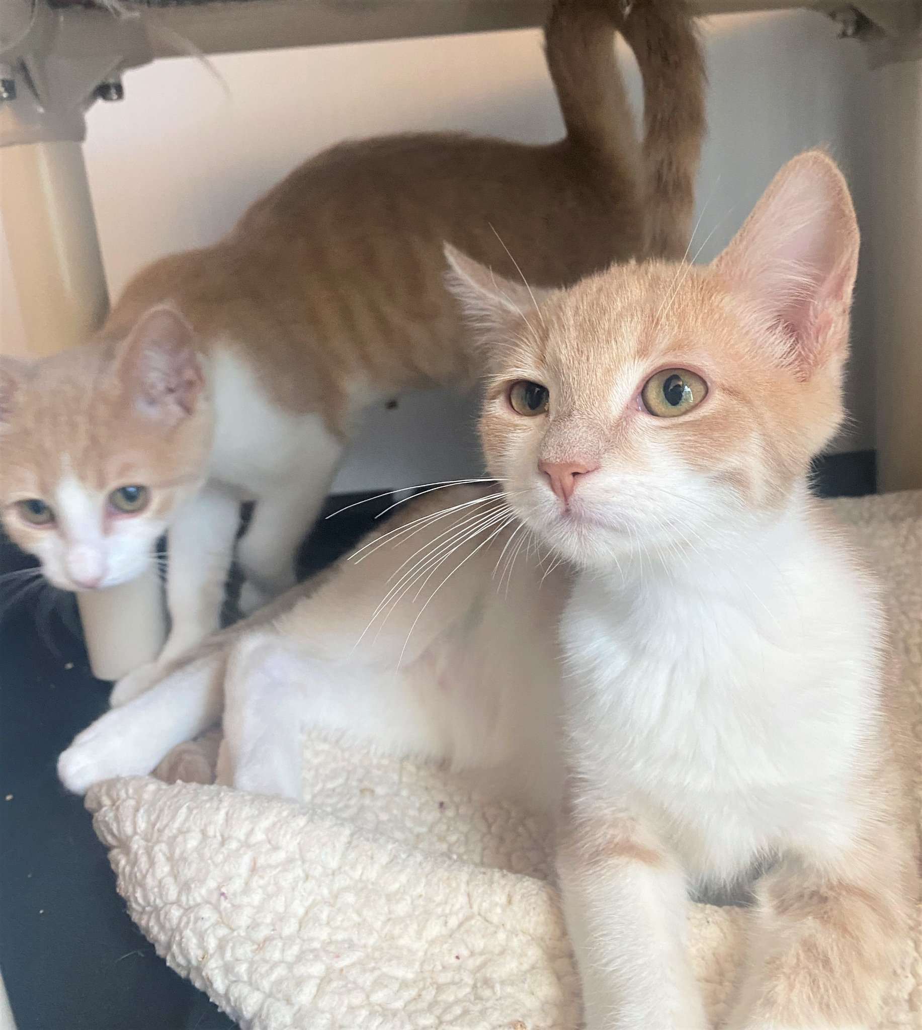
FY2023-2024 Goals
  Begin construction on new animal shelter facility.
  Increase dog license compliance. Estimated 13,500 dogs in Lincoln County (per AVMA), approximately 1,500 currently licensed. Which creates approximately $240,000 missing revenue annually.
  Launch new shelter software (ShelterBuddy) which allows for online licenses and online adoption processing options.
  Continue implementation of pet retention programs through partnerships with Central Coast Humane Society and FOLCAS (Friends of Lincoln County Animals).
  Continue to develop additional options to maintain accessibility of shelter services throughout Lincoln County.

Slide 12

Contact Information
Sheriff Curtis Landers
lcsheriff@co.lincoln.or.us
541-265-0652
Animal Shelter Manager
Sara Wynveen
swynveen@co.lincoln.or.us
541-265-0725

