Slide 1

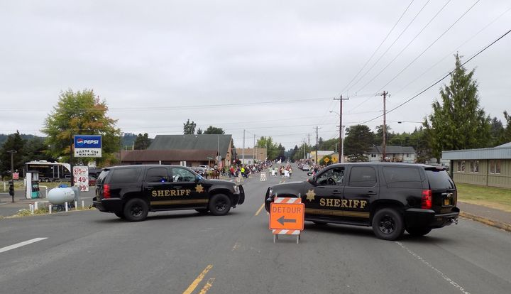
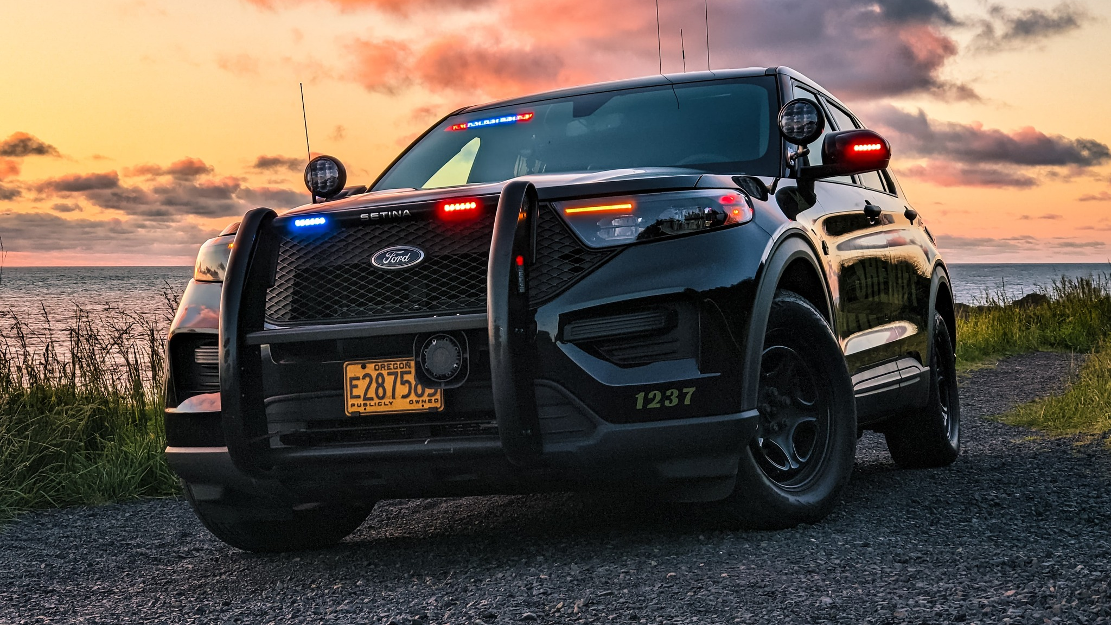
Lincoln county Sheriff’s Office
Budget Presentation fy23-24
Siletz Enhanced Law Enforcement District

Slide 2
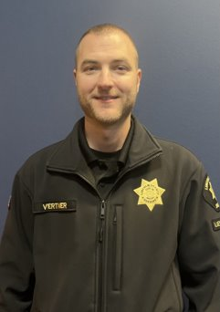
Siletz Area Enhanced Law Enforcement District
The Lincoln County Sheriff's Office provides 80 hours of dedicated patrol services to the geographical area of the Siletz Rural Protection Fire District in collaboration with funding from Confederated Tribes of Siletz Indians and a special taxing district within Siletz Fire District at $1.31/$1,000 assessed value. Coverage is 40 hours on day shift and 40 hours on nights.
Patrol Commander
Lieutenant Karl Vertner

Slide 3
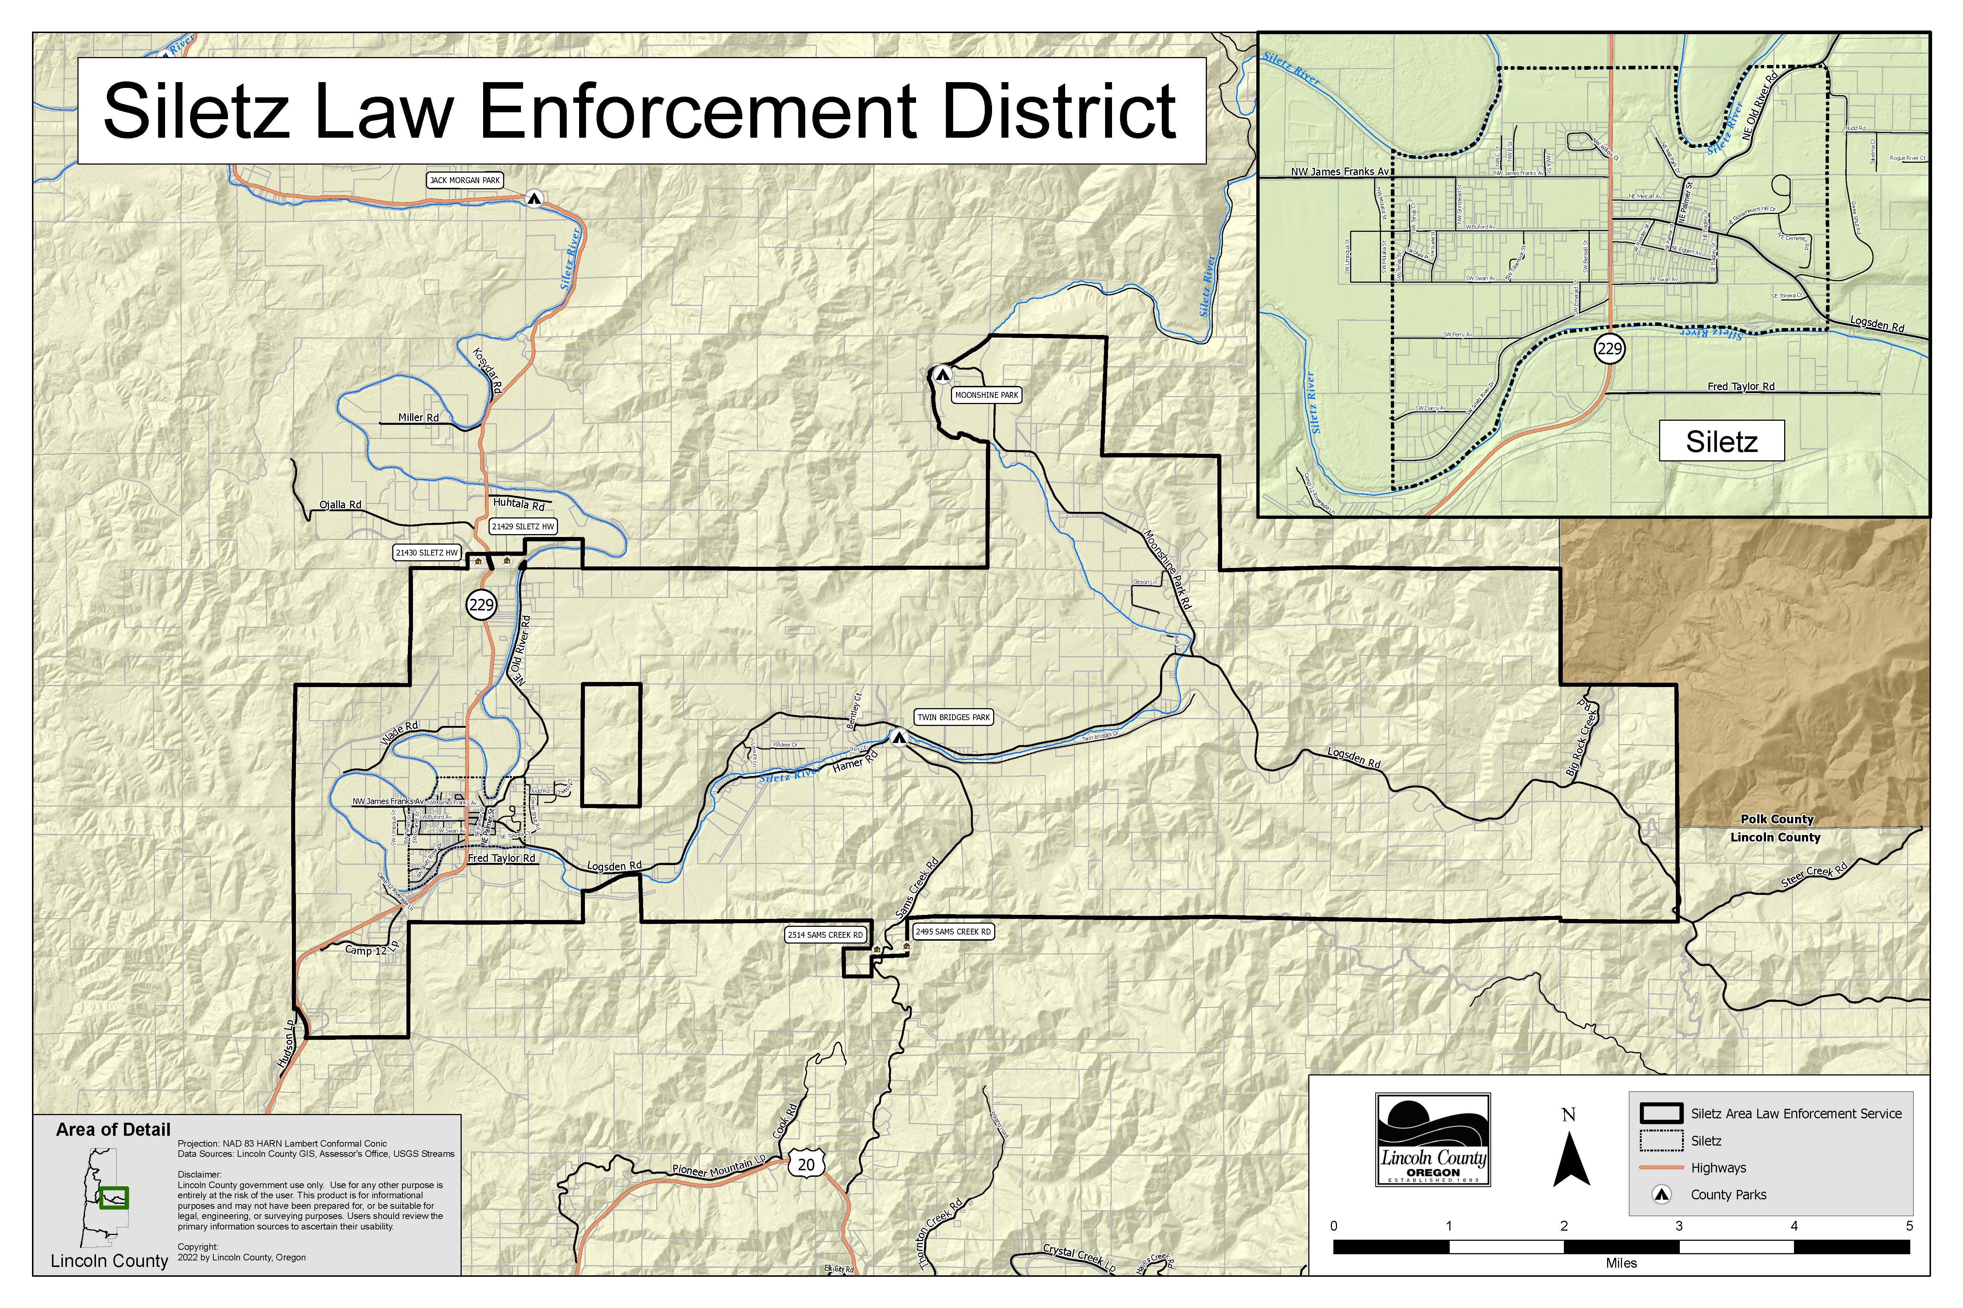

Slide 4
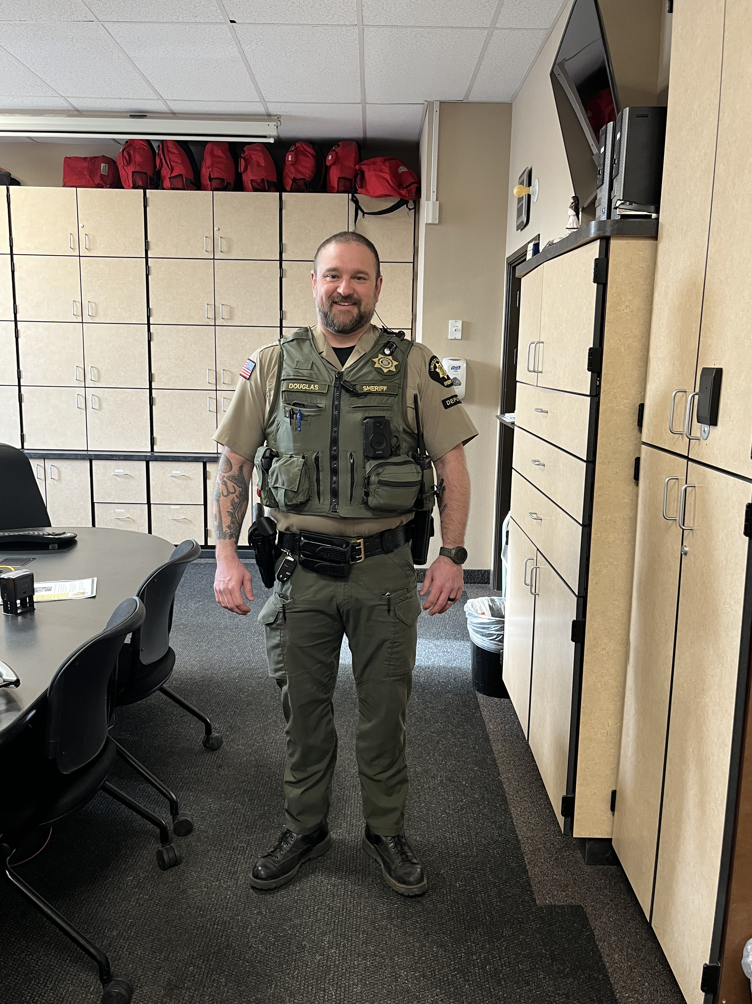
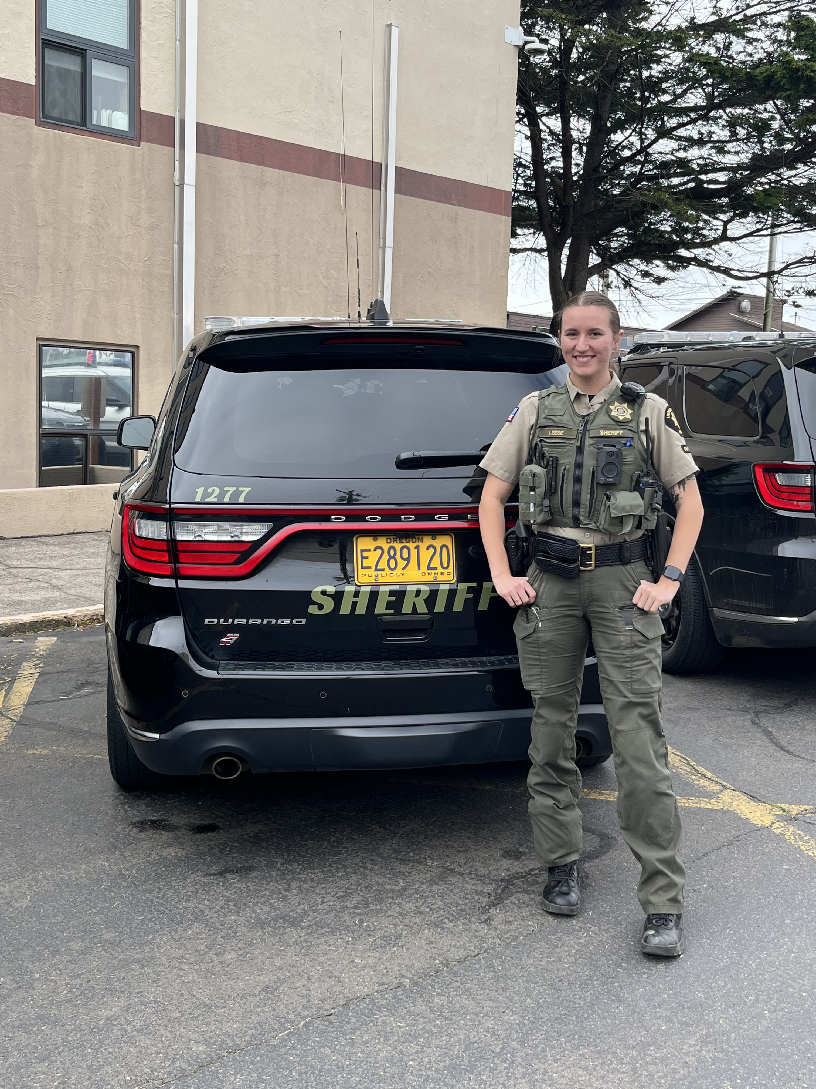
Siletz Enhanced Law Enforcement District Overview
  Siletz District Team:
  2 FTE Contract Deputies
    1 Dayshift
    1 Nightshift
  2 Patrol Vehicles
  Services:
  Enhanced Patrol services 7 days (80 hours) a week in the Siletz Enhanced Law Enforcement District.

Slide 5
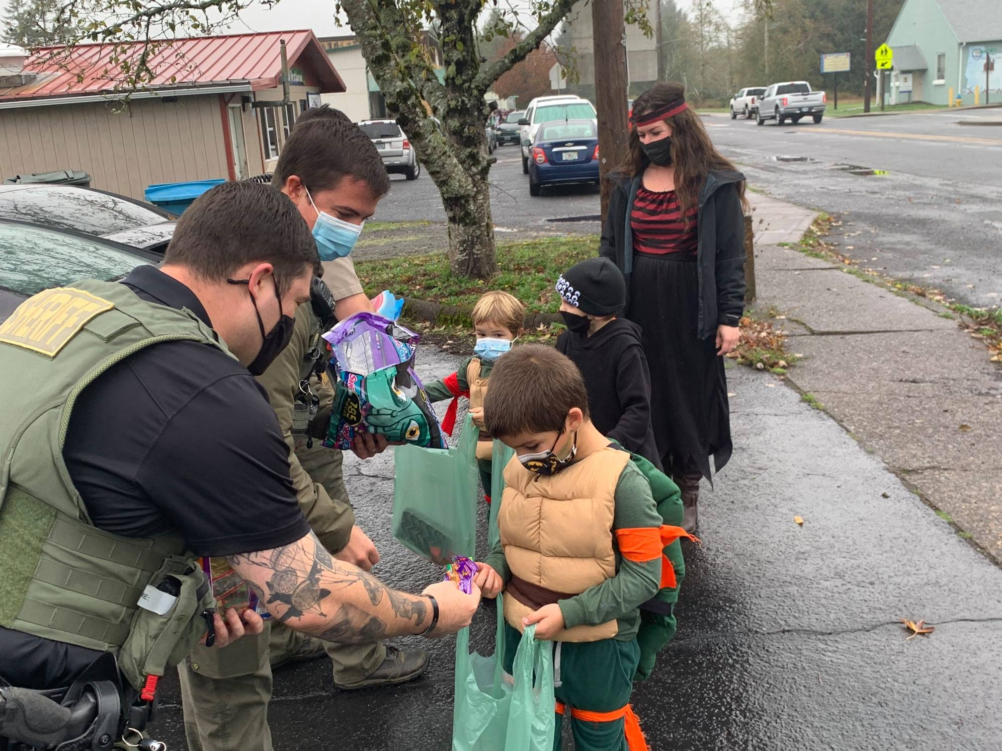
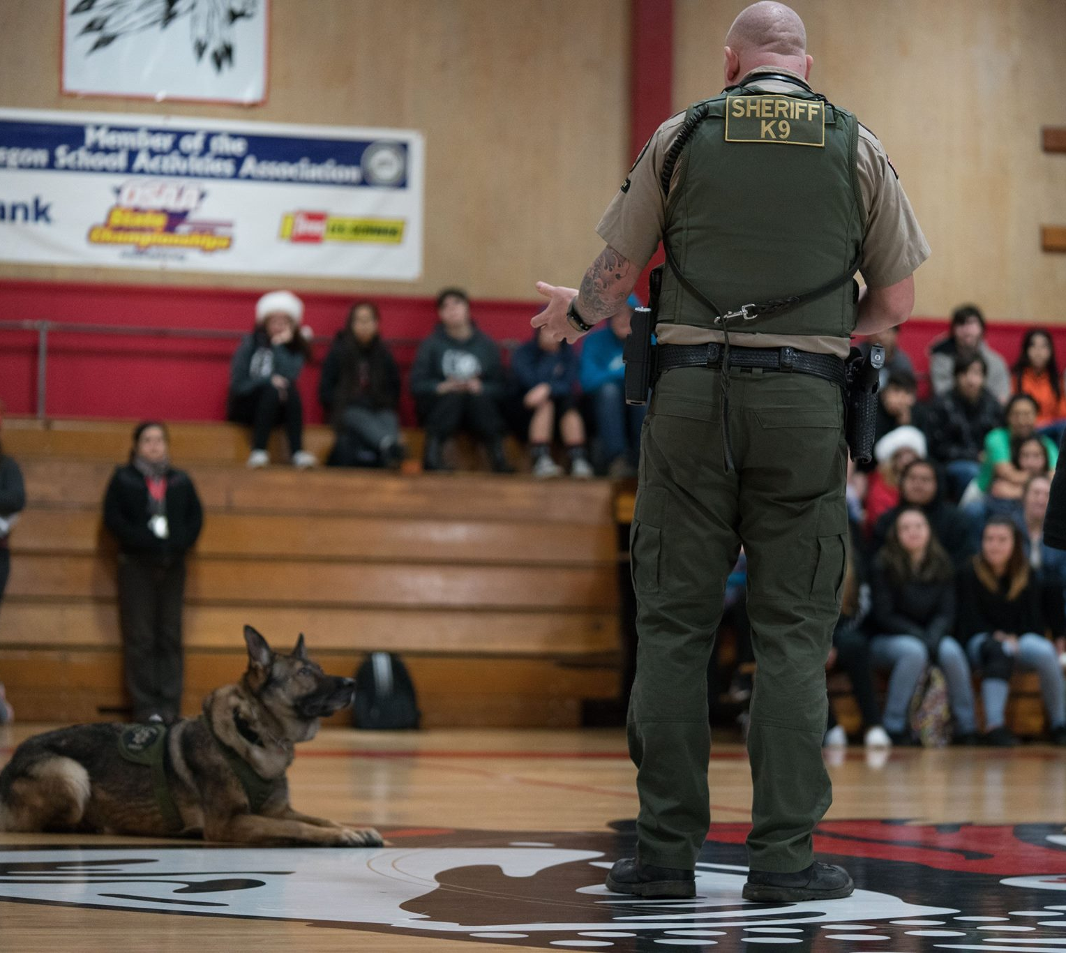
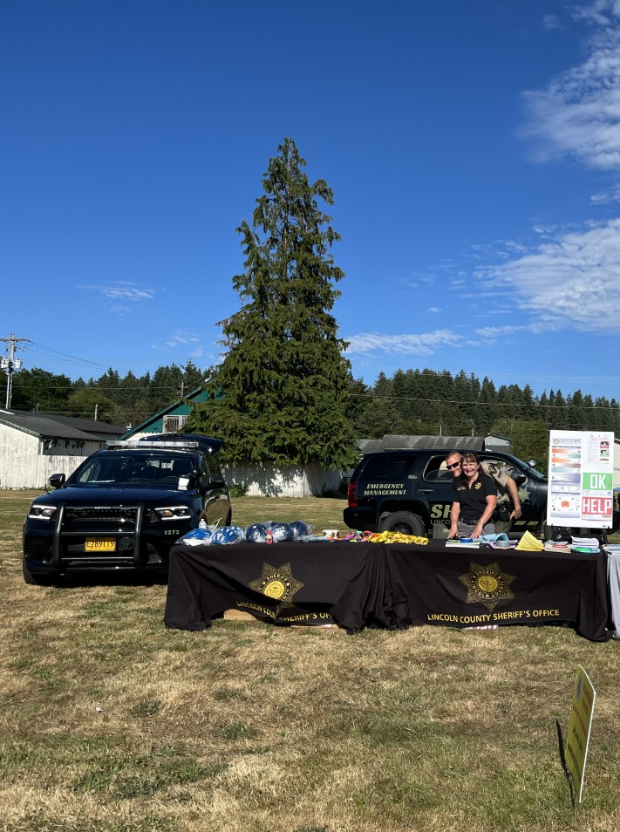
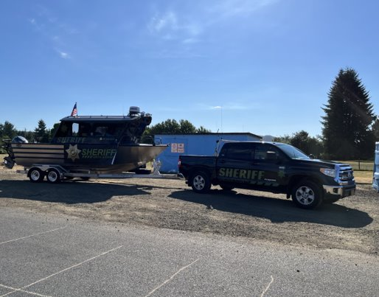
Recent Successes
  Attended community events throughout the year including National Night Out, Hot Summer Nights, Trunk or Treat, Pow Wow and Parade.
  Updated agreement with Confederated Tribe of Siletz.
  Cooperation with Confederated Tribes of Siletz Indians to act as Sergeant of Arms for Tribal Elections.
  Ongoing monthly meetings with stakeholders.

Slide 6
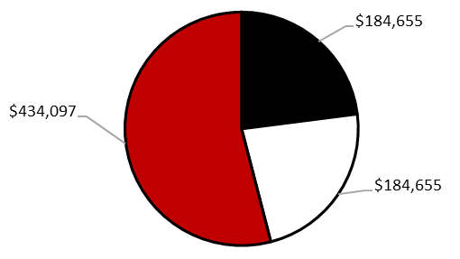
Siletz district expenses
Confederated Tribes of Siletz Indians
$184,655
Contingency Fund
$434,097
Property Tax
$184,655

Slide 7
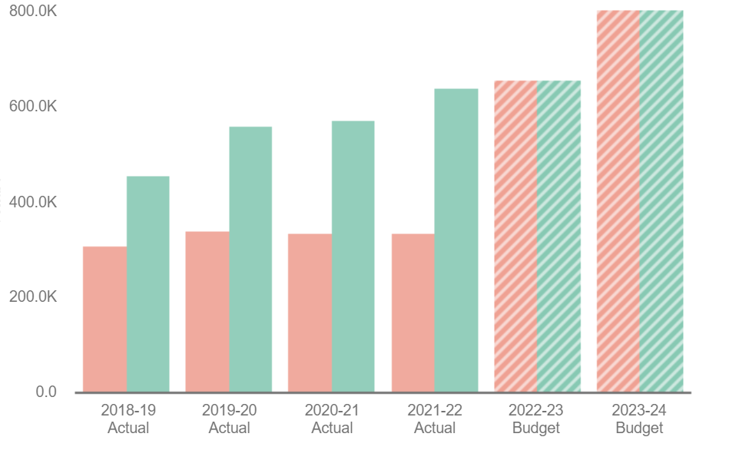



Siletz district
Expenses and Revenue
= Expenses
= Revenues
= Projected Expenses
= Projected Revenues

Slide 8
2022 Calls for Service
Animal Calls = 98
Assaults = 8
Burglary = 24
Domestic Violence = 62
DUI = 1
Illegal Parking Complaints = 12
Mental Health Related Response = 35
Missing Person = 5
Property Damage = 10
Runaways = 3
Sex Offense = 8
Stolen Vehicle = 6
Theft Complaints = 37
Traffic = 81
Traffic Crashes = 25
Trespass Complaints = 23
1,458 total calls for service
Top three (non-self initiated) calls:
  Animal (98)
  Domestic Violence (62)
  Theft (37)

Slide 9
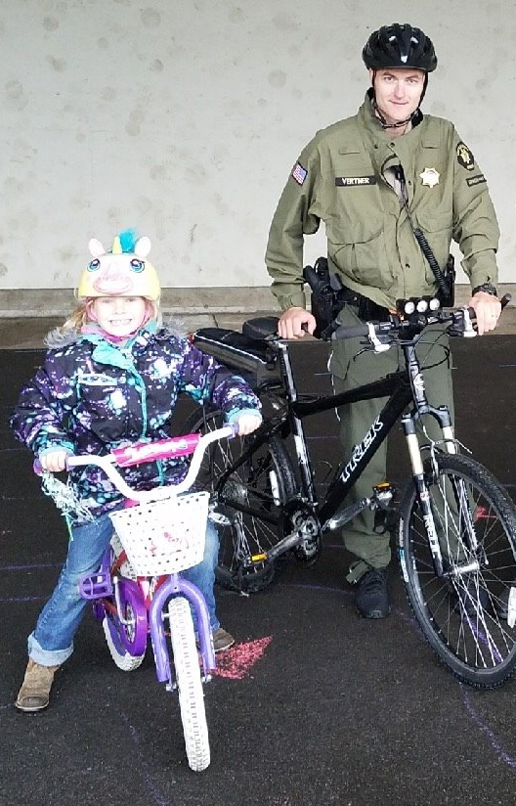
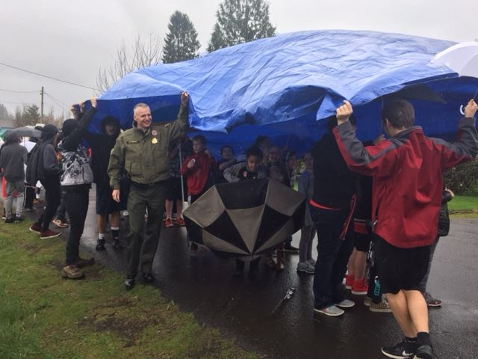
FY 2023-2024 Goals
  Participate in community events, including National Night Out and Pow Wow.
  Hold quarterly saturation patrol events.
  Acquire radar speed signs in specified zones in enhanced law enforcement district.

Slide 10

Contact Information
Sheriff Curtis Landers
lcsheriff@co.lincoln.or.us
541-265-0652
Lieutenant Karl Vertner
kvertner@co.lincoln.or.us
541-265-0681

