Slide 1
Community Justice
Director Tony Campa

Slide 2
Community Justice includes:
Juvenile
Work Crew
​Adult Parole and Probation
CJC Justice Reinvestment Grants
CJC-Specialty Courts Grants

Slide 3
Juvenile
This department provides public protections, positive intervention and worked towards reduction of juvenile delinquency.
This department provides non-behavioral shelter care for youth ages 12+, providing a co-ed home environment for up to 12 youth. This center operates 24/7, with 12 FTE Youth Care Specialists, 1 FTE Shelter Supervisor and several PTNB Youth Care Specialists to provide the needed staff coverage required by our license.
Funding Sources:
General Funds,
Oregon Youth Authority
Oregon Department of Human Services

Slide 4
Juvenile Accomplishments in 22/23
Partnering with the School District to provide prevention education
Community Outreach
Implementing Cultural Enrichment Opportunities
Youth served in the Tides Program increased by 12.5%.
Youth Tides average length of stay per youth in the program is about 62 days.
The average population remained stable.
Youth Tides staff has decreased in this program.

Slide 5
Juvenile- Future
Reduce Detention Bed Usage and Enhance Youth Services:
  Increase Prevention Services
  Continue to move away from Culture of punishment and confinement
    Provide support so Youth can thrive in home/home like settings in their community.
      Assist Youth with making stable connections with supportive adults and opportunities.

Slide 6
Work-Crew
Work-Crew program provides:
a lower cost alternative to incarceration,
  less likely to lead to future criminal behaviors,
  Ability for the Justice Involved Individual to continue pro-social/positive activities/changes in their lives.
    Community-based treatment can continue
    Home with family nightly
    Less/no disruption to employment/school schedule.
satisfy the community’s desire for retribution
  that can be scaled to the seriousness of the Justice Involved Individuals behavior/crime.
  hold justice involved individuals a way to be held accountable.
Providing beneficial services to the community
﻿Work sites include non-profit and government agencies.
Funding Sources:
General Funds
Program Generated Revenue

Slide 7
Work-crew ACCOMPLISHMENTS in 22/23
In 2022 Work-Crew program 5280 participant labor hours provided to the community. Assisting local city and state governments, county departments, school district with beautification, labor intensive projects throughout the county.

Slide 8
Work-Crew- Future
Continue to use evidence based, risk factors practices to deliver sure, swift, graduated sanctions to promote behavior change, using best practices.

Slide 9
Adult Parole and Probation
Supervise adults who have committed felony and specific misdemeanor crimes and have been placed under community supervision by the courts. Employing a focused supervision model and prioritize supervision resources following proven models that concentrates resources on medium and high-risk individuals. 62% of individuals in Lincoln County are classified as high or medium risk- using quantitative risk prediction tools.
Funding Source:
Parole and Probation is a function of state government, in partnership with county-operated Parole and Probation departments. Funding for these functions come from Department of Corrections.
General Funds support locally desired public safety functions. 1.30 FTE PPO position.

Slide 10
Parole and Probation Accomplishments 22/23
Population of Adults on Supervision in Lincoln County as of 7/1/2022
365 Felony Supervision, 73 Misdemeanor Supervision
Focusing resources on evidence-based practiced with the goal of reducing recidivism within Lincoln County. Increasing the number of downward departure clients.
Outcome Measures for High and Medium risk level supervised individuals:
Employment is 70% vs statewide/baseline 46%
Actively in Treatment is 58% vs statewide/baseline 28%
Restitution payments 67% vs statewide/baseline 17%

Slide 11
Parole and Probation future Accomplishments
Continue to Focusing resources on evidence-based practiced with the goal of reducing recidivism within Lincoln County.
Continue to meet or exceed Outcome Measures for High and Medium risk level supervised individuals.

Slide 12
Parole and Probation Future
  Continue to Focusing resources on evidence-based practiced with the goal of reducing recidivism within Lincoln County.
  Continue to meet or exceed Outcome Measures for High and Medium risk level supervised individuals.

Slide 13
Justice Reinvestment
This program targets individuals convicted of non-violent crimes and those accepted on short-term transitional leave from prison.
The goals of the program:
Reduce recidivism through evidence-based practices
Decreasing prison utilization for property, drug, and driving offenses
While protecting public safety
Holding individuals accountable
Funding Source:
Criminal Justice Commission Funding Opportunities (includes competitive grant)

Slide 14
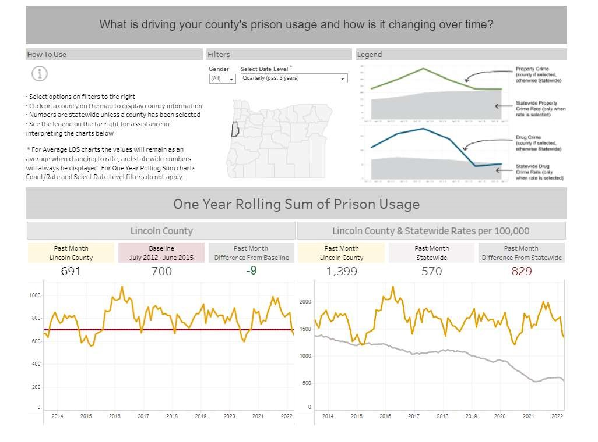
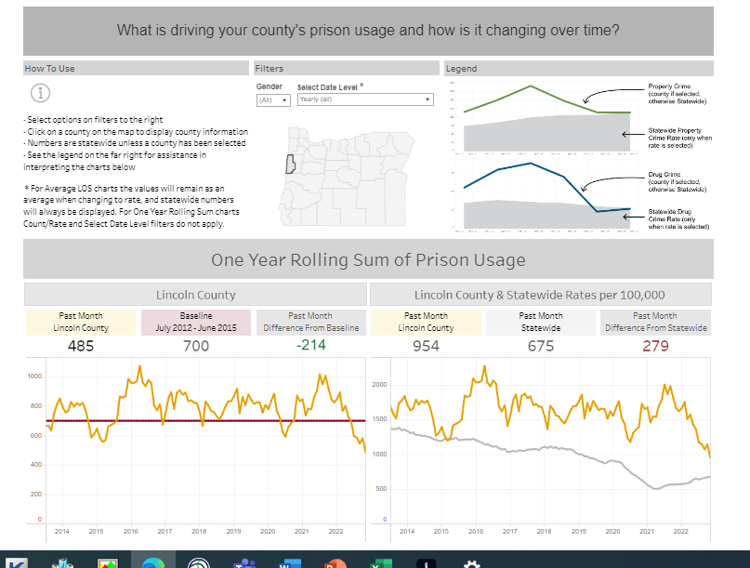
Justice Reinvestment achievements:
Comparing Lincoln Counties Prison Usage from April 2022 to April 2023-

Slide 15
Justice Reinvestment
Work toward keeping Prison intakes at or below baseline
Work toward imbedding equity throughout the county’s criminal justice system.

Slide 16
Specialty Courts
“Specialty Courts are problem solving courts that operate under a specialized model to provide court-directed supervision and mandated treatment to nonviolent individuals with substance use or mental health issues underlaying their criminal behavior.
Funding source:
Criminal Justice Commission Grant,
The Application process started in March, with due dates in April and June.
Three competitive grants were submitted for the three specialty courts in our county.
General Fund does support 0.50 FTE PPO

Slide 17
Specialty Courts
Goals and Priorities:
Increase the participants likelihood of successful rehabilitation through early, continuous and judicially supervised treatment, and community supervision.
Reducing substance use and recidivism among participants and embedding equity throughout the process

Slide 18
Specialty Courts Future
Assistance to Enroll or keep participants enrolled in OHP:
Grant required dedicated funding for services not covered by OHP or other private insurance. The Specialty Court team are working together to make sure eligible participants enroll in OHP as the Public Health Emergency expires.
Form Alumni Program for each of the three specialty courts
Increase DEI Committee participation
Offer DEI training
  DEI Diversity, Equity and Inclusion

