Slide 1

Parks
Overview
  Key Staff
    Roy Kinion – Public Works Director
    Kelly Perry– Parks Operation Supervisor
  Programs
    Park natural resource management and maintenance of all park facilities

Slide 2
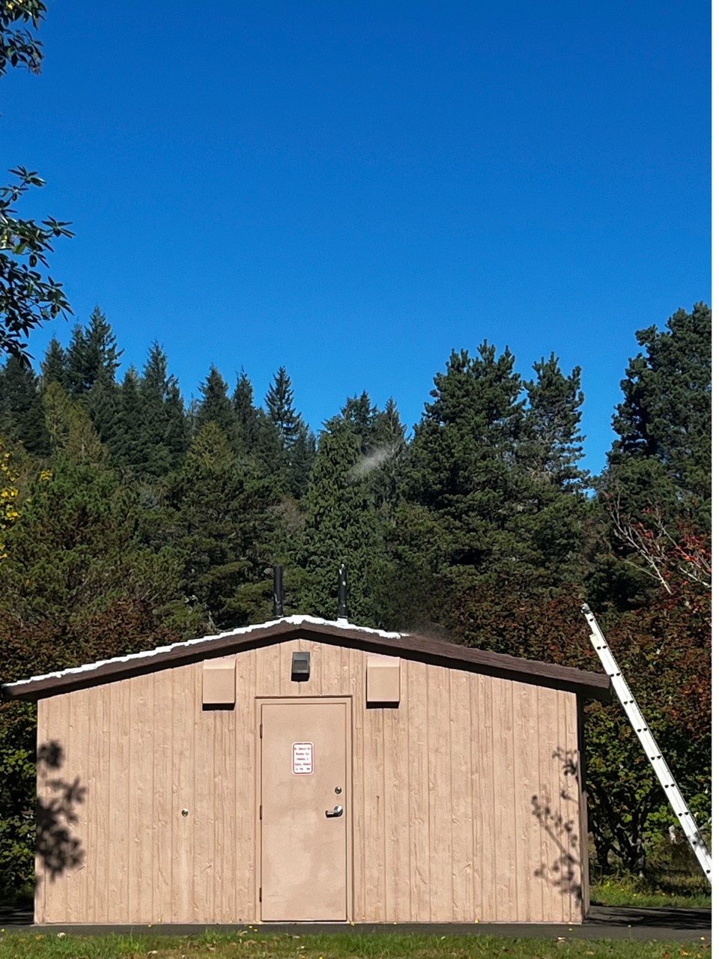
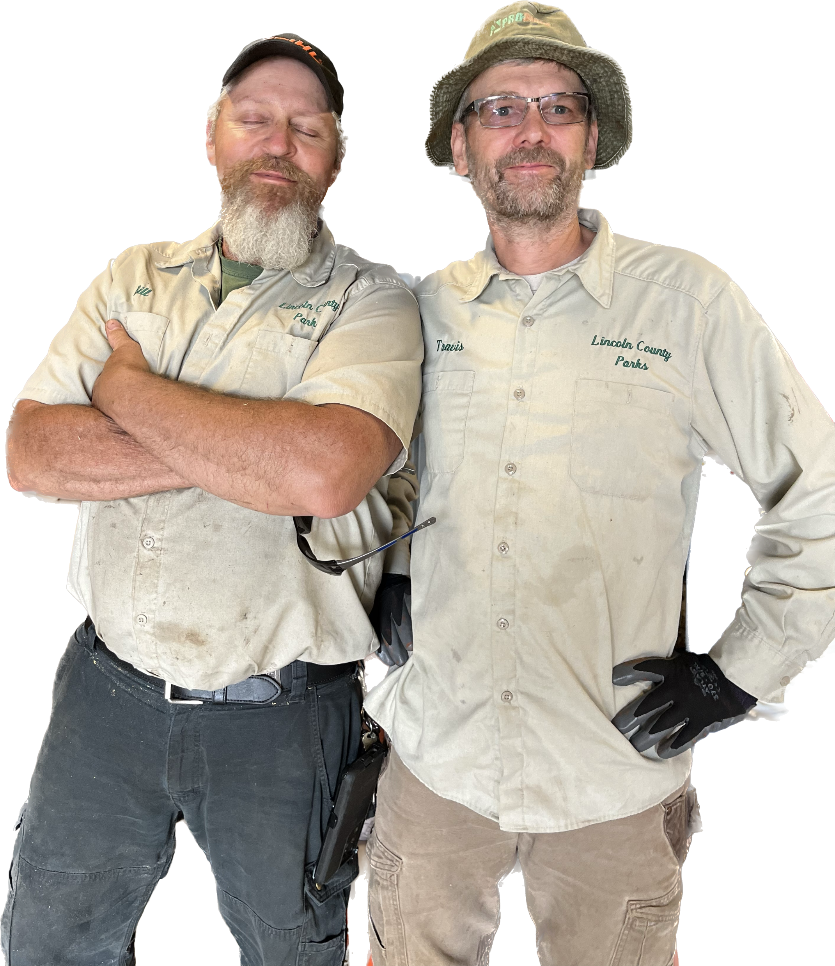
Parks
Accomplishments FY 2022/23
  Planted and restored 2 acres of stream front property
  Restored and repaired aging infrastructure at Moonshine Park
Department Metrics
  333 acres of parks
  ~16,000 people overnight in campgrounds
  ~3000 boaters accessing rivers via boat ramps
Travis Todd & Bill Clark – repairing Moonshine Park’s bathroom roof.

Slide 3
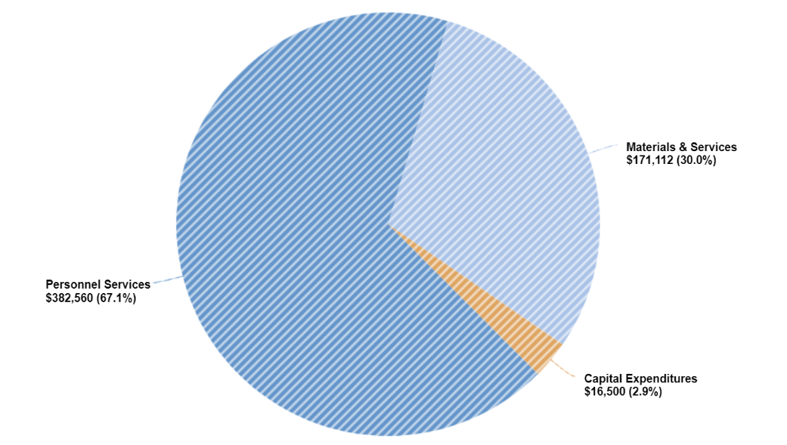
Parks

Slide 4
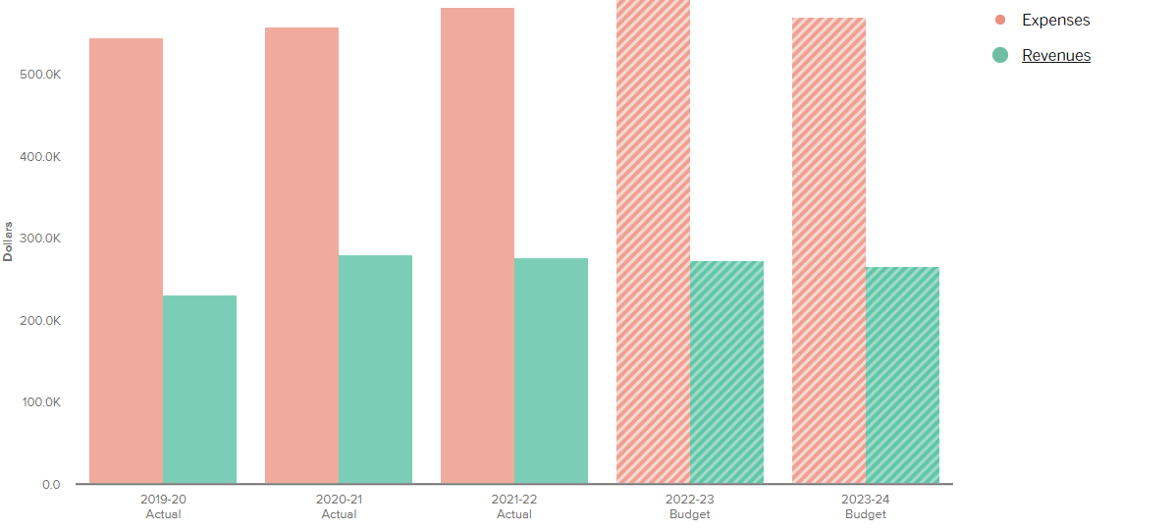
Parks

Slide 5
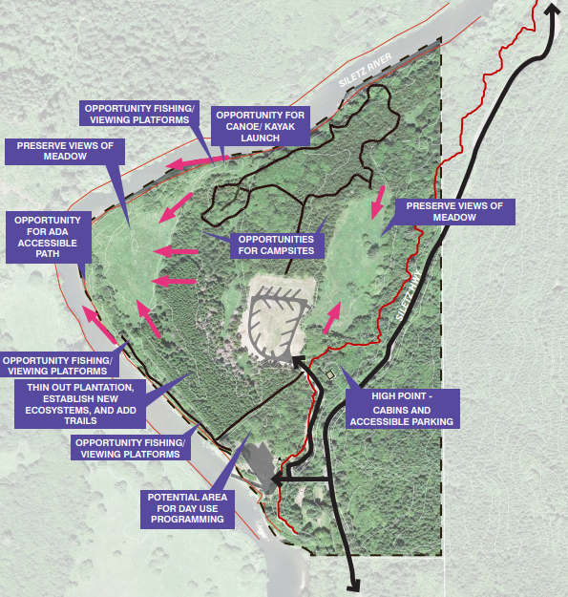
Parks
Future Achievements
  Sustainably manage natural areas
  Diversify Park amenities for all user groups
  Continue the development of Brown Park Campground
Concept design of Brown Park Campground

Slide 6
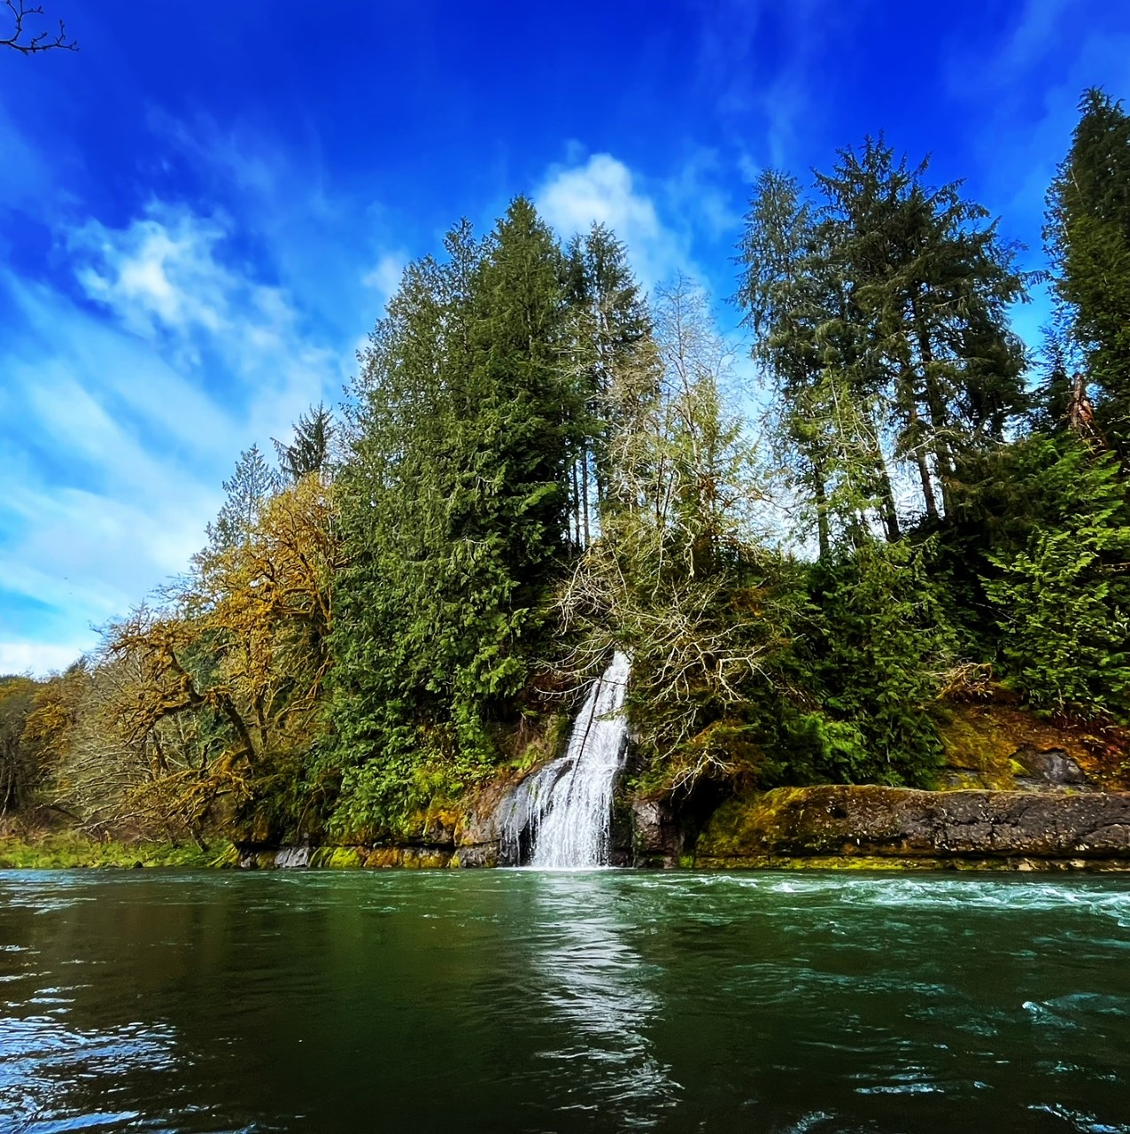
Parks
Questions & Answers
Moonshine Park waterfall and swimming hole.

