Slide 1

Vehicle Replacement Fund
Overview
  Key Staff
    Roy Kinion – Public Works Director
    Mark Malnack – Fleet Manager
  Program
    Providing a means to accumulate funding for future vehicle replacement for each General Fund department
    The vehicle replacement plan is monitored and implemented by the Fleet Services Department

Slide 2
Vehicle Replacement Fund
Accomplishments FY 2022/23
    The Vehicle Replacement Fund was able to replace 9 General Fund vehicles in Fiscal year 22/23.
Department Metrics
    There are 97 vehicles that are currently listed as part of this fund
    ﻿Approximately $300,000 is spent annually on vehicle replacement

Slide 3
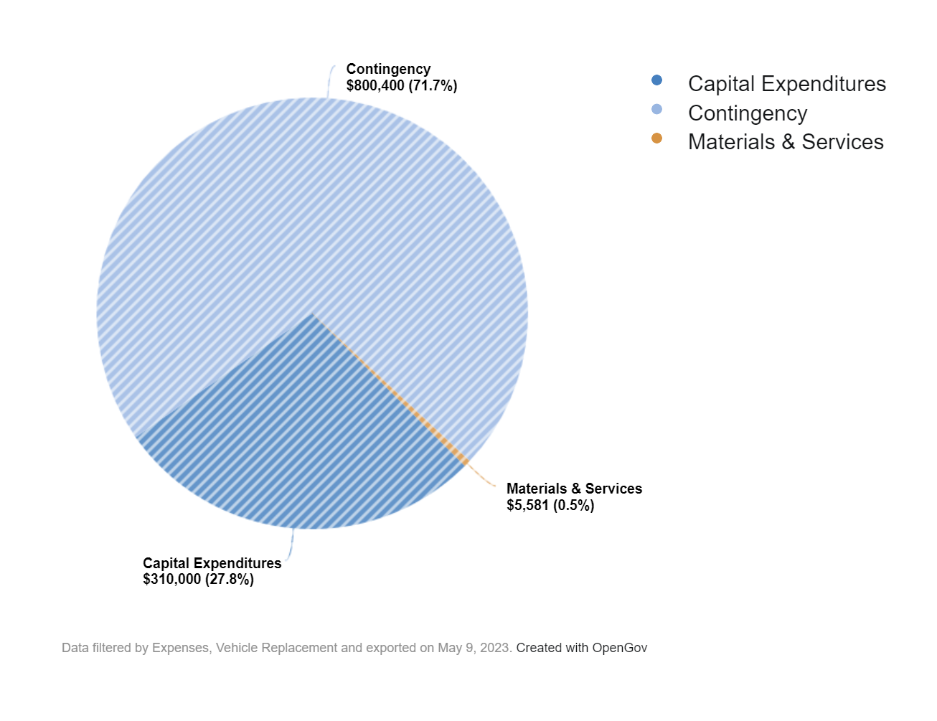
Vehicle Replacement Fund
Budget

Slide 4
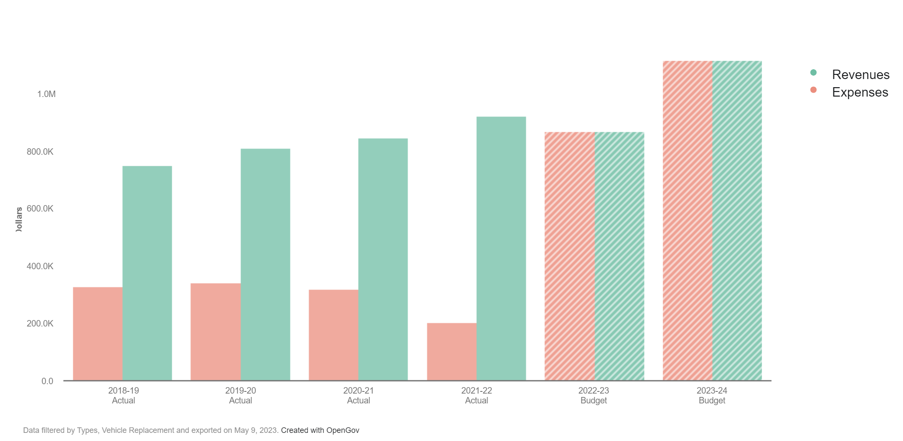
Vehicle Replacement Fund

Slide 5
Vehicle Replacement Fund
Future Achievements
  The Vehicle Replacement Fund will be replacing 6 General Fund vehicles in Fiscal year 23/24

Slide 6
Vehicle Replacement Fund
Questions & Answers

