Slide 1

Facilities Maintenance Services
Overview
  Key Staff
    Roy Kinion – Public Works Director
    Jack Whaley – Facilities Maintenance Supervisor
  Programs
    Maintain, supply, service and modify all existing county properties and equipment for all County facilities
    Provide project management and oversight for County Facilities Capital Projects

Slide 2
Facilities Maintenance Services
Accomplishments FY 2022/23
    Waldport Clinic acquisition
    Jail improvement and ADA modification
    COVID safety protocol implementation
Department Metrics
    Facilities Maintenance crew processes an average of 1400 unscheduled work requests annually.
    Facilities Maintenance crew performs approximately 1000 preventative maintenance functions annually.

Slide 3
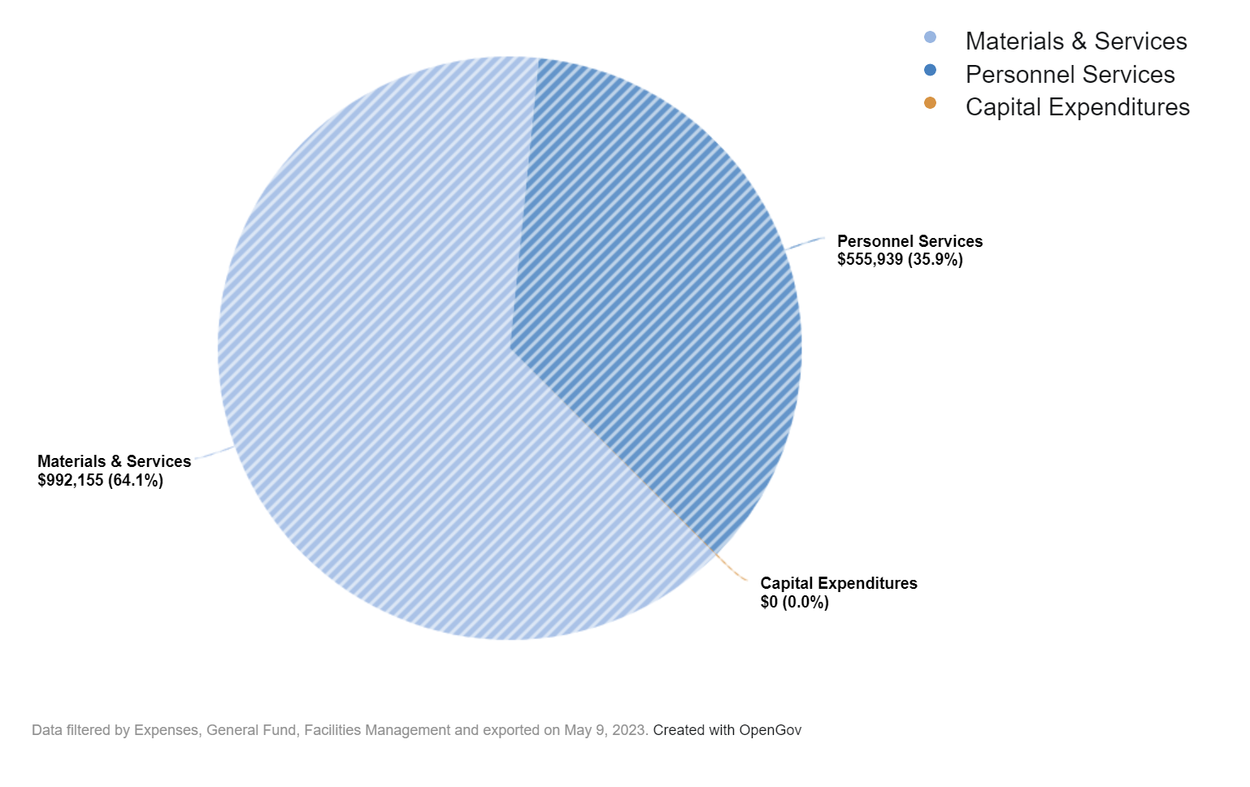
Facilities Maintenance Services
Budget

Slide 4
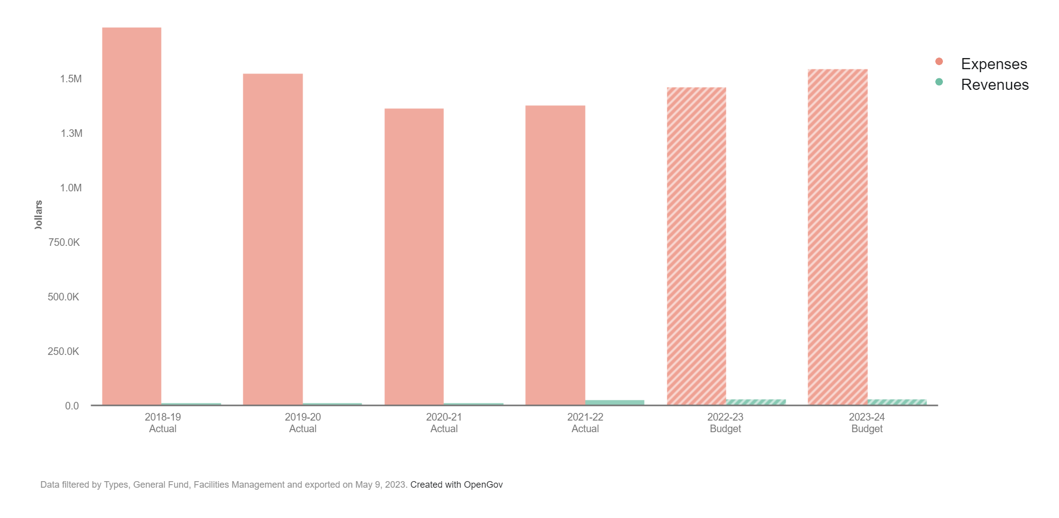
Facilities Maintenance Services

Slide 5
Facilities Maintenance Services
Future Achievements
  Expansion of the Facilities Maintenance Department to keep pace with growing County services and logistical requirements.
  ﻿Transit Office expansion
  Completion of Animal Shelter Relocation
  Implementation of Commons Master plan

Slide 6
Facilities Maintenance Services
Questions & Answers

