Slide 1

Lincoln County Solid Waste District
Overview
  Paul Seitz Solid Waste District Manager
  Divisions
    Forest Enforcement Program
    District Administration
  Programs
    Forest Program
    Waste Shed Education, Events, and Reporting
    Sustainability Community Support
    Abandoned RV Abatement Program
    Agate Beach Landfill Consortium

Slide 2
Lincoln County Solid Waste District
Accomplishments FY 2022/23
    Old Tire Roundup Event – 3,000 tires collected at 4 transfer stations
    Coastal Character Newsletter – Earth Day
    Home Compost Booklet
    Cleanup Resource Guide for Law Enforcement
    July 5th Beach Cleanup Event

Slide 3
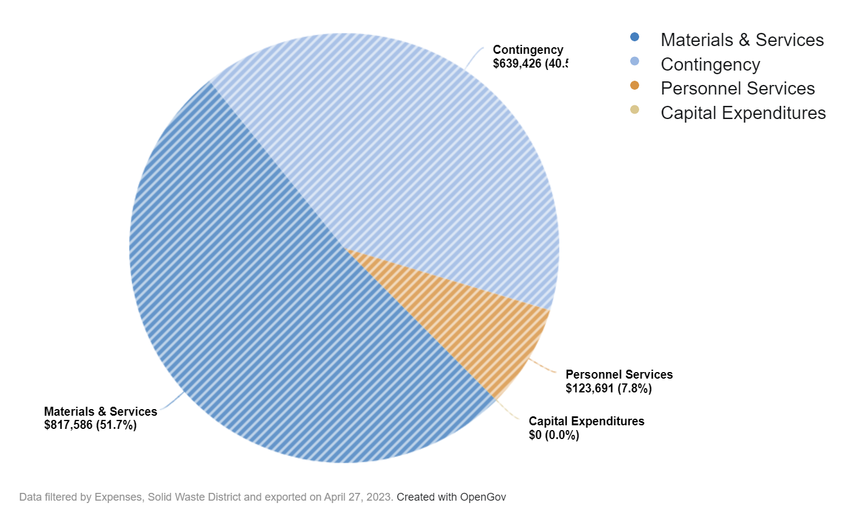
Lincoln County Solid Waste District
Budget

Slide 4
Lincoln County Solid Waste District

Slide 5
County Administration
Future Achievements
  Launch new Abandoned RV Abatement program
  Publish new household hazardous waste booklet focused on reducing purchase of toxic and harmful products
  Introduce new lithium batteries awareness campaign (HHW reduction)

Slide 6
County Administration
Questions & Answers

