Slide 1
Information Technology
The IT Department manages all computer, phone, and network services for the county. IT staff provides all levels of support to county users, while maintaining compliance with a number of audits.

Slide 2
Accomplishments FY2022/23
Finished migration to Office365 from Google apps. This year has been focused on security and stability of the system.
Annual replacement of hardware, over 100 machines were imaged and deployed.
Upgrade to our firewall and implementation of MFA.
Upgraded our network core to new equipment.
Expanded our backup systems to include cloud locations.
Deployed MFA to VPN and Office365.

Slide 3
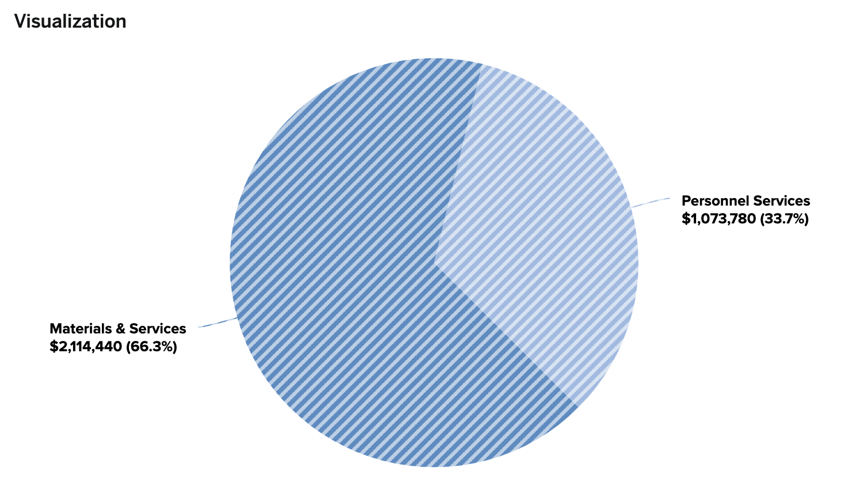
IT Budget 2023/24

Slide 4
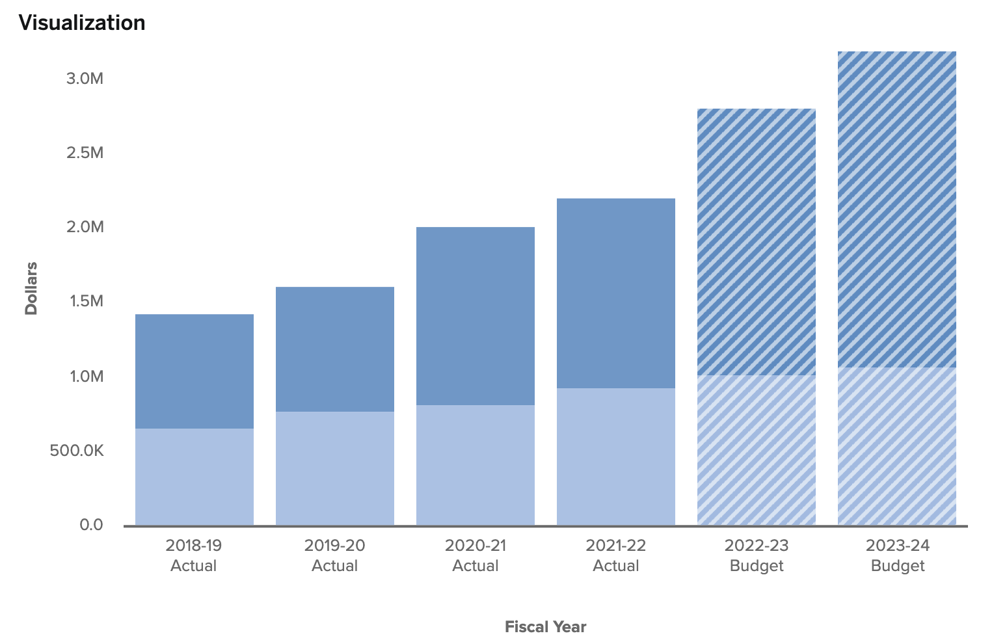
IT Budget Over Time

Slide 5
2022/2023 Achievements
Helpdesk support
Network support
Application support
Phone system support
Long term planning
Audit support
Remote access and mobile workforces support

Slide 6
Future Achievements
Finish deployment of MFA
Development of a redundant site
Implementation of new log management
Development of a Disaster Recovery Plan
Continued work on compliance

Slide 7
Questions ?

