Slide 1
Finance & Accounting
FY24 Proposed Budget
Christina Shearer
Finance Director

Slide 2

Primary Responsibilities
Financial Accounting
Budget Development, Management, & Reporting
Payroll
Accounts Payable
Audit Coordination

Slide 3

FY22-23 Accomplishments
Budget Software
Process Stabilization
Selection, Configuration, & Deployment of OpenGov Software
Training and Process Coordination
Publication of Lincoln County’s first Online Budget
Completed transition to Incode payroll implementation
Completed first full year of Bi-Weekly payroll
Enhanced Budget Calendar and development process
Coordinated development of Revenue Forecast model

Slide 4
FY22-23 Accomplishments
Mandatory Deliverables
Countywide Financial Support
Tax Reporting (1099, W-2, Quarterly Payroll)
Audit Fieldwork preparation and supporting schedules
Budget Certifications & Notices
Indirect Cost Allocations
Ad Hoc analysis
  Animal Shelter
  Planning
Continued deployment/refinement of project accounting
  Grants
  Special Purpose tracking
Collective Bargaining financial analysis

Slide 5
FY24 Proposed Budget

Slide 6
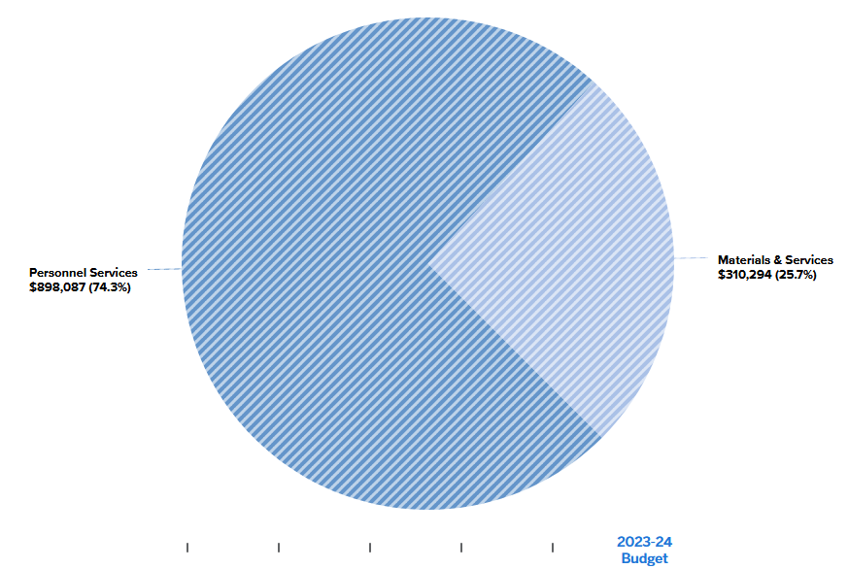
Finance Budget by Category

Slide 7
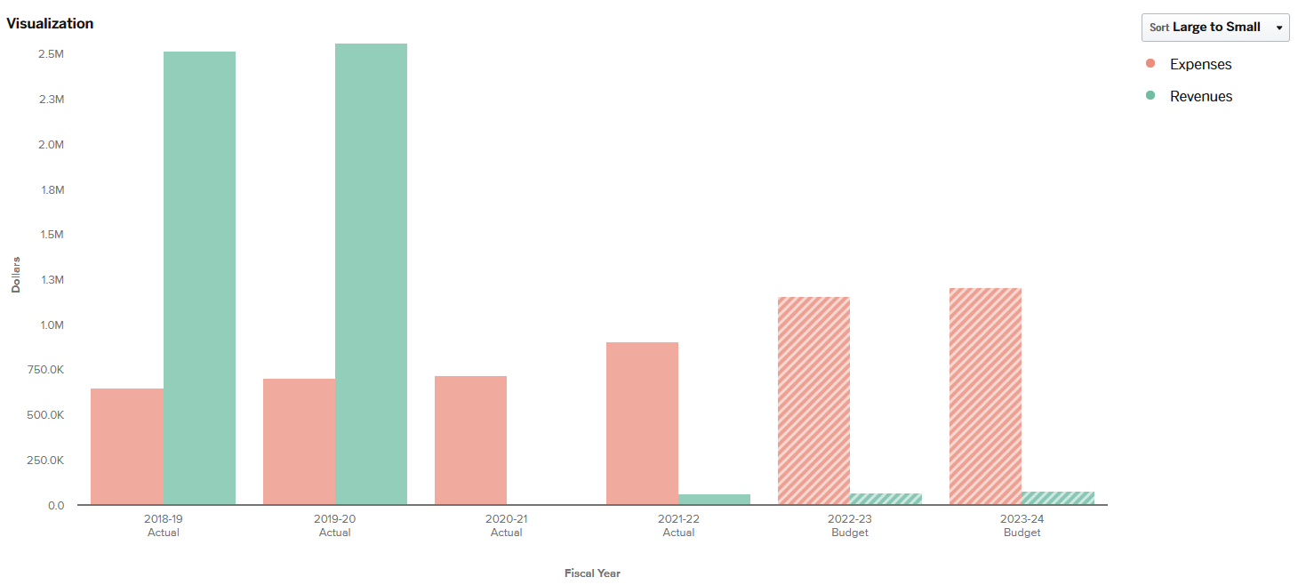
Finance Budget History

Slide 8
Looking ahead to FY24
Cost Accounting
OpenGov
Financial Software
Develop uniform methodology, policies & procedures for allocation of direct and indirect expenses
Establish framework for determining full cost of all operational departments
Evaluate potential software resources
Explore possibilities for Internal Service Fund(s)​
Create process & procedures for mid-year budget adjustments
Create standardized budget to actual reports for managers & other users
Create Dashboard for County Administration/ Board of Commissioners
Reconfigure Incode security profiles to better utilize available features
Evaluate opportunities to decentralize routine fiscal activities
Review Pooled Cash configuration to streamline & modernize (joint project with Treasurer’s office)

Slide 9
A budget is more than just a series of numbers on a page; it is an embodiment of our values.
-Barack Obama

Slide 10

THANK YOU
Christina Shearer​, Finance Director
cmshearer@co.Lincoln.or.us
www.co.Lincoln.or.us/204/Finance-Accounting

