Slide 1

Human Resources
David Collier, HR Director

Slide 2

Human Resources
Major Activities
Recruitment and retention
Employee relations
Administration of:
  Benefit plans
  Classification plans
  Compensation Plans
Promoting a safe and healthy working environment
Ensuring compliance with applicable employment laws

Slide 3

Human Resources
Accomplishments FY 22/23
Provided a baseline supervisor training to all supervisors
Streamlined the Onboarding process
Onboarded 117 employee in 2022

Slide 4
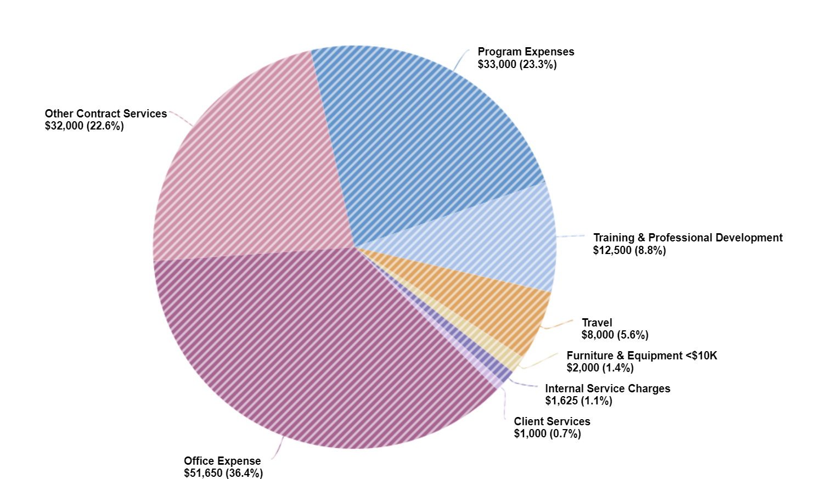
Human Resources
Budget
Notes:
Office Exp
Maint. Agreements $45k
Office Supplies $4k
Print. & Public. $1,700
Postage$500
Telephone $400
Other Contract Services
Professional Services $30k
Contractual Services $2k
Program Exp
Employee Training $21k
Other Supplies $5k
Special Events $4k
Tuition Reimbursement $3k
Training and Prof. Dev.
Prof. Conf. $5k
Cont. Edu. $5k
Membership & Dues $2,500
Travel $8k
Furniture % Equipt. $2k
Internal service Charges $1625
Client Services-Med Lab $1k

Slide 5
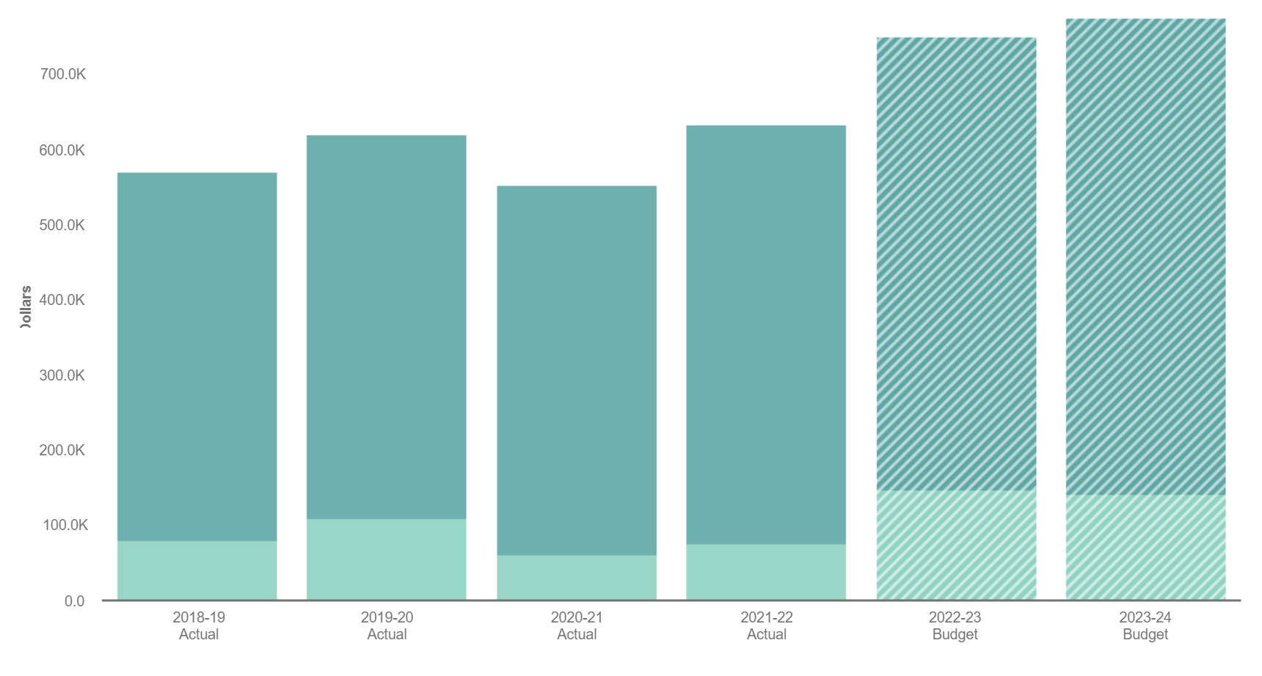
Human Resources
Budget by Year 2019-2024
Notes:
Increased expenses as we have come out of the pandemic and are trying to catch up on training.
Added Onboarding software
HR fully staffed and all employees take benefits.

Slide 6
Human Resources
Goals and Objectives FY 23/24
Continue County wide trainings
Reduce “Time to Fill”
Roll out Paid Leave Oregon Equivalent Program
Notes:
Continue to work on supervisor training
PLO equivalent plan will provide a small savings to PLO plan, but we believe it will provide better service to our employees

Slide 7

Human Resources
Metrics FY 23/24
Time to Fill-112 days for 2022
Benefits as a percentage of salary falls between 40% and 68% for an individual making $65,000.
Notes:
The benefit cost varies depending on if the individual has single coverage or family coverage. The percentage also would be greater if the individual earns less and less if the individual earns more.

Slide 8
Human Resources Team
Tianna Al-Khodhair
HR Assistant
Nan Buck
HR Generalist
Jayleen Cook
Asst. HR Director
Daniel Martinez
HR Assistant
Notes:
Tianna is our lead recruiter
Nan is our benefits, ADA, and workers’ comp expert
Jayleen is our compensation and classification guru
Daniel is in charge of administrative duties

Slide 9



Summary
The Human Resources department provides support to internal and external customers on all personnel related matters from hire to retire. As Human Resource professionals, we assist employees, supervisors, and the Board of Commissioners in interpreting County rules, policies, and procedures as well as assist with negotiations and the administration of collective bargaining agreements.
Notes:
We work very hard to get employees the information they need to navigate our systems and we work hand in hand with County Counsel to make sure the County adheres to legal obligations.

Slide 10

The way to get started is to quit talking and begin doing.
The way to get
started is to quit talking and begin doing.
Walt Disney
Walt Disney

Slide 11


Thank you
David Collier
dcollier@co.Lincoln.or.us
www.co.Lincoln.or.us

