Slide 1

Local Communities
Voluntary Agencies/Houses of Worship
County Emergency Managers
State of Oregon
Oregon Voluntary Organizations Active in Disaster (OR VOAD)
FEMA
Partnering Together to Support Long Term Recovery
For Individuals and Families
Notes:
For Individuals to achieve successful long term recovery following a disaster requires a team effort from the “Whole Community” beginning neighbor helping neighbor during the response to the event
Partnering begins with relationship building and sharing business cards in blue skies allowing time for understanding capabilities, capacity, limitations and flexibility of partners.

Slide 2
Definitions/Basis of Understanding
VOAD: Voluntary Organizations Active in Disaster (VOAD)-a consortium of recognized volunteer groups who work within a defined area (local, county, regional, etc.) in all phases of an emergency-generally in concert with a local Emergency Operations Plan.
COAD: Community Organizations Active in Disaster (COAD)-generally the same purpose as a VOAD but may have more localized partners and are more comfortable utilizing the word Community
LTRC/LTRG: Long Term Recovery Committee or Group-a group that comes together to provide disaster assistance to individuals and households in both the immediate response through however long recovery lasts. Many times, the members within the LRTC/LTRG are the same that would be in a VOAD/COAD but these groups serve different purposes.
Notes:
In order to understand the partners needed to support Long Term Recovery for Individuals and families it is important to understand the different kinds of assistance available to support efforts from preparedness through long term recovery

Slide 3
How does an LTRG help applicants?
Gets help to those that need it.
  Non-governmental organizations can help provide direct assistance to individuals and households in many more ways than government can.
One Stop Shop
  For disaster survivors, they can go to one place to get help instead of calling around and becoming frustrated with the process. It also avoids duplication of benefits among groups.
A quickly fixed community is a win!
  Helping a community recover from a disaster isn’t just an emergency management problem-it’s a community problem. Everyone can help!
  Find those in the community willing and able to work with volunteers and volunteer groups. Again, everyone can help!
  It takes a lot of resources human and financial to support successful recovery the more resources available the better for the recovery for the survivor and the community
Notes:
Everyone in a disaster impacted community needs support including emergency management
Non-governmental organizations can provide services and resources not available from government resources with a flexibility not existing in government processes
When everyone works together the disaster survivors benefit by only going to one place to get the additional services and resources needed
FEMA is concerned about duplication of benefits and having voluntary organizations providing funding already provided through government programs
Everyone can support resource management, understanding the resources available and needs identified and sharing that information produces solutions that extend resources
Everyone should be involved in seeing individuals in their neighborhoods recover, when individuals recover well the community is more resilient

Slide 4
EMERGENCY MANAGEMENT FUNCTIONS
Prevention
Preparedness
Mitigation
Response
Recovery
Long Term Recovery
Pre-incident
Incident
Post Incident
Notes:
You are emergency managers and are familiar with the functions of emergency management.
Traditionally Emergency Management is heavily involved in prevention, preparedness, mitigation, response, and some recovery but long term recovery is new for some of you
Long Term Individual Recovery is achieved through a Long Term Recovery Group that comes together to combine and share resources, volunteer labor, and services to help individuals and families

Slide 5
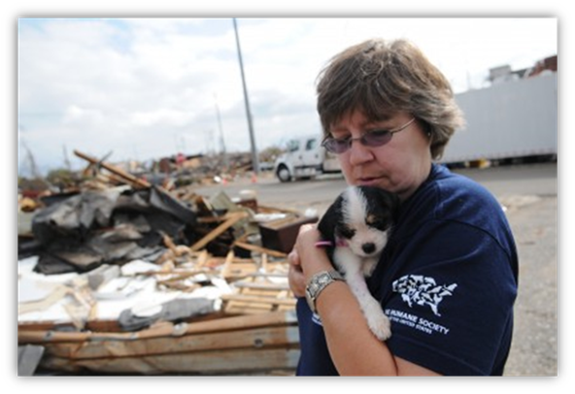
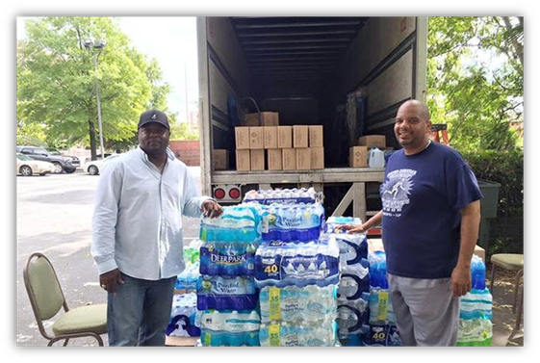
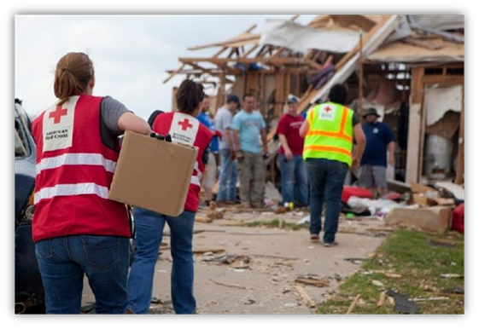
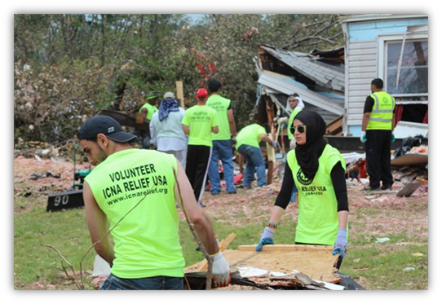
The 4 C’s of National VOAD
Communication
Collaboration
Cooperation
Coordination

Slide 6


All disasters are local
They begin in your own home
Neighbor helping Neighbor
Then
Regional COAD or VOAD
Local Non-governmental organizations
Houses of Worship
Individuals
Non Profit Organizations
Notes:
Disasters are Local
Immediately following an event you will find everyone taking care of their families then neighbors begin checking on each other as emergency management begins to respond
Local voluntary organizations, houses of worship, individuals, and private sector partners begin to provide emergency services and supplies
When the event exceeds the ability of the local resources to respond they reach to the regional COAD/VOAD
When those resources and services prove inadequate to meet needs State VOAD partners are engaged
In some cases the resources are not sufficient and National level VOAD partners will become engaged to provide additional resources

Slide 7
Long Term Recovery Group Structure/Functions
Fundraising
Budget
Policy Advocacy
Needs
Assessment
Public Affairs
Information
Case Management
Information Technology
Management
Volunteer
Management
Construction Management
Memberships
Donations
BOARD
EXECUTIVE BOARD
Spiritual
and
Emotional Care
CHAIRPERSON
VICE-CHAIRPERSON
SECRETARY
TREASURER
Executive Board
Notes:
The organizational model of recovery from a voluntary organization perspective is collaborative, consensus building based on relationships
It is more incident coordination than the government model of Incident Command

Slide 8
Response
Access and Functional needs Durable and emergency Medical
Food/Shelter
Recovery
Disaster Case management
Long Term Recovery
Home repair and rebuild
Resilience Programs for Caregivers and the Community
Health and Safety
Disaster Clean-up
Debris Removal
Referrals for ongoing social services needs and mental health services
Clean up supplies
Personal Property
Volunteers and Donations Management
Replacement of Personal Property UN-met Disaster Caused Needs
Needs Assessment
Spiritual and Emotional Care
Spiritual and Emotional Care
Durable Medical
Disaster Case Management
Volunteers and Donations
Points of Distribution
Disaster Child Care
Disaster Child Care
Emergency Supplies
Disaster Case Work
MARC (Multi Agency Recovery Center)
Training and additional resources
Donations and Volunteer Management
Voluntary Agency Services Timeline
Notes:
Voluntary Agencies offer services through all phases of disaster and can be counted on to support disaster survivors throughout

Slide 9
The Recovery Process
Voluntary Emergency
Assistance
Insurance
Individual Household Program/ Housing Assistance (IHP/HA)
Small Business Admin. (SBA)
Other Need Assistance (ONA)
State Unmet Needs
Long Term Recovery
Group
Notes:
Sequence of delivery on screen

Slide 10
Sequence of Assistance
Voluntary Organizations
Food
Shelter
Clothing
Medical
Clean Up
Insurance
Homeowners
Renters
Flood
FEMA
Temporary Housing
Repair
Medical
Dental
Funeral
Child Care
SBA
Home loan
Real Property Loans
Personal Property Loans
FEMA
ONA
Personal Property
Moving and Storage
Transportation
Group Flood Insurance
LTRG
Disaster caused unmet needs

Slide 11
Why is the sequence of Assistance Important to me?

Slide 12
Resource Management
LTRG
FEMA
Disaster Case Management
Applicant Resources
Community Resources
State
Disaster Survivor Achieves Successful Recovery

Slide 13
FEMA Disaster Assistance Sequence of Delivery
Voluntary Agencies and Mass Care
Emergency Food, Shelter, Clothing, Medical Needs, Emergency Repairs, Clean Up Supplies
Insurance
Homeowner, Renter, Flood, etc.
Federal assistance may be available for uninsured or underinsured needs, or when insurance benefits are significantly delayed*
FEMA Housing Assistance
Financial: Lodging Expense Reimbursement (LER), Rental, Repair and Replacement Assistance
Direct: Multi Family Lease and Repair (MLR), Minimal Home Repair (MHR), Permanent Housing Construction (PHC)
FEMA/State/Territory/Tribal Government Other Needs Assistance (ONA)
Non-SBA (Small Business Administration) Dependent Items
(Funeral, Medical, Child Care, Other)
Notes:
The FEMA Sequence of Delivery is an important tool to understand non duplication of benefits, resource management and the role of voluntary agencies/organizations
The sequence begins with Voluntary organizations

Slide 14
FEMA Disaster Assistance Sequence of Delivery
SBA Income Evaluation (Repayment Capability)
To determine if the applicant can qualify for a low-interest loan.
The applicant must complete the SBA loan application and be denied for a loan to be eligible for further FEMA assistance
SBA Referral
For SBA Dependent items and those applicants who qualify for a low interest loans
Real Property (owners) loans up to $ 200,000
Personal Property (owners and renters) loans up to $ 40,000
*If it is later determined that an applicant cannot qualify for a loan, the applicant is referred back to FEMA
FEMA/State ONA
SBA-Dependent Items
For those applicants who do not qualify for a SBA loan.
  Personal Property
  Transportation
  Moving and Storage
  Group Flood Insurance Policy
Unmet Disaster Caused Needs-Voluntary Organizations
FEMA will coordinate with whole community partners to address remaining unmet disaster caused needs once and applicant has received all Federal assistance for which they are eligible
Notes:
And ends with voluntary organizations

Slide 15
Local Lincoln County Contact Information
Lincoln County Emergency Management
541-265-4199
vdemaris@co.Lincoln.or.us
**This presentation was sponsored by the Office of Oregon Emergency Management and Federal Partners
Notes:
If you need additional information or support please contact:

