Slide 1
Saving Lives
Lincoln County Animal Shelter Medical Fund

Slide 2
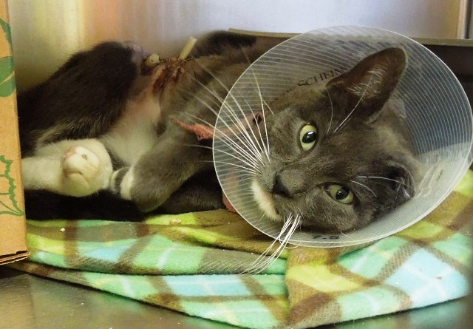
Abner had an abcess removed

Slide 3
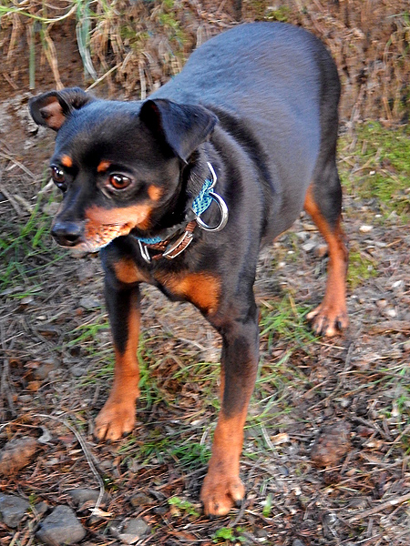
Gator had extensive dental disease

Slide 4
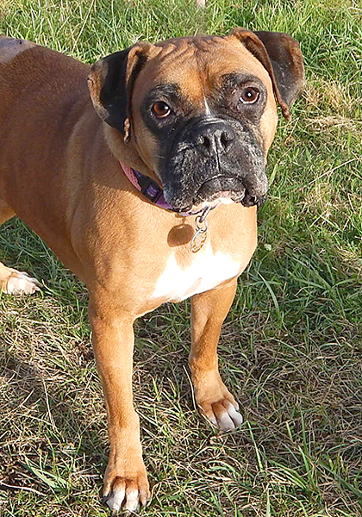
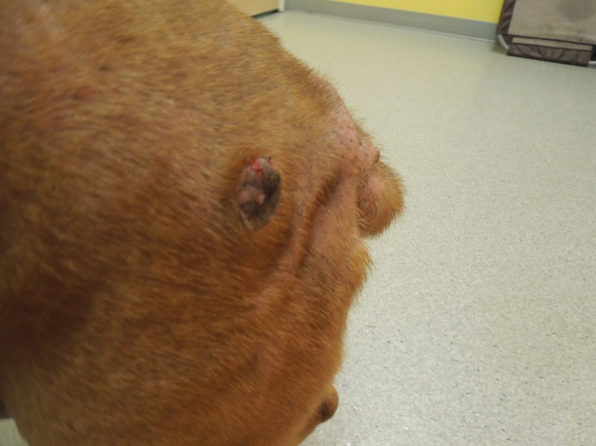
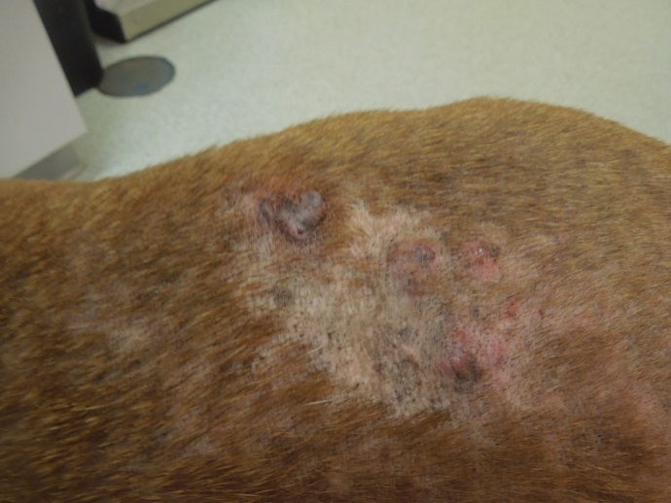
Resolved Dixie’s skin infections

Slide 5
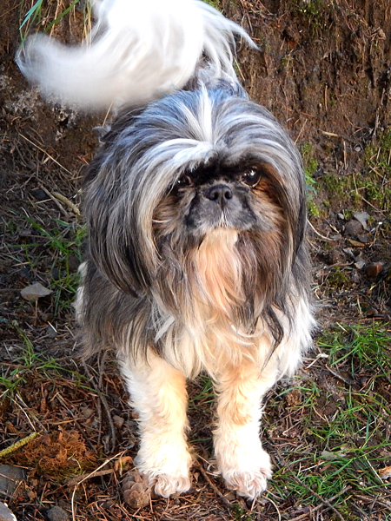
Molly had dental disease

Slide 6
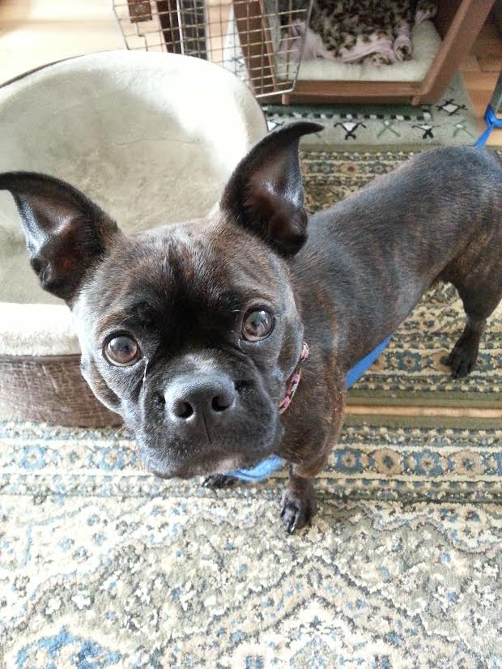
Jackson’s broken pelvis

Slide 7
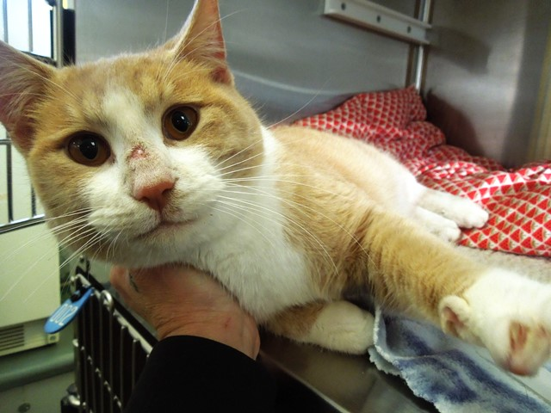
Rasta’s injuries

Slide 8
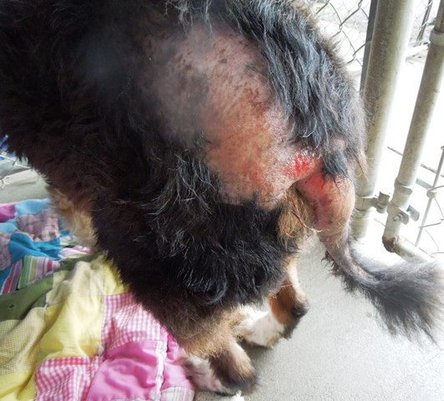
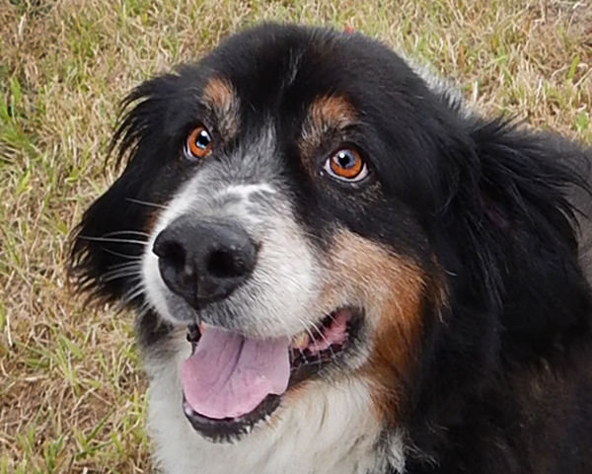
Bernie had severe flea allergy dermatitis and infections

Slide 9
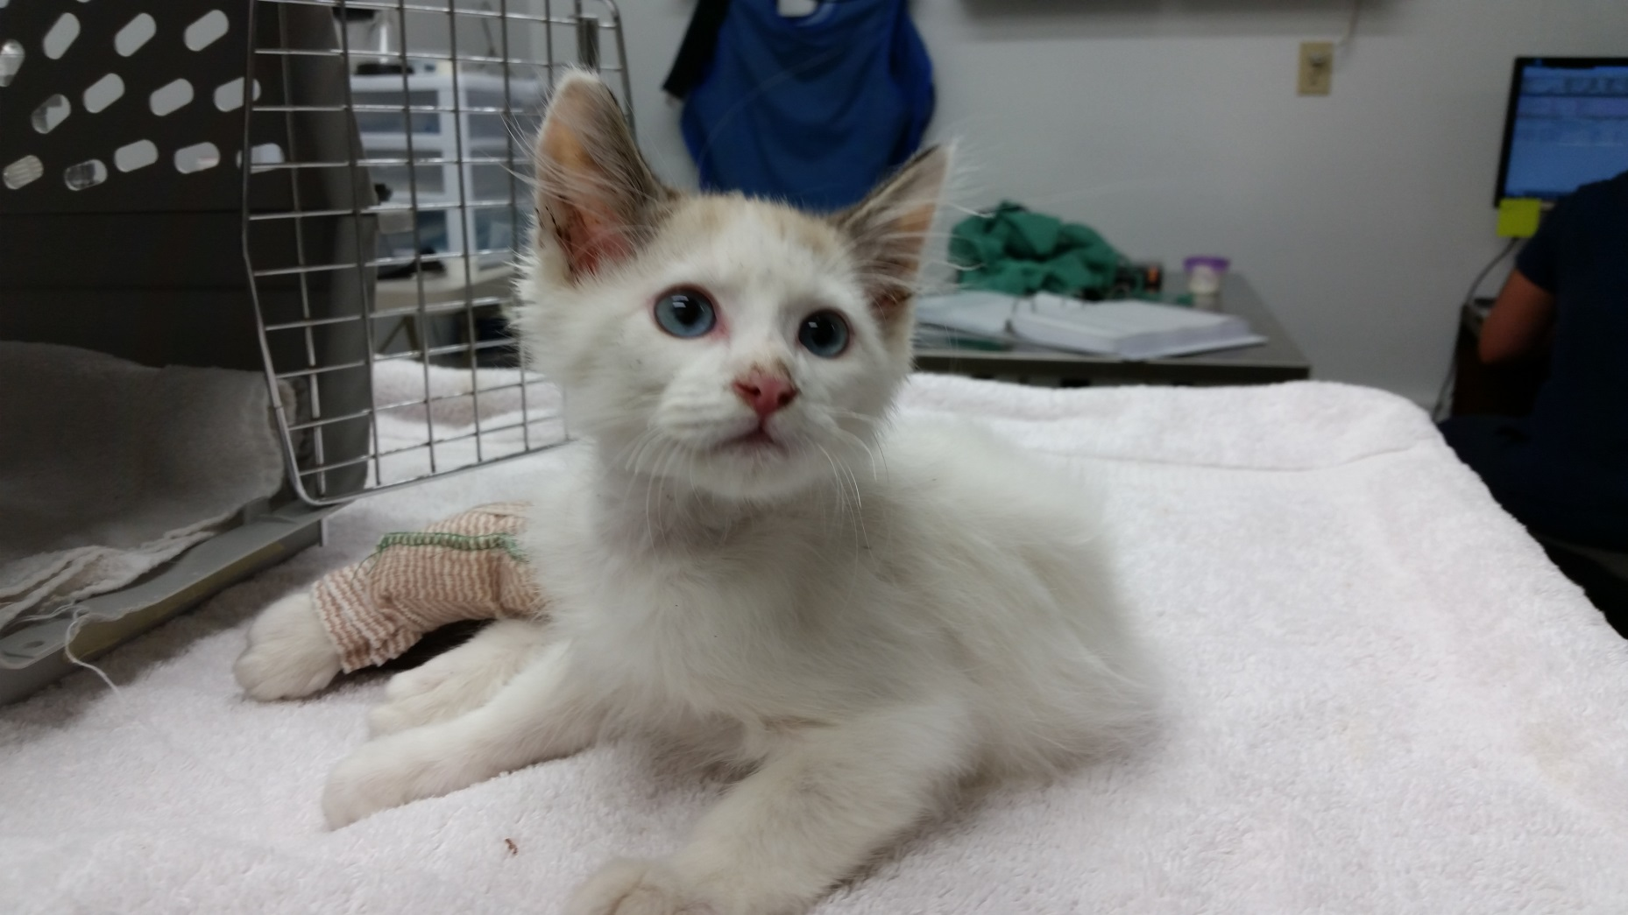
River Pup’s broken leg was amputated

Slide 10
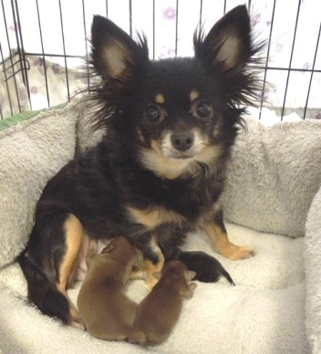
Mariah had an emergency C-section saving her and her three puppies

Slide 11
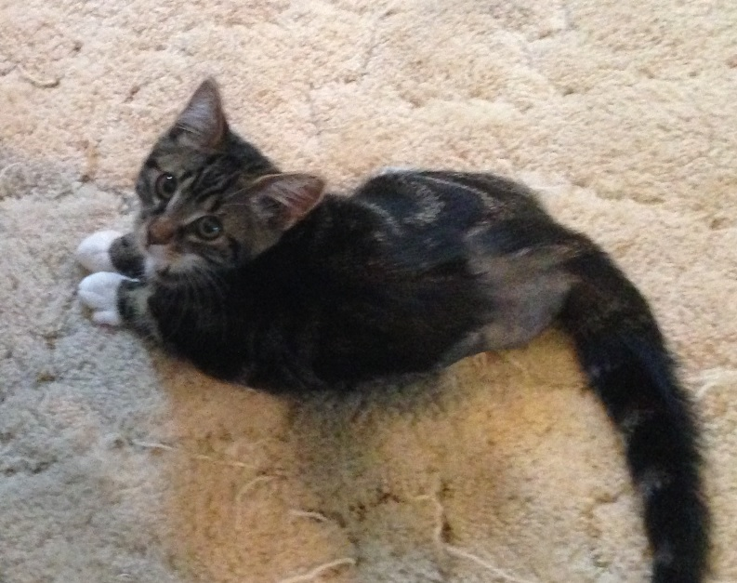
Skippyjon Jones had his leg amputated after being hit by a car

Slide 12
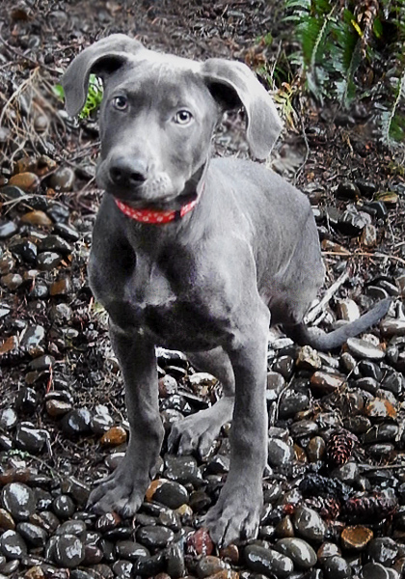
Kenai’s leg amputation

Slide 13
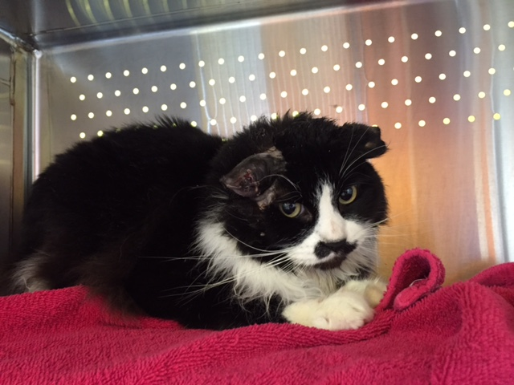
Dumbo’s severe ear infection was healed

Slide 14
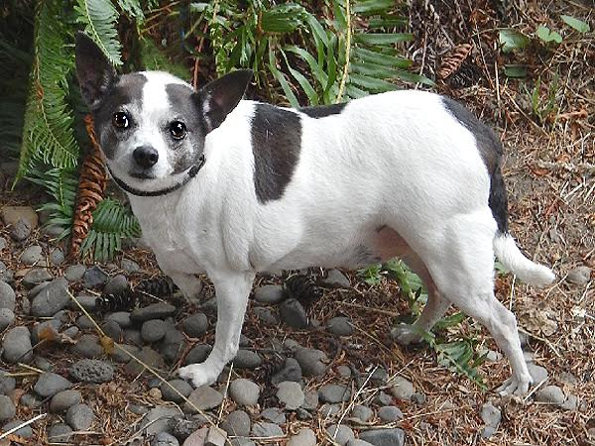
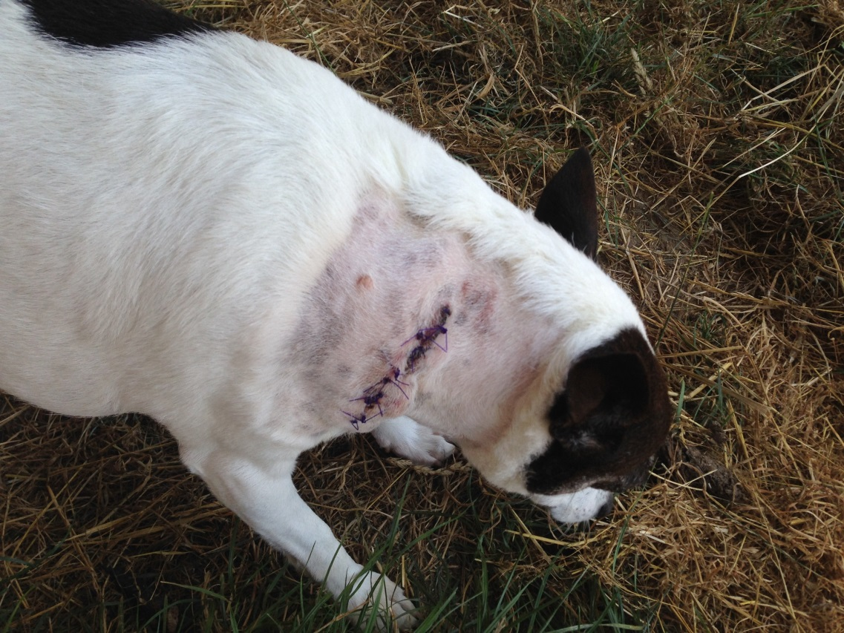
Liza’s tumor was removed

Slide 15
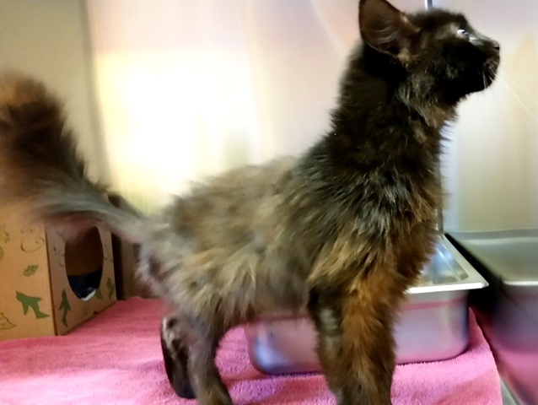
Circe’s skin infection

Slide 16
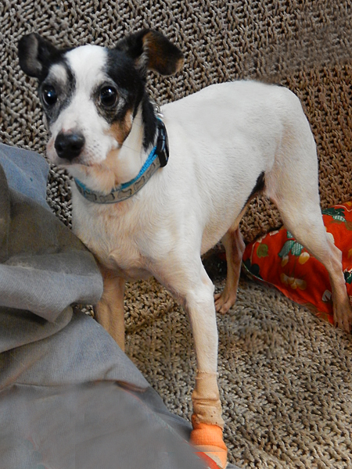
Good Boy’s toe

Slide 17
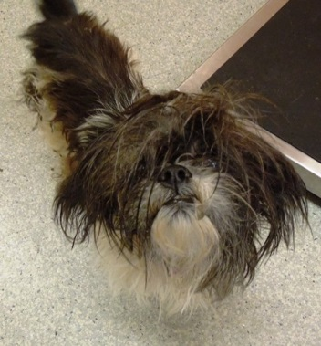
Red Hot Mess’s mess

Slide 18
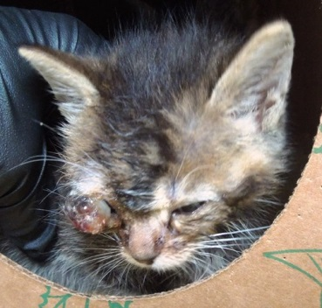
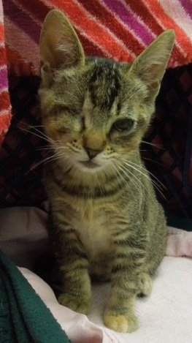
Spat had her infected eye removed

Slide 19
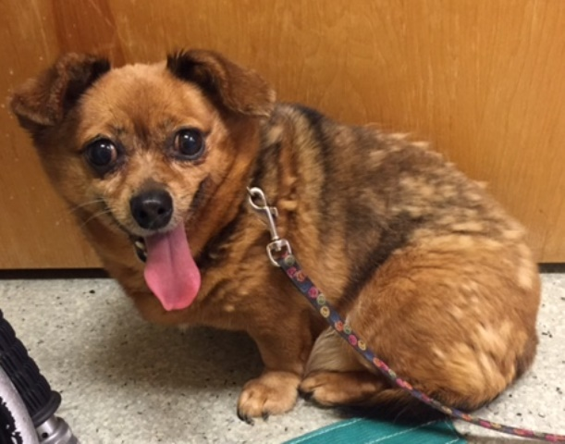
Tiny’s had many teeth and a large tumor removed

Slide 20
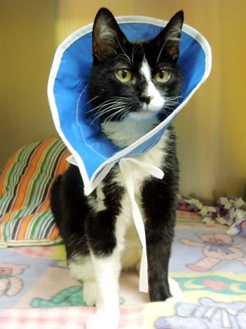
Spumoni

Slide 21
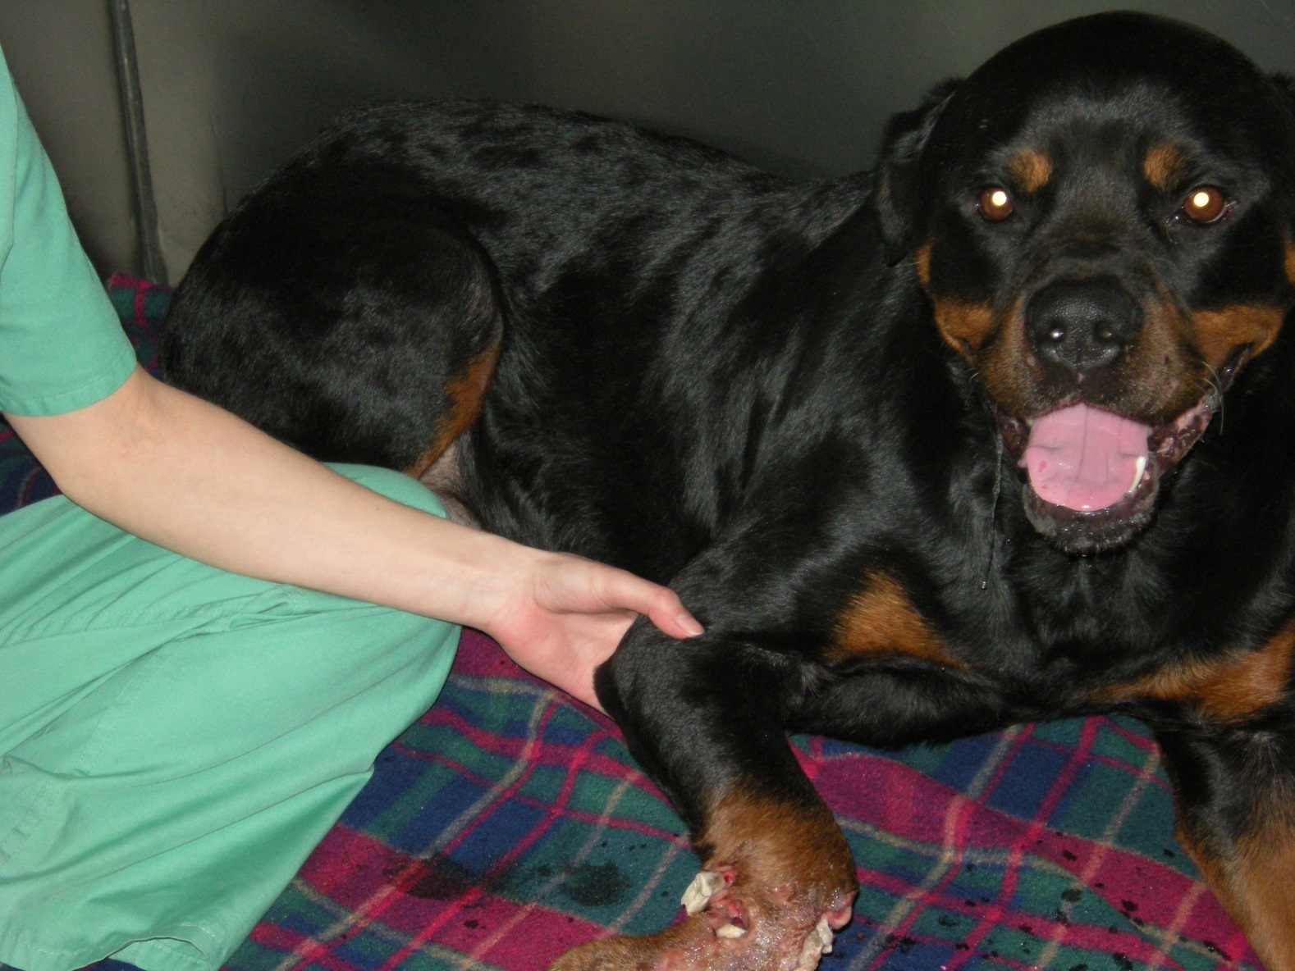
Bear’s crushed and infected food

Slide 22
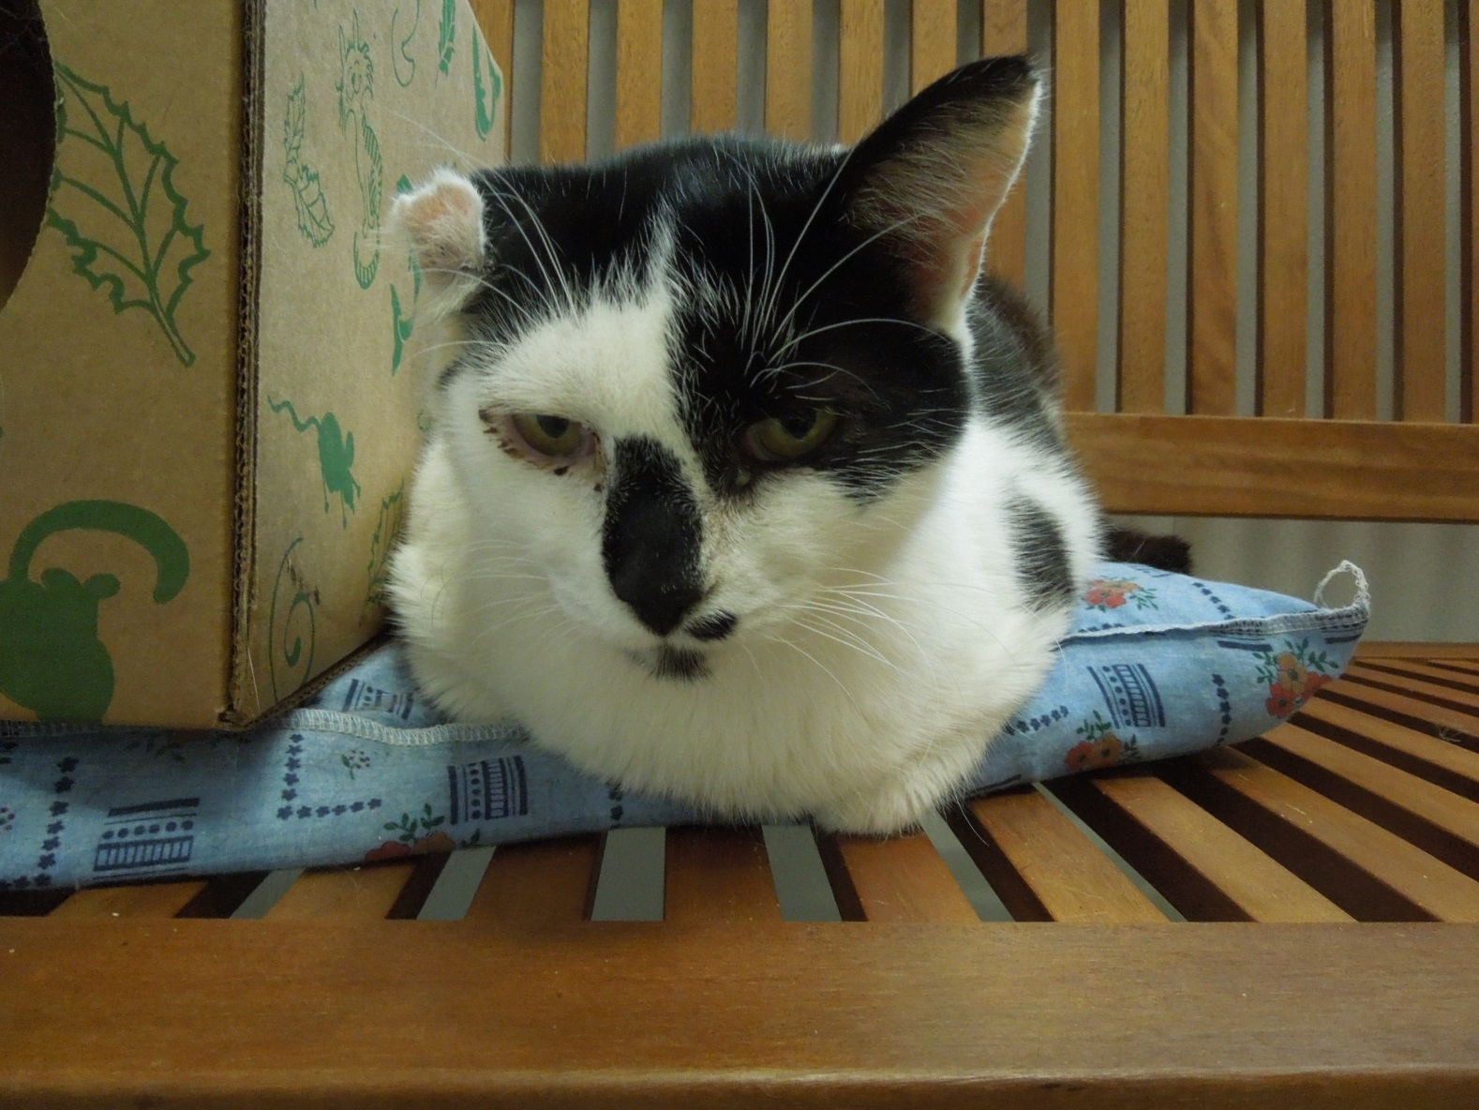
Guido had a chronically infected ear

Slide 23
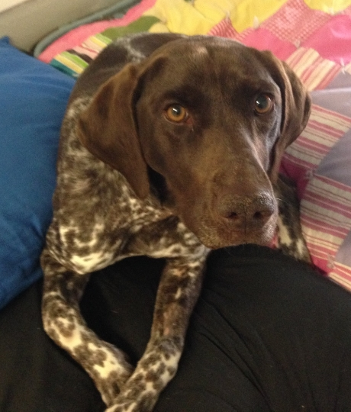
Betty’s lungs after being hit by a car

Slide 24
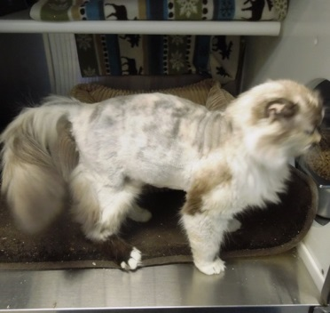
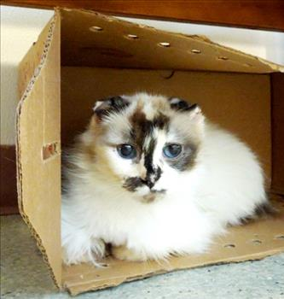
Rhonda skin infection

Slide 25
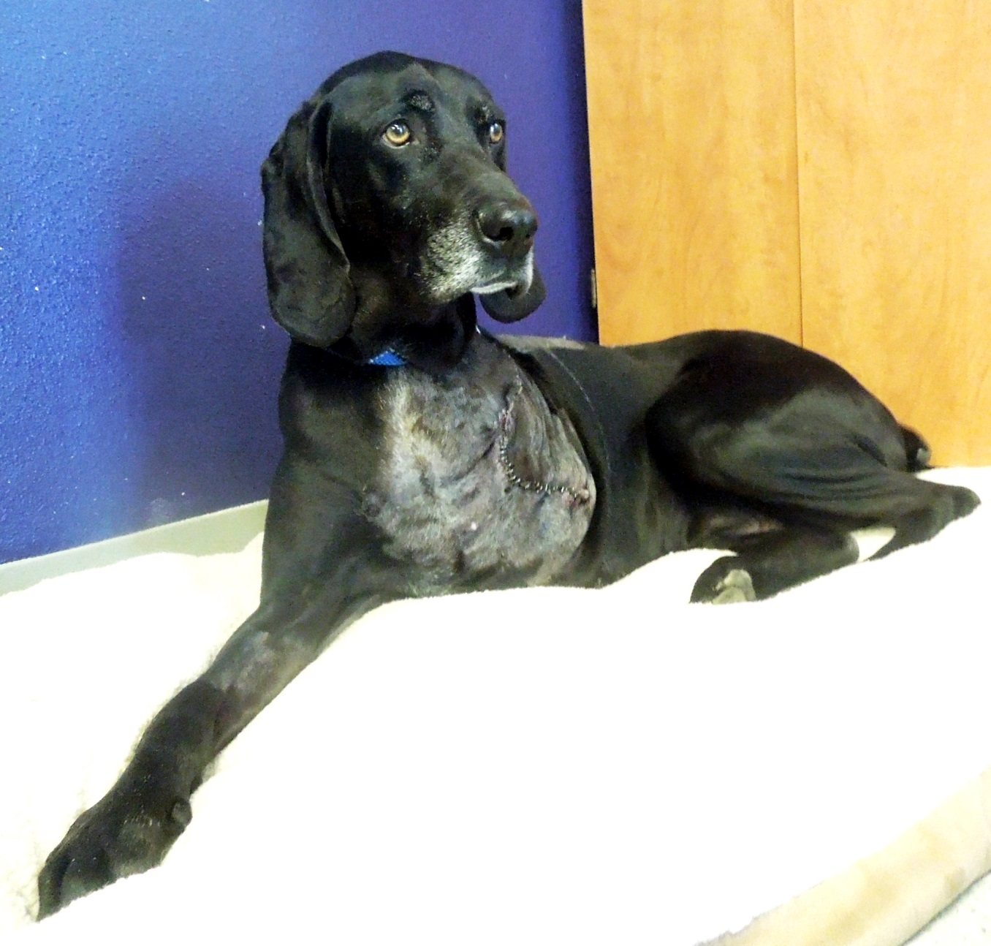
Jo‘s leg amputation

Slide 26
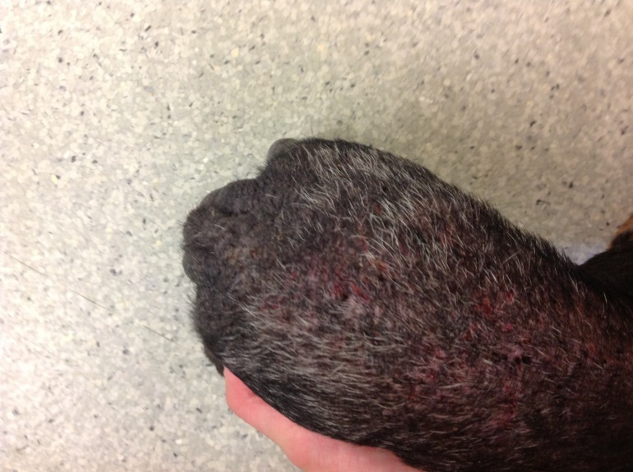
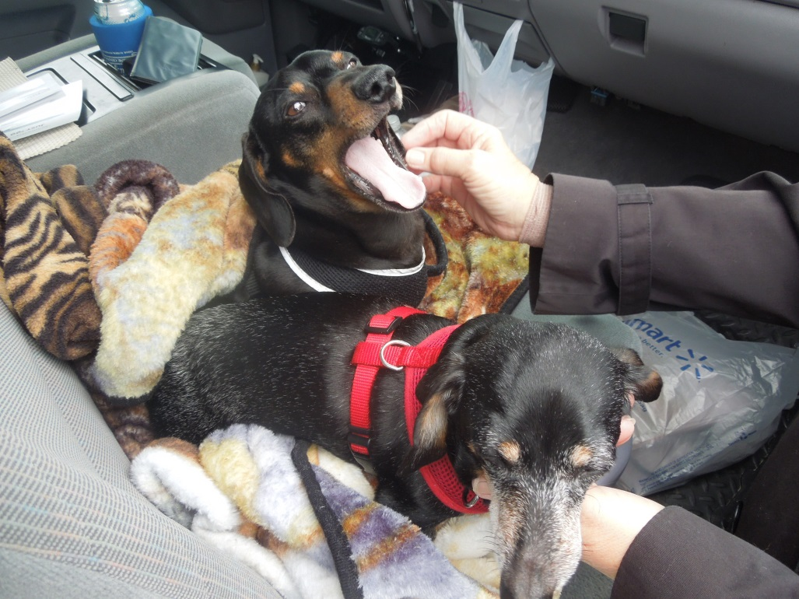
Lilly’s skin infection

Slide 27
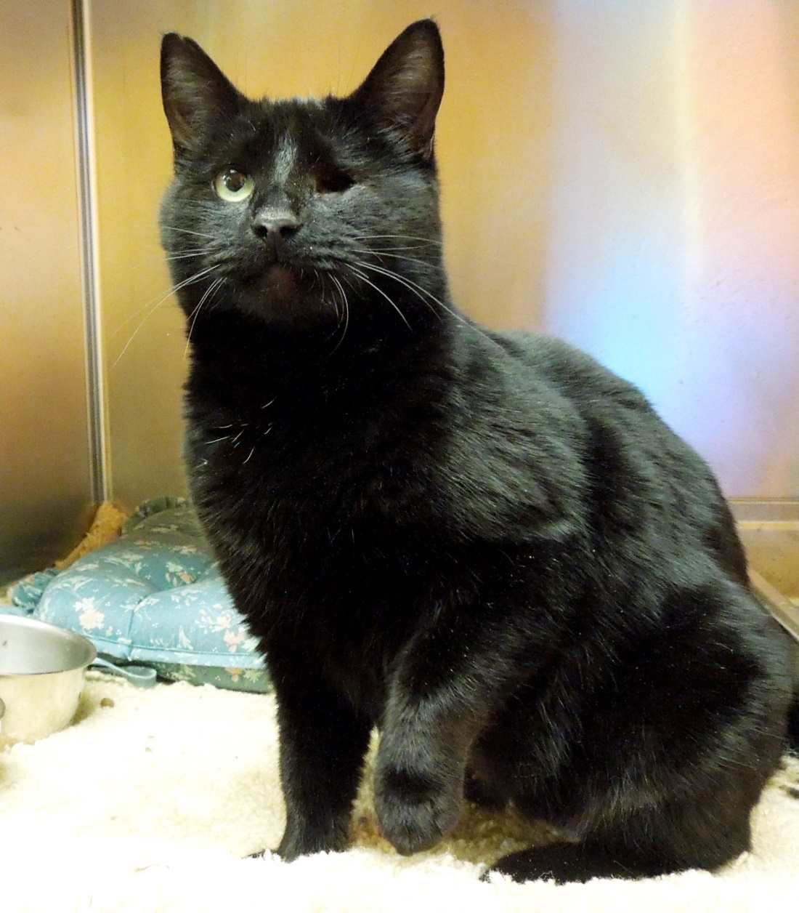
Ginger Snap’s eye removal

Slide 28
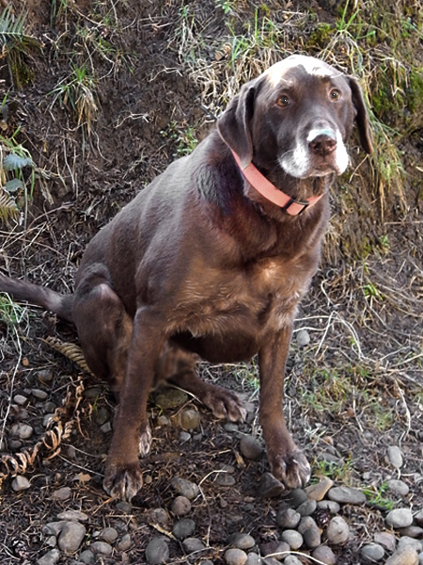
Hostess

Slide 29
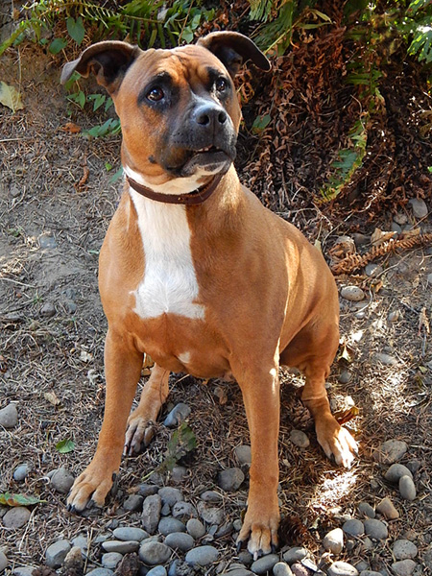
Roxy emergency pyometra surgery

Slide 30
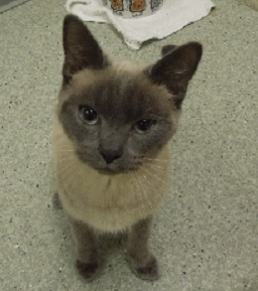
Lacie

Slide 31
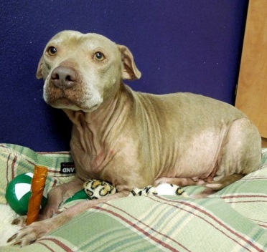
Faith’s skin infection

